Slide 1
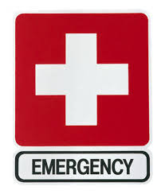
Food Service Emergencies
Non-Metro NM Agency on Aging
May/June 2024
Constance Rudnicki MS, RDN, LD
Registered Dietitian/Nutritionist
Karen Zarrella - Nutrition Education Intern

Slide 2
Objectives
Know what plans should be created to prepare for an emergency
Describe ways to prepare to keep food cold in case of an emergency
Explain how long food can be in the refrigerator or freezer at safe temperatures if the power goes out
Explain what resources can be used for emergency food supplies
Know what should be in a First Aid Kit

Slide 3
Things happen unexpectedly
ARE YOU PREPARED?

Slide 4
A PLAN OF ACTION should be put into place in the event of any type of emergency: natural disaster, epidemic, or staff/consumer injury.
The plan should include how any disruption to food, water, power, and labor will be handled.

Slide 5
Natural Disasters
Flood
Wind
Fire
Tornadoes

Slide 6
Who to Contact?
Know your City/County Emergency Managers
These people have the day-to-day responsibilities of supervising emergency management programs and activities.

Slide 7
Here’s an Example - Contact
https://www.santafecountynm.gov/fire/emergency-management-division
The Santa Fe County Office of Emergency Management is responsible for preparing our community for All-Hazard Preparedness and Response, which encompasses Natural, Technological, Human Caused Risks and Threats. We maintain partnerships with over 108 Agencies in the Santa Fe Area that include County Departments, private sector, faith-based organizations, schools and volunteer organizations active in disaster response. Adjacent cities, counties and tribes complete this horizontal community. Vertically we work in partnership with the State, Federal and in some instances International organizations. Emergency planning, training and maintaining mission ready deployable equipment is also required to meet this preparedness mission. The County Emergency Operations Center is one of several facilities ready to activate if needed. Several mobile command units are routinely deployed to support first responders on more complex emergencies. A significant portion of our programs agenda is mandated by Presidential Policy Directives in Homeland Security and Emergency Management. Santa Fe County was one of few communities in the Nation who prepared for non-traditional roles between Law Enforcement and the Fire Service in responding to mass shootings starting back in 2010. We have had significant involvement in preparing our responders for a Highly Infectious Disease Pandemic. As we watched the Nation, deal with the lack of Personal Protective Equipment for Health Care Workers Santa Fe County Responders had ample supplies of PPE. A result of ten years of preparing for another Public Health Emergency. During the COVID-19 Pandemic, our Office has played a key role in our community coordinating vaccine operations, supplying PPE and assisting in guidance for responder COVID-19 cases.
CONTACT:
Martin A. Vigil
Assistant Chief/ Emergency Manager
505-992-3072
mavigil@santafecountynm.gov

Slide 8
Who will be responsible in your facility to know/contact the Emergency manager? Do you need to contact non-metro area agency on aging? If yes, who is responsible
Notes:
It’s best to have one or two people responsible for contacts instead of everyone calling.

Slide 9
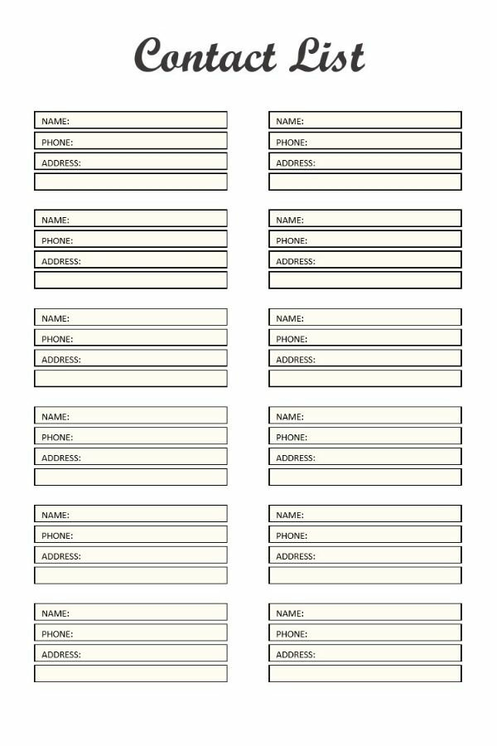
Very important !
Please make sure your consumer contact information is updated periodically.
The list should include names, phone numbers, and addresses.
If your clients have cell phones or email addresses, include those as well.
IMPORTANT:
Contact lists for staff and volunteers should also be maintained and updated. This list should be accessible to the staff but not to your clients.

Slide 10
How will you communicate with your seniors?
A “call tree” is a simple way of reaching out to your seniors during an emergency. By assigning names and phone numbers to your staff (or volunteers), seniors can be reached promptly during an emergency. Remember that the message that is transmitted needs to be consistent with all the messages being delivered during the emergency.

Slide 11
A good plan will ensure that managers and their staff are prepared

Slide 12
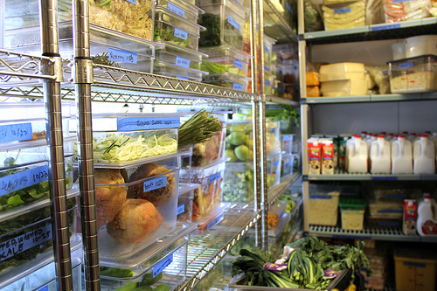
Food Safety during an emergency
Without electricity or a cold source, foods stored in refrigerators and freezers can become unsafe. Bacteria in food grow rapidly at temperatures between 40 - 140 °F (4.4 - 60 °C) and if these foods are consumed, illness can occur.

Slide 13
Cold foods
Food can be maintained cold in the refrigerator for 4 hours if the door is unopened. After 4 hours without power, refrigerated perishable food must be thrown away (i.e. meat, poultry, fish, soft cheese, milk, eggs, leftovers, and deli items).
A full freezer will hold the temperature for approximately 48 hours if the door remains closed.
A half full freezer will hold the temperature for approximately 24 hours if the door remains closed.
Never taste a food to determine if its safe.

Slide 14
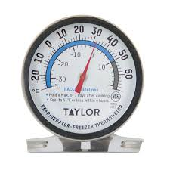
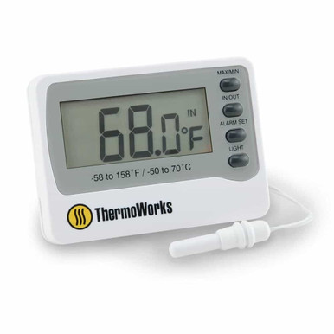
Cold foods- Appliance thermometer
Place an appliance thermometer in the warmest location of the refrigerator or freezer. Make sure it can be viewed easily. If possible, have an exterior gauge to avoid having to open the door.
Food may be safely refrozen if it still has ice crystals or is at 40°F or less when checked with a food thermometer.

Slide 15
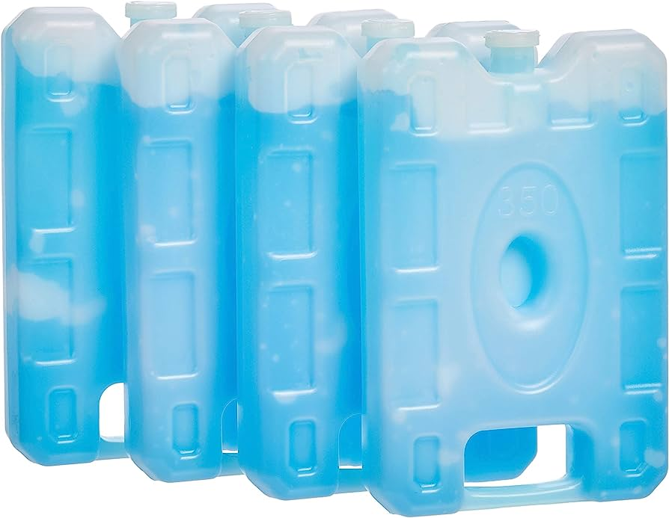
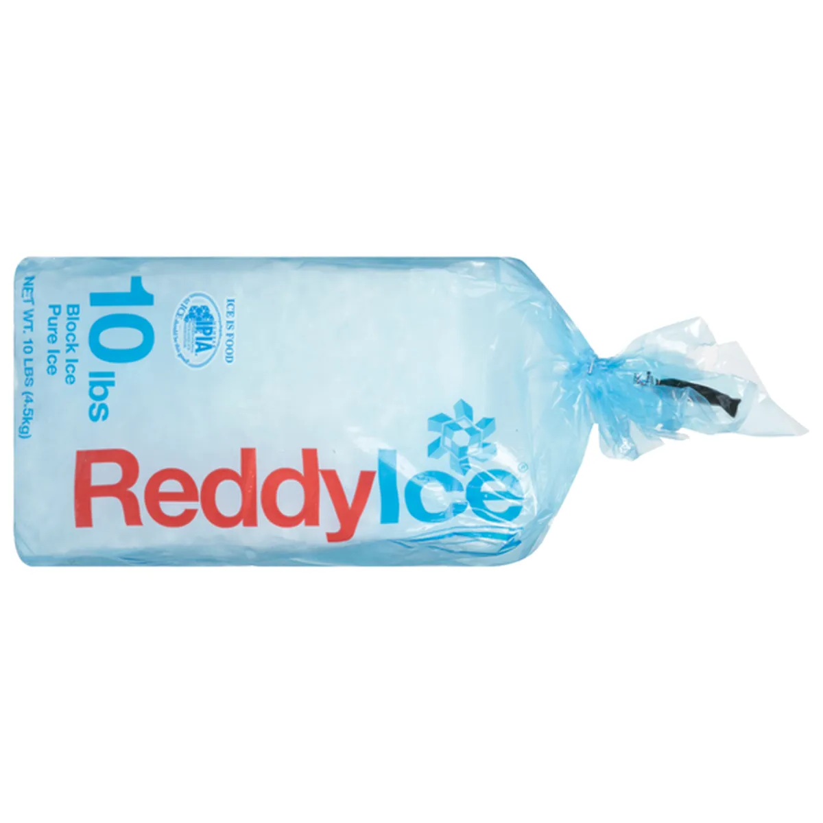
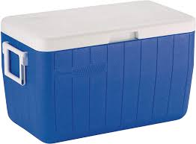
Be Prepared – in advance
Freeze and store containers of water for ice to help keep food cold in the refrigerator and freezer.
Have insulated containers on hand in case the power is out for more than 4 hours.
Freeze gel packs ahead of time for the insulated containers. You could also purchase or make ice cubes to store.
Obtain dry or safe block ice to keep your refrigerator and freeze cold if the power is going to be out for a prolonged period of time.
Notes:
Silicone ice buckets sold on Amazon or Walmart

Slide 16
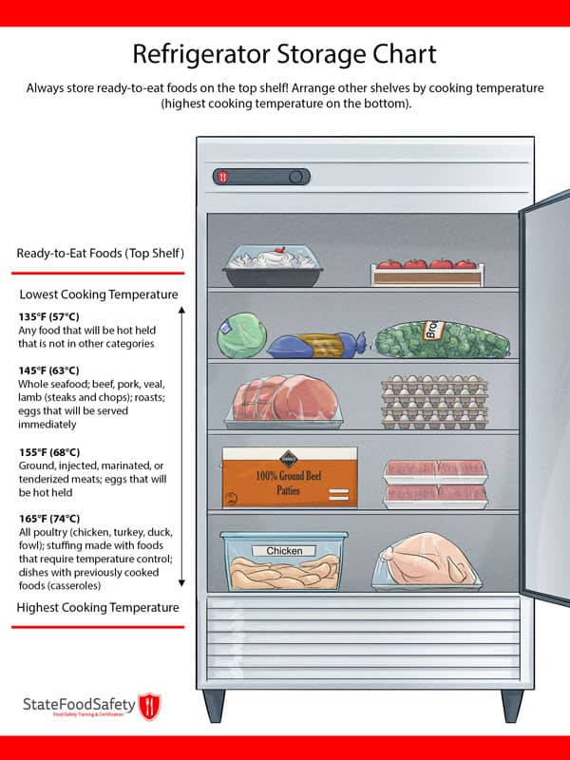
Food for thought
Rearrange frozen foods to avoid cross contamination during any anticipated thawing process.
Make sure to have drainage containers to collect liquids from melting freezers and refrigerators.
In case of flooding, make sure to store dry food products at least 12 inches off the floor. Food that is not in a waterproof container must be discarded if it comes into contact with any type of flood waters.
When in doubt, throw it out!

Slide 17
Emergency Menus
Plan emergency menus that can be quickly deployed based on what you have available in your facility.

Slide 18
Emergency Food Supply
Work with vendors to ensure you have an ample emergency food supply and go-to emergency ordering guide. Make sure your vendor contact information is up to date.
Other options:
Miss Olives Ready Made Meals
CPI Foods
Emergency Relief Catering Company
Mom’s Meals
(shelf stable, reduce labor costs, easy storage)

Slide 19
Plan for Staffing
Speak with your employees beforehand to discuss limitations they may have to get to work in emergencies and create a minimum staffing plan just in case.

Slide 20
Meal prep and distribution
Have a contingency plan to pull resources from other locations. This may include centralizing meal prep and creating a meal distribution plan. Communicate your plan to employees and train them on how to react in these situations.
Is there a school, church, or another location near by?

Slide 21
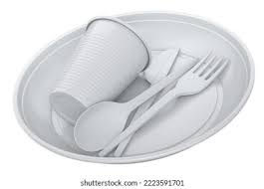
Disposables
Ensure you have an adequate supply of disposables readily available should dishwashing become a concern.
Plates
Napkins
Eating utensils
Paper/plastic cups
Water

Slide 22
Limited resources
Assess how you can keep your kitchen running using limited resources like battery power or a generator.
Is your kitchen safe for cooking?
Can you reach the required cooking temperatures?
Are you able to clean and sanitized utensils and equipment?
Are you able to maintain hygiene (washing hands) (water, hand antiseptics, chemically treated towelettes)

Slide 23
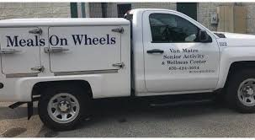
Drivers and vehicles
In your plan, include the process for how drivers and vehicles will be distributed and the routes that will be taken.
Make sure vehicles are fully fueled.
Do your drives know what to do if a senior is injured , unconscious or can’t get up on their own?

Slide 24
Other considerations

Slide 25
Do you have a plan for technology?
What if the internet and phone systems are out of service?
Wi-fi access
Hotspot from phones
Portable power stations to charge phones and other devices
What other things should you be aware of?

Slide 26
The most common Facility incidents
Cuts and scrapes from handling sharp knives or other kitchen equipment
Burns from hot liquids or cooking surfaces
Slip and fall injuries from wet floors or uneven surfaces
Strains and sprains from lifting heavy objects or performing repetitive tasks
Food poisoning from consuming contaminated food
Allergic reactions to ingredients in food

Slide 27
First aid kits
OSHA states that “First aid supplies are required to be readily available”
All kits should be kept well-stocked
Items in kits should be clean and up-to-date (check expiration dates) and should be checked monthly
Notes:
OSHA= The Occupational Safety and Health Administration

Slide 28
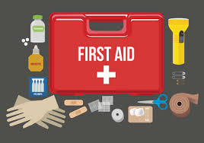
THE TOP ESSENTIALS:
Adhesive bandages in various sizes
Antiseptic wipes
Antibiotic ointment or burn gel
Gauze pads
Adhesive tape
Disposable gloves to protect against bodily fluids
Scissors and tweezers
Tourniquet
CPR face shield
Splint to immobilize injuries and support sprains
Instant cold packs
Anti-inflammatory medication such as ibuprofen
Consider having Epinephrine auto-injectors (EpiPen) to treat severe allergic reactions.

Slide 29
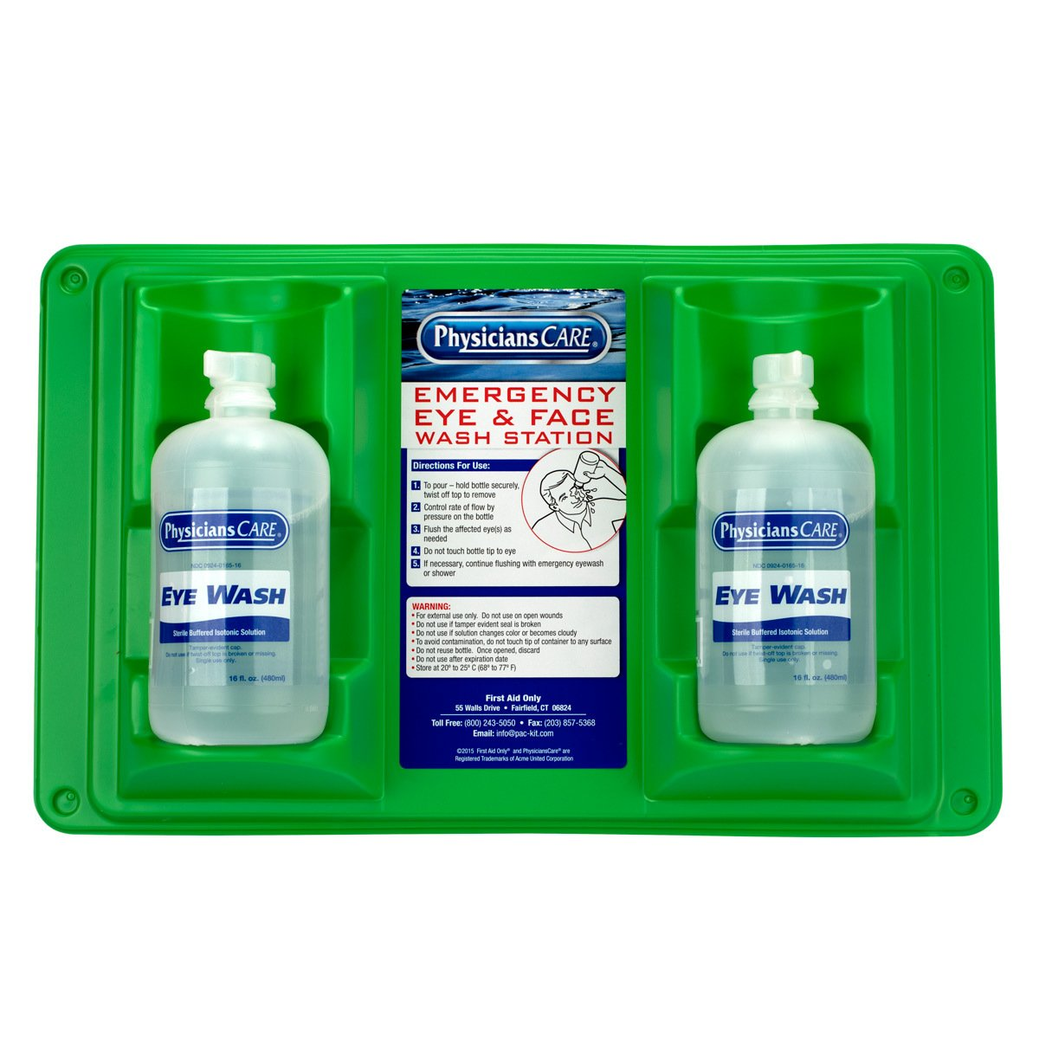
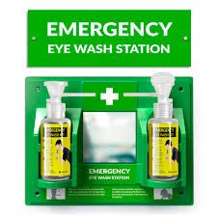
Don’t forget the eyes!
Eye wash stations are one of those things that you hope you never have to use but are thankful for if you do have to use them. They flush out any hazardous substance (physical or chemical) from the eye helping to reduce the risk of eye injuries.
Eye Wash Station Alternatives
Ideally, eyewash stations are installed in your facilities.
Notes:
Plumbed-in stations wash both eyes at the same time.
Eye wash station from Amazon $29.95 NO Eye wash solution included
Physicians Care $29.95

Slide 30
Illness
If an emergency involves an illness, proper cleaning and sanitation are essential in controlling the spread of viruses or bacteria. Make sure your team is aware of how to handle cleaning products correctly and safely.
PERSONAL HYGIENE SHOULD BE A MAJOR FOCUS.

Slide 31
Other things to consider:
Are your staff members certified in CPR?
Does your staff know what to do if someone is choking
Does your staff know where the AED is and how to use it?
Does your staff know where the fire extinguishers are?
Do you know what Standard Precautions are:
Does your staff know how to clean up blood and body fluids?
Does your facility need a sharps container?
Broken glass, needles, box cutters

Slide 32
Tips to prevent burns
Stand to the side when opening oven doors
Open lids away from your body
Wear Closed toe shoes
Ensure that oven mitt and or potholders are available to anyone who handles hot foods
Empty steam table when water has cooled
Wear protection when handling chemicals

Slide 33
How to prevent a steam burn when cooking:
Don’t stick body parts in the steam! Being aware of the possibility of burns is step one.
Have, and use oven mitts or potholders
Always open lids away from you and /or away from hands, arms and your face, know where the condensed steam on the inside of the lid is going to drip.
Before you move a hot pan, know if you can safely lift it. Also be sure that you know where you are going to put it. Make sure the space is available before you begin the move
If draining hot food like pasta, pour slowly, know that hot great or other liquids can run right down the channels in the handles and onto your arms
NEVER lift the grabbing end higher than the end that’s in your hand

Slide 34
Cuts
Carry knives and sharp object pointed down
Keep knife blades sharp, handles secure and store with blades covered
Do not leave knives in sinks-keep knives and sharp objects visible at all times
Do not us bare hand to clean up broken glass-use a broom and dust pan
Do not converse with other while cutting
Do not hands to push down garbage
Do not use glass to scoop ice
Administer First aid or if appropriate call 911

Slide 35
Other Resources: available below or on the NM-AAA Website
Greater Wisconsin Agency on Aging Resources, Inc. Emergency Preparedness in the Food Service Area: For Staff and Volunteers. Available at: https://gwaar.org/emergency-preparedness-in-the-foodservice-area-for-staff-and-volunteers.
Emergency Handbook for Food Managers: Advanced Practice Centers: Available at: https://diversitypreparedness.org/~/media/Files/diversitypreparedness/APC_Emergency_Handbook_for_Food_Managers.ashx?la=en.
FoodSafety.gov. Eat Safe In a Power Outage (English) Available at: https://www.cdc.gov/food-safety/media/pdfs/eat_safe-r5-infographic2-h.pdf
FoodSafety.gov. Eat Safe In a Power Outage (Spanish) Available at:https://www.cdc.gov/food-safety/media/pdfs/eat-safe-infographic-spanish-h.pdf
Foodsafety.gov. Food Safety During Power Outage: Refrigerated food and Power Outages: when to save it and when to throw it out : Available at: https://www.foodsafety.gov/food-safety-charts/food-safety-during-power-outage
Foodsafety.gov. Food Safety During Power Outage: Frozen food and Power Outages: when to save it and when to throw it out : Available at: https://www.foodsafety.gov/food-safety-charts/food-safety-during-power-outage
Emergency Preparedness Committee of Council II 2004-2006 Conference for Food Protection. January 22, 2014. Emergency Action Plan for Retail Food Establishments: Available at: https://www.foodprotect.org/media/guide/Emergency%20Action%20Plan%20for%20Retail%20food%20Est.pdf

Slide 36
References:
Emergency Planning for Food Service, Culinary Services Group
https://culinaryservicesgroup.com/emergency-planning-for-food-service/
Appendix A to 1910.151 – First aid kits
https://www.osha.gov/laws-regs/regulations/standardnumber/1910/1910.151AppA
National Foundation to End Senior Hunger
https://acl.gov/sites/default/files/nutrition/NFESH_Emergency-preparedness.pdf
Top 5 First Aid Kits for Restaurants
https://www.aedbrands.com/blog/top-5-first-aid-kits-for-restaurants/
What should be in a Restaurant First Aid Kit?
https://www.dotit.com/blog/what-should-be-in-a-restaurant-first-aid-kit.html
Food Safety During A Weather Emergency
https://datcp.wi.gov/Documents/foodsafetyweatheremergency.pdf

Slide 39
#1
Contact Lists should include:
addresses, social security numbers, names
names, ages, phone numbers, zip codes
names, phone numbers, addresses
all the above

Slide 40
#2
Bacteria in food grow rapidly at a temperature of:
35º to 120º F
42º to 135º F
40º to 140º F
38º to 142º F

Slide 41
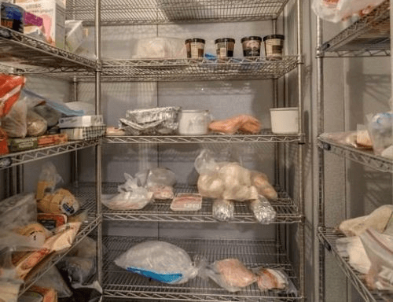
#3 True or false?
A full freezer will hold the temperature for approximately 48 hours if the door remains closed.

Slide 42
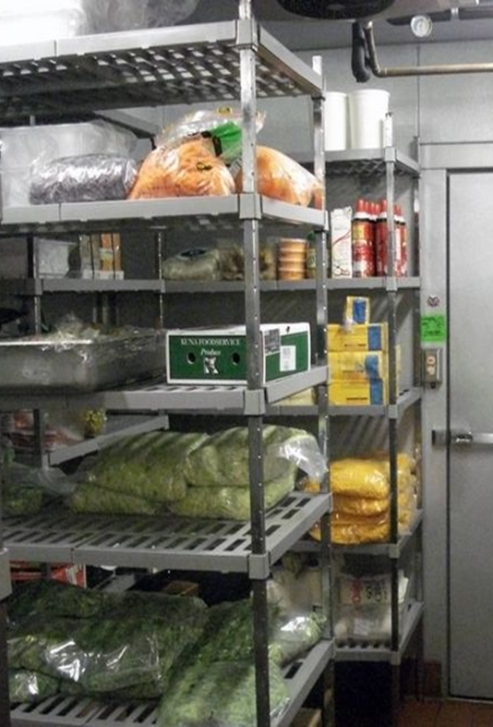
#4 Fill in the blank
After __________ hours without power, refrigerated perishable food must be thrown away (i.e. meat, poultry, fish, soft cheese, milk, eggs).

Slide 43
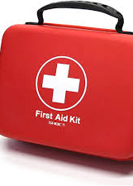
#5
First Aid Kits should be:
Clean
Well-stocked
Up-to-date
Checked often
(choose all that apply)

