Slide 1
Cleaning, Sanitizing, and Foodborne Illnesses
NM-AAA
February 2024
Constance Rudnicki MS, RDN, LD
Registered Dietitian/Nutritionist
Karen Zarrella - Nutrition Education Intern

Slide 2
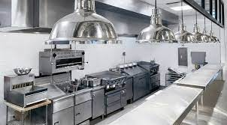
Objectives
Define a foodborne illness
Know how food contamination can happen and how to avoid cross-contamination
Explain what the danger zone is
Know the difference between cleaning and sanitizing
Know the 5-step process for cleaning and sanitizing

Slide 3
Food contamination

Slide 4
Types of food Contamination
Biological
Physical
Chemical
Notes:
Biological are the microorganisms (bacteria, viruses, parasites, and fungi). Physical contaminants are hazards such as plastic pieces, metal shavings, dirt. There are natural physical contaminants such as fish bones. Chemical contaminants cleaners, sanitizers, and polishes. Foodborne illnesses come from the Biological contaminants.

Slide 5
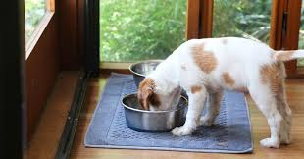
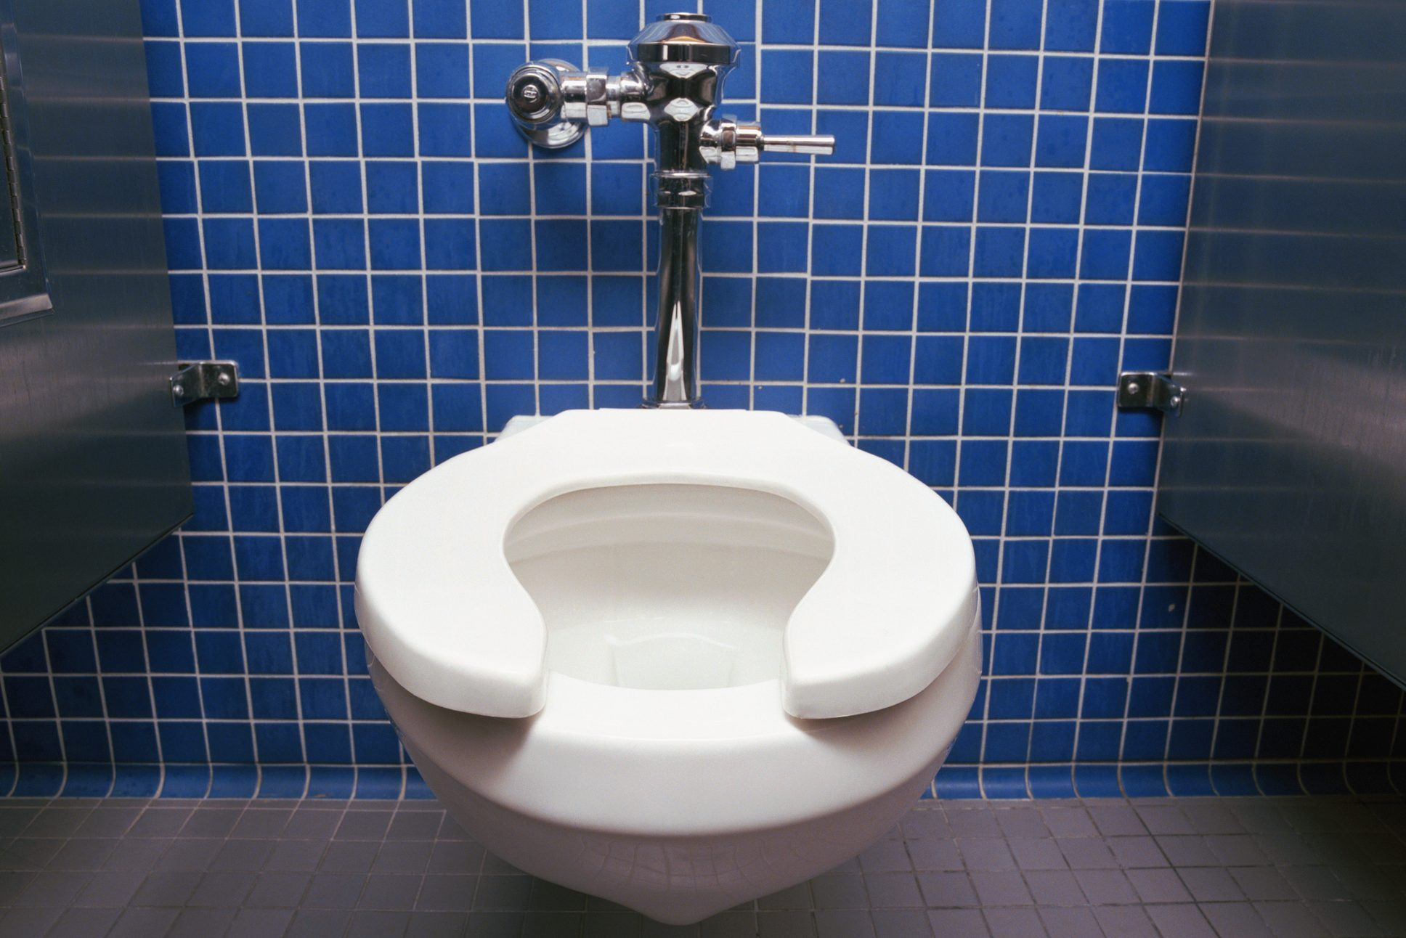
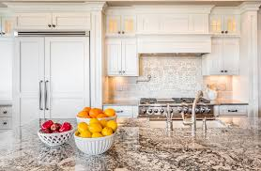
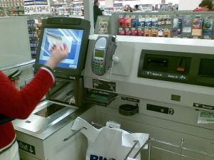
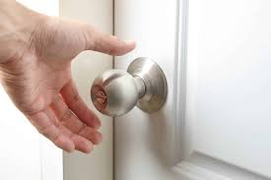
Fun Facts
Toilet seat: 1,201 bacteria per square inch
Checkout screen: 4,500 bacteria per square inch
Kitchen counter: 1,736 bacteria per square inch
Doorknob: 8,643 bacteria per square inch
Pet food dish: 2,110 bacteria per square inch
Cell Phone:
25,127 bacteria per square inch
Notes:
tatefoodsafety.com/Resources/Resources/the-dirty-cell-phone-25-127-bacteria-per-square-inch

Slide 6
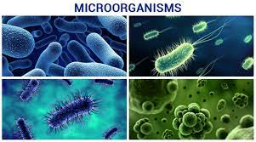
Microorganisms are everywhere…doorknobs, money, pens, pencils, towels, fingernails, soil, saliva…
Harmful bacteria & viruses cause most foodborne illnesses
To control growth , employees must control the conditions necessary for growth
Notes:
Microorganisms can only be seen with a microscope. Many are harmless but it’s the harmful ones that cause most foodborne illnesses. We will discuss the different ways that we can control the conditions to keep pathogens from spreading.

Slide 7
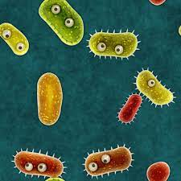
Pathogens can spread to food when:
Equipment and utensils are not washed, rinsed, and sanitized between uses
Food contact surfaces are wiped clean rather than washed, rinsed, and sanitized
Wiping cloths are not stored in sanitizer solution between uses
Sanitizing solutions are not at the required levels
Notes:
As we discuss cleaning and sanitizing, here are some ways that pathogens can spread to food.

Slide 8
Food Contamination can happen…..
During receiving and storing
During preparation and serving
During preparation techniques such as cooking and cooling
By cross-contamination
From employees to food by unwashed hands, coughing, or sneezing
From unsanitary facilities and equipment to people or food
From disease-spreading pests
Notes:
There are several ways contamination can happen. (Read list) Today we’re going to focus on making sure our facilities and equipment are sanitary. But first, let’s review the whys.

Slide 9
Foodborne Illnesses

Slide 10
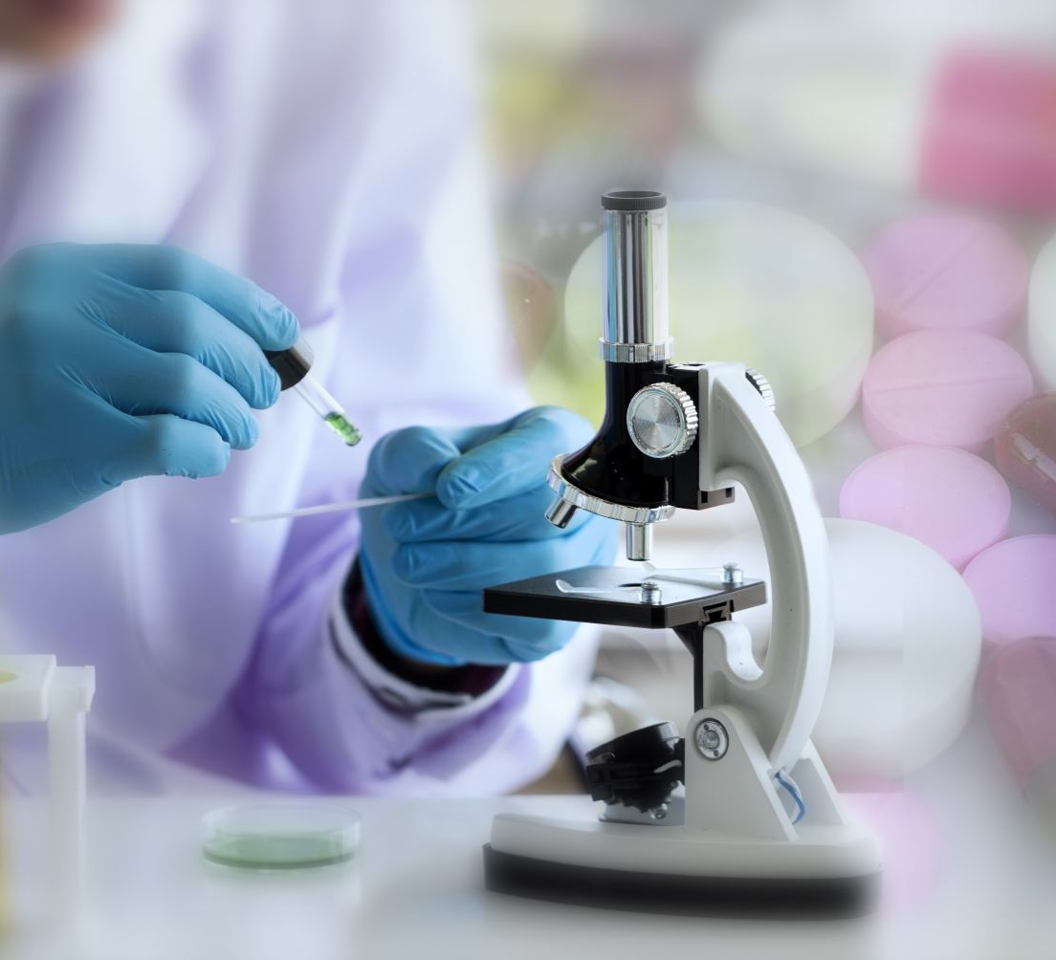
Foodborne illnesses
Disease transmitted to people through food
An illness is considered an outbreak when:
Two or more people have the same symptoms after eating the same food.
An investigation is conducted by state and local regulatory authorities.
The outbreak is confirmed by laboratory analysis.

Slide 11
Top 5
1. Salmonella
2. Shingella
3. E. coli
4. Hepatitis A
5. Norovirus
Notes:
The first three are bacteria and the other two are viruses

Slide 12
High Risk Populations
Infants
Preschool age children
Pregnant women
Older adults
People taking medications
People who are ill
Notes:
Every day in your centers you are dealing with people who are at high risk because their immune systems have weakened with age. Some may be on medications that weaken their immune systems, or some may have a disease such as cancer.

Slide 13
Take Action!
To keep your seniors safe, focus on these processes:
Practicing personal hygiene
Controlling time and temperature
Preventing cross-contamination
Purchasing from approved reputable suppliers
Cleaning and sanitizing
Notes:
Poor personal hygiene practices are the leading cause of foodborne illnesses.

Slide 15
Handwashing sink
Have dedicated handwashing sink
Garbage can
Single use paper towels
Handwashing sign
Posted at all handwashing sinks that are used by food service employees
Clearly visible

Slide 16
Fingernails
Fingernails should be no longer than the tip of your finger
Fake nails and nail polish should not be worn (physical contaminant)

Slide 17
Hair
Physical contaminant
Wear hats, hairnets
ALL hair needs to be restrained

Slide 18
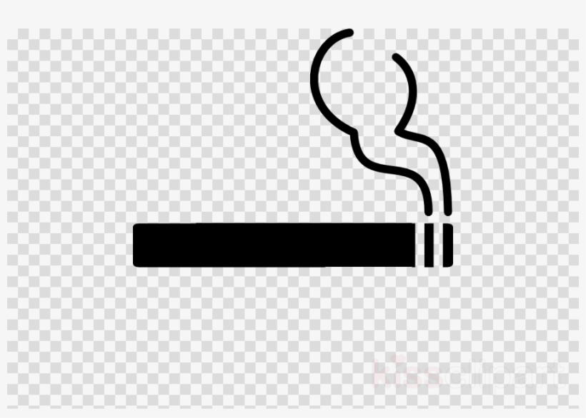
Jewelry
Watches, earrings, and rings can’t be worn except for a plain metal band or a medical bracelet
No Gum or chewing tobacco in food prep areas

Slide 19
Time and Temperature
Food should be cooked to its correct minimum internal cooking temperature
Food should be held at the correct temperature
Food should be cooled or reheated correctly
Notes:
Internal cooking temperatures are different for each type of food.

Slide 20
danger
Notes:
Germs thrive in temperatures between 40 degrees and 140 degrees Fahrenheit. If food was held at this temperature for 4+ hours, it must be thrown out.

Slide 21
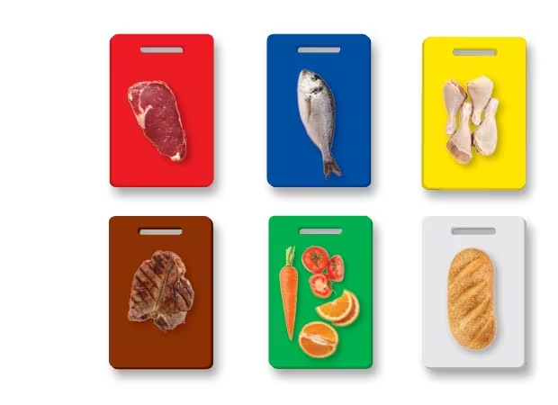
Cross-Contamination
Cross-contamination occurs when bacteria are transferred from one food to another by a non-food surface, such as utensils, equipment, or human hands. It can also occur food to food, such as when thawing meat drips on ready-to-eat vegetables.
Follow proper handwashing and hygiene guidelines
Store cooked food away from raw food
Don’t prepare batches of food too far in advance
Clean and sanitize equipment, utensils, and cutting boards

Slide 22
How to use single use gloves
Wash hands before putting on gloves
Use the correct glove and size
Make sure that the fit
not too tight or loose
Change gloves regularly
don’t wash or reuse gloves
When changing into a new pair
Gloves should be changed when torn or ripped
Starting a new task
After handling raw meat, seafood, or poultry
Handling ready to eat food
Change gloves every at least every two hours during continually use

Slide 23
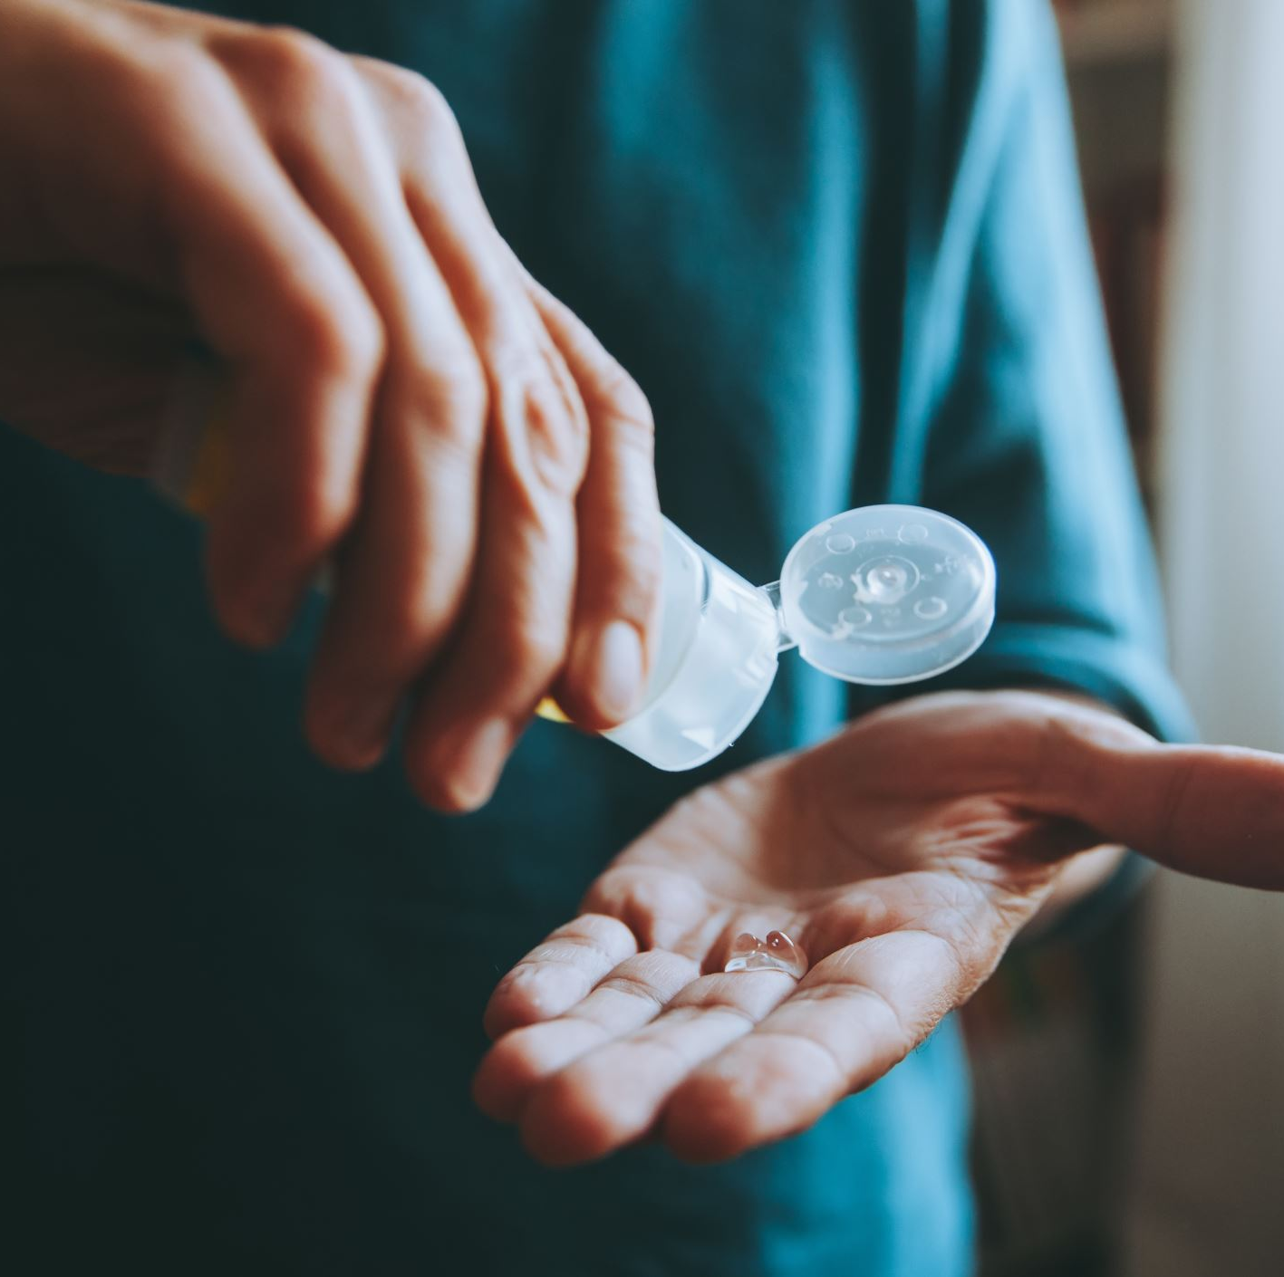
Cleaning and sanitizing

Slide 24
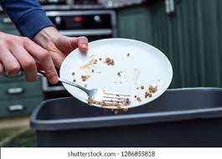
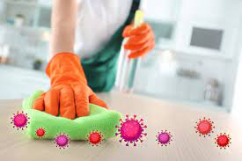
What’s the Difference?
Cleaning Removes food and other types of soil from a surface such as countertop, plates, or utensils. | Sanitizing Reduces the number of pathogens on the clean surface to safe levels.
Everything in your facility must be kept clean, but any surface that comes in contact with food must be cleaned AND sanitized.
Notes:
For instance, walls and floors should be cleaned daily, but don’t need to be sanitized.

Slide 25
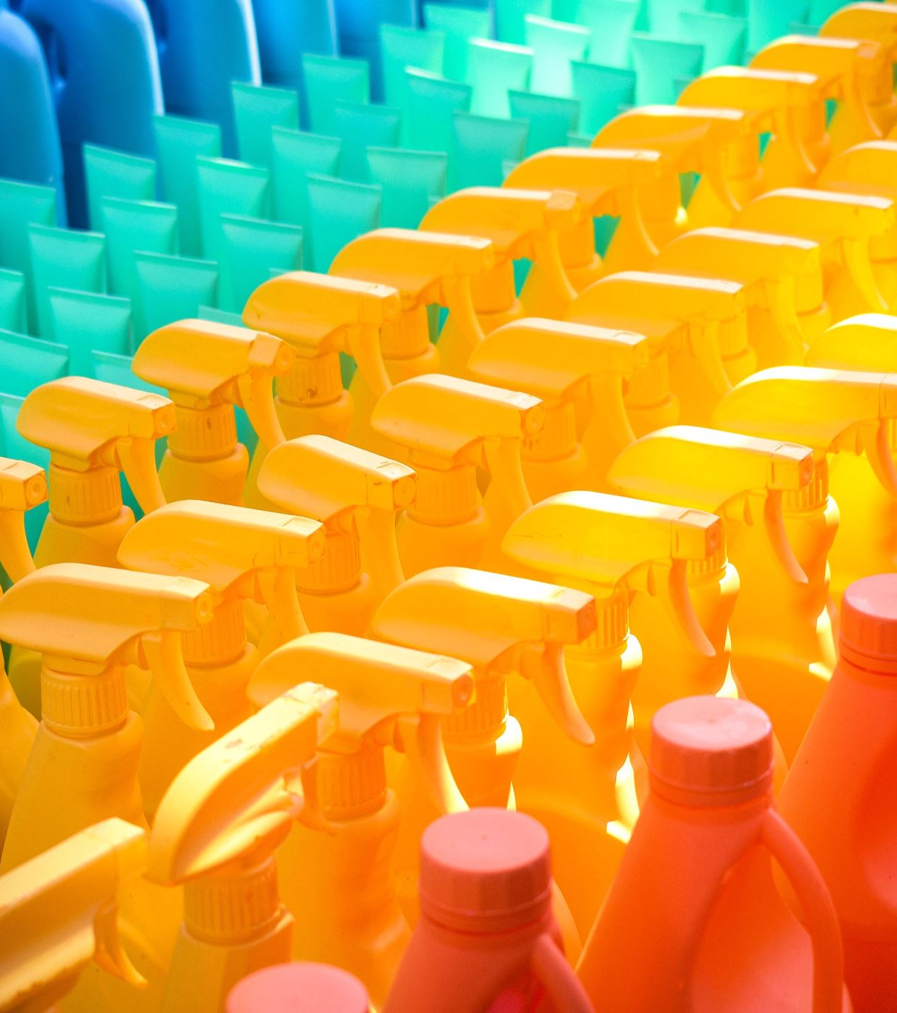
When to clean and Sanitize
Food Contact surfaces must be cleaned and sanitized:
After they are used
Before working with a different type of food
Between prepping raw chicken and cutting lettuce
After handling different raw TCS Fruits and vegetables
Between cutting melons and leafy greens
Any time a task was interrupted, and the items may have been contaminated
At 4-hour intervals if the items are in constant use

Slide 26
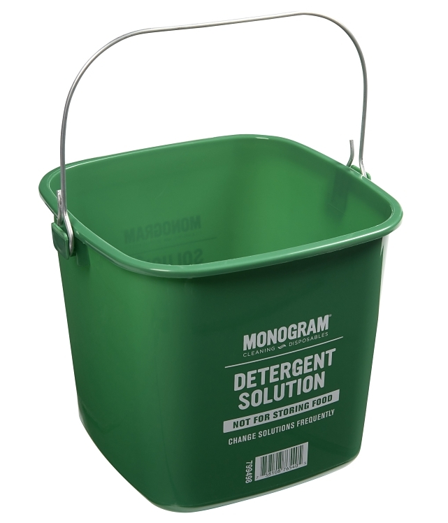
Cleaners
Must be stable, non-corrosive and safe to use
Follow manufactures instructions carefully on how to use product
Only use products for their intended use
Never combine cleaners

Slide 27
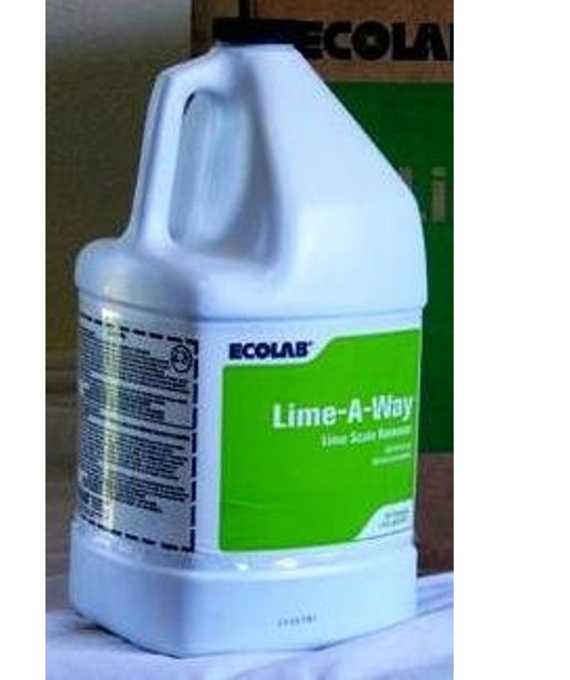
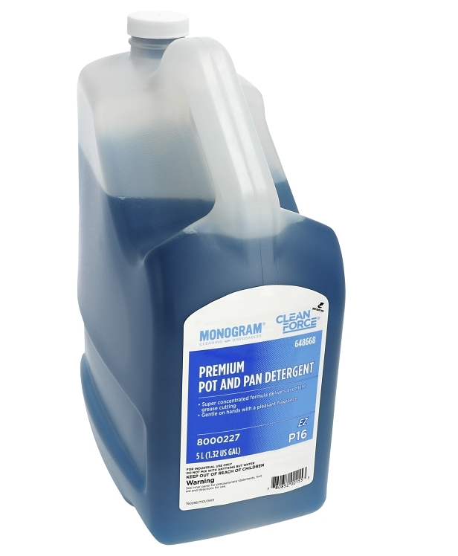
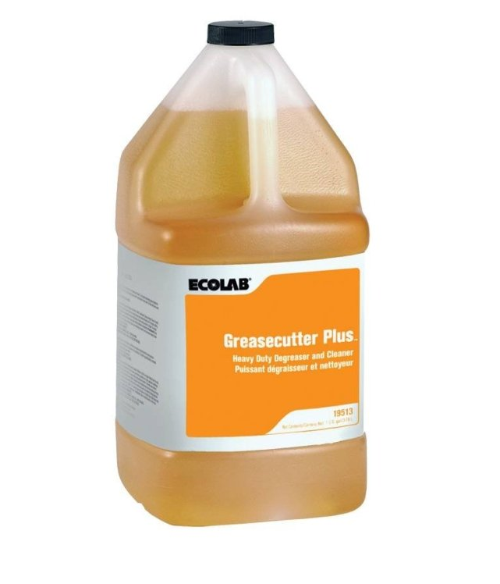
Types of Cleaners
Detergents
General purpose-Removes dirt from floors, walls, ceiling, prep surfaces and most equipment surfaces
Heavy duty detergents-remove wax, aged or dried dirt, wax, baked on grease
Degreasers
backsplashes, oven doors, range hoods
Delimers-Acid cleaners used on mineral deposits and dirt that other cleaners can’t remove-
steam tables, dishwashers
Abrasive cleaners-Have a scouring agent that helps scrub hard to remove dirt
used to remove baked on food
Can scratch surfaces

Slide 28
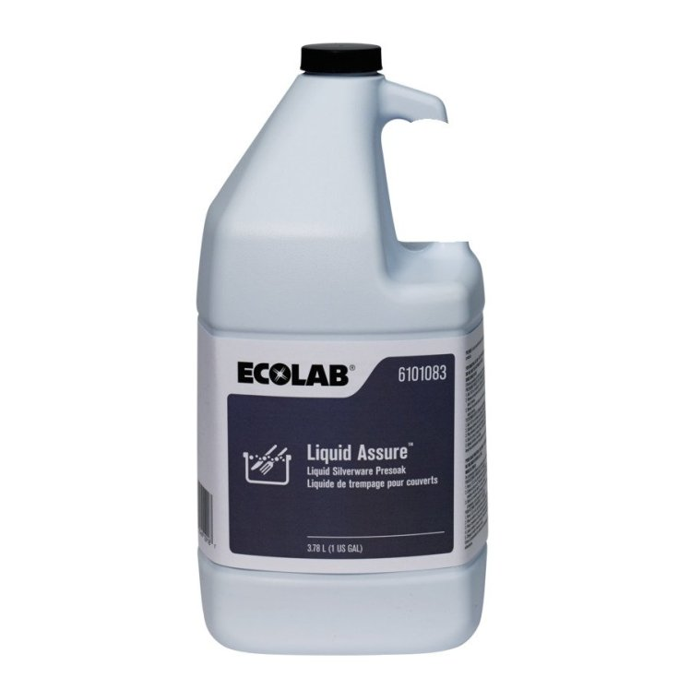
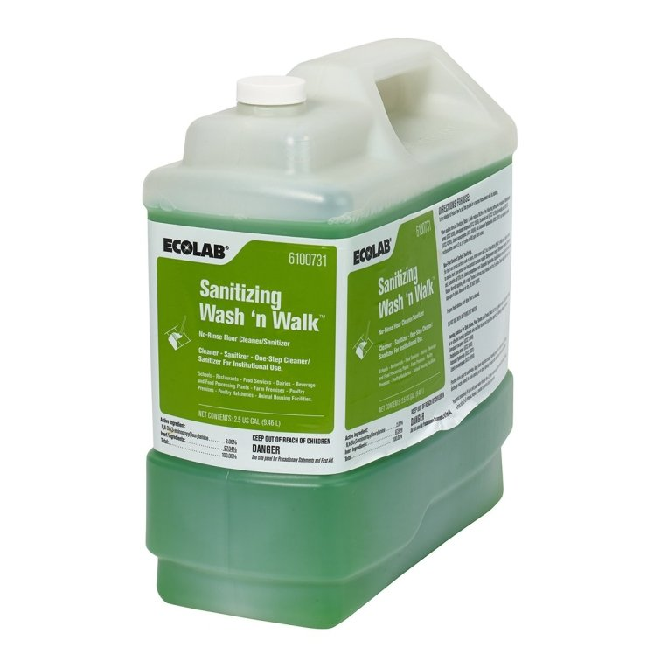
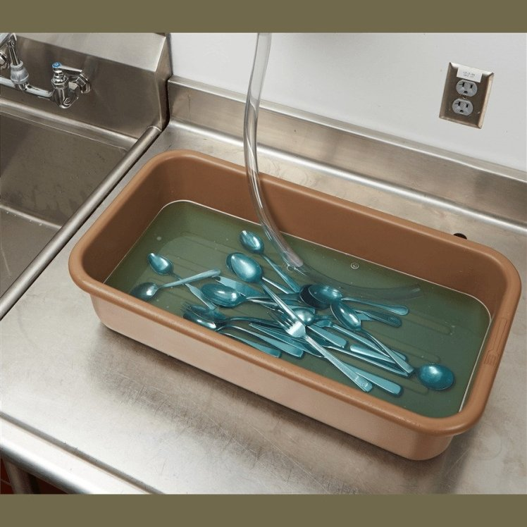

Slide 29
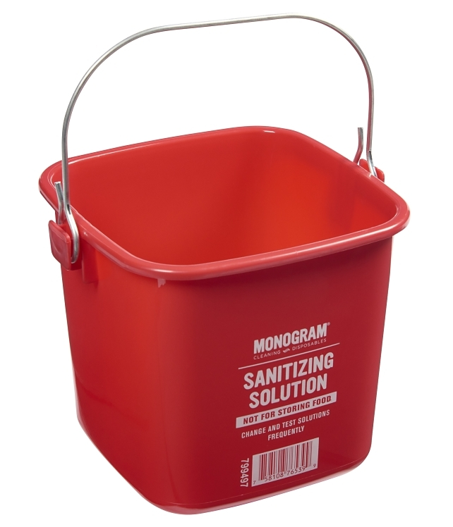
Sanitizers
Food contact surfaces must be sanitized after they have been cleaned and rinsed
Can be done either by using heat or chemicals

Slide 30
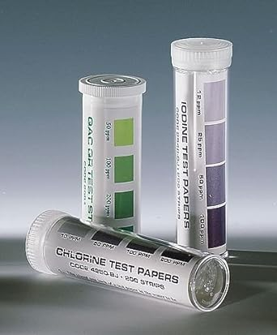
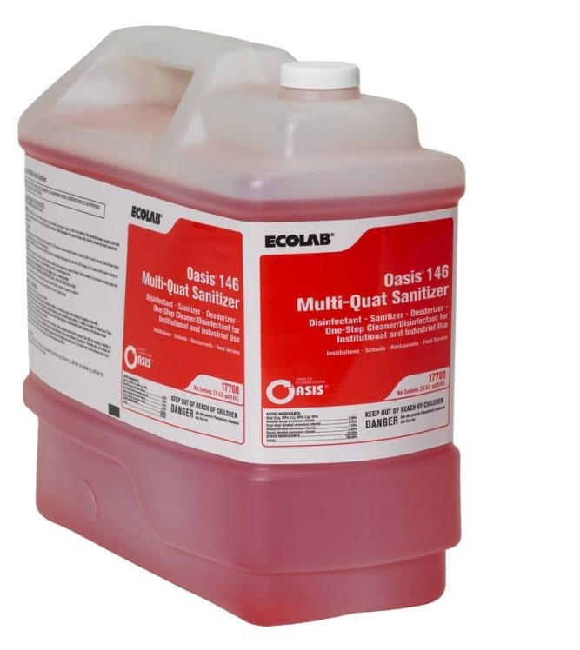
Chemical Sanitizing
Tableware, utensils and equipment can be sanitized by soaking them in chemical sanitizing solution
Can also rinse, swab, or spray them with a sanitizing solution
3 common types of chemical sanitizers
Chlorine
Iodine
Quaternary ammonium compounds
Different chemicals have different requirements

Slide 31
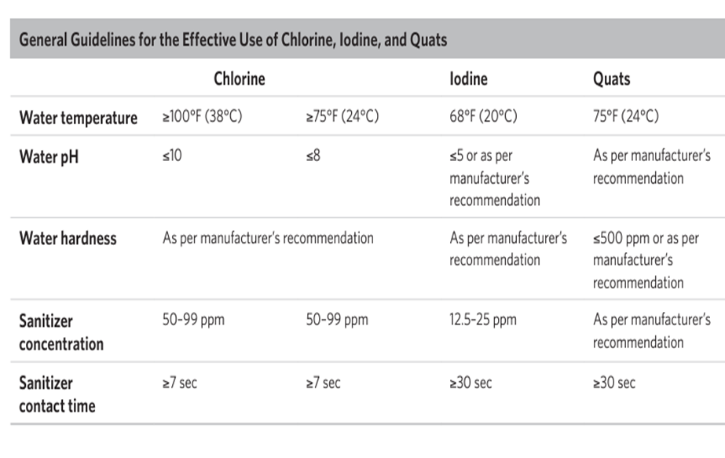
Notes:
Notice the factors that influence the effectiveness of chemical sanitizers.. Follow manufacturer’s recommendations for correct temperature. Water hardness is determined by the amount of minerals in the water.

Slide 32
Sanitizer Effectiveness
Concentration
Mix of chemical sanitizer and water
Proper amount of this mix is critical
Too much solution to strong and unsafe and corrode metal
Too little solution-weak and useless
Measured in Parts per million (ppm)
Use the proper test strip for the right sanitizer
Available from chemical manufacturer or supplier (Ecolab)
Hard water, food bits and leftover detergent can reduce the effectiveness
Change the solution when it looks dirty or its concentration too low

Slide 33
Sanitizers Continued
Temperature
Follow manufactures instructions
Contact time:
To kill pathogens, it must make contact with the object being sanitized for a specific amount of time (contact time)
Water Hardness
Can affect how well sanitizer works
Amount of minerals in your water
Find out water hardness from your municipality
PH
Find out your water pH from your municipality

Slide 34
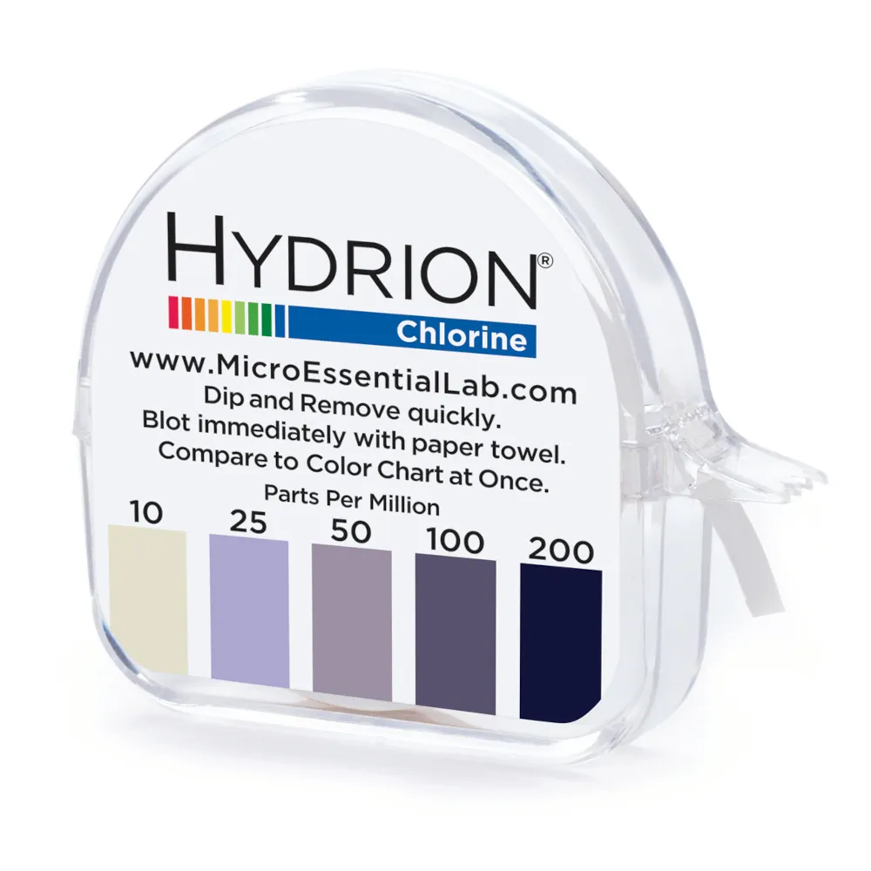
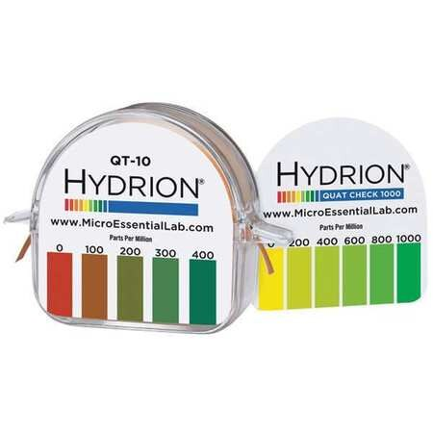
Test Solutions
This tests the concentration of Chlorine.
This test kit tests the concentration of Quats.
Concentrations can be checked with a test kit.
Notes:
Dip the paper into the solution and then compare the color.

Slide 35
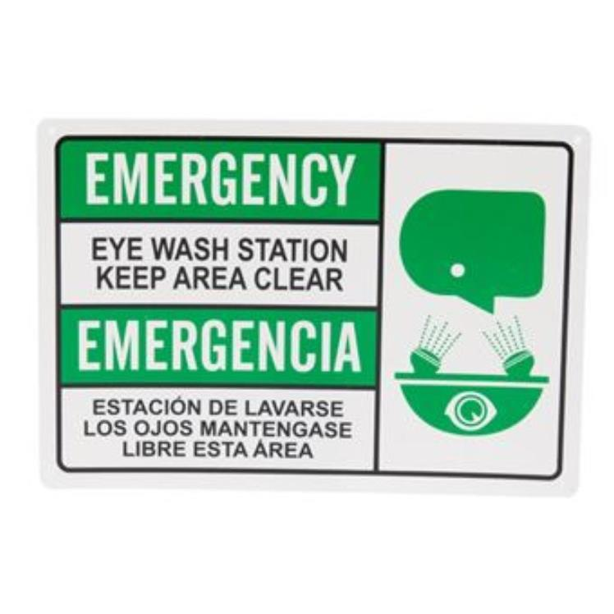
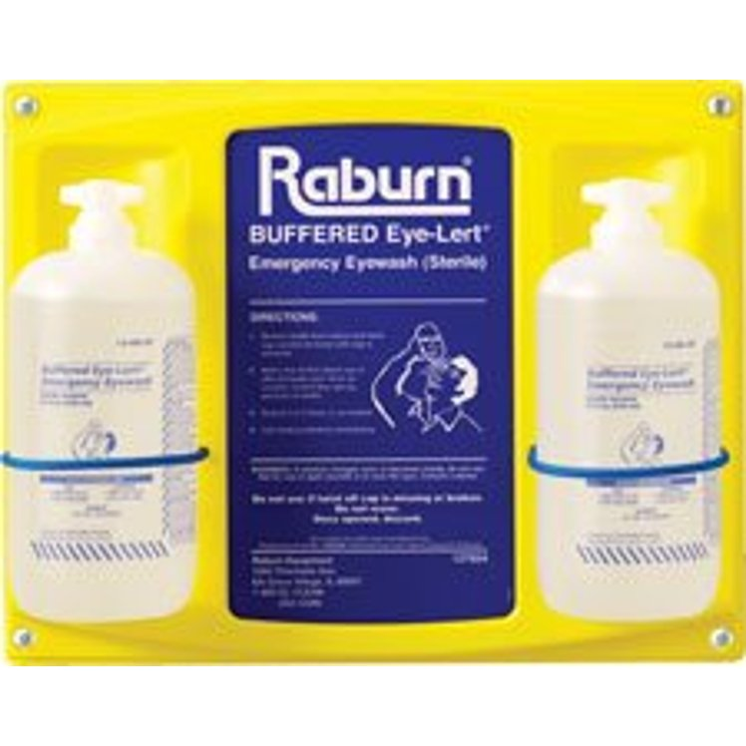
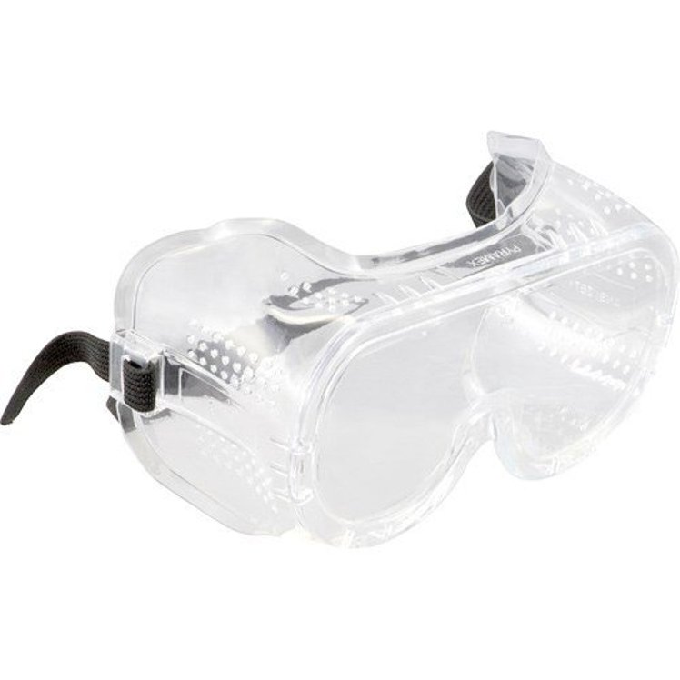
Personal protective equipment

Slide 36
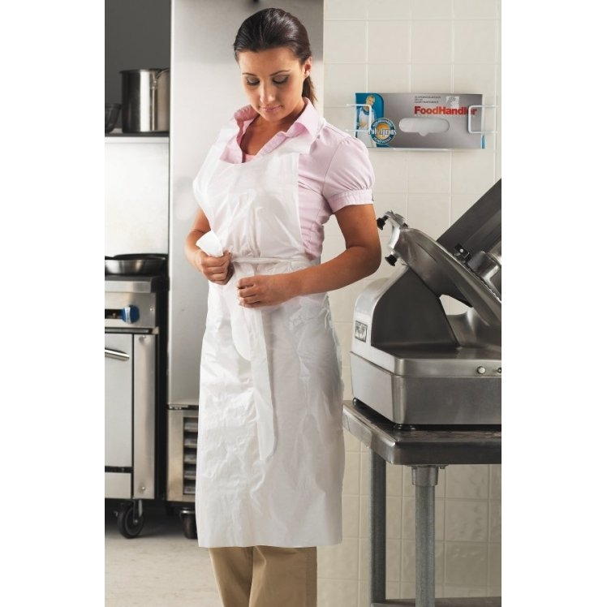
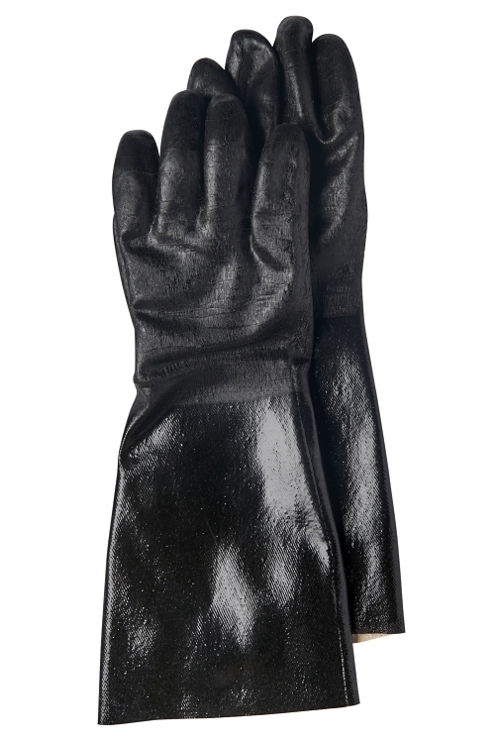
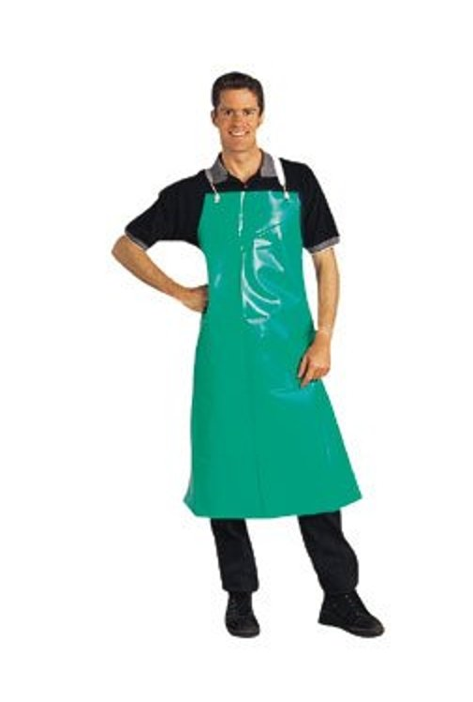
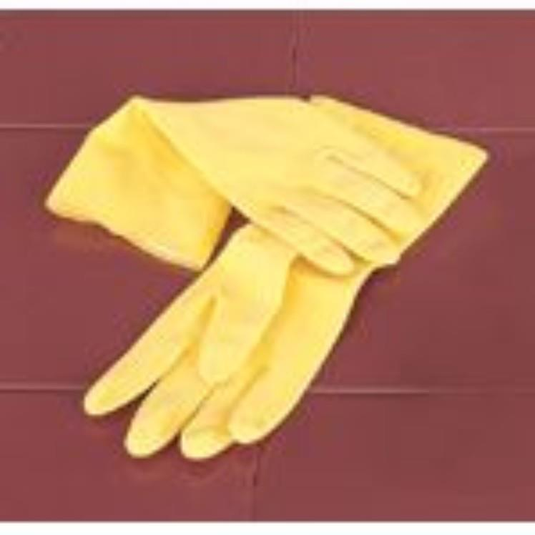

Slide 37
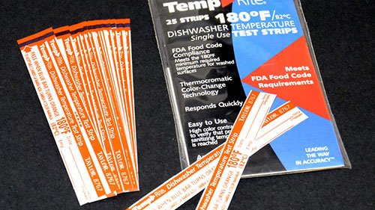
Heat Sanitizing
Hot water-soaking
Water must be at least 171˚F (77˚C)
Items must be soaked/immersed for at least 30 seconds
Can use a high temperature dishwasher

Slide 38
Dishwashing
High Temperature machine
Final sanitizing rinse must be at least 180˚F (82˚C)
165˚F (74˚C) for stationary rack, single temperature machines
Chemical Sanitizing Machines
Follow the temperature guidelines provided by the manufacturer

Slide 39
Dishwashing operation
Guidelines
Clean the machine as often as needed
Scrape, rinse or soak items before washing
Use the right rack for the items being washed
Check racks as they come out of the machine
Air-dry all items
Check the machine’s water temperature and pressure

Slide 40
Manual dishwashing
Preparing a Three Compartment Sink
Clean and sanitize each sink and drain board
Fill the first sink with detergent and water
Water Temperature must be at least 110˚F.
Follow the manufacturer’s recommendations
Fill the second sink with clean water
Fill the third sink with water and sanitizer to the correct solution
Hot water can be used as an alternative
Provide a clock with a second hand. This will let food handlers know how long items have a been in the sanitizer

Slide 41
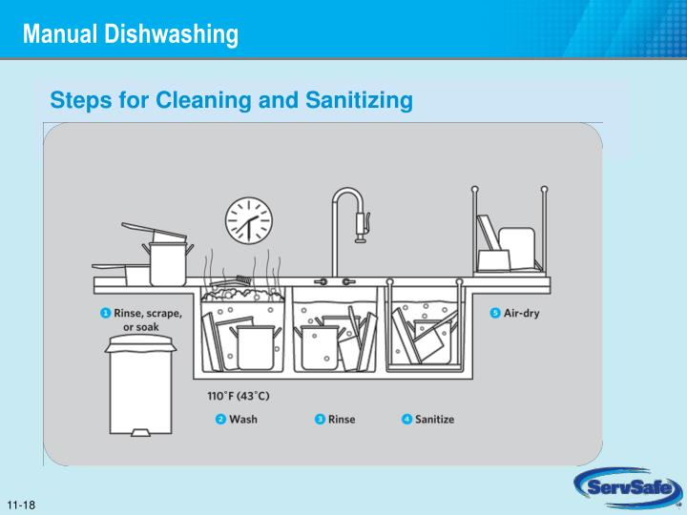

Slide 42
Storing Tableware and Equipment
When storing clean and sanitized tableware and equipment
Store them at least 6” off the floor
Clean and sanitize drawers and shelves before items are stored
Store glasses and cups upside down on a clean and sanitized shelf or rack
Store utensils with handles up
Cover the food-contact surface of stationary equipment until ready for use

Slide 43
Cleaning and Sanitizing stationary equipment
Unplug the equipment
Take the removable parts off the equipment
Wash, rinse, and sanitize them by hand or run the parts through a dishwasher if allowed
Scrape or remove food from the equipment surfaces
Wash the equipment surfaces
Rinse the equipment surfaces with clean water use a cloth towel or other correct tool.
Sanitize the equipment surfaces
Make sure the sanitizer comes in contact with each surface
Allow all surfaces to air-dry
Put the unit back together

Slide 44
Cleaning and sanitizing in the operation
When cleaning the premises
Clean nonfood contact surfaces regularly
Includes floor, ceilings, walls, equipment exteriors etc
Prevents dust, dirt, food residue, and other debris from building up
Prevent cleaning tools from contaminating surfaces
Clean tools before storing them
Assigning tools for specific tasks
Replace worn tools
Never use towels for cleaning food spills for any other purpose
Store towels in a sanitizer solution between uses

Slide 45
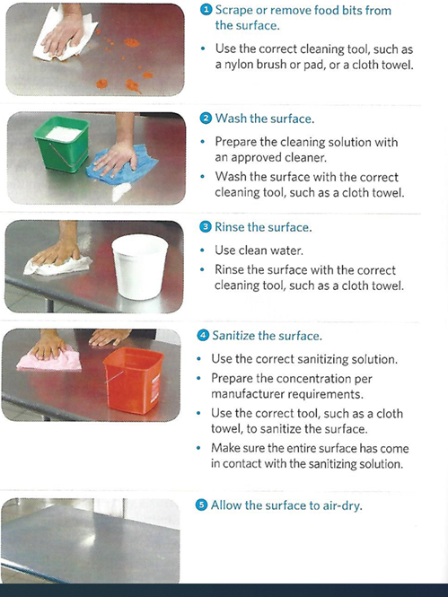
5-STEP PROCESS For food contact areas
Scrape or remove food from the surface
2. Wash the surface
3. Rinse the surface
4. Sanitize the surface
5. Allow the surface to dry
Notes:
Notice that we allow the surface to air dry. Using paper towels or cloths increases the risk of contamination.

Slide 46
Using Heat
There are three methods of using heat to sanitize surfaces
steam
hot water
hot air
Hot water is the most common method used in restaurants. If hot water is used in the third compartment of a three-compartment sink, it must be at least 171 degrees F (77C).
If a high-temperature ware washing machine is used to sanitize cleaned dishes, the final sanitizing rinse must be at least 180oF (82oC).
For stationary rack, single temperature machines, it must be at least 165oF (74oC).
Cleaned items must be exposed to these temperatures for at least 30 seconds.

Slide 47
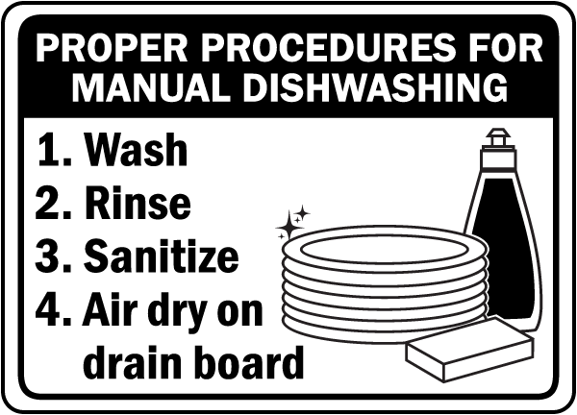

Slide 48
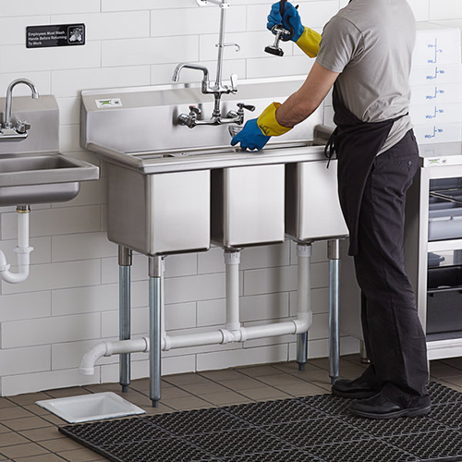
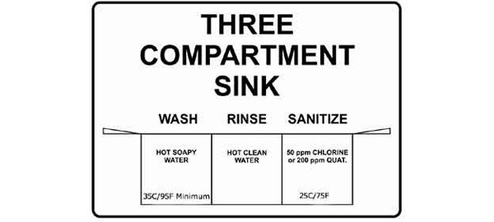

Slide 49
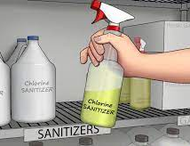
storage
Store all cleaning tools and chemicals away from food and prep areas.
Only Purchase those approved for use in food service operation
Store them in their original containers away from food and food prep areas
If transferring them to a new container, label it with the common name of the chemical

Slide 50
Material safety and Data Sheets
Keep MSDS for each chemical-can be online or in book
Keep updated
When throwing them away follow:
Instructions on label
Local regulatory requirements

Slide 51
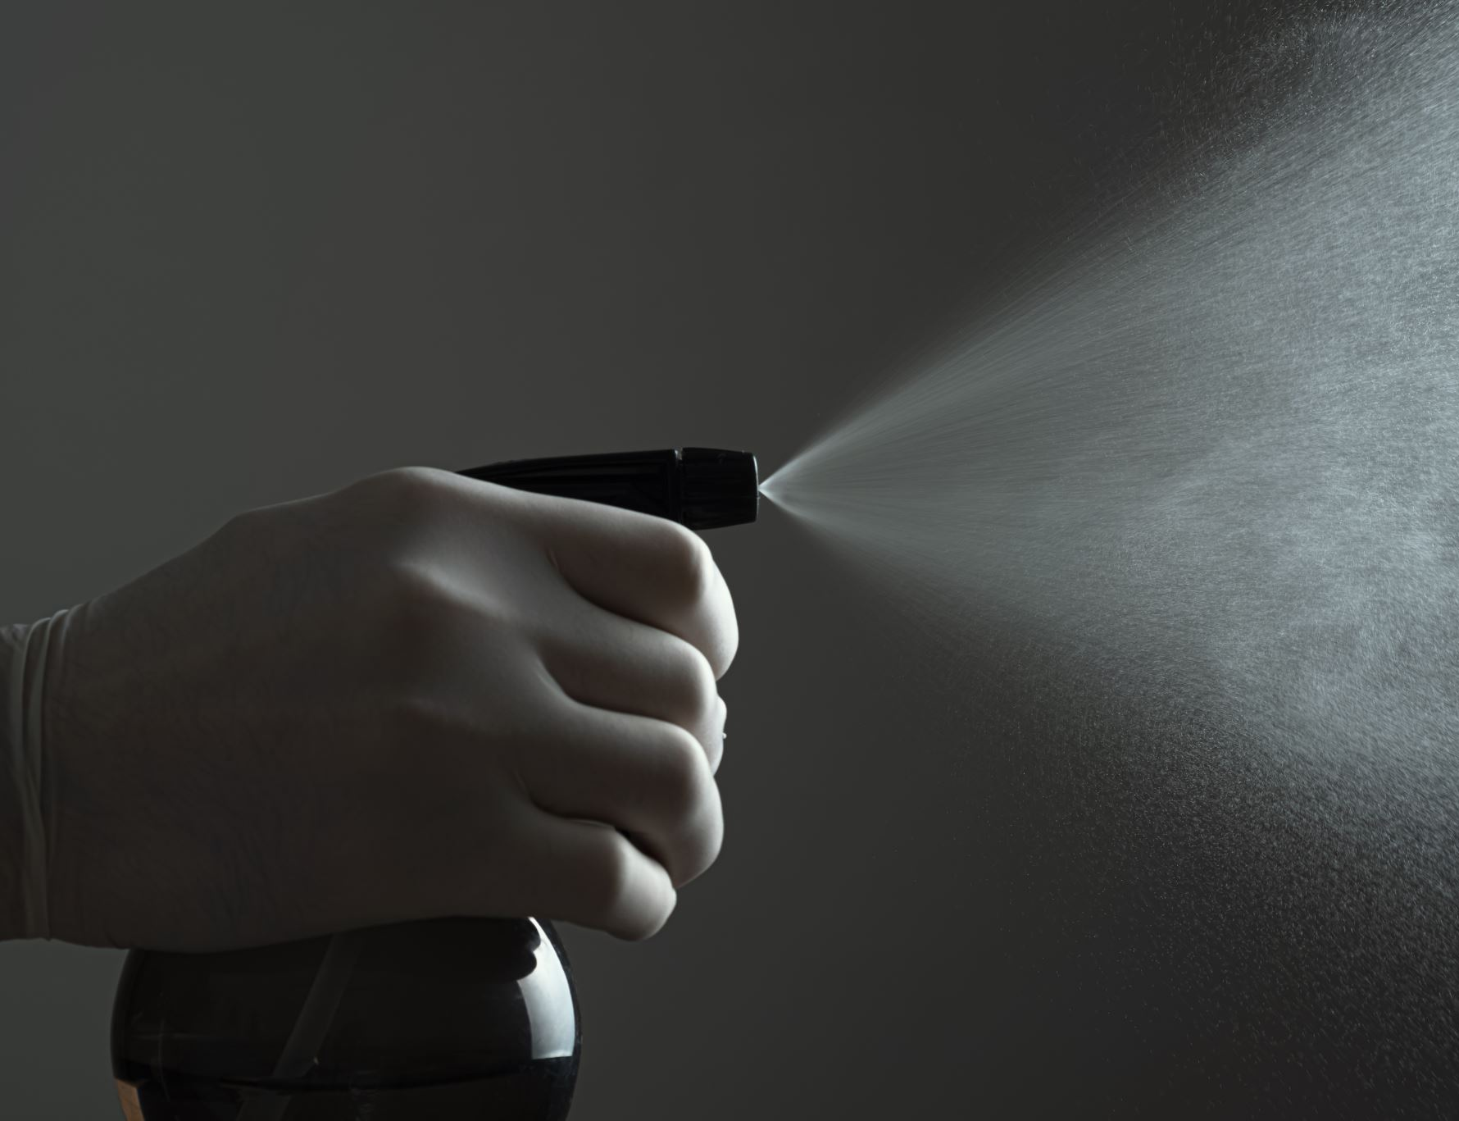
Develop a cleaning program
To develop an effective cleaning program:
Create a master cleaning schedule
Make sure your employees are using it
Monitor to make sure it is working

Slide 52
Master Cleaning schedule
To create a master cleaning schedule, identify:
What should be cleaned
Who should clean it
When it should be cleaned
How it should be cleaned

Slide 53
Monitoring of cleaning program
Supervise daily cleaning routines
Check cleaning tasks against the master schedule every day
Change the master schedule as needed
Ask staff for input on the program

Slide 54
Storage area
Utility sink for filling buckets and washing cleaning tools
Floor drain for dumping dirty water
Hooks for hanging cleaning tools

Slide 55
References
7th Edition SERVSAFE Manager Manual (2018)
Cleaning-vs-Sanitizing (www.foodsafetyfocus.com)
ServSafe – National Restaurant Association Educational Foundation (servsafe.com)

Slide 58
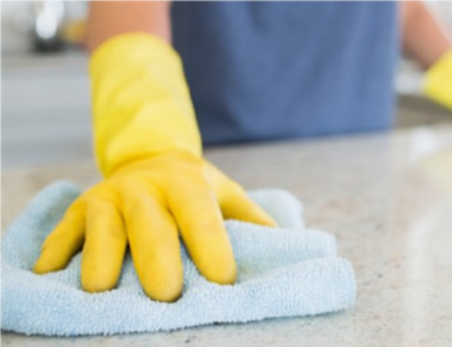
#1
To be effective, cleaning and sanitizing must be a ________-step process.
Two
Three
Four
D. Five

Slide 59
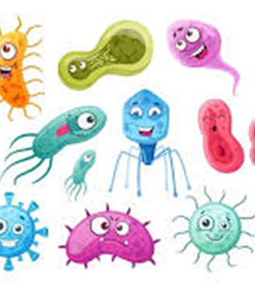
#2
True or False?
Cleaning reduces the number of pathogens on a surface to safe levels.

Slide 60
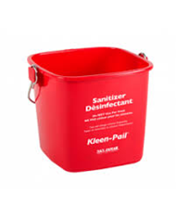
#3
Which of the following affect a sanitizer’s effectiveness: (choose all that apply)
Water hardness
Water pH
Solution contact time
Room temperature
Solution concentration

Slide 61
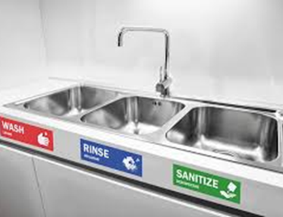
#4
True or False?
Utensils cleaned and sanitized in a three-compartment sink should be dried with a clean towel.

Slide 62
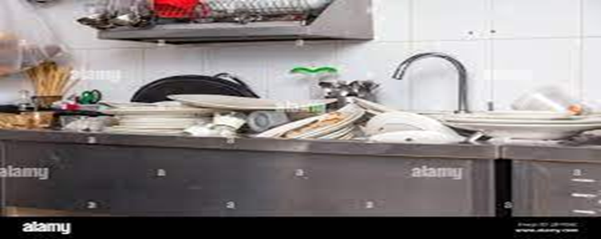
#5
What are the 5-steps to cleaning and sanitizing?
sanitize, scrape food from surface, place in dishwasher, dry with clean cloth, put away
wash, rinse, dry, sanitize, put away
scrape or remove food bits from surface, wash surface, rinse surface, sanitize surface, air-dry
rinse, place in dishwasher, air-dry, sanitize, put away

Slide 63
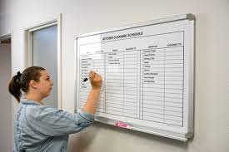
#6
True or False?
In order to have an effective cleaning program, it should be monitored every day.

Slide 64
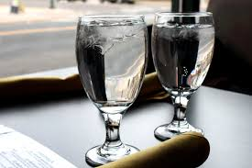
#7
Glasses should be stored ________________on a clean and sanitized shelf or rack.
and stacked
with drinking lip up to allow air into the glass
upside-down

