Slide 1
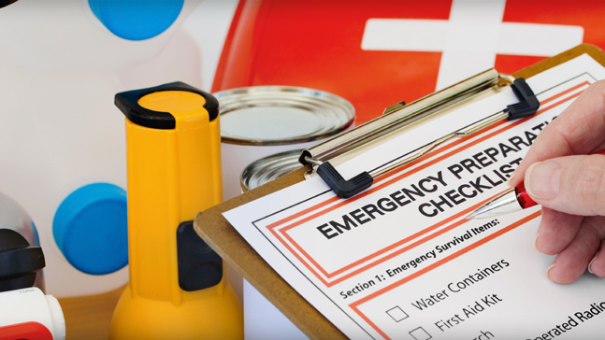
NCNMEDD/Non-Metro AAA Provider Emergency/Preparedness Training 9/22/2022 by: Laura Martinez-Provider Specialist II

Slide 2
Call Your Emergency Management Office or New Mexico Red Cross Chapter: (505) 265-8514 Find out which disasters could occur in your area. Ask how to prepare for each disaster Ask how you would be warned of an emergency. Learn your community’s evacuation routes. Ask about special assistance for elderly or disabled persons. Also… Ask your workplace about emergency plans. Learn about emergency plans for your family’s workplace and children’s schools or daycare. | Create an Emergency Plan Meet with staff members to discuss the dangers of fire, severe weather, earthquakes and other emergencies. Explain how to respond to each. Find the safe spots in your home/ workplace for each type of disaster. Discuss what to do about power outages and personal injuries. Draw a floor plan of your home/workplace . Mark two escape routes from each room. Show family/staff how to turn off water, gas and electricity at main switches when necessary. Post emergency telephone numbers near telephones. Instruct household/staff members to turn on the radio for emergency information. Take a basic first aid and CPR Class. Keep family/staff/sensitive records in a water and fire-proof container. | Prepare a Disaster Supplies Kit Assemble supplies you might need in an evacuation. Store them in an easy-to-carry container such as a backpack or duffle bag. Include: A supply of water (one gallon per person per day). Store water in sealed, unbreakable containers. Identify the storage date and replace every six months. A supply of non-perishable packed or canned food and a nonelectric can opener. A change of clothing, rain gear and sturdy shoes. Blankets or sleeping bags. A first aid kit and prescription medications. An extra pair of glasses. A battery-powered flashlight and plenty of extra batteries. Credit cards and cash. An extra set of car keys. A list of family physicians. A list of important family information: style and serial number of medical devices such as pacemakers. Special items for elderly or disabled family members.

Slide 3
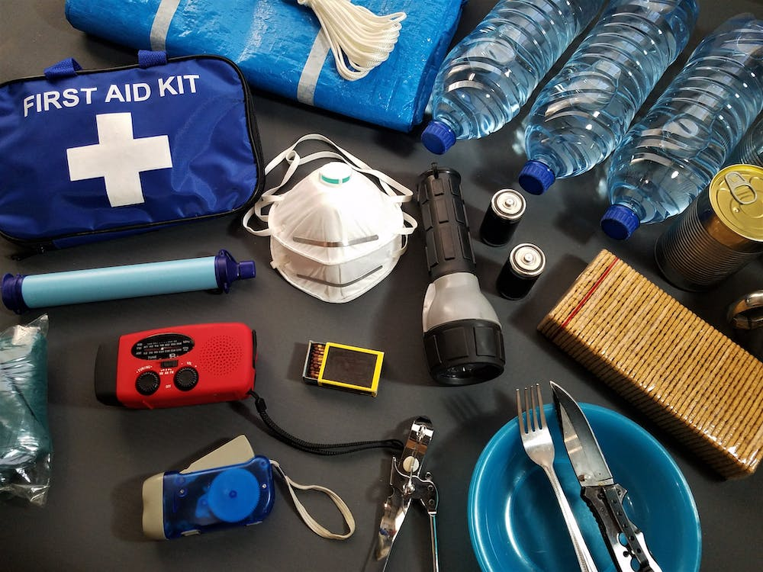
Prepare an Emergency Car Kit
Battery powered radio, flashlight and extra batteries
Blanket
Booster Cables
Fire extinguisher (5 lb., A-B-C Type)
First aid kit and manual
Bottled Water and non-perishable high energy foods such as granola bars, raisins and peanut butter.
Maps, shovel, flares
Tire repair kit and pump

Slide 4
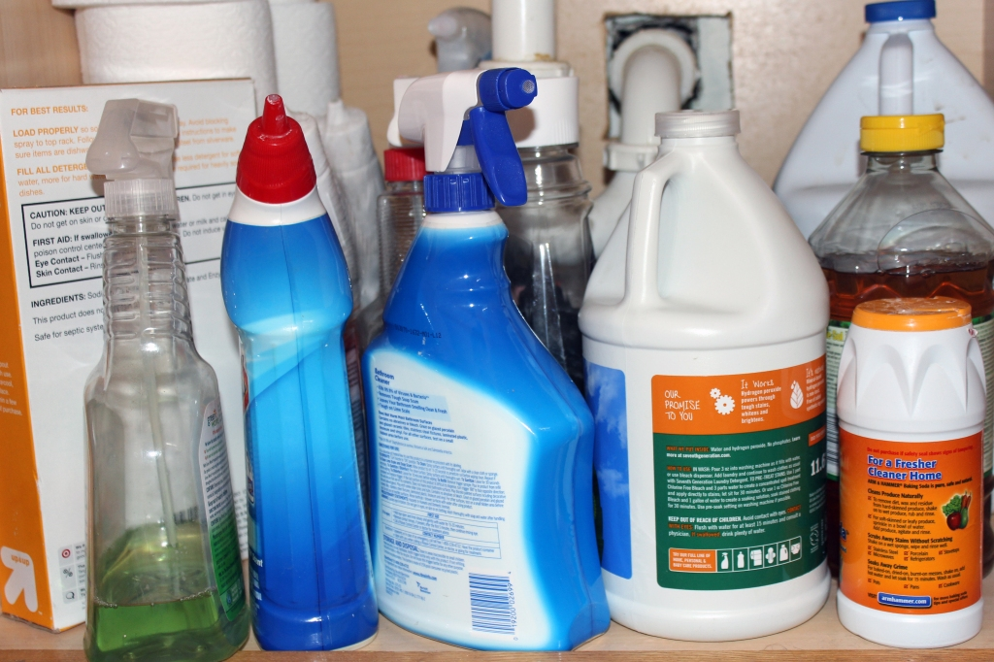
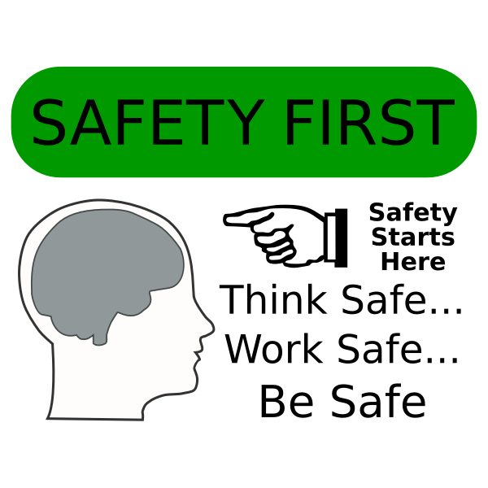
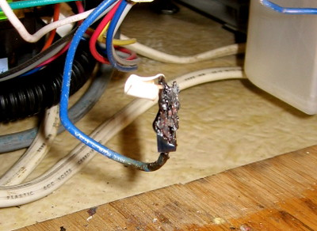
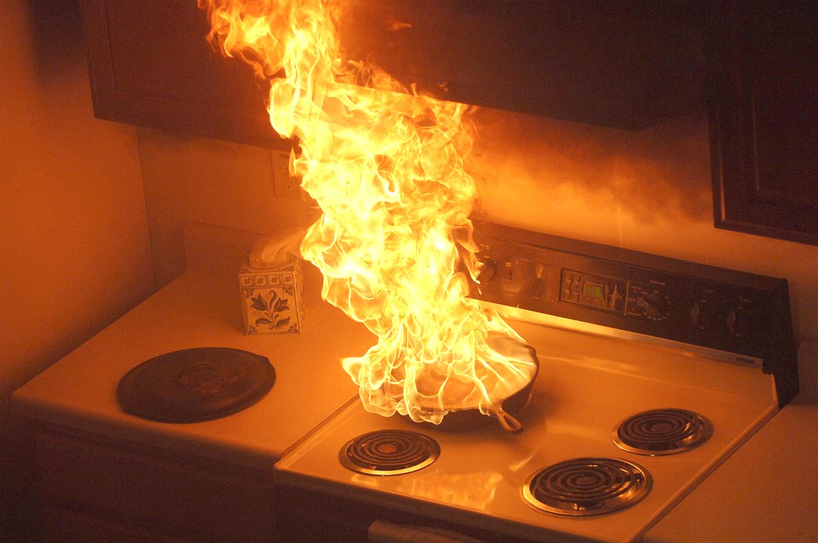
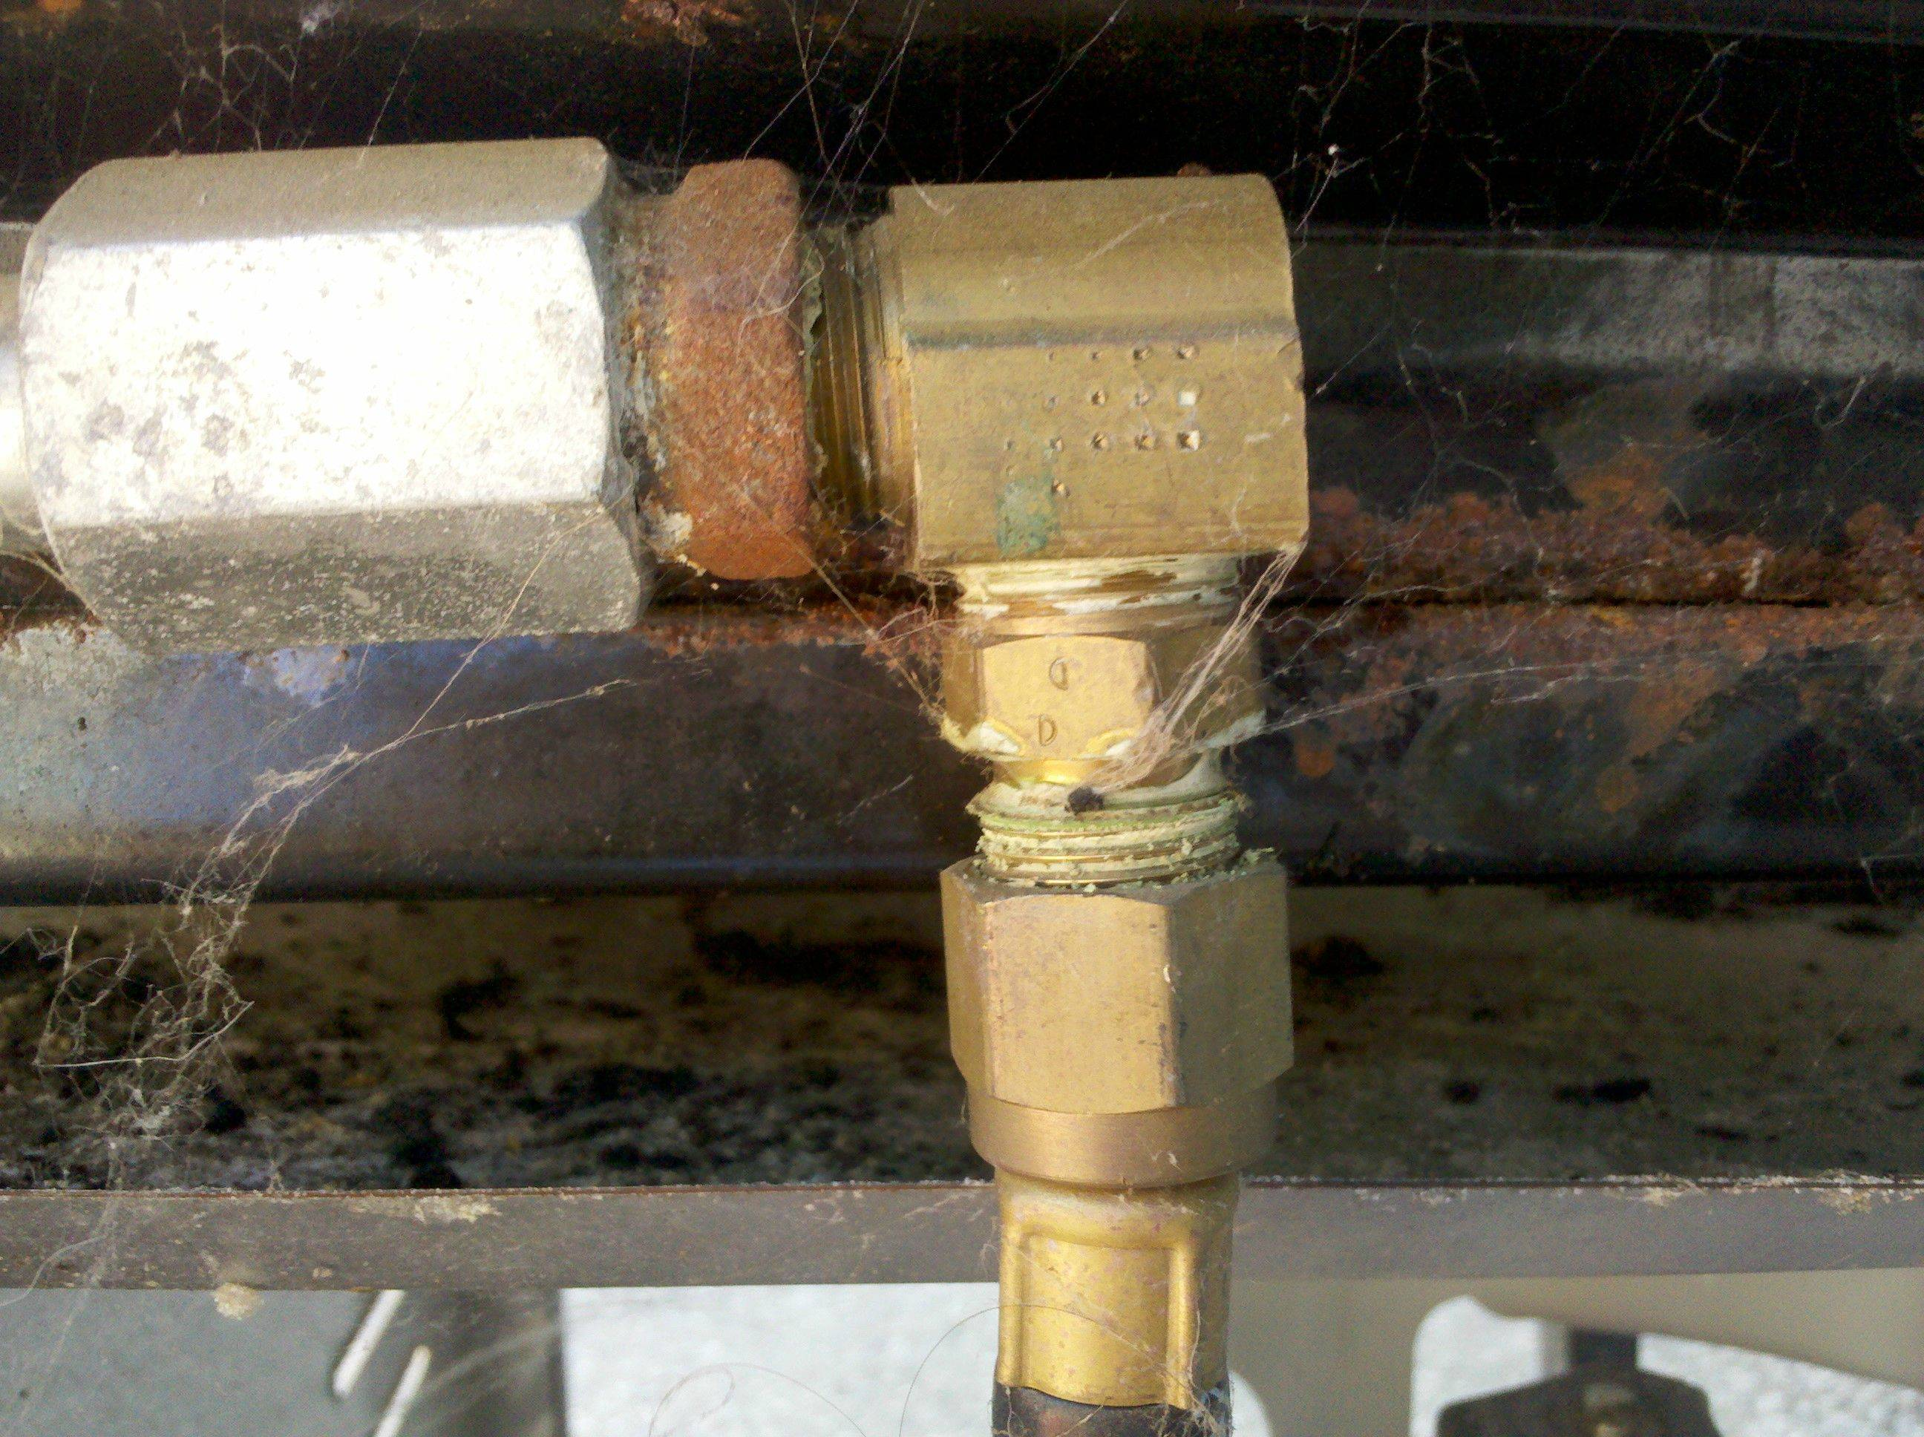
Home and Workplace Hazard Hunt
In a disaster, ordinary items in the home can cause injury and damage. Anything that can move, fall, break or cause a fire is a potential hazard.
Repair defective electrical wiring and leaky gas connections.
Fasten shelves securely and brace overhead light fixtures.
Place large, heavy objects on lower shelves.
Hang pictures and mirrors away from beds.
Strap water heater to wall studs.
Repair cracks in ceilings, roofs and foundations.
Store all weed killers, pesticides and flammable products away from heat source.
Place oily polishing rags or waste in covered metal cans.
Clean and repair chimneys, flue pipes, vent connectors and gas vents.
This Photo by Unknown Author is licensed under CC BY
This Photo by Unknown Author is licensed under CC BY-SA-NC

Slide 5
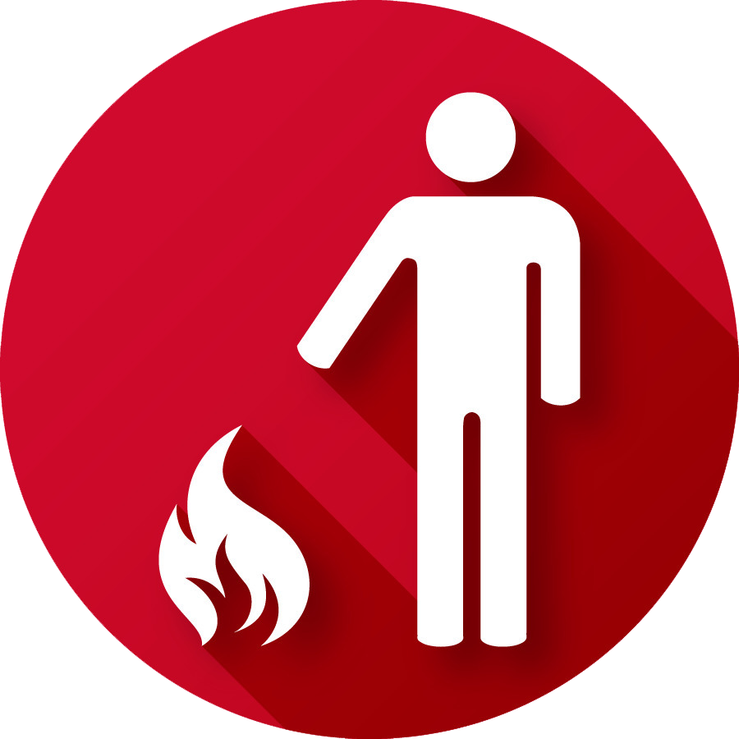
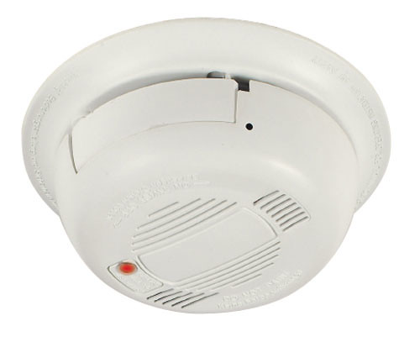
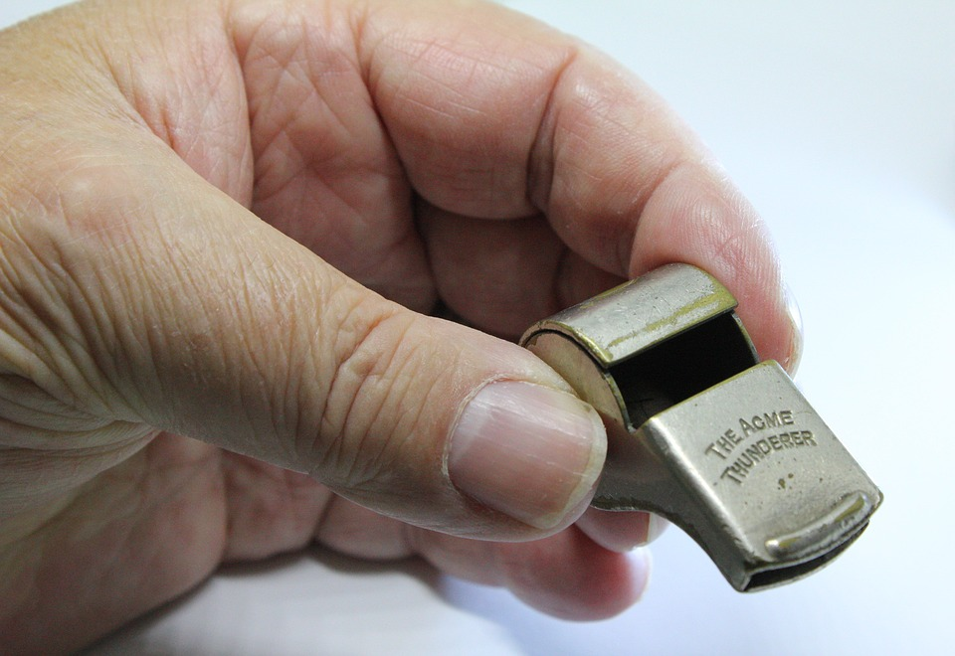
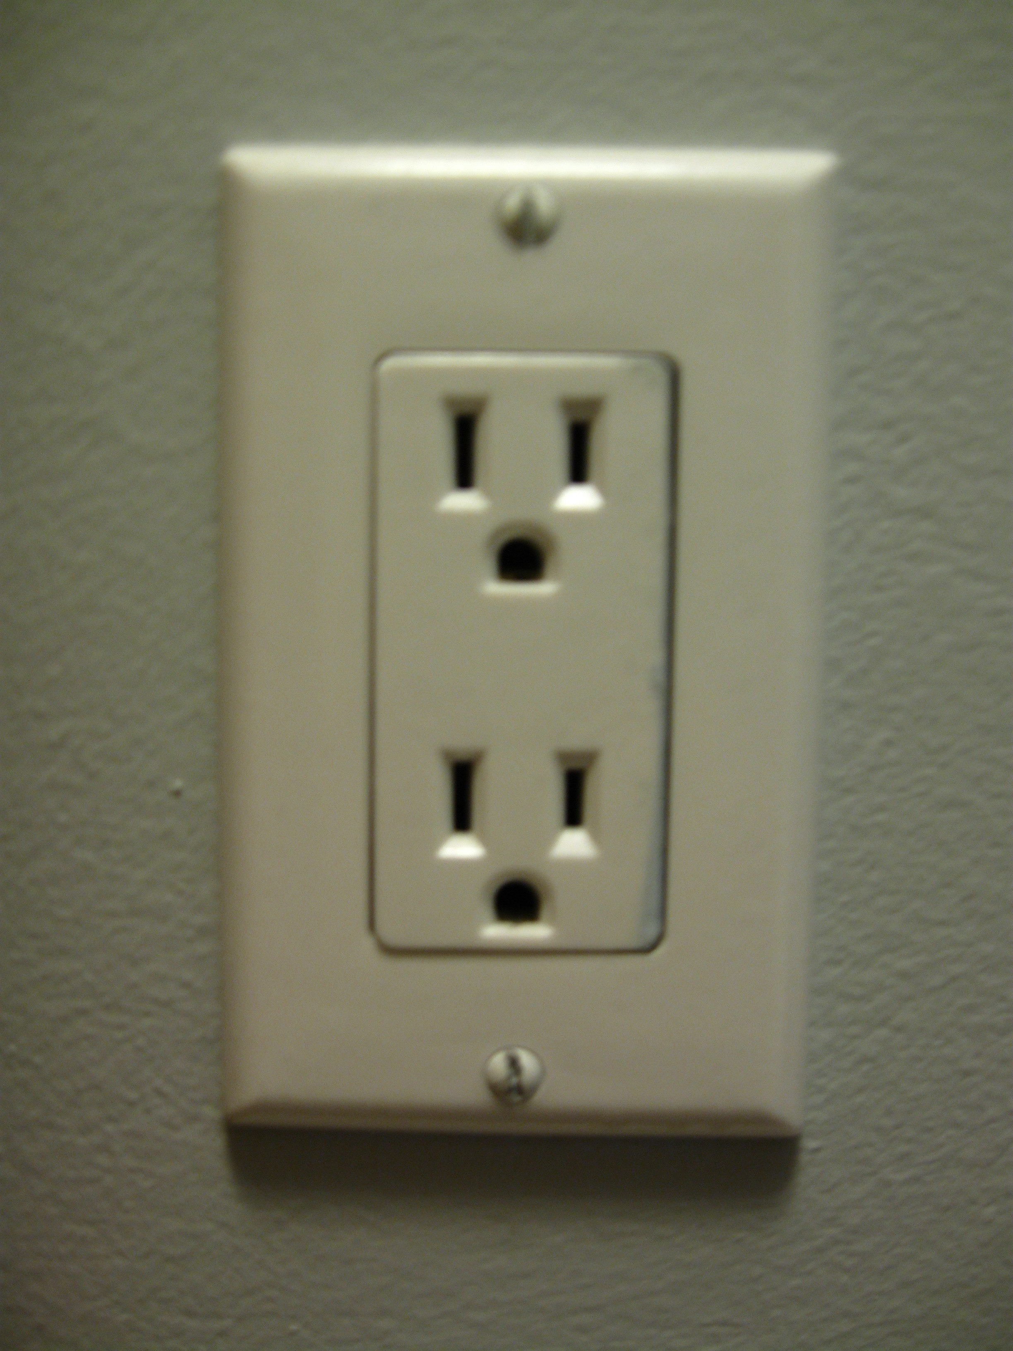
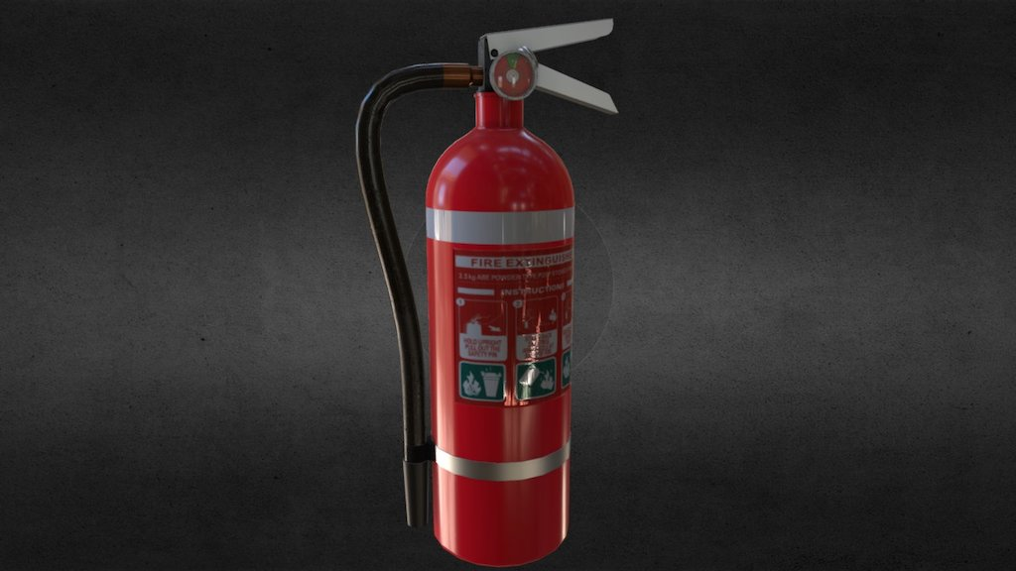
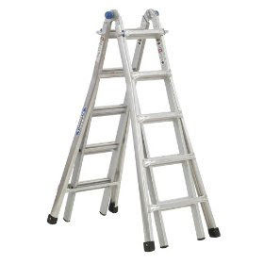
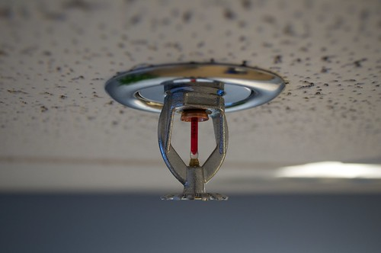
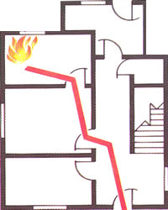
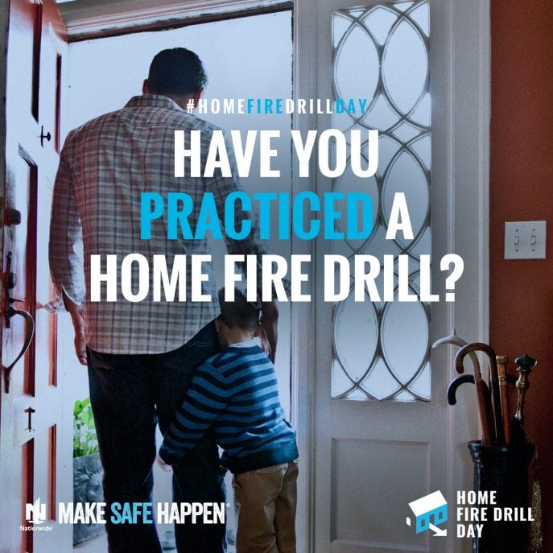
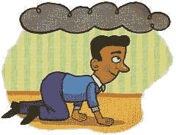
FIRE
Plan
Plan two escape routes out of each room.
Practice
Practice fire drills at least twice a year.
Teach
Teach family and coworkers to stay low to the ground when escaping from a fire.
Teach
Teach family members and staff never to open doors that are hot. In a fire, feel the bottom of the door with the palm of your hand. If it is hot, do not open the door. Find another way out.
Install
Install smoke detectors on every level of your home or workplace. Clean and test them at least once a month. Change out batteries once a year or as needed.
Keep
Keep a whistle in each bedroom to awaken household in case of fire.
Check
Check electrical outlets. Do not overload outlets.
Purchase and learn
Purchase and learn how to use a fire extinguisher (5lb., A-B-C type)
Have
Have a collapsible ladder on each upper floor of your house.
Consider
Consider installing sprinklers.

Slide 6
Emergency Preparedness Seniors and Emergencies
This Photo by Unknown Author is licensed under CC BY-NC-ND
This Photo by Unknown Author is licensed under CC BY-SA-NC

Slide 7
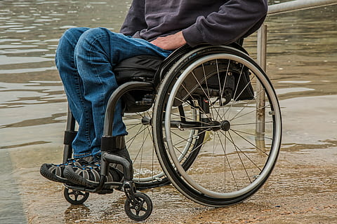
SENIOR ADULTS
Whether a senior lives alone or depends on a caregiver, it is vital to have a plan for what to do before, during and after a disaster.
Get/Make a kit:
Consider storing your supplies in a container or bag that has wheels. Label any equipment—such as wheelchairs, canes, or walkers—that you would need with your name, address, and phone numbers. Keep hearing aids, glasses, or assistive devices near the bedside. You may want to attach the equipment with Velcro as some disasters, like earthquakes, may cause items to shift.
Make a Plan, know the answers and plan accordingly:
Do you live alone?
Do you drive or own a car?
How good is your sense of smell?
Do you have any physical, medical, thinking, or learning disabilities?
Do you use any medical equipment?
Do you have a caregiver who helps you carry out activities of daily living?

Slide 8
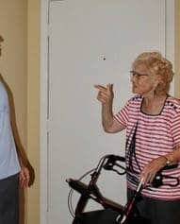
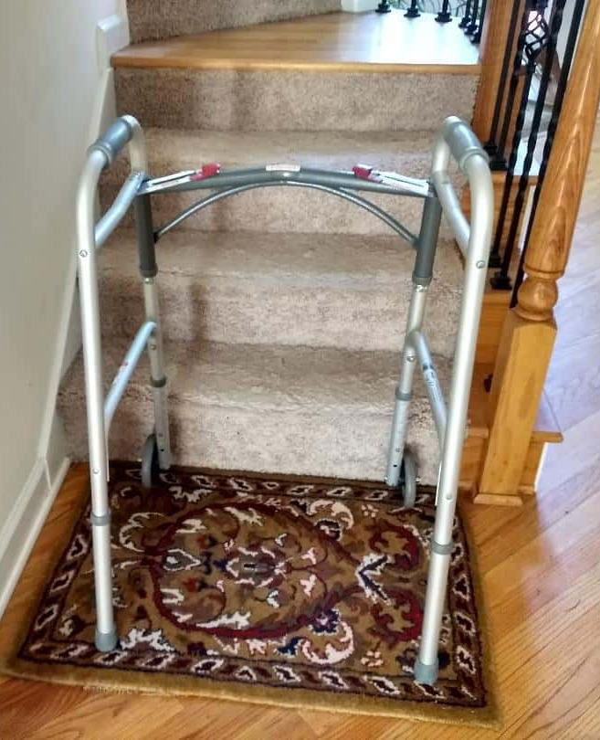
SENIOR ADULTS (Continued)
It is important to assess your household and remove any items that could be hazardous when evacuating.
Know the safe places within your home in case you need to shelter during extreme weather events.
If you use a wheelchair, find escape routes that are wheelchair accessible.
Keep support items like wheelchairs and walkers in a designated place so they can be found quickly.

Slide 9
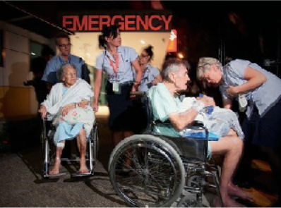
SENIOR ADULTS (Continued)
Be Informed
Your seniors should always be informed about your community’s disaster plans and your area’s evacuation plans in an emergency. If you know a senior who receives home care, speak with their family or case manager to see what their plan is in times of emergency and how they can assist him/her.
This Photo by Unknown Author is licensed under CC BY-NC

Slide 10
Tips on Preparing for Emergencies that occur in New Mexico
Home Fire Safety: Get out, stay out, and call 911. | Wildfire Safety Don’t wait. Evacuate | Landslide Safety Landslides take place most often where they’ve happened in the past.
Cooking safety: Keep an eye on what you fry. Stay in the kitchen when frying, grilling or using an open flame. Fireplaces, Space Heaters, Baseboards, etc.: Keep furniture, curtains, dish towels and anything that could catch fire at least 3 feet from any type of heat source. Smoking safety: Never smoke in bed. Electrical and Appliance Safety: Large and small appliance are plugged directly into the wall outlets. Children Playing: Matches and lighters are locked away. Smoke and Carbon Monoxide Alarms: Check them, replace batteries every year, replace alarms every ten years. | Before: Keep a “safe zone” of 30 feet around your home with no dry vegetation or flammable items like propane or firewood. During: Listen to local radio and TV stations for wildfire information. Evacuate immediately if evacuation is instructed or if you the wildfire is close. Close all home opening to limit exposure to smoke and dust. Move outside future and plants indoors. After: Do not return until officials declare the area is safe. Use caution when entering burned areas, as hot spots may still exist and flare up without warning. Wet debris down to minimize breathing in dust. Do not drink water that you think may be contaminated. Discard food that has been exposed to smoke or dust. | Before: Become aware of evacuation plans for all the buildings you occupy regularly. Keep and maintain an emergency supplies kit in an easy-to-access location. Be aware of your area’s risk. Watch patterns of water runoff near your home. Landslides are more likely after heavy or sustained rain or rapid snowmelt. During: After heavy rain, listen for unusual sounds that might indicate moving debris, such as trees cracking or boulders knocking together. If you suspect a landslide will occur, evacuate immediately. Be especially alert when evacuating. Watch for collapsed pavement, mud, fallen rocks, and other debris. After: Stay away from the slide area, as additional slides may occur. Check yourself for injuries and get first aid, if necessary, before helping injured or trapped persons. Get updated emergency information and instructions by listening to local radio and TV stations. If there is not electricity, use your mobile devices, car radio or listen to your portable, batter-operated or hand-crank radio. Watch for flooding. Floods sometimes follow landslides because they may both be started by the same event. Check the building foundation and surrounding land for damage, as it will help you assess the safety of the area.

Slide 11
Tips on Preparing for Emergencies that occur in New Mexico
Winter Snowstorms (continued) | High Windstorms or Tornadoes | Flooding
Stay Indoors if Possible: Wear layers of loose-fitting, lightweight, warm clothing. Listen to local news or NOAA Weather Radio for updated emergency information. Bring your companion animals inside. Move other animals to sheltered areas with a supply of non-frozen water. Eat regularly. Drink fluids such as warm broth or juice. Avoid caffeine and alcohol which can cause dehydration. Conserve fuel. Lower the thermostat to 65° F (18° C) during the day and to 55° F (13° C) at night. Check on relatives, neighbors, and friends who are elderly or live alone. Protect Yourself Outdoors Wear layered clothing, mittens or gloves, and a hat. Outer garments should be tightly woven and water repellent. Cover your mouth to protect your lungs from severely cold air. Avoid taking deep breaths; minimize talking. Watch for signs of hypothermia and frostbite. Keep dry. Wet clothing loses much of its insulating value and transmits heat rapidly away from the body. Avoid overexertion, such as shoveling heavy snow, pushing a vehicle, or walking in deep snow. Walk carefully on snowy, icy sidewalks. Use public transportation if possible. | Right Before a Tornado Don’t wait until you see the tornado to act! If you do nothing else: 1. Listen to local area radio, NOAA radio or TV stations for the latest information and updates. 2. Move to an underground shelter, basement or safe room. If none is available, a small, windowless interior room or hallway on the lowest level of a sturdy building is the safest alternative. Remember: no area of a mobile home is safe during a tornado. If you have access to a sturdy shelter or a vehicle, go there immediately, using your seat belt if driving. 3. Find a local emergency shelter and know the best routes to get there if you need to. What Should You Do During a Tornado? If You Are Outdoors Seek shelter in a basement, shelter or sturdy building. If you cannot quickly walk to a shelter, immediately get into a vehicle and try to drive to the closest sturdy shelter. Remember to buckle your seat belt. Stay away from bridge/highway overpasses. If strong winds and flying debris occurs while driving, pull over and park, keeping your seat belt on and engine running. Put your head down below the windows, covering your head with your hands and a blanket. | Fact vs. Fiction Fiction: Fill your sinks and bathtubs for drinking water in case flooding water interrupts or contaminates the public water supply. Fact: Water Stored in bathtubs and sinks should never be used for drinking or for bathing young children because led can leak from the glaze in bathtubs and sinks into the water stored in them. However, you can use water stored in bathtubs and sinks for flushing the toilet or washing the floor or clothing. Right Before a Flood: Listen to local area radio, NOAA radio (National Oceanic and Atmospheric Administration) or TV stations for the latest information and updates. Be prepared to evacuate quickly and know your routes and destinations. Find a local emergency shelter. Check your emergency kit and replenish any items missing or in short supply, especially medications or other medical supplies. Keep it nearby. During a Flood: Indoors Turn off the power and water mains if instructed to do so by local authorities. Boil tap water until water sources have been declared safe. Avoid contact with floodwater. It may be contaminated with sewage or contain dangerous insects or animals. Continue listening to local area radio, NOAA radio or TV stations for the latest information and updates. Don’t use gas or electrical appliances that have been flooded. Dispose of any food that comes into contact with flood water.

Slide 12
Tips on Preparing for Emergencies that occur in New Mexico
Winter Snowstorms (Continued) | High Windstorms or Tornadoes (Continued) | Flooding (Continued)
After a Winter Storm Continue listening to local news or a NOAA Weather Radio station for updated information and instructions. Access to some parts of the community may be limited or roads may be blocked. Help people who require special assistance—infants, elderly people, those without transportation, large families who may need additional help in an emergency, people with disabilities, and the people who care for them. Avoid driving and other travel until conditions have improved. Avoid overexertion. Heart attacks from shoveling heavy snow are a leading cause of death during the winter. Check on your animals and ensure that their access to food and water is unimpeded by drifted snow, ice, or other obstacles. If you are using a portable generator, take precautions against carbon monoxide poisoning, electrocution and fire. Frostbite and hypothermia are cold-related emergencies that may quickly become life or limb threatening. Take these steps to avoid frostbite and hypothermia: Be aware of the wind chill. Dress appropriately and avoid staying in the cold too long. Wear a hat and gloves when appropriate with layers of clothing. Avoid unnecessary exposure of any part of the body to the cold. Drink plenty of warm fluids or warm water but avoid caffeine and alcohol. Stay active to maintain body heat. Take frequent breaks from the cold. Get out of the cold immediately if the signals of hypothermia or frostbite appear. Recovering After a Winter Storm Once you are physically safe, take time to ensure your family’s emotional and financial well-being. | How Can You Stay Safe After a Tornado? If you do nothing else: Let friends and family know you’re safe. The American Red Cross can help you reconnect with family members. If evacuated, return only when authorities say it is safe to do so. Continue listening to local news or a NOAA Weather Radio for updated information and instructions. Check for injuries. If you are trained, provide first aid to persons in need until emergency responders arrive. | During a Flood Outdoors: Don't walk, swim or drive through floodwater. Just six inches of fast-flowing water can knock you over and two feet will float a car. If caught on a flooded road with rapidly rising waters, get out of the car quickly and move to higher ground. Don't walk on beaches or riverbanks. Don’t allow children to play in or near flood water. Avoid contact with floodwater. It may be contaminated with sewage or contain dangerous insects or animals. Stay out of areas subject to flooding. Underpasses, dips, low spots, canyons, washes, etc. can become filled with water. After: Let friends and family know you’re safe. The American Red Cross can help you reconnect with family members. If evacuated, return only when authorities say it is safe to do so. Continue listening to local news or a NOAA Weather Radio for updated information and instructions. Keep children and pets away from hazardous sites and floodwater.

Slide 13
Tips on Preparing for Emergencies that occur in New Mexico
Biological or Chemical Threat | Don't Forget to Make a Back-Up Plan | If You Are Instructed to Evacuate
Before: Avoid mixing chemicals, even everyday household products. Store chemical products properly and away from food items. Never smoke while using household chemicals. Clean up spills immediately, being careful to protect your eyes and skin. Dispose of unused chemicals properly. During: Follow instructions of authorities. Listen to your emergency broadcast stations on radio and TV. If you are told to “shelter in place,” go inside, close all windows and vents and turn off all fans, heating, or cooling systems. Use duct tape to secure plastic sheeting around all cracks or sills where air could enter. If you don’t have tape and plastic, use wet cloths. If you find someone who is injured, make sure you are not in danger before administering first aid. Use your phone only in life-threatening emergencies. Call poison control (1-800-222-1222) or 9-1-1 immediately. After: Do not return until officials have declared the area safe. Contact your local public health department for recommendations for boiling or treating , as water may be contaminated. Follow instructions from emergency officials concerning proper clean-up. | Emergencies and disasters can unfold in unpredictable ways, and even carefully made plans may need to adapt to changing circumstances. That’s why it’s so important to arrange a back-up solution for the most critical parts of your emergency plan. Know how to connect and start a back-up power supply for your essential medical equipment. Do you have a medical alert system that allow you to call for help if you are immobilized in an emergency? Most alert systems require a working phone line, so have a back-up plan, such as a cell phone, if the regular landlines are disrupted. If you use an electric wheelchair or scooter, have a manual wheelchair for back-up. Teach those who may need to assist you in an emergency how to operate necessary equipment. Also, label equipment and attach laminated instructions for equipment use. Store back-up equipment (mobility, medical, etc.) at your neighbor’s home, school, or your workplace. Arrange for more than one person from your personal support network to check on you in an emergency, so there is at least one back-up if the primary person you rely on cannot. If you are a person who is vision impaired, deaf or hard of hearing, plan ahead for someone to convey essential emergency information to you if you are unable to use the TV or radio. If you use a personal care attendant obtained from an agency, check to see if the agency has special provisions for emergencies (e.g., providing services at another location should an evacuation be ordered). Have a cell phone with an extra battery. If you are unable to get out of a building, you can let someone know where you are and guide them to you. Keep the numbers you may need to call with you if the 9-1-1 emergency number is overloaded. | Your first option and plan should always be to go to family or friends first; they can accommodate you, your service animal and pets, and help you be most comfortable in a stressful situation. Emergency Public Shelters can provide a safe place to stay and meals while you are there, but not all shelters provide personal health care or assistance with activities of daily living. If you require the care of a personal attendant and choose to go to a shelter, bring the attendant with you. Listen to the radio or television for the location of emergency shelters. Note those that are accessible to people with physical disabilities and those that have other disability friendly assistance features such as TTY lines. Wear appropriate clothing such as sturdy shoes. Take your disaster supplies kit. Confirm upon arrival at an emergency shelter that it can meet your care needs. Inform members of your support network and out-of-town contact of your location and status.

Slide 14
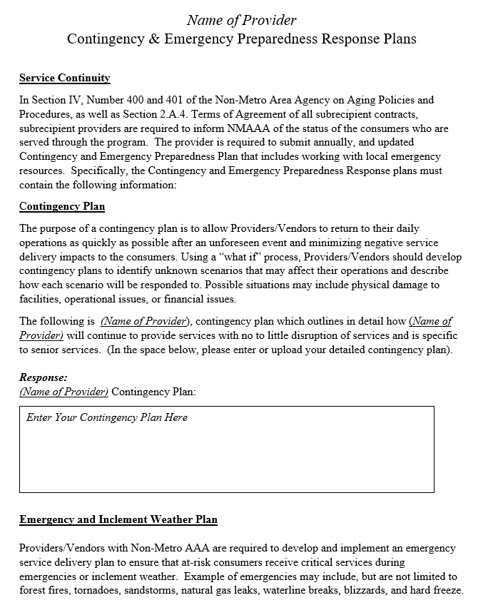

Slide 15
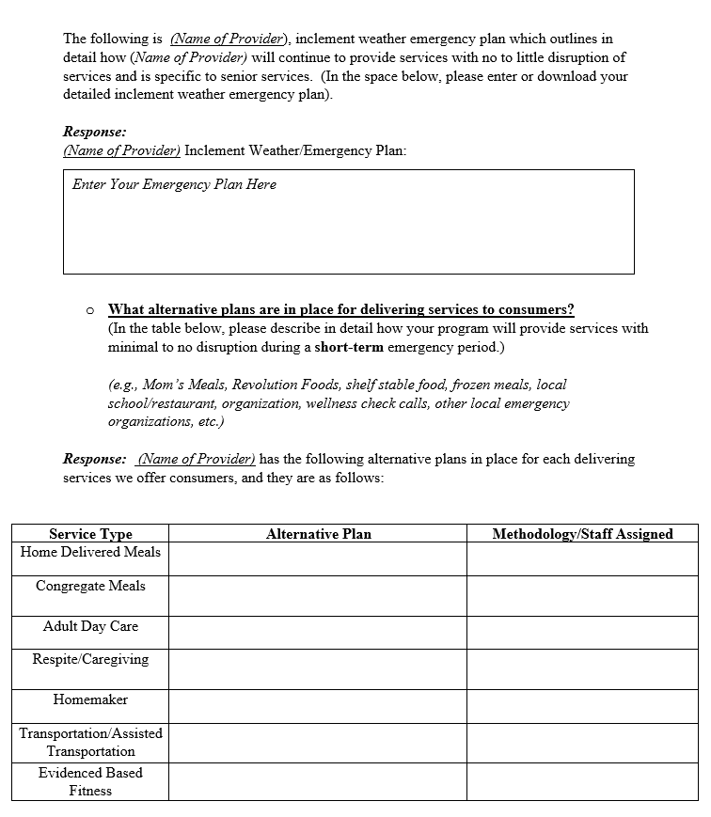

Slide 16
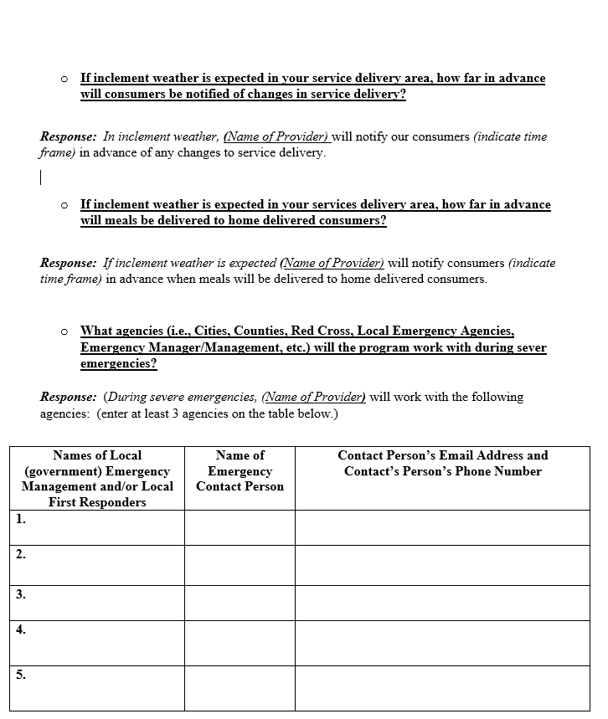

Slide 17
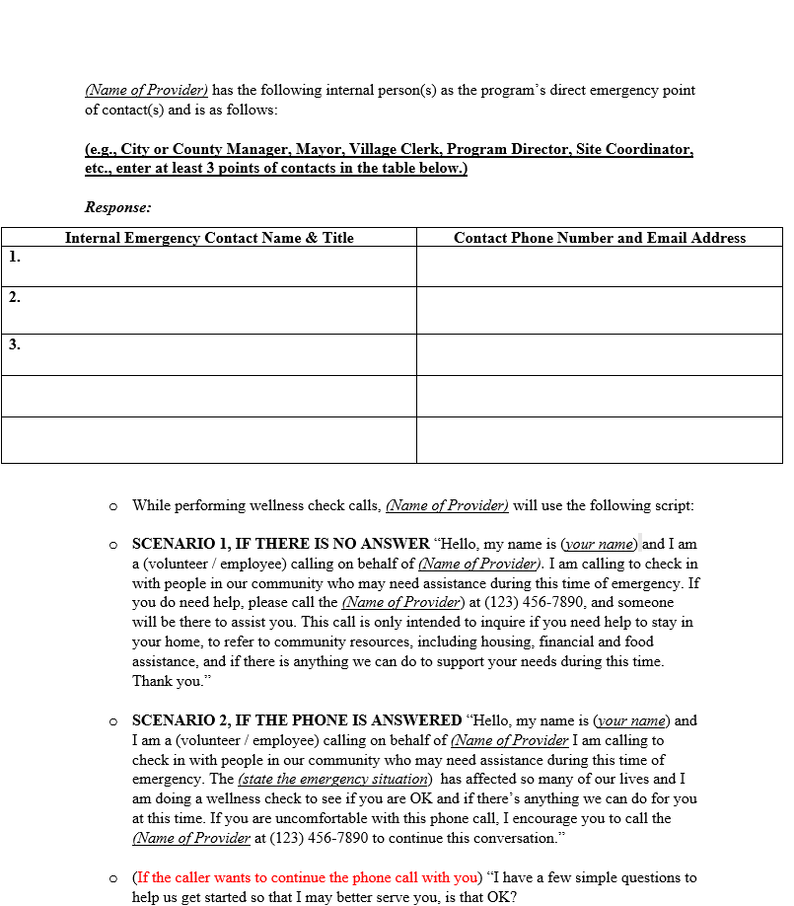

Slide 18
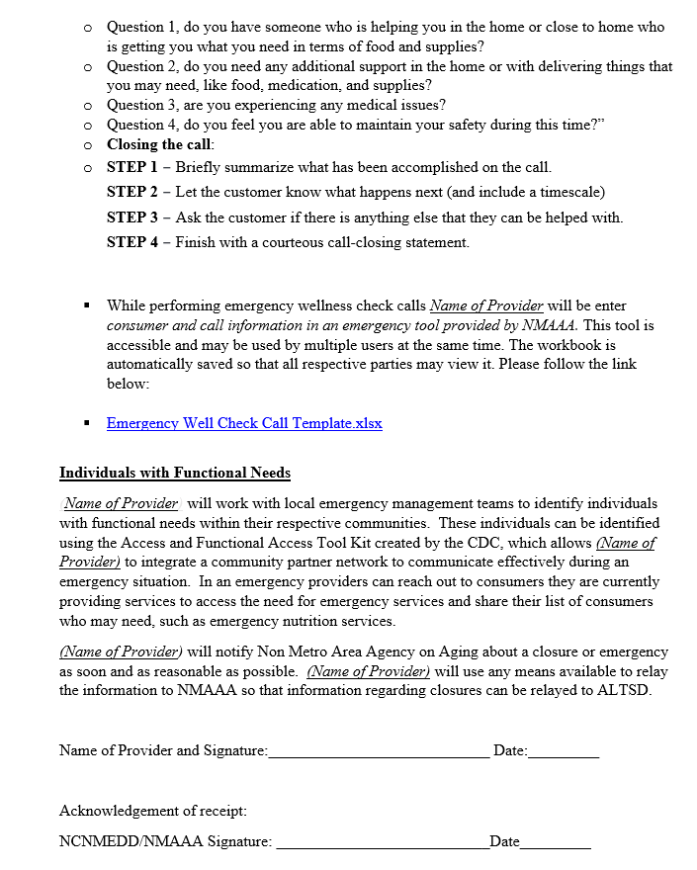

Slide 19
NCNMEDD/Non-Metro AAA’s Role in Emergency Situations
Beginning in FY 2023, North Central New Mexico Economic Development District will require a list of updated emergency contact information for each program, as well as the wellness script that will be used by the program.
Policies and Procedures Section IV also requires providers to contact the NMAAAA about a closure or emergency as soon as it is reasonable to do so and should include a plan for delivering meals and conducting welfare checks. The provider should use any means available to relay the information to NMAAA so that information regarding closures can then be sent via email to ALTSD. NMAAA currently provides information regarding closures weekly in a report to ALTSD.
If a subrecipient provider reports an emergency that may result in a closure or modification of services NMAAA helps within its staffing and budgetary capabilities to ensure continued service delivery. Such assistance includes identifying and coordinating alternative site(s) from which to prepare and distribute meals, securing self-stable meals and/or food boxes, conducting wellness checks, and distributing food and/or supplies.

Slide 20
NMAAA’s Role in Emergency Situations
NMAA follows the universally accepted “all hazards” approach to emergency preparedness and response planning which includes four elements:
Communication
Preparedness
Training & Education
Information Management. Organized by these elements, our role in emergency situations is outlined below:

Slide 21
NMAAA’s Role in Emergency Situations
Preparedness: Designate an Emergency Coordinator at NMAAA to oversee planning and preparedness tasks and coordinate with emergency management in the appropriate jurisdiction Require Emergency & Contingency Plans for all providers Require provider training on emergency preparedness and Emergency Contingency Plans Frequency: Annual and as needed
Mechanisms: NMAAA Policies Annual contract requirements NMAAA review of provider Emergency and Contingency plans

Slide 22
NMAAA’s Role in Emergency Situations
Training & Education Provide annual NMAA staff and provider training on emergency preparedness and review of Emergency and Contingency Plans Provide educational and informational resources to providers, to include materials for distribution to older adults, adults with disabilities, and community members with functional needs Frequency: Annual and as needed
Mechanisms In-person and web-based training sessions Printed and online training materials Wellness call scripts Informational brochures and flyers

Slide 23
NMAAA’s Role in Emergency Situations
Communication Notify and update providers on emergency conditions, contacts and protocols Provide educational and informational resources to providers, to include materials for distribution to older adults, adults with disabilities, and community members with functional needs Frequency: Annual and as needed
Mechanisms In-person and web-based training sessions Printed and online training materials Wellness call scripts Informational brochures and flyers

Slide 24
NMAAA’s Role in Emergency Situations
Information Management Maintain file of Emergency Management and Contingency Plans Maintain up-to-date list of provider emergency contact personnel Document wellness calls and consumer data Track emergency expenditure requests from providers and NMAAA, if submitted as Title III reimbursements Frequency: Ongoing
Mechanisms Excel spreadsheets WellSky database NCNMEDD accounting system (MIP Abila)

Slide 25
NMAAA’s Role in Emergency Situations
Service Continuity Assist with modified Nutrition delivery, including identification of alternative meal sites, coordination with private vendors, and delivery of food boxes and shelf stable meals. Ensure welfare checks are conducted by providers and emergency managers. (Welfare check should include the assessment of food, water, heating and cooling, support network, functional needs and durable medical equipment and medication. Assist in obtaining and/or delivering emergency funding, supplies and equipment as needed. Frequency: Ongoing
Mechanisms Coordination of local resources, providers, emergency managers, community organizations, and private vendors NAMAA policies Annual contract requirements Referrals to relief agencies and emergency responders Calls and check-ins with providers

