Slide 1
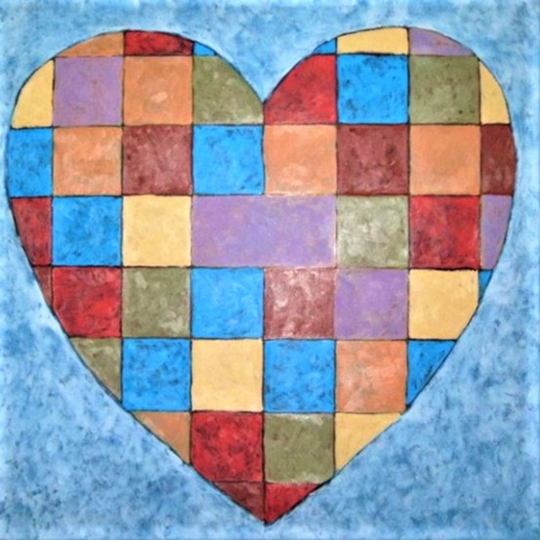
Prepare to Care The Art of Caregiving
Presented by The Memory Care Alliance.
2024 Innovation Summit
Las Cruces, New Mexico

Slide 2
David Davis
Founder / Executive Director of The Memory Care Alliance.

Slide 3
The Memory Care Alliance
We are comprised of:
Current caregivers.
People living with Alzheimer’s or another dementia-related illness.
Past caregivers.
Other related non-profits, businesses and professionals.
Aging Long Term Services Department, State of New Mexico

Slide 4
This material is from our
PREPARE TO CARE course.
Eight-hour comprehensive caregiving program designed for both family and professional caregivers.

Slide 5
“The Art of Caregiving”
Educate ourselves – with knowledge comes the ability to succeed.
Compassionate Understanding – gaining empathy.
Empowerment – find the strength and courage.
“LEARN TO THINK LIKE A CAREGIVER”

Slide 6
Types of Caregivers
Family caregiver – at home
Family caregiver – residential or memory care facility
Long distance caregiver
Sandwich caregiver
Cross-generational caregiver
Reluctant caregiver
Resentful caregiver
Professional caregiver
Volunteer caregiver

Slide 7
Question?
What is it that makes you human?

Slide 8
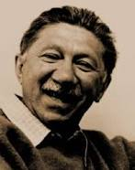
Abraham Maslow

Slide 9
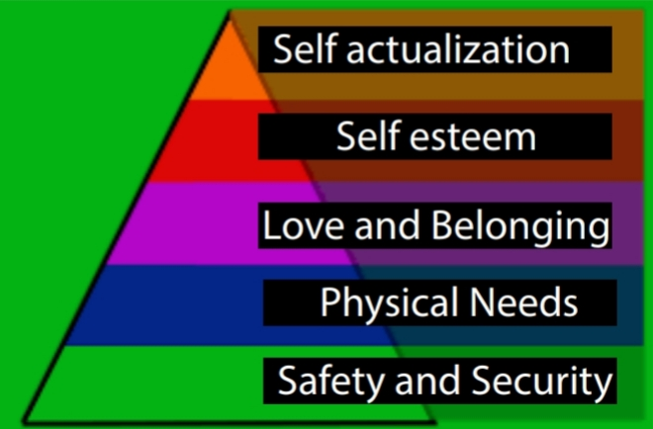
Hierarchy of Needs

Slide 10
Our needs - first
Physical safety and security
Removed from harm
“ If you are being chased by a mountain lion, what else matters”?

Slide 11
Our Needs - second
Physical needs:
Air – 3 minutes
Water – 3 days
Food – 3 weeks
Sleep
Using the toilet. Hygiene.
Warmth
“How long will it take for you to stop paying attention if I just keep on talking”?

Slide 12
Our needs - third
Love and Belonging
Love
Be loved
Calm
Reassured

Slide 13
Our needs - fourth
Self esteem
Valued and appreciated
Integrity, a sense of self-worth
Sense of inclusion – part of the pack
Able to contribute
Confidence
Recognition
Power. Control over our own lives and everything around us

Slide 14
Our needs – fifth
Self Actualization. Quality of life.
Engaged socially
Learn new things
What we truly enjoy. Leisure time. Hobbies.
Creativity….Art, music, literature
Nature
Spiritual beliefs

Slide 16
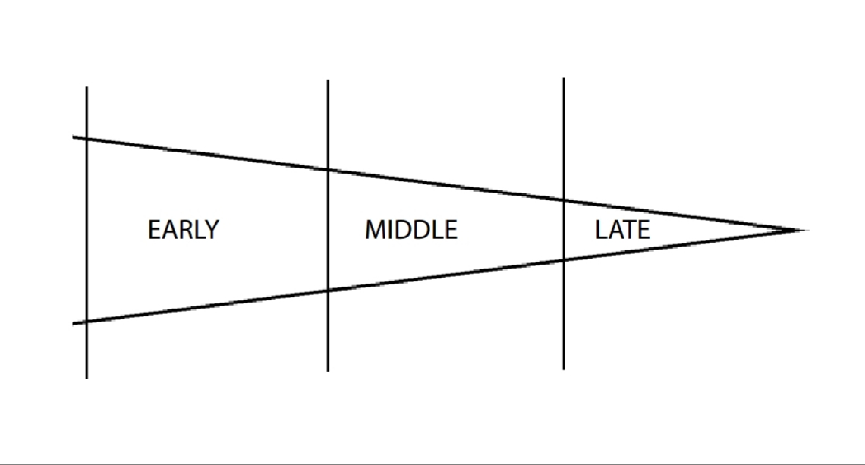
Three stages of any type of dementia

Slide 17
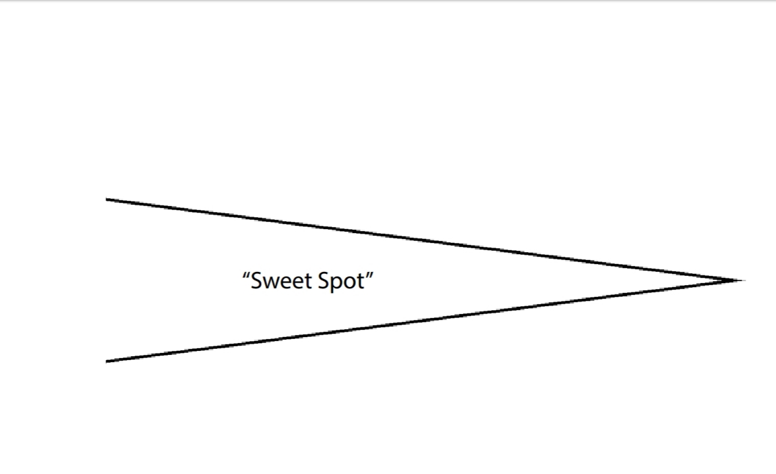
“BLISS”

Slide 18
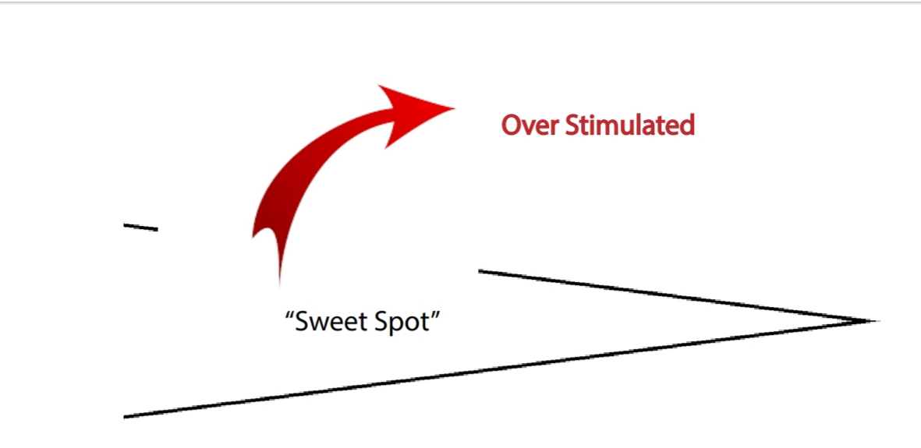
“BLISS”

Slide 19
Over stimulated—too much stimulus
Agitated
Restless
Argumentative
Angry
Yelling
Lashing out
Verbally
Physically

Slide 20
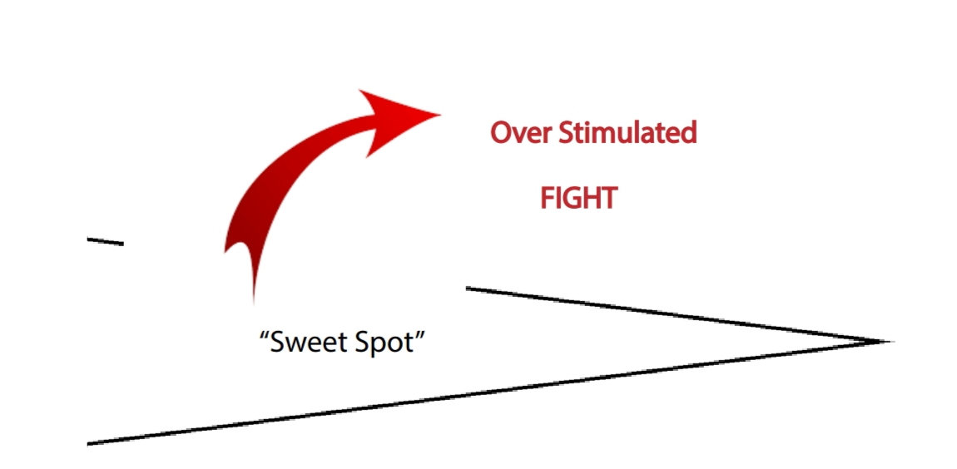
“BLISS”

Slide 21
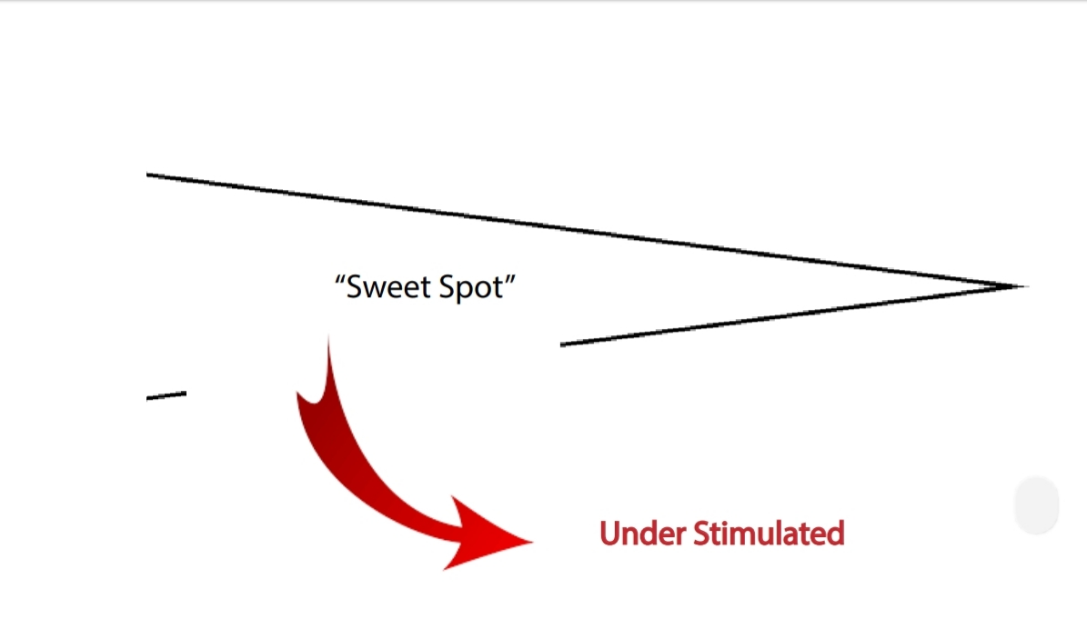
“BLISS”

Slide 22
Under stimulated—not enough stimulus
“Cabin Fever”
Bored
Restless
Poor Judgement
Anxious
Wandering
Futility / Give up
Eventually depression

Slide 23
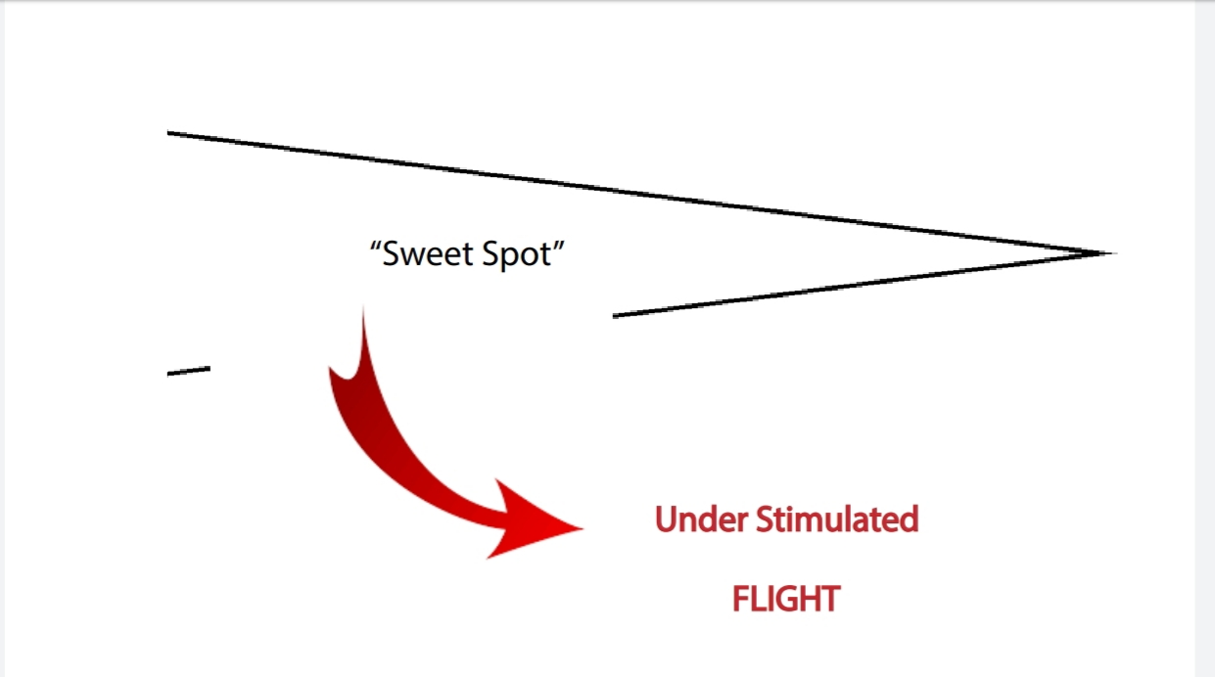
“BLISS”

Slide 24
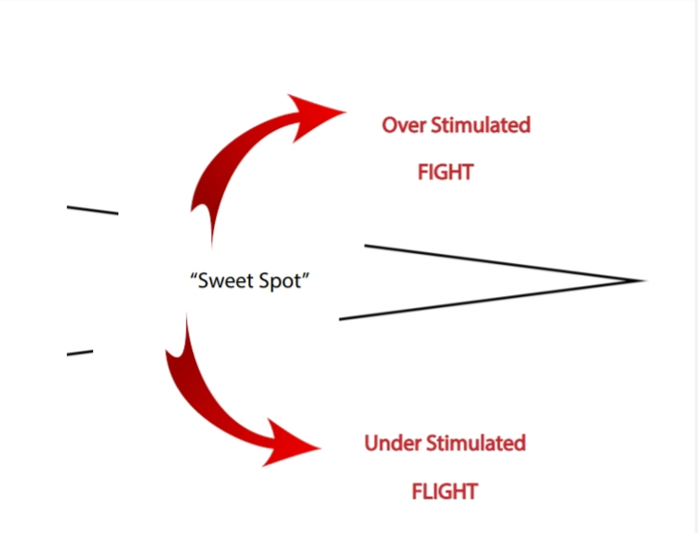
For those living with dementia
“BLISS”

Slide 25
For caregivers of someone with dementia.
“BLISS”

Slide 26
Our needs as human beings are the same….whether a person has dementia or not.
How many of you…..

Slide 27
Our needs as human beings are the same….whether a person has dementia or not.
…like to be rushed?

Slide 28
Our needs as human beings are the same….whether a person has dementia or not.
…be put on the spot?

Slide 29
Our needs as human beings are the same….whether a person has dementia or not.
…told you are wrong?

Slide 30
Our needs as human beings are the same….whether a person has dementia or not.
…yelled at?

Slide 31
Our needs as human beings are the same….whether a person has dementia or not.
…argued with?

Slide 32
Our needs as human beings are the same….whether a person has dementia or not.
…embarrassed or humiliated?

Slide 33
Our needs as human beings are the same….whether a person has dementia or not.
…told what to do?

Slide 34
Our needs as human beings are the same….whether a person has dementia or not.
…be afraid?

Slide 35
Our needs as human beings are the same….whether a person has dementia or not.
…feel useless?

Slide 36
Our needs as human beings are the same….whether a person has dementia or not.
…feel isolated and alone?

Slide 37
When you get to a point you no longer know what to do, ask yourself one question:
If you were the one who was living with this disease….

Slide 38
…”what would you want”?

Slide 40
Traits of a good caregiver
It takes many different skills to be successful.
Not every caregiver can be good at every skill.
Let’s talk about some skills that a person is going to need to be a good caregiver.

Slide 41
Traits of a good caregiver
Creative

Slide 42
Traits of a good caregiver
Patient

Slide 43
Traits of a good caregiver
Positive Thinker

Slide 44
Traits of a good caregiver
Good Planner

Slide 45
Traits of a good caregiver
Tough

Slide 46
Traits of a good caregiver
Compassionate

Slide 47
Traits of a good caregiver
Reassuring

Slide 48
Traits of a good caregiver
Problem solver

Slide 49
Traits of a good caregiver
Good detective

Slide 50
Traits of a good caregiver
Fast thinker

Slide 51
Traits of a good caregiver
Willing to ask for help. Willing to accept help.

Slide 52
Traits of a good caregiver
Maintain self care

Slide 53
Traits of a good caregiver
Forgiving

Slide 54
Traits of a good caregiver
Sense of humor

Slide 55
Traits of a good caregiver
Empowered

Slide 57
What’s the greatest resource caregivers have?

Slide 58
The greatest resource caregivers have is
Each other.

Slide 59
I’m here to ask for your help.

Slide 60
Current Chapters
Santa Fe
Santa Fe – men’s chapter
Santa Fe – Spanish chapter
Los Alamos
Zuni Pueblo

Slide 61
“Communities of Care”
1. On-going weekly caregiver meetings
2. Monthly Memory Cafe
3. Monthly Out and About
4. Prepare to Care training
5. Dementia Friends New Mexico

Slide 62
thememorycarealliance.org
David Davis
director@thememorycarealliance.org
505-310-9752

