Slide 1
Handheld scanner
Netum Barcode Scanner

Slide 2
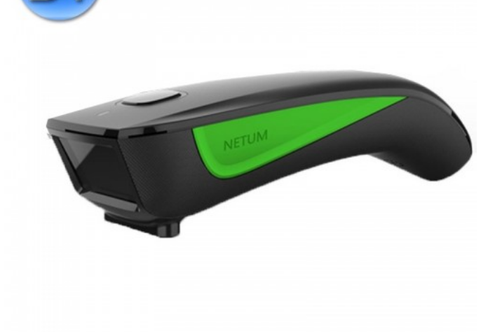
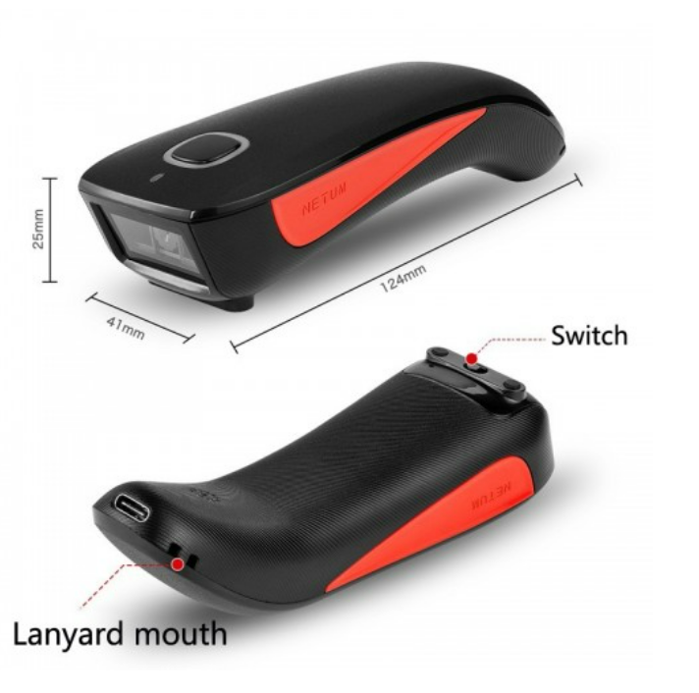
Netum
Front & Bottom
On/Off

Slide 3
Unpacking your Handheld
Unpack
Unpack handheld make sure to keep your instruction book
Charge
Charge handheld
USB Dongle
Put the dongle in your computer
Charge Cord
Dongle
Bluetooth
Connect to your Bluetooth via your computer

Slide 4
Firmware
First Scan firmware bar-code – Scan here before you start anything you will only have to scan the firmware once to setup your devise

Slide 5
Transmission Speed Via Bluetooth Connection
Keyboard Language
Medium Speed: Scan here for upload speed
America EN Keyboard: English lettering

Slide 6
Wireless & Bluetooth
Working Vis USB Dongle (Wireless Mode) - Scan bar-code
Bluetooth – Scan working Via Bluetooth bar-code
USB Dongle: Wireless mode using the dongle to connect to your computer
Put the USB Dongle into a USB port in your computer
Bluetooth: Connect to your computer via Bluetooth
Go into your settings then Bluetooth connect click search for devise

Slide 7
Normal Mode: Scan here if you are Scanning straight to your computer
Store Mode: Scan here to store scans in the handheld devise
Normal Mode: If you are wanting to Scan straight to computer
Store Mode: This mode is to keep the scanned bar-codes in the “memory” of the handheld

Slide 8
Uploading to Computer
Login into WellSky Service Scan Desktop – Test: Find your job. click on (Highlight) the job you want to upload your scanned units to.
Now scan the output store data bar-code on the next slide (this will upload all the scanned units that are in the scanner)

Slide 9
Output Stored Data:
Output Total Entry:
Will upload scanned items in job/computer

Slide 10
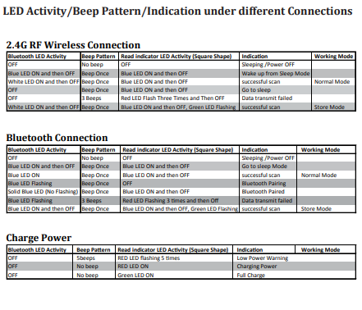
Clear Memory: Scan here after you are done with each job to clear out the previously scanned items

