Slide 1
Service Scan
Training Guide

Slide 2
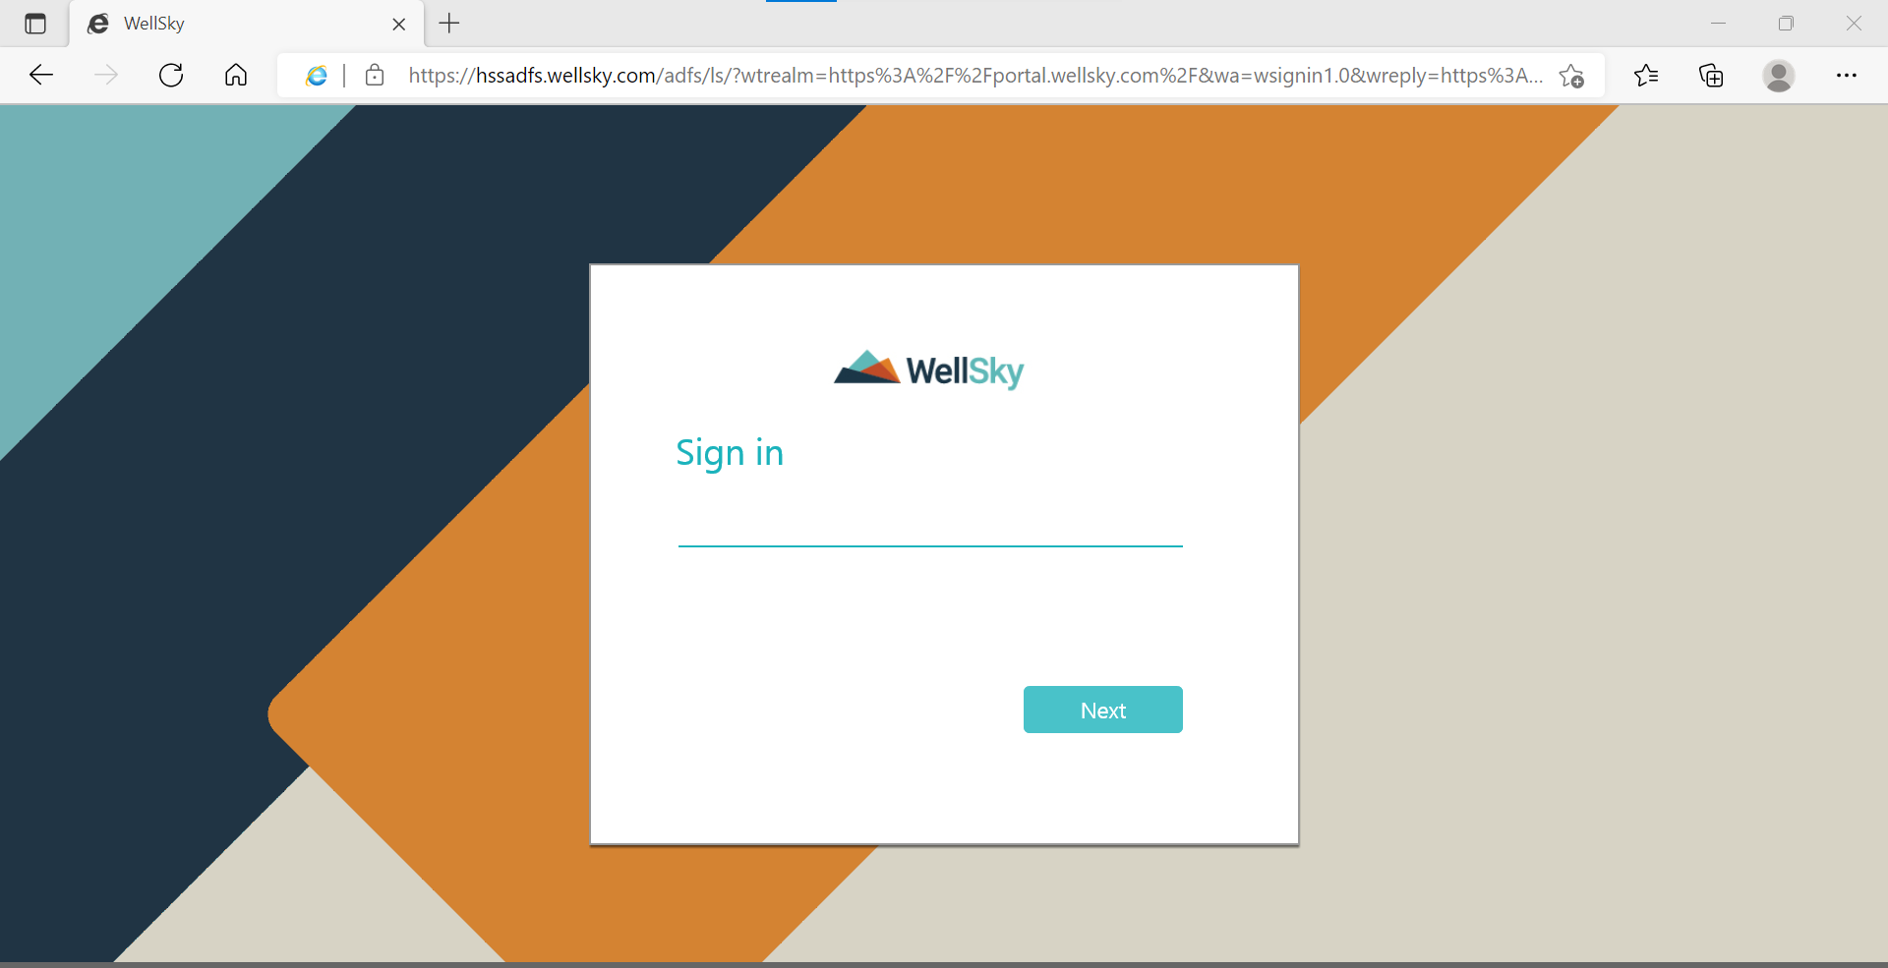
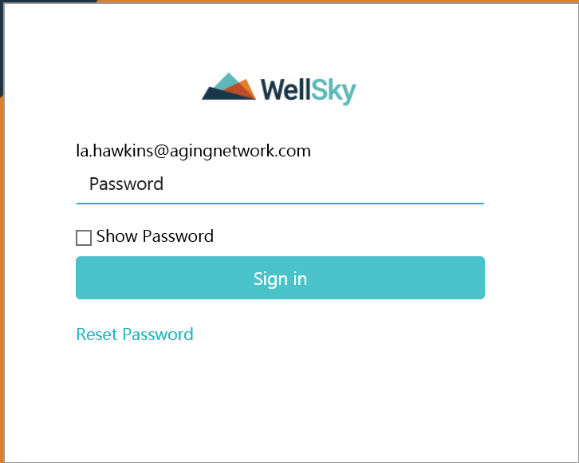
Signing into wellsky
The WellSky Page
First open your browser; then, click on the WellSky bookmark.
After clicking the bookmark; the WellSky login page should load.
1
2
1 - User name Enter your username | 2 - Password Enter your password
Once you have entered your username & password click Sign In
We will call these your 1st set of credentials

Slide 3
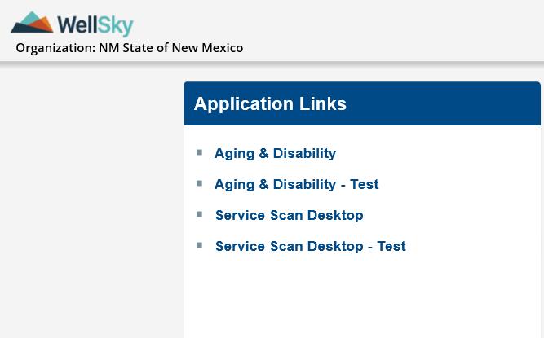
Service Scan Desktop - Test
The application link high-lighted in green to the
right of the screen is what we will be using to create
jobs during the testing period.
Click here to
Enter the testing page

Slide 4
Signing into service Scan login
1
1 - User name Enter your username | 2 - Password Enter your password
2
Once you have entered your username & password click Login
We will call these your 2nd set of credentials.
Helpful reminder:
These credentials are used for both Aging & Disability (A&D) and Service Scan.

Slide 5
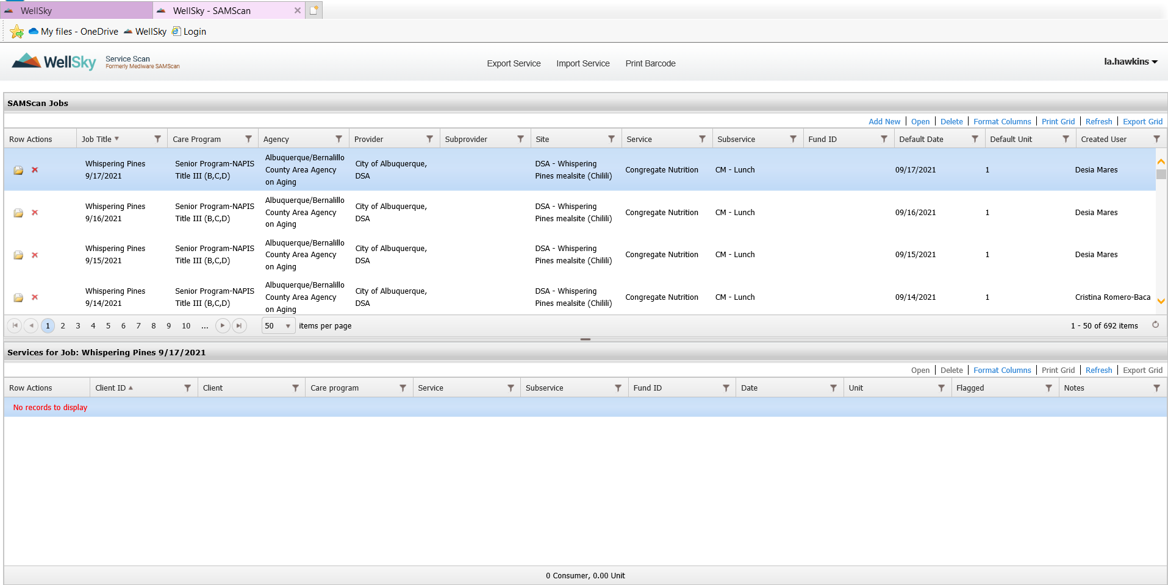
Creating a New Job
Add New
The following steps will be used to add jobs:
Start by clicking “Add New” thereby prompting a smaller window to pop-up, allowing you to enter the information needed to create your new job.

Slide 6
1. – Import from roster – click on import from roster and pick the roster you will be using (make sure you remember which roster you use; you will need this later on) (take note of the roster you are using; as it will be required later.) 2. – Job title - Name the job (for example provider – Site if applicable – service – sub-service – date) 3. – Care Program – click the care program you will be using 4. – Agency – click the agency you will be using 5. – Provider – click the provider you will be using 6. – Service – click the service you will be using
2
3
4
5
6
Note: You shouldn’t have to change the Care Program, Agency, Provider, Service once you import the rosters, check to ensure that all information is populated correct
1

Slide 7
7. – Prompt user to choose from service(s) after scan? – make sure the box has a check mark in it 8. – Always use current date? – make sure the box has a check mark in it 9. – Default date – make sure your default date matches the date in your job Title 10. – default unit – Enter your default units here (for example if your default units are 1 then you set this to 1, if your default units are 2 then change it to 2 11. – duplicate scan warning? – Make sure there is a check mark in this box (this will stop you from scanning the same bar-code twice) 12. – save – Make sure you click on save to save all your work
7
8
9
10
11
12

Slide 8
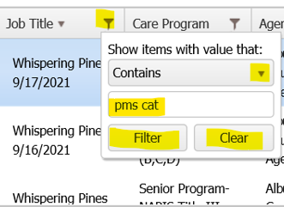
Refresh
To ensure the job, you have created in the system; begin by refreshing the page; then use the following steps below.
These steps will assist you in locating your newly created job easier
1 – Click the filter by job title, which will bring-up the search bar.
2 – Click the arrows then choose between “Starts with” or “Contains”.
3 – Enter part or the full name of the job to search for.
4 – Click “Filter” after you enter the name in the search bar.
5 – Click clear if you want to clear the search bar.
1
2
3
4
5

Slide 9
Aging & Disability - Test
Click Aging & Disability - Test
Now we are going to click on the Service Scan Desktop – Test (Aging & Disability - Test) this will allow us to access to print the barcodes

Slide 10
This is what the login page looks like when you're signing into the Aging & Disability – Test.
You will use your 2nd set of credentials to login here.
– Enter Username
- Enter Password
- Click Sign In
1
2
3

Slide 11
Your Aging & Disability – Test will display this warning which is letting you know that it’s a Non- Production Database.
Click OK to enter the page.
Click on rosters to open rosters. (the roster you use to create your new job)
Click here to enter the test data page
Click here to open your rosters

Slide 12
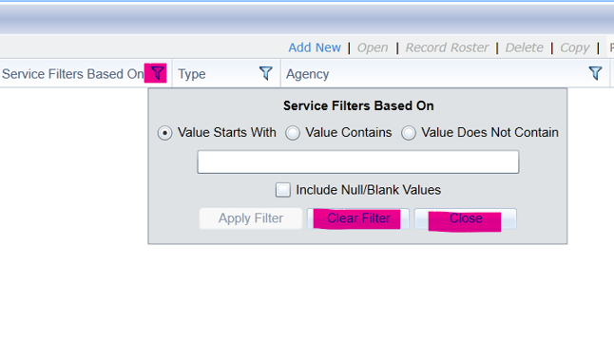
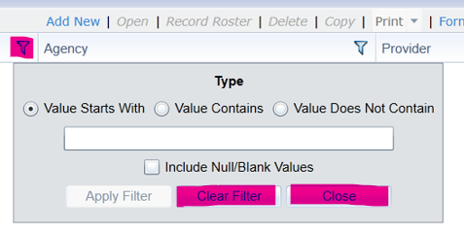
searching for your roster
To “Clear” search bar click filter tab
1
2
3
4
5
6
– Click the tab to open search bar.
- Click either Value Starts with or Value Contains.
- Enter full or part of rosters name.
- Click Apply Filter. (this will start the search)
- Click “Clear” to clear the search bar.
- Click “Close” if you want to close the search bar.

Slide 13
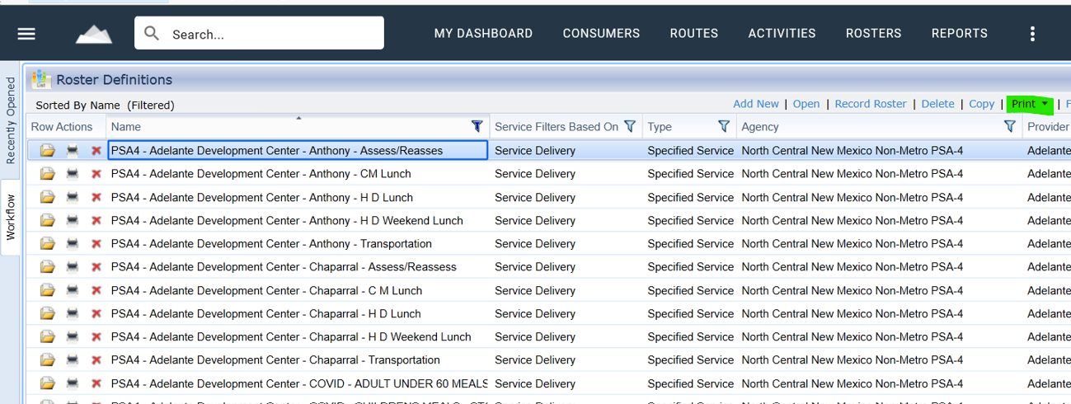
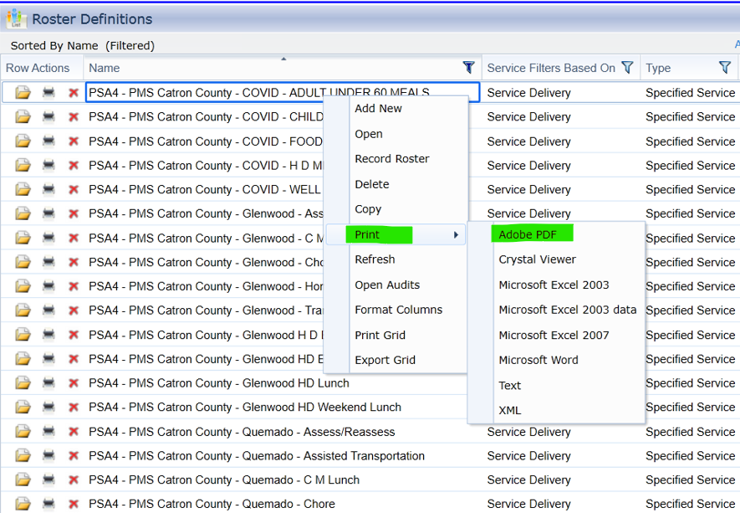
Printing bar-codes
A
Click Print
Click here
A
Right click here
B
B
Right click on the rosters you’re using.
Now click on print.
Now click Adobe PDF.
Click here
Click here

Slide 14
Continuing Printing bar-codes
1 – Click bar-coded client ID labels. (Avery 5260)
2 – Unclick suppress client ID. (this will allow the client ID to show on top of the bar-code)
3 – Unclick suppress name. (this will allow the name to show on top of the bar-code)
4 – Preview – This will open the loading page.
5 - Wait for the page to load; then, click open now you will see the bar-code pages example picture on the left.
1
2
3
4

Slide 15
Wait for the page to load; then, click open now you will see the bar-code pages example picture on the left.
Client Name
Client ID
Bar-code

Slide 16
1. – Click Scan bar-coded roster sheet.
2. – Make sure “Suppress SSN” is selected.
3. – If you want the phone number to not show make sure suppress primary phone is selected. (deselect to show phone number)
4. – Select suppress date of birth.
5. – Deselect suppress client name.
6. – Click Preview to generate the bar-code roster sheet after doing this will bring up a loading screen.
2
1
3
4
6
5

Slide 17
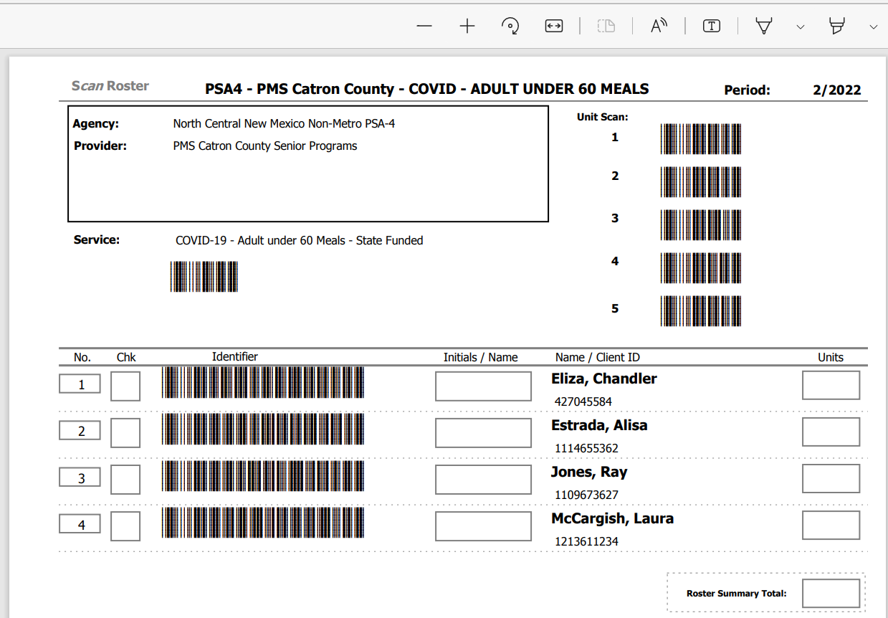
7. – Click open to open the Scan roster sheet seen on the left.
This sheet is where you or your drivers can keep a hard copy on hand.
8. – Check mark with pen when the meal is delivered.
9. – Place your initials here
10. – Write how many units
8
9
10
Loading Screen
7

Slide 18
Printing Weekly bar-code
1 – “Select the correct start date.” Make sure the date is the right start date. (i.e., date of the first day of the week you are using)
2 – Click “Weekly single service roster with unit entry per day.
3 – Suppress SSN: Make sure this is selected
4 – Suppress Primary Phone: Select if you want it not to show, deselect if you want to show.
5 – Suppress date of birth: Select if do not want to show, deselect if you want to show.
6 – Suppress Client ID: Select if do not want to show, deselect if you want to show.
7 – Suppress Scan bar-Code: Select if do not want to show, deselect if you want to show.
8 – “Click preview”
1
2
3
4
5
6
7
8

Slide 19
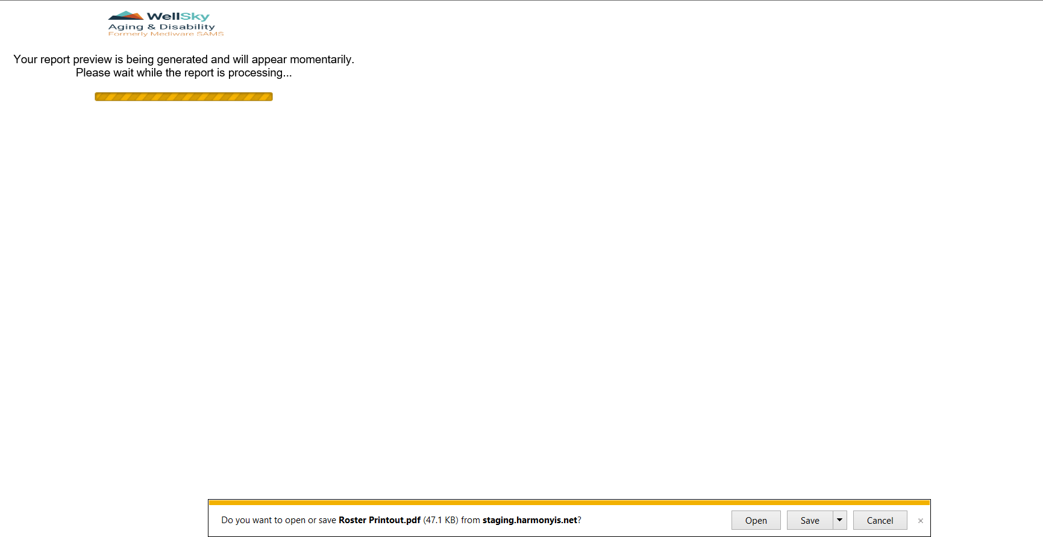
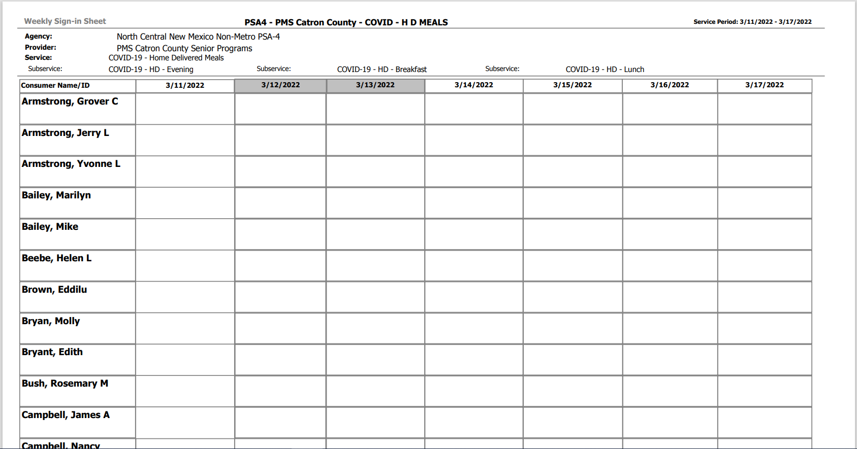
Printing Weekly bar-code Continued
9
8 – “Click Open”
9 – Example of weekly bar-code page
8

Slide 20
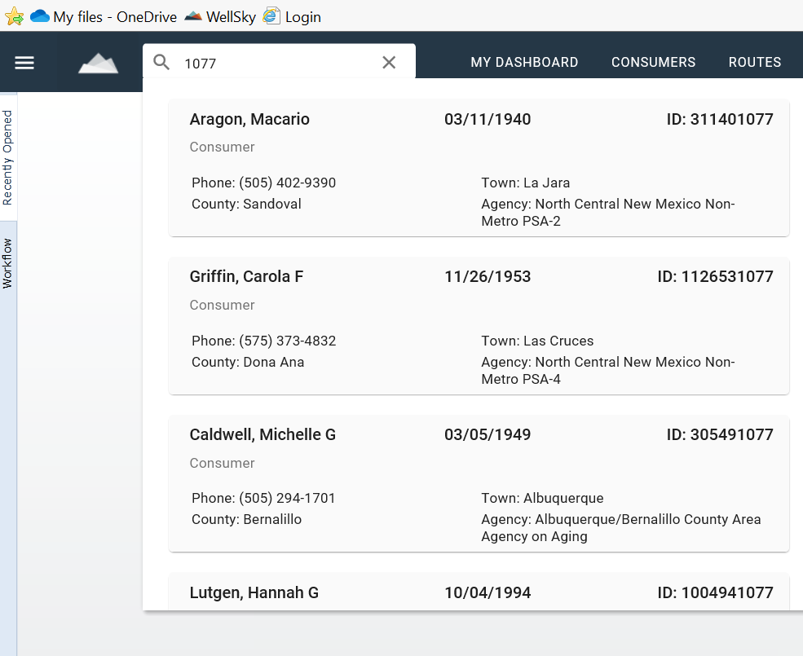
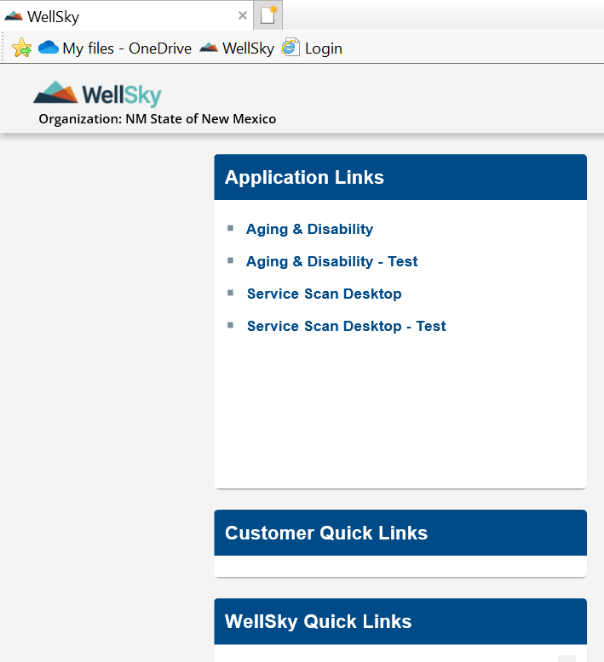
individual bar-code printing
C
B
A
Go to your WellSky and login to your Aging & Disability - Test
B
Click in the search bar, now enter the consumer's ID number
C
After entering the ID or consumer name hit enter
A

Slide 21
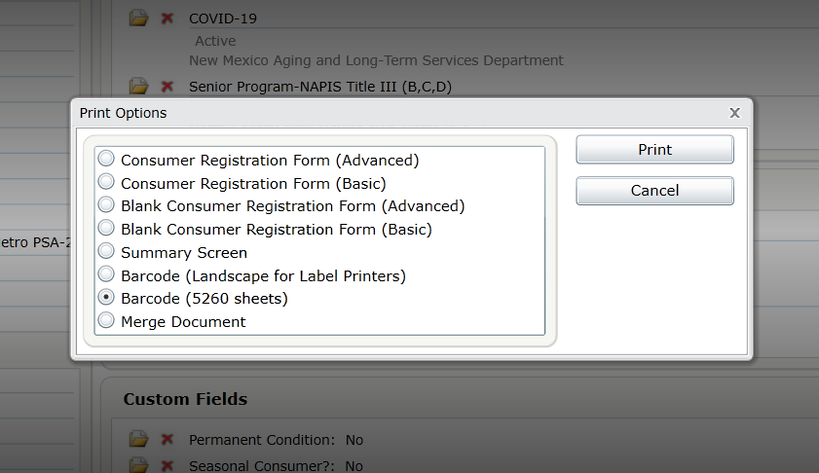
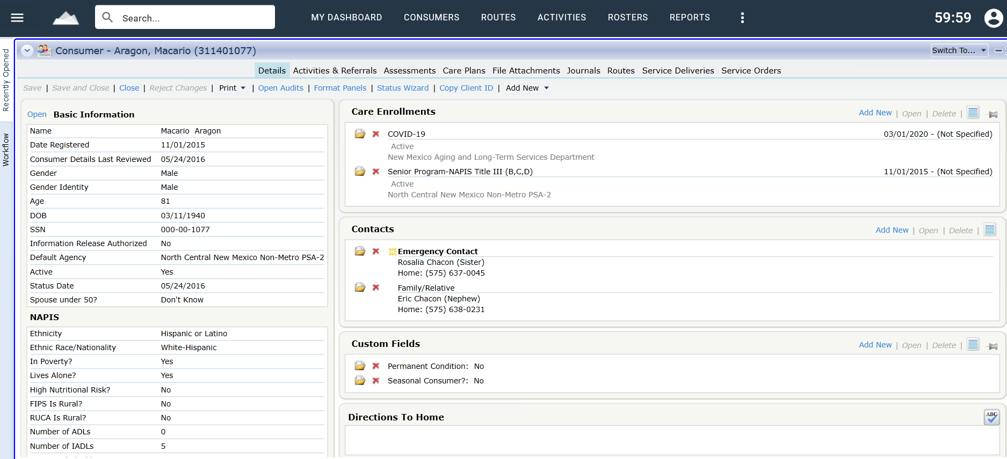
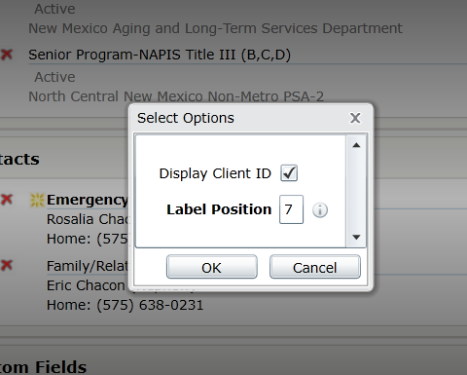
individual bar-code printing continues
D
E
F
D – “Click Print”
E – A smaller window will pop-up click Barcode (5260 sheets), now click print.
F – This is the position you want to print on the label sheet, after you enter the position. number click OK (example on next slide)

Slide 22
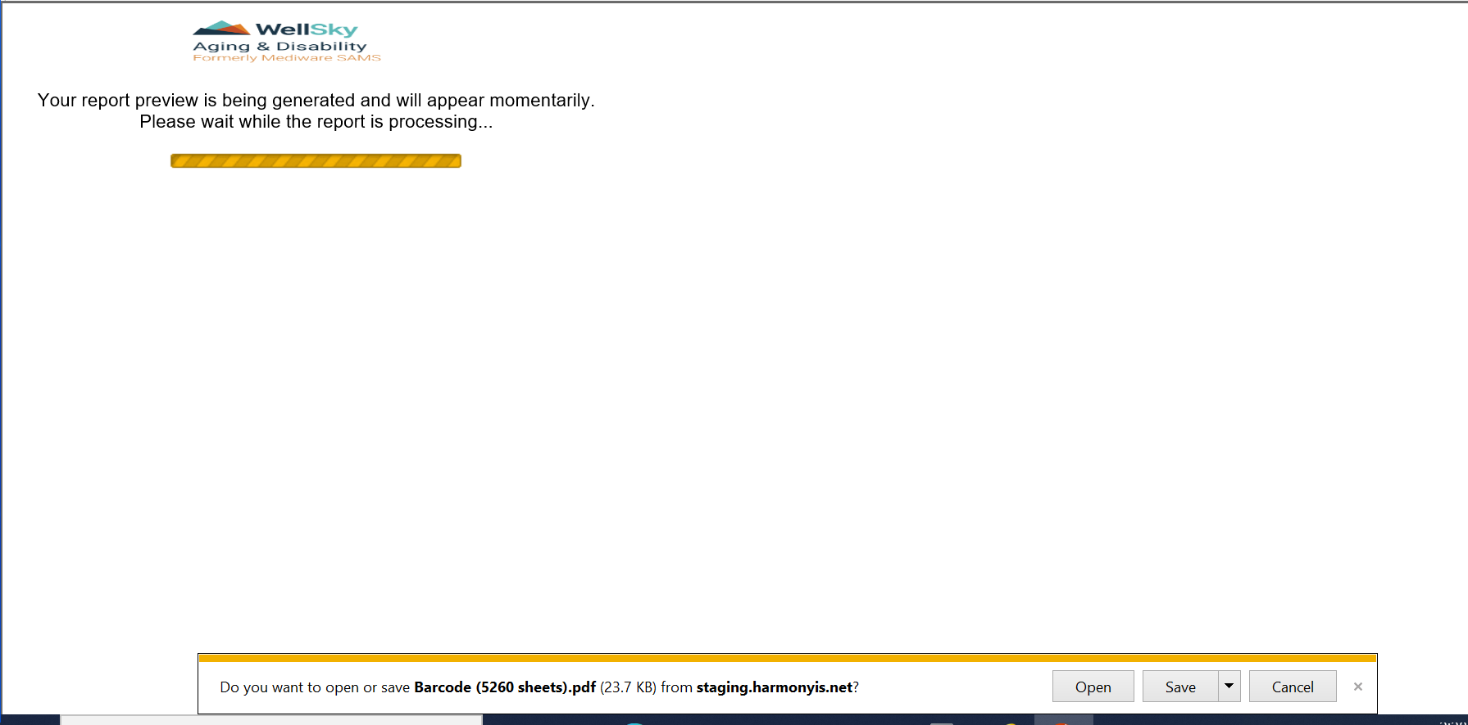
individual bar-code printing continued
I – Your barcode will show
G – Example of Avery label sheet
H – Loading Screen click open
I
G
H
Note – The Avery 5260 sheet has 30 labels on a page it’s three labels across and ten labels down. We are going to print on position 7 load the sheet into your printer.

Slide 23
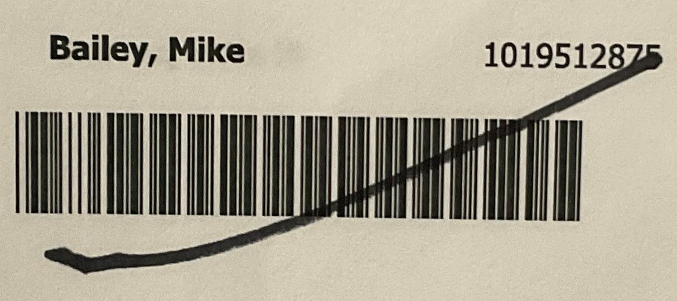
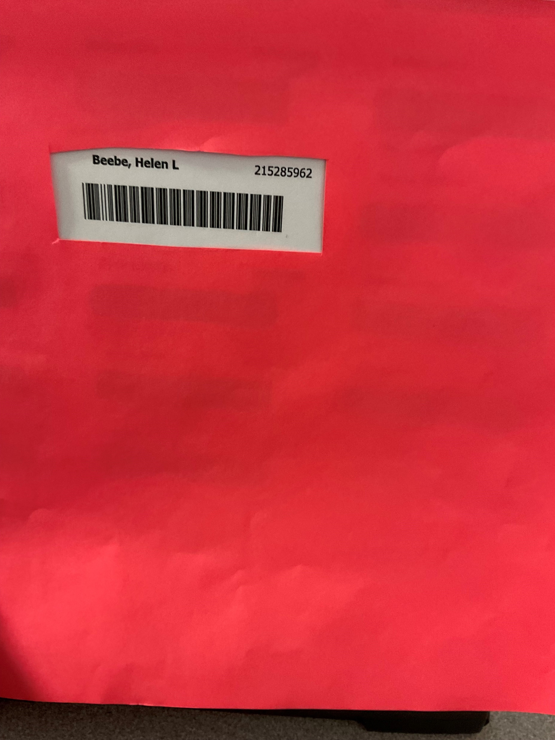
J
Helpful Note’s
J
If a consumer is no longer getting service’s, you can just mark out their bar-code with a marker.
K
If your having problems scanning one code get a piece of paper and cut out a rectangle the size of the bar-code.
K

Slide 24
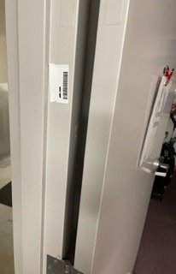
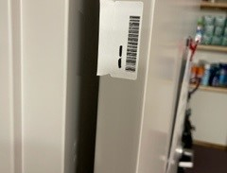
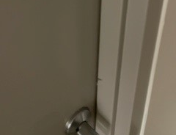
Where to place the Bar-code on the Consumer door.
Place the Bar-Code on the inside door jamb by the hinges or on the other side of the door by the knob.
you will not see the bar-code with the door closed.

Slide 25
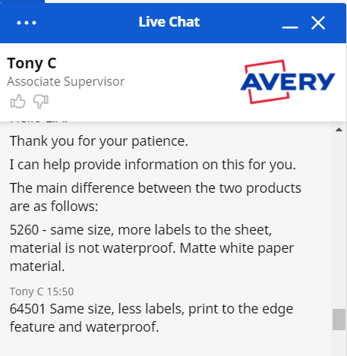
The difference between Avery 5260 and the waterproof
The only difference is the name and that they come with less on a sheet and that they are waterproof.

Slide 26
How to turn on/off the iPad
A
On/ Off Button
B
A – Hers is a front, back and side view of your iPad.
B – Your On/Off Button.
C – Closer view of your On/Off button.
Turn on the iPad the On/Off Button is on the right top of the iPad.
On/ Off Button
C

Slide 27
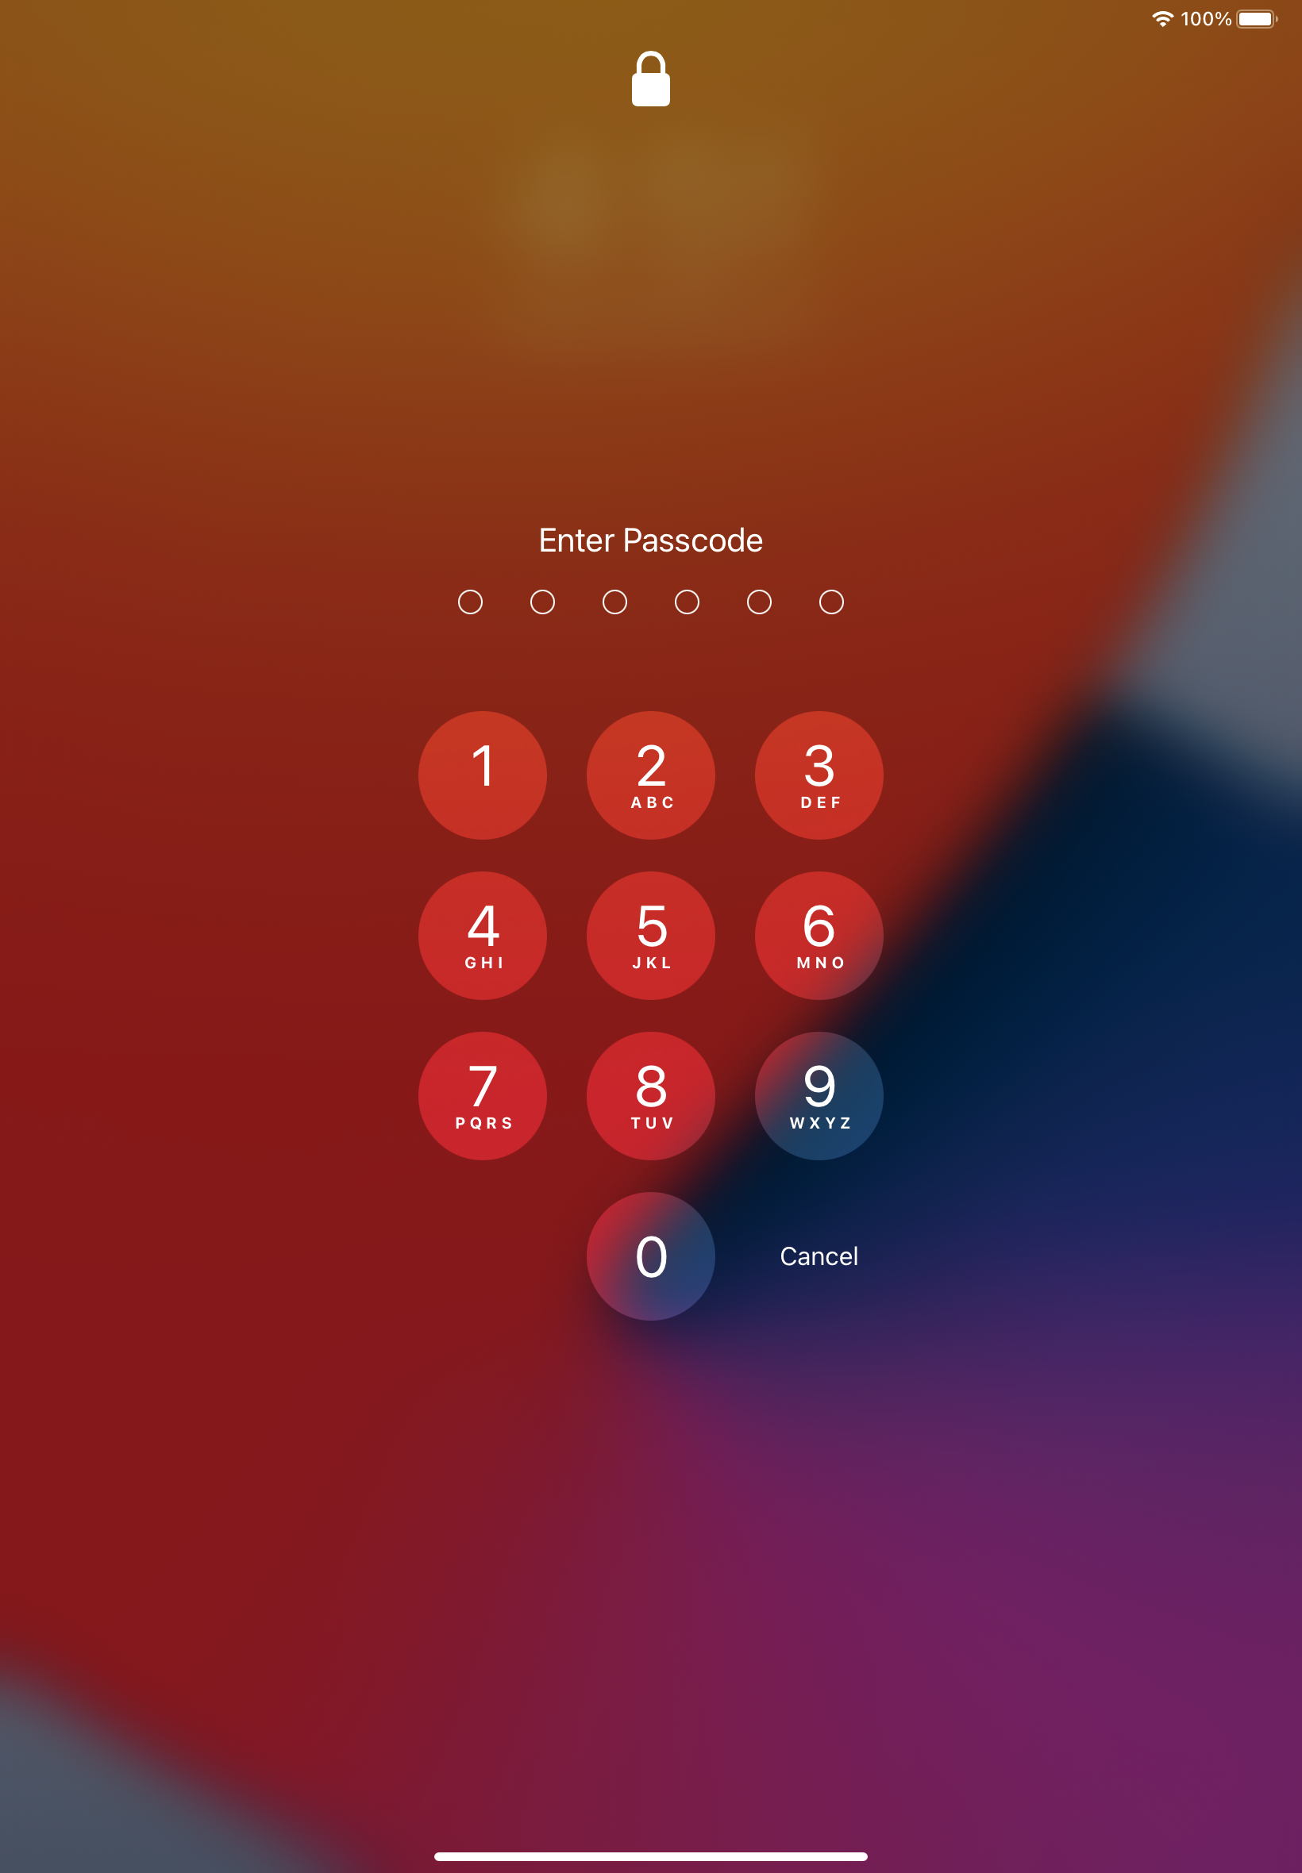
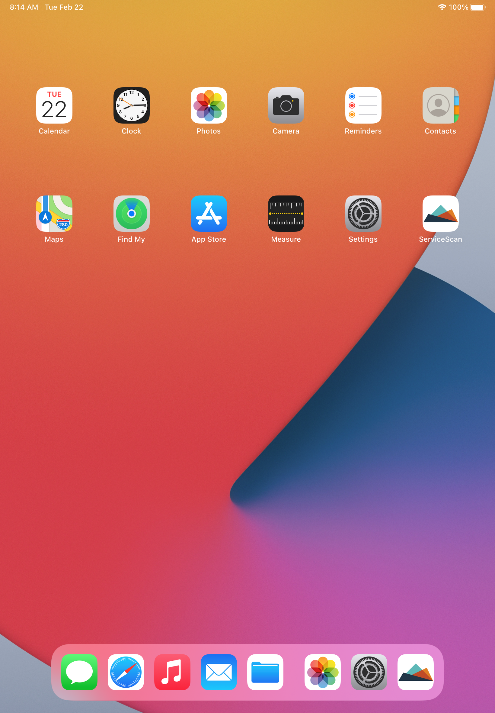
Accessing iPad
A
To open the iPad screen, use your fingertip and slide up.
1 – You will be prompted you to enter a passcode tap lightly with the tip of your finger.
B
This will bring up the app screen (also known as the home screen) example is picture B.
2 – Tap your service Scan.
1
B
2
A

Slide 28
2
1
Login Screen
Enter your 1st set of credentials.
1) Username
2) Password

Slide 29
Once you enter your credentials this page will open.
3) Make sure you have it on SAMS2K_NM_TEST this is the test page. (working in the “test” system allows mistakes to be fixed easily)
This is the live screen.
4) – When you are ready to use the active database, you will make sure SAMS2K_NM_STATE.
WiFi is need to login, download the job(s), and export to the “Service Scan Desktop.” WiFi is not needed for scanning the units.
3
4
Warning: If you close the “Service Scan” app, WiFi will be required to log back on.

Slide 30
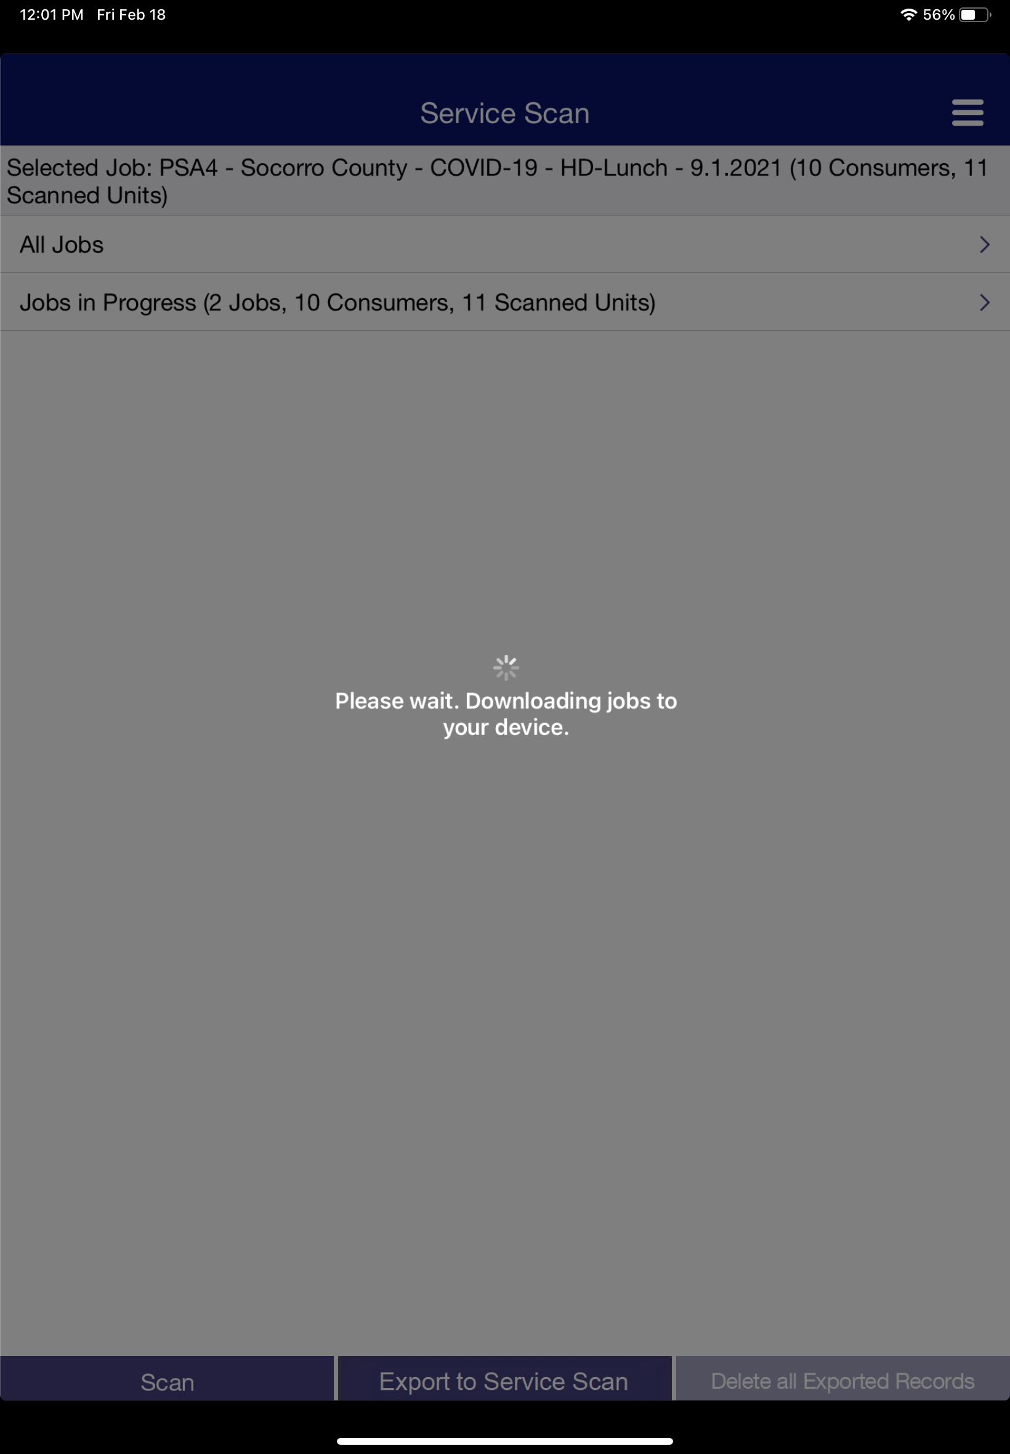
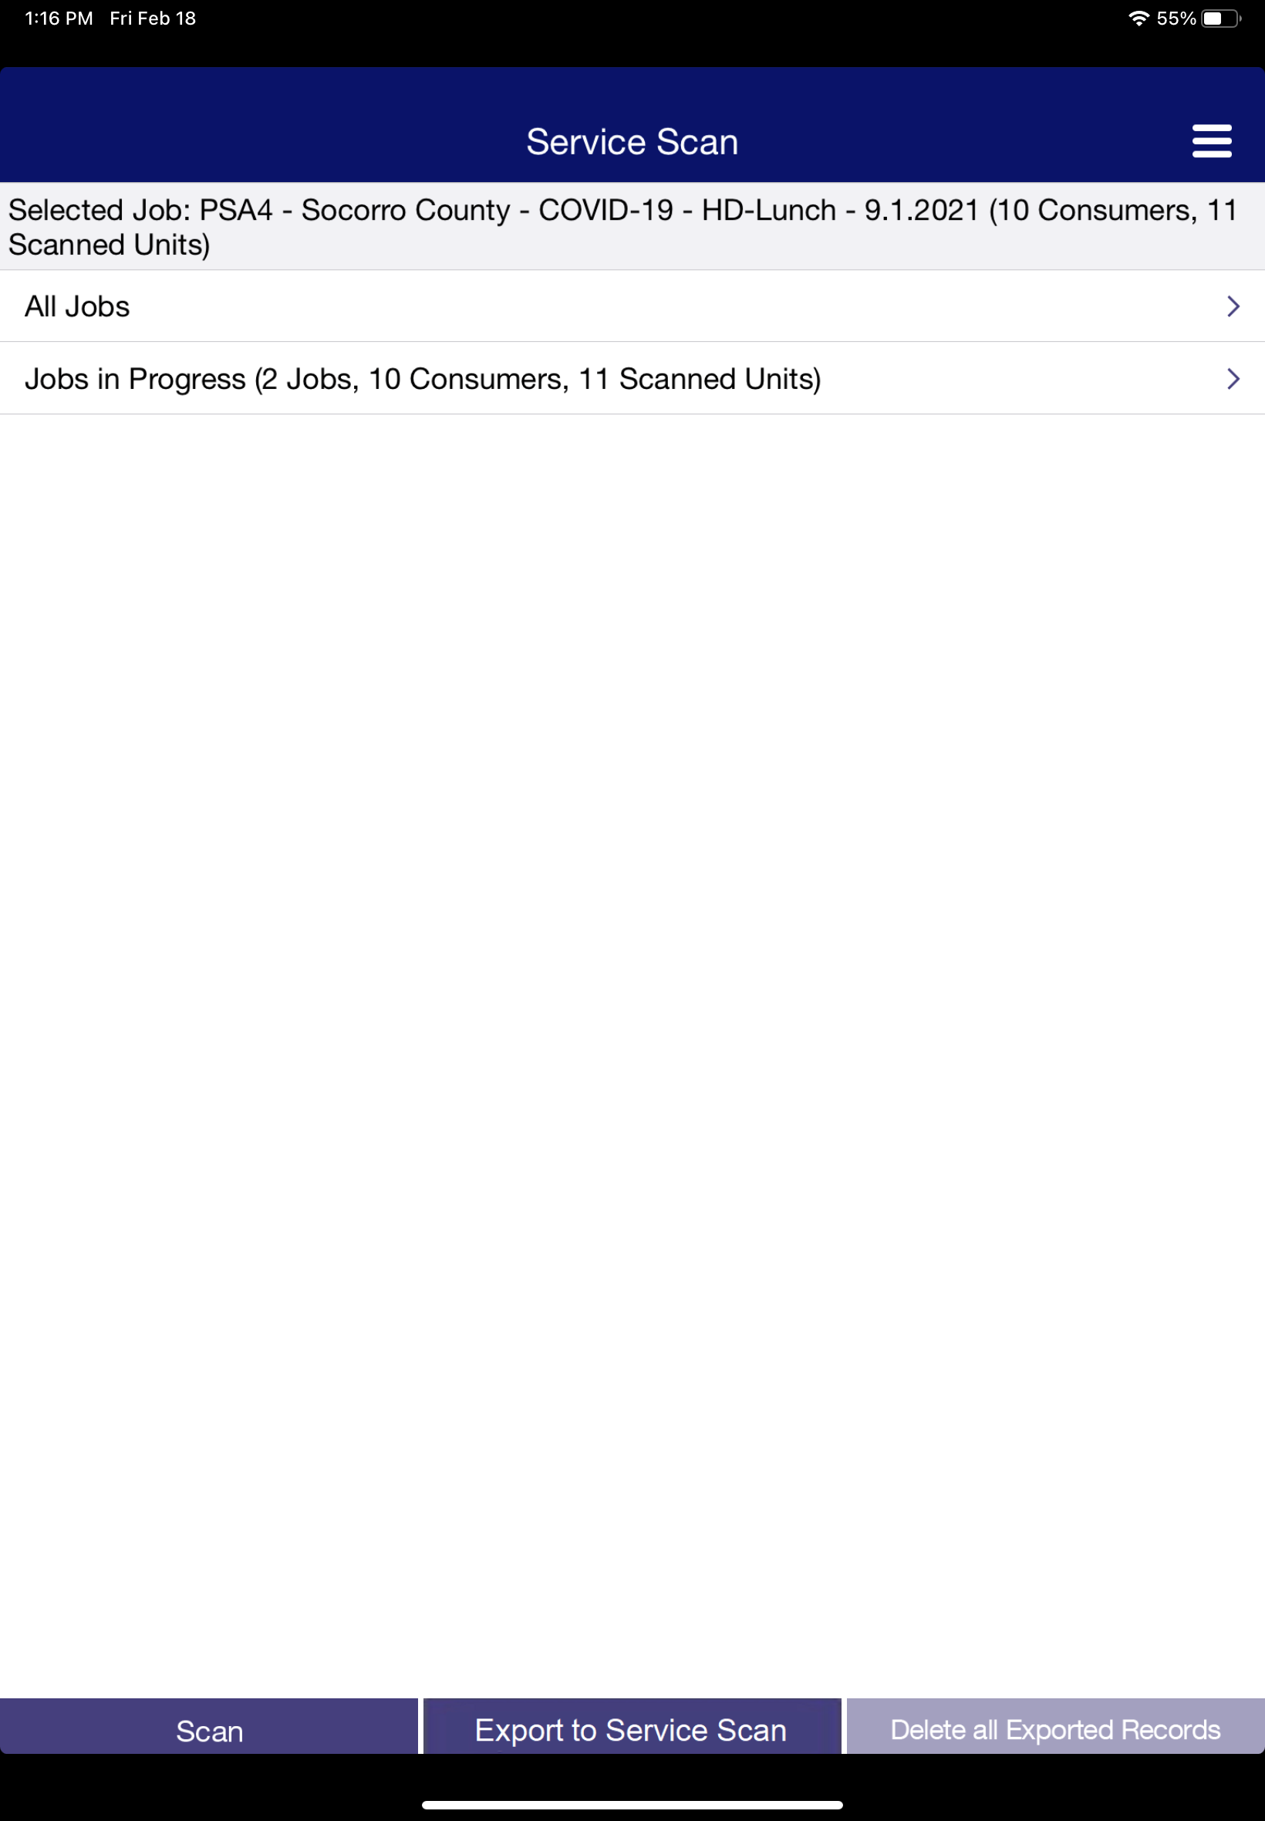
Finding your “Job” in the ipad
A
A
Give it a time to download the jobs into the iPad.
(it will take a little while for the jobs to download to your iPad)
B
Example of “Service Scan” page.
B

Slide 31
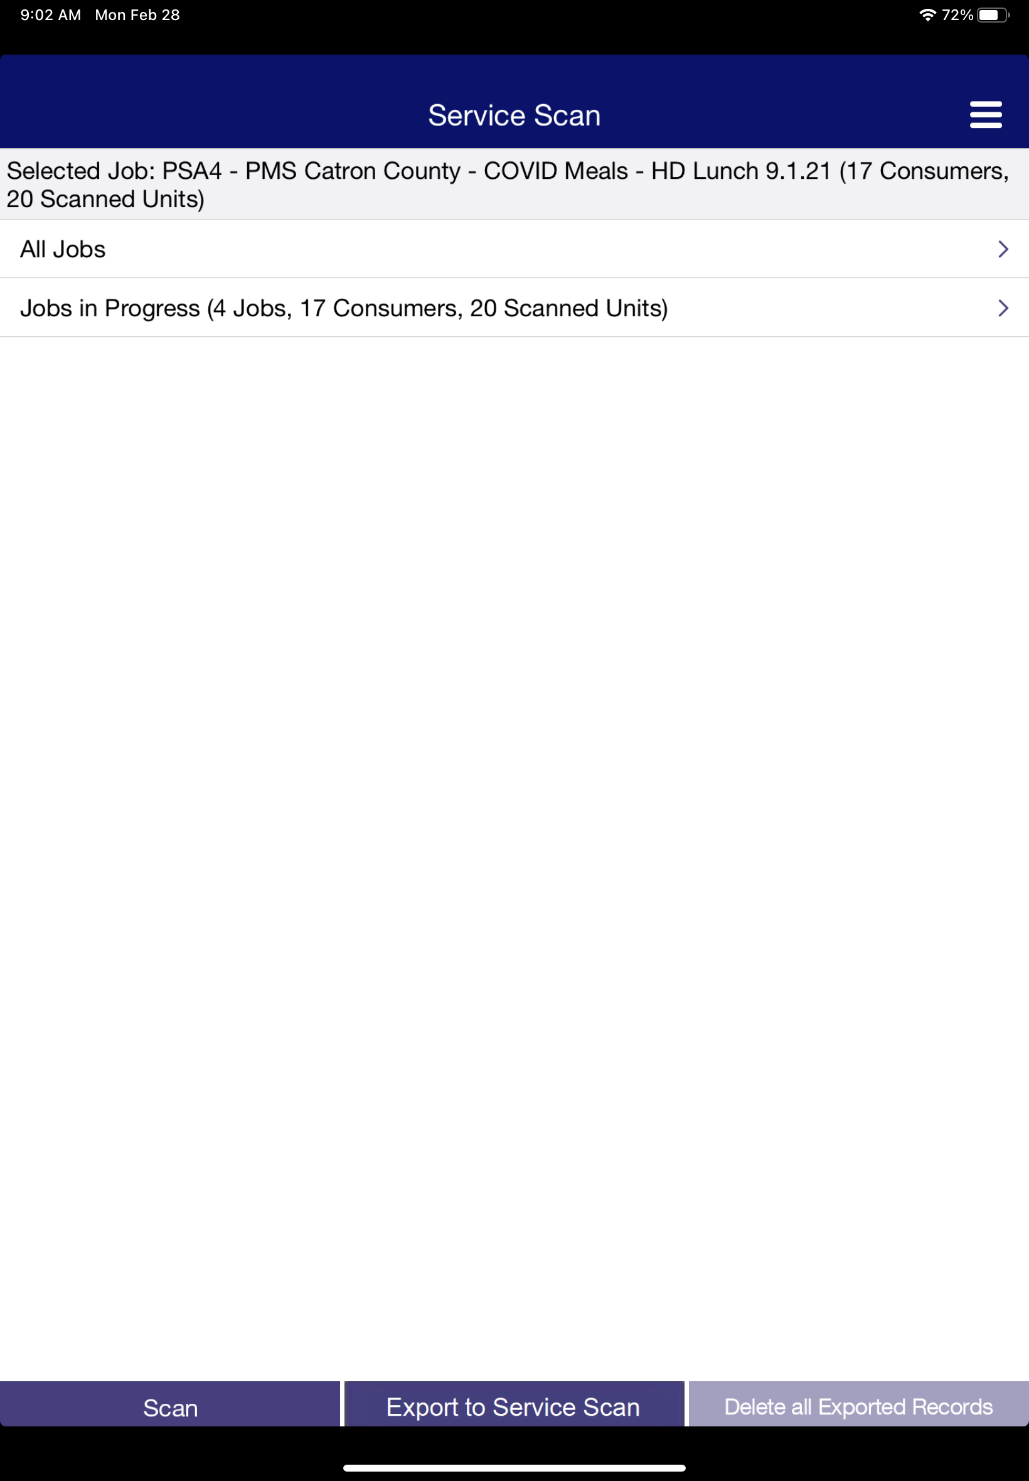
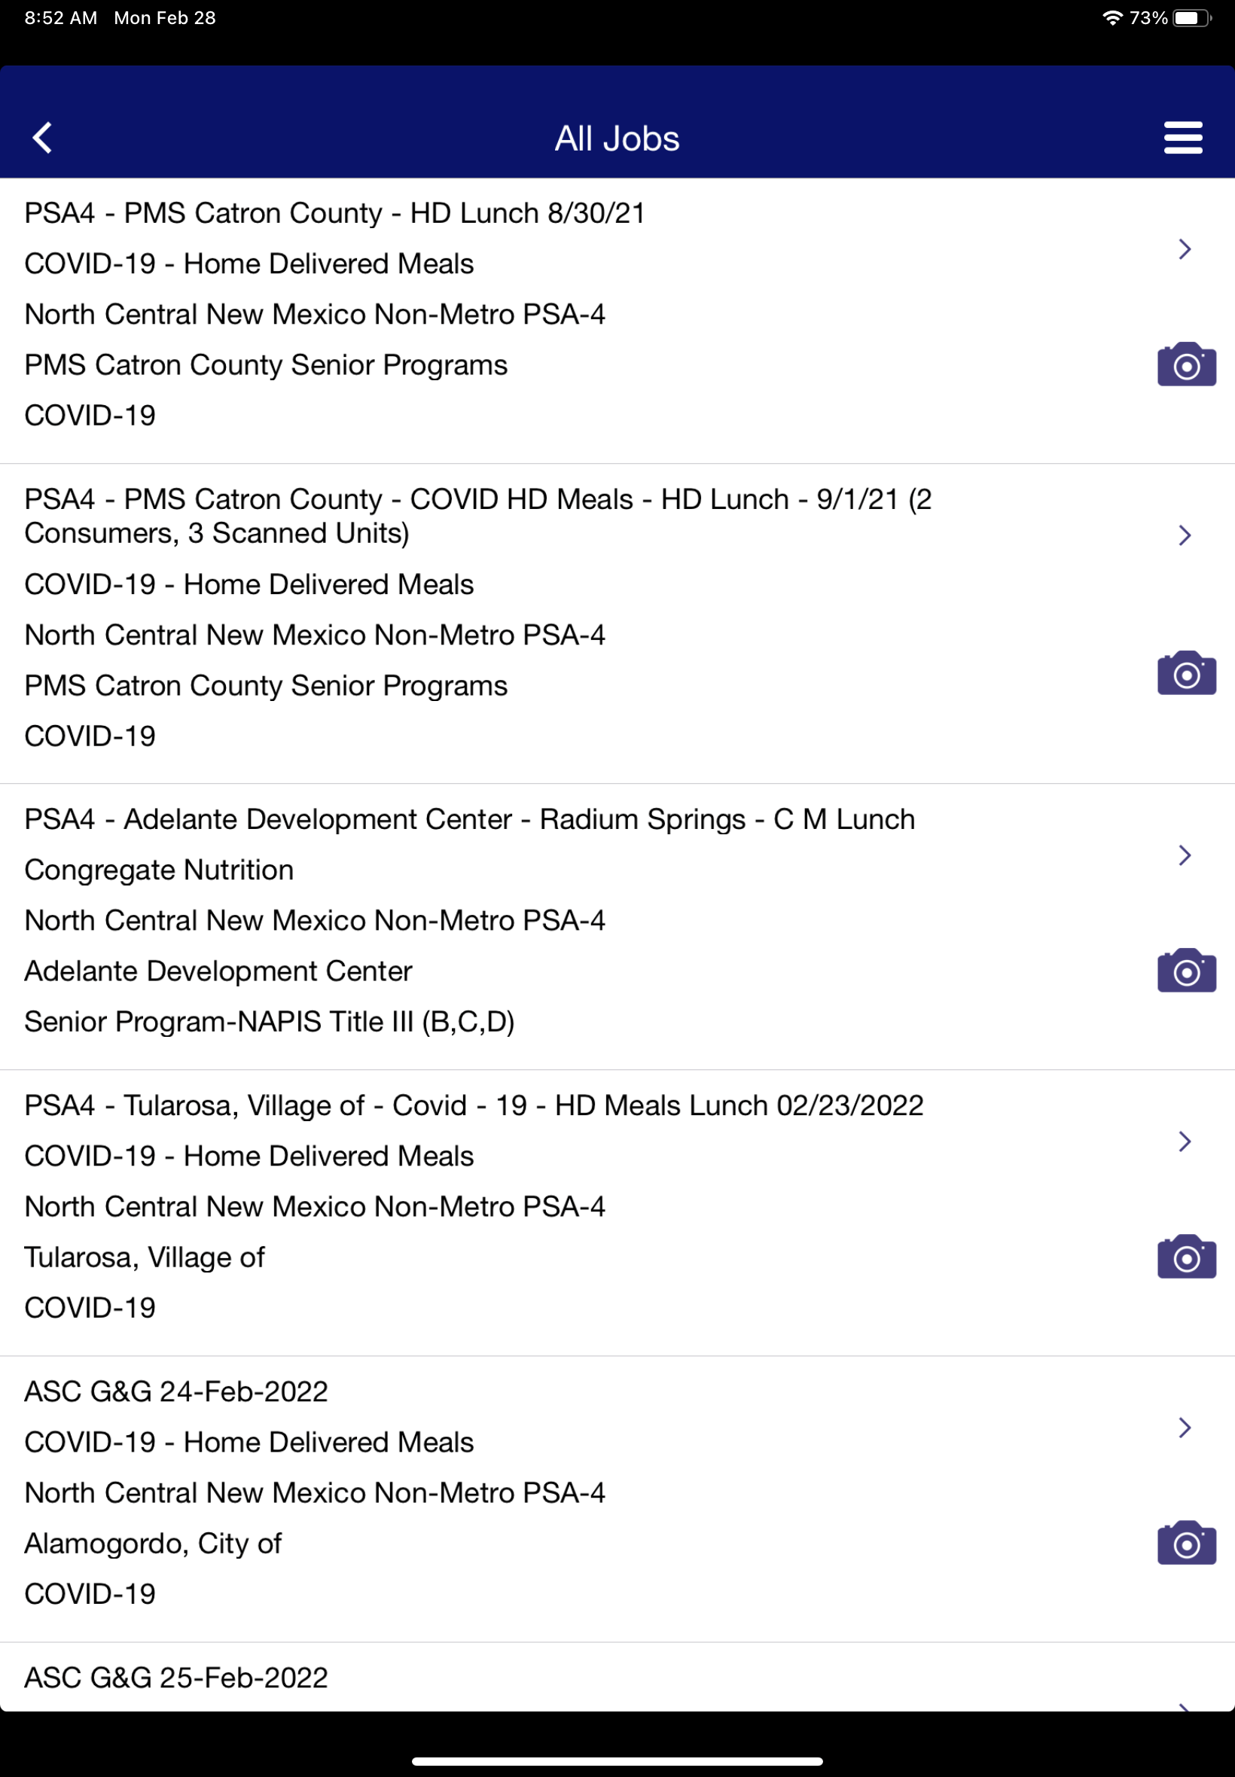
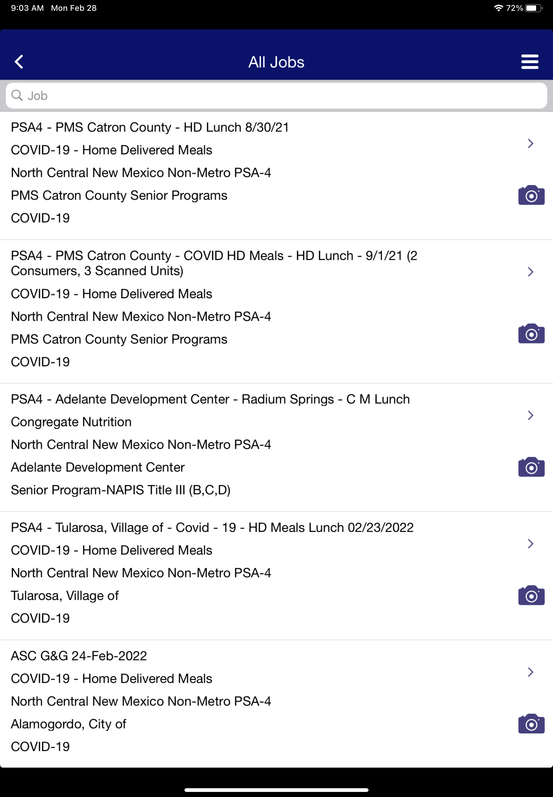
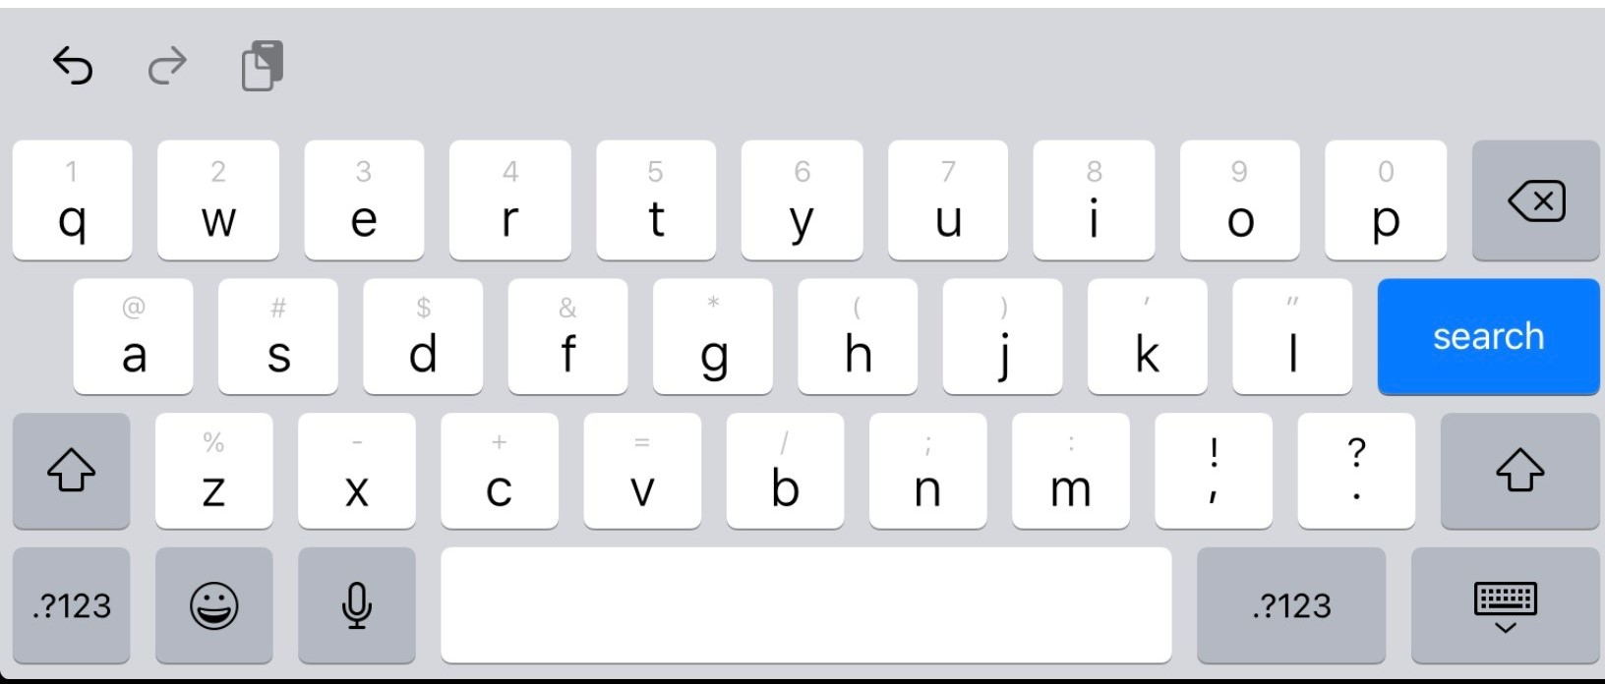
Search Bar
Tap All Jobs
Tap on screen
C
D
E
Tap
C
Tap the all job.
D
This will bring up the all-jobs page now using your fingertip swipe down on the screen once you do this you will see the search bar.
E
Tap the search bar then type part or the full jobs name you are searching for then tap search.

Slide 32
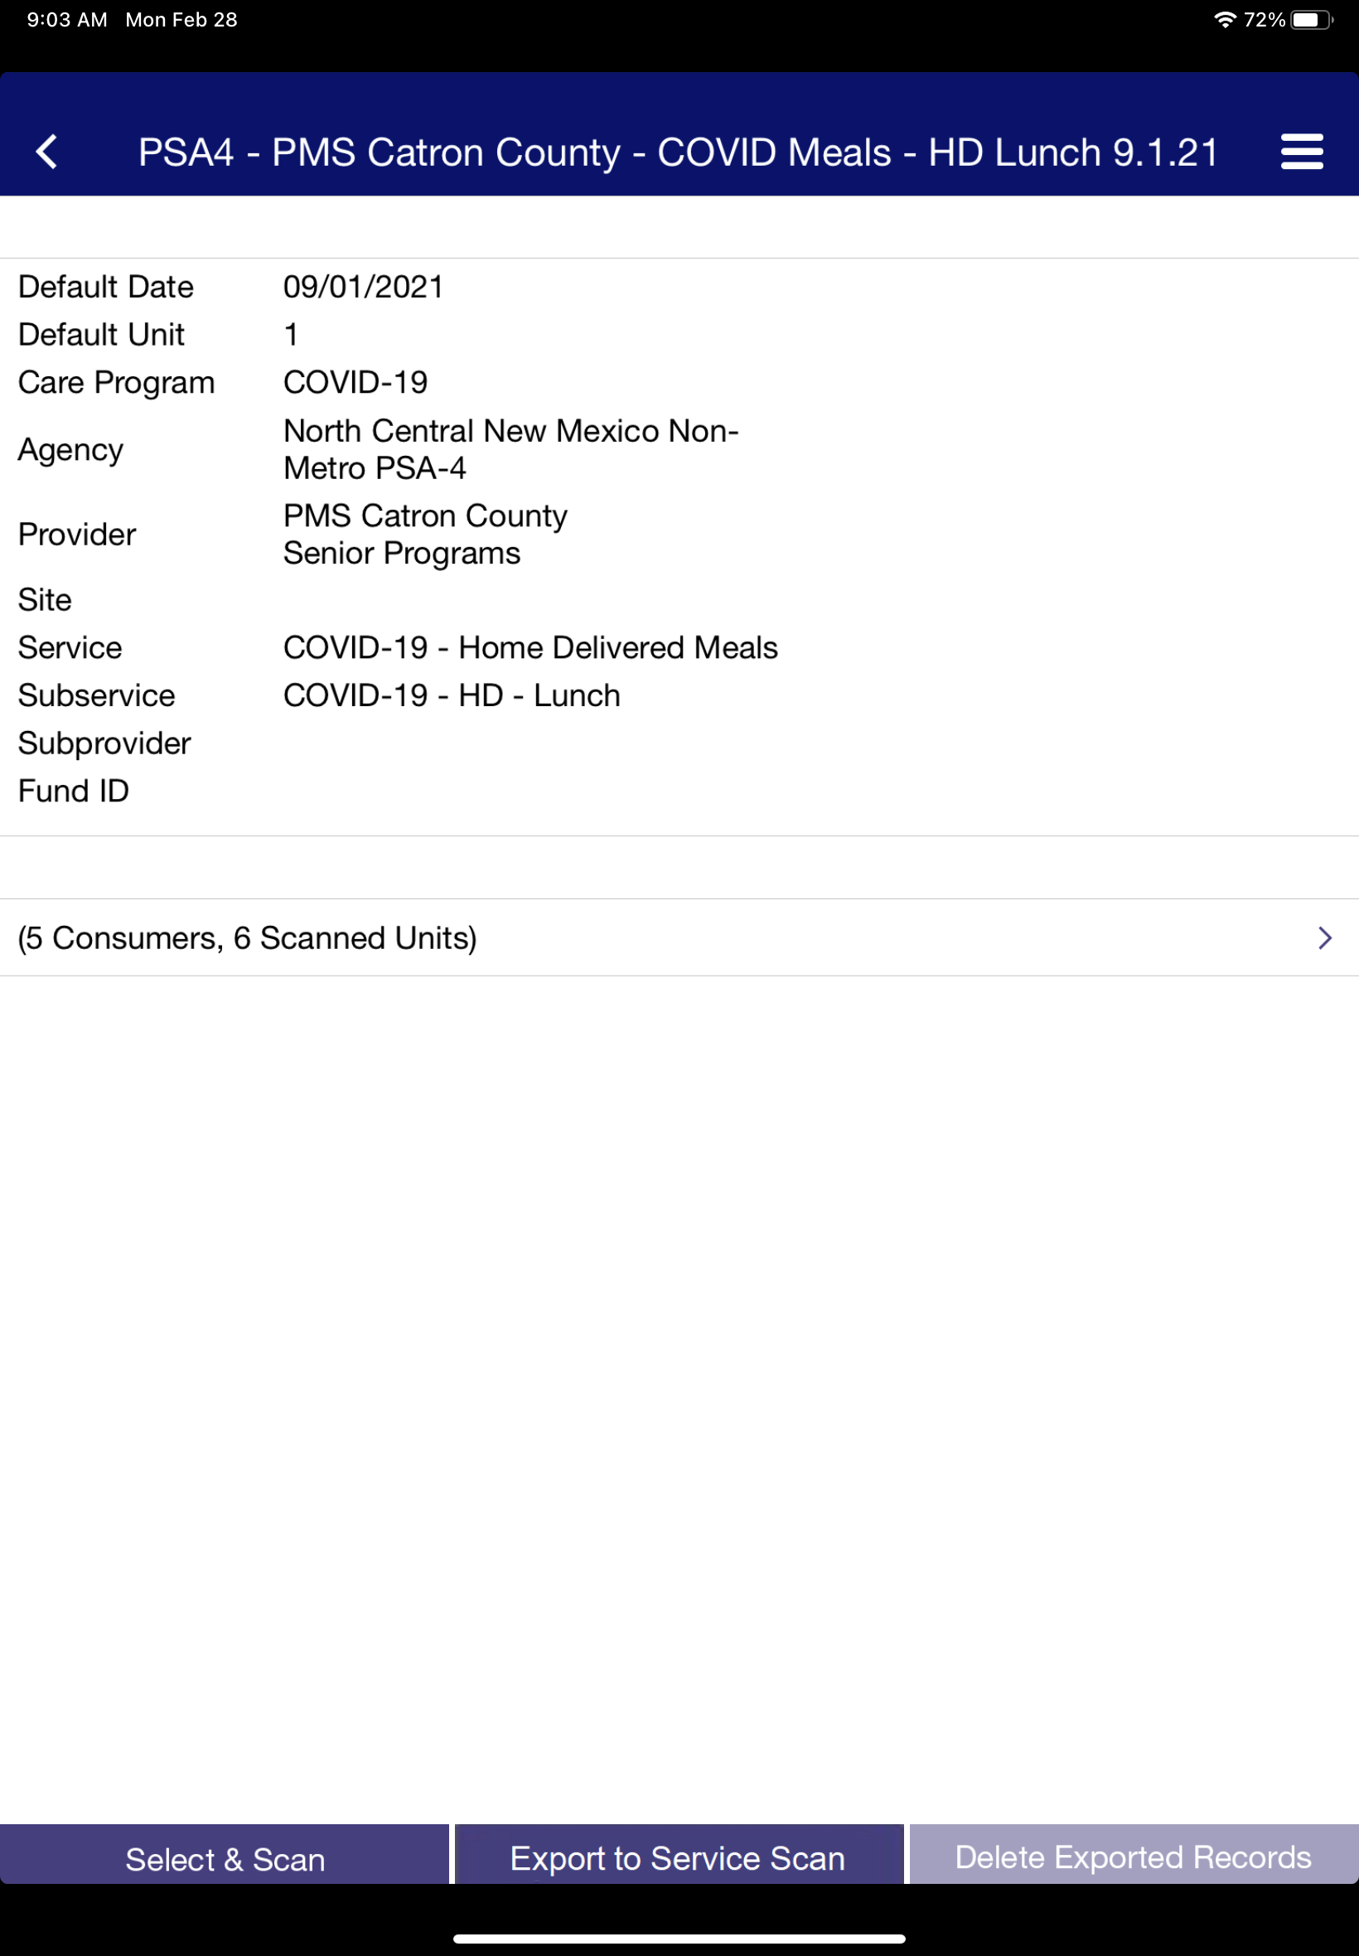
F
After you tap search, the job associated with your entry should populate.
Select the job tied to the roster you are needing to record units for.
G
This is an example of the selected job.
Now tap “Select & Scan” this will bring up your camera so you can start scanning.
WiFi in not required for scanning.
F
G
Leave app open on this page
Once you get here you don’t need WiFi
Select & Scan

Slide 33
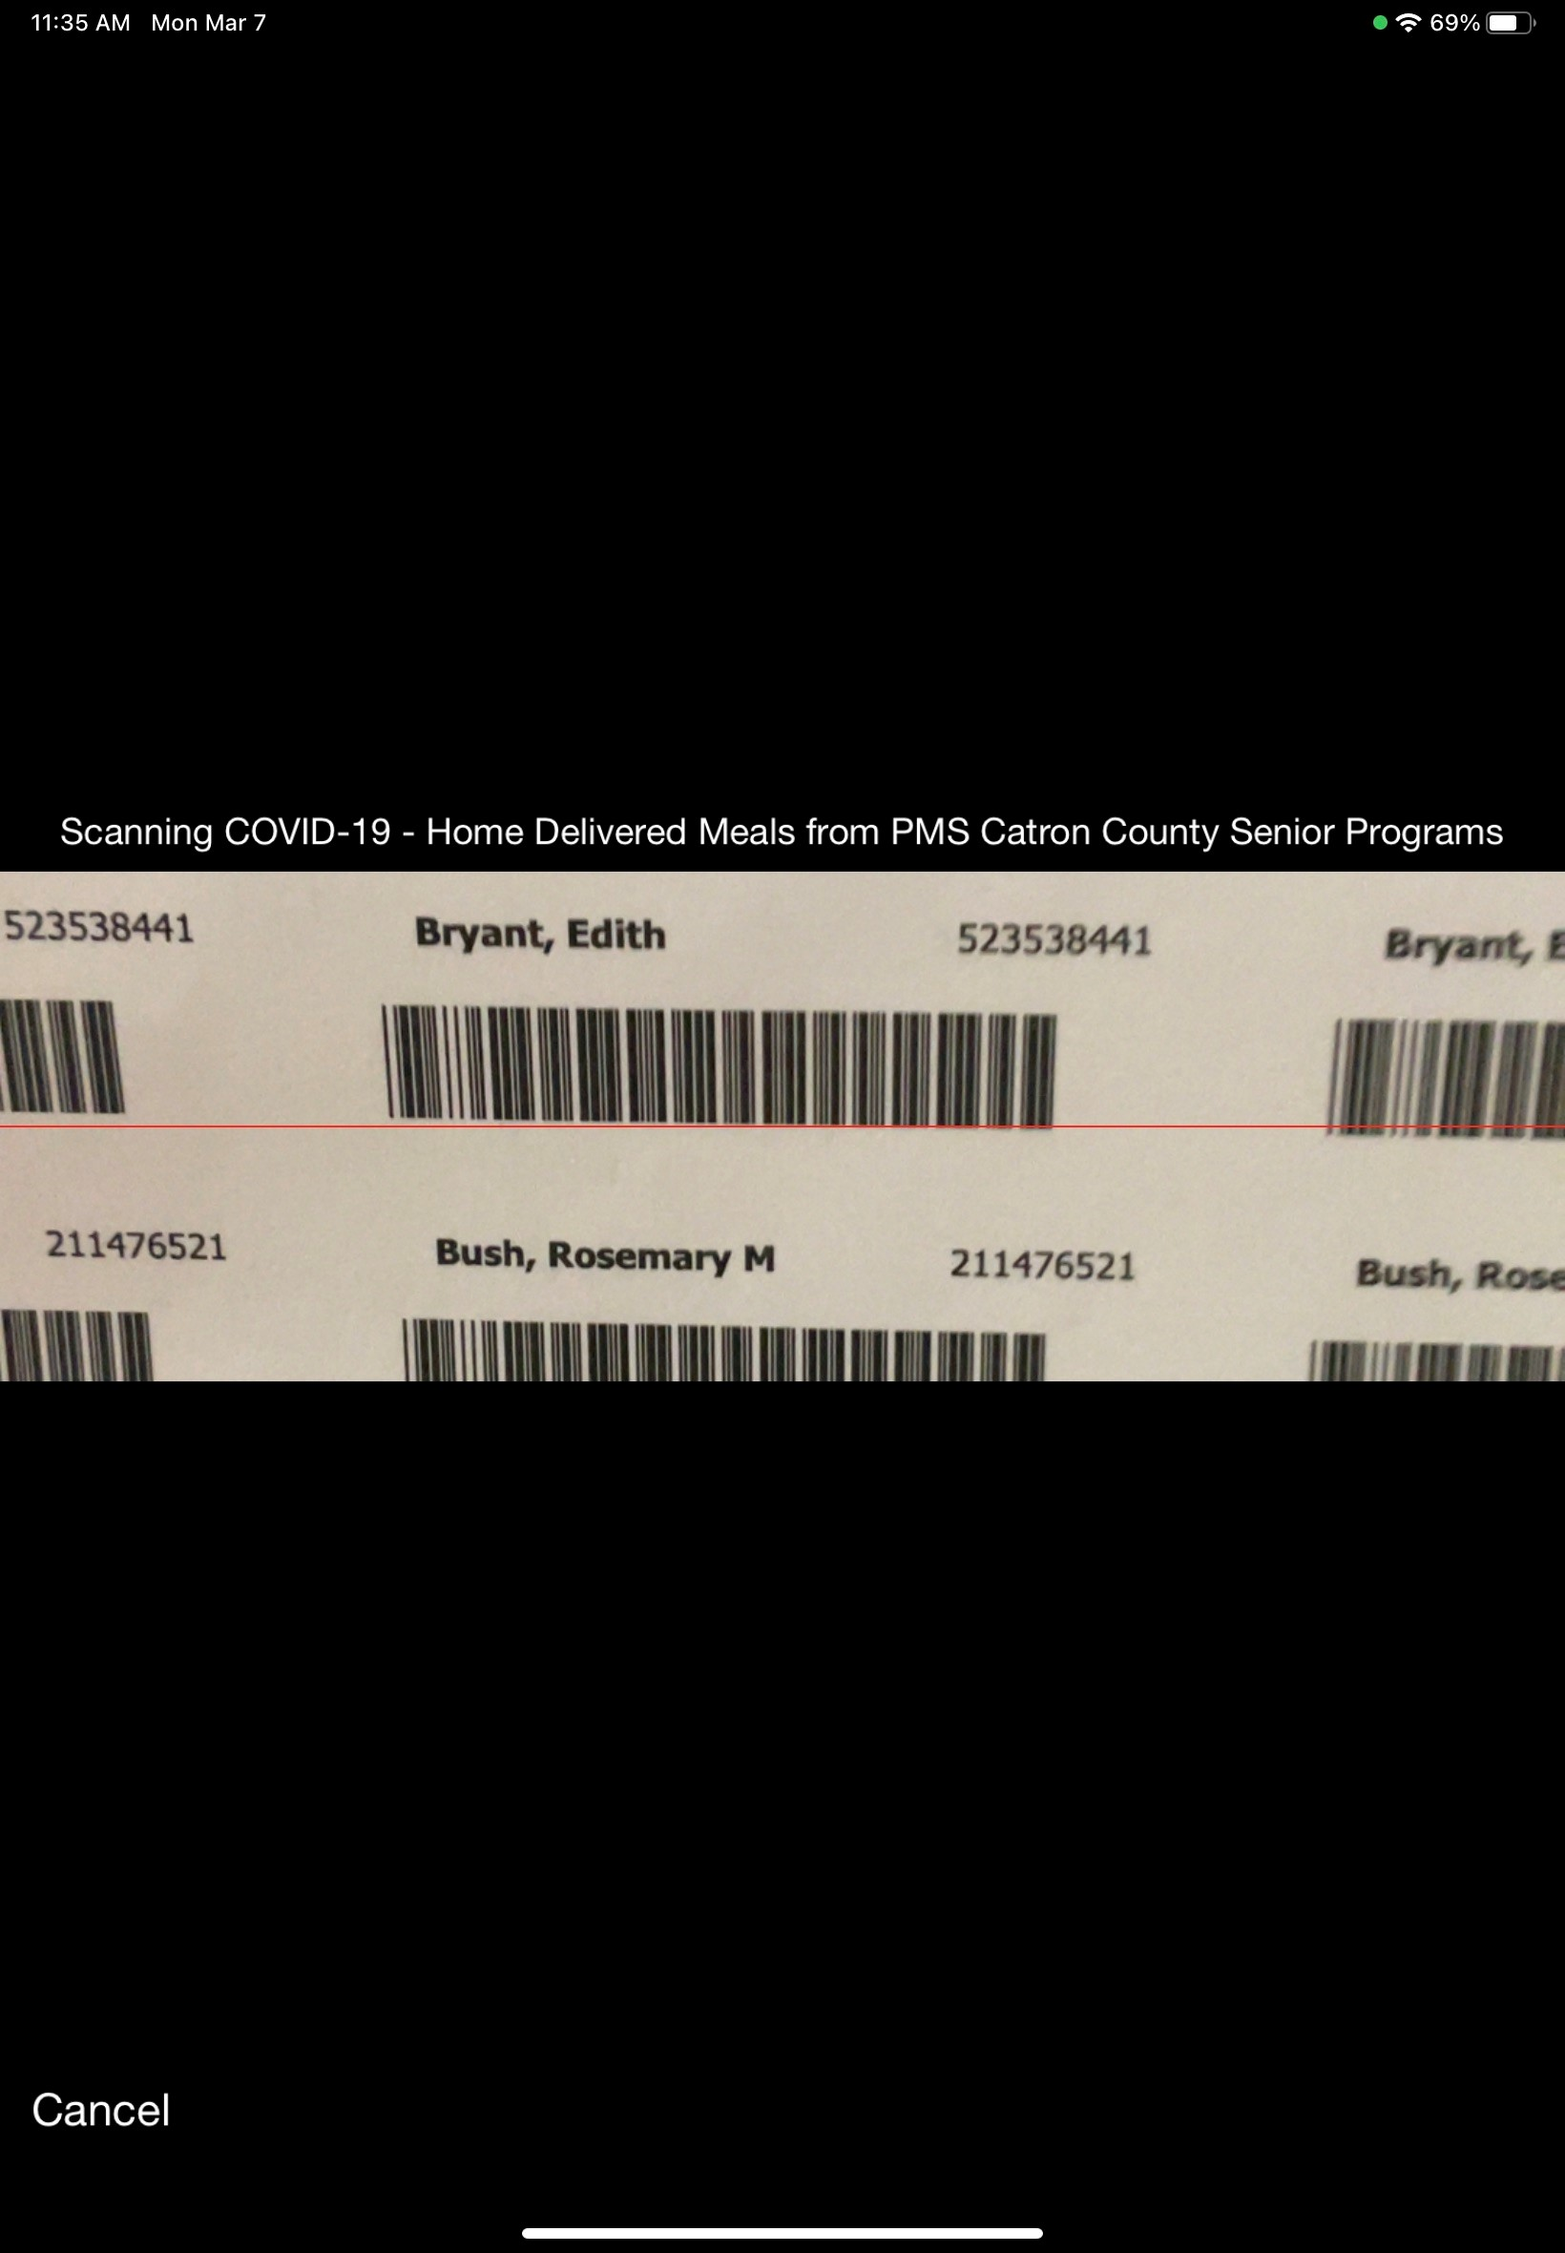
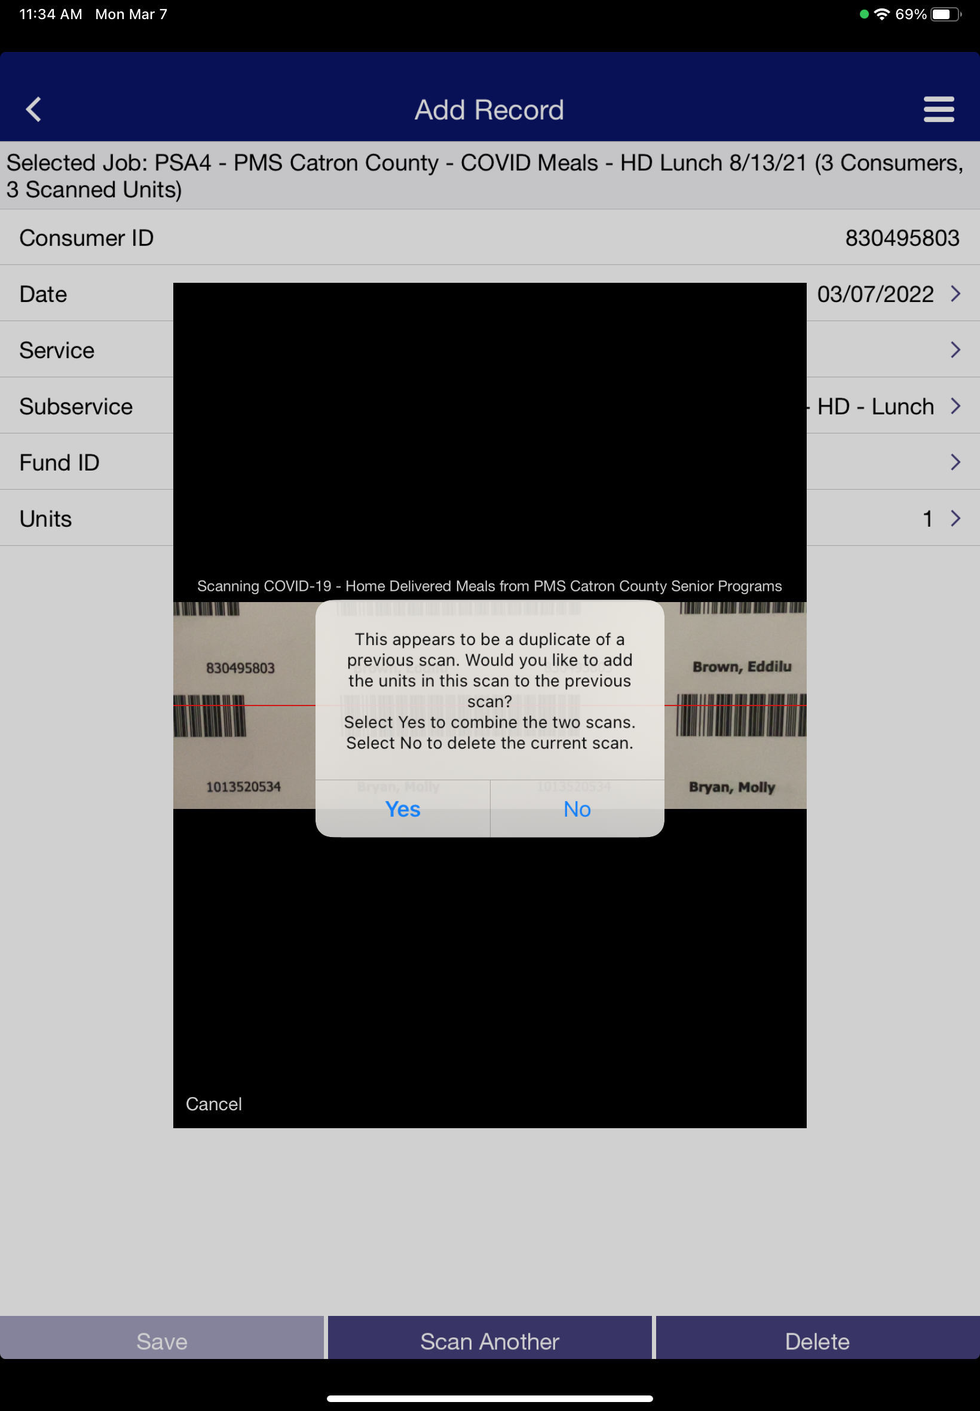
Scanning
H
I
H
This is an example of what the camera/scanner will look like.
I
Now aim your camera to the bar-code you want to use. (it will scan the bar-code and enter it in the iPad)
J
If you scan the same bar-code an alert will pop-up.
The alert reads as follows:
This appears to be a duplicate of a previous scan. Would you like to add the units in this scan to the previous scan?
Select Yes to combine the two scans.
Select No to delete the current scan.
J

Slide 34
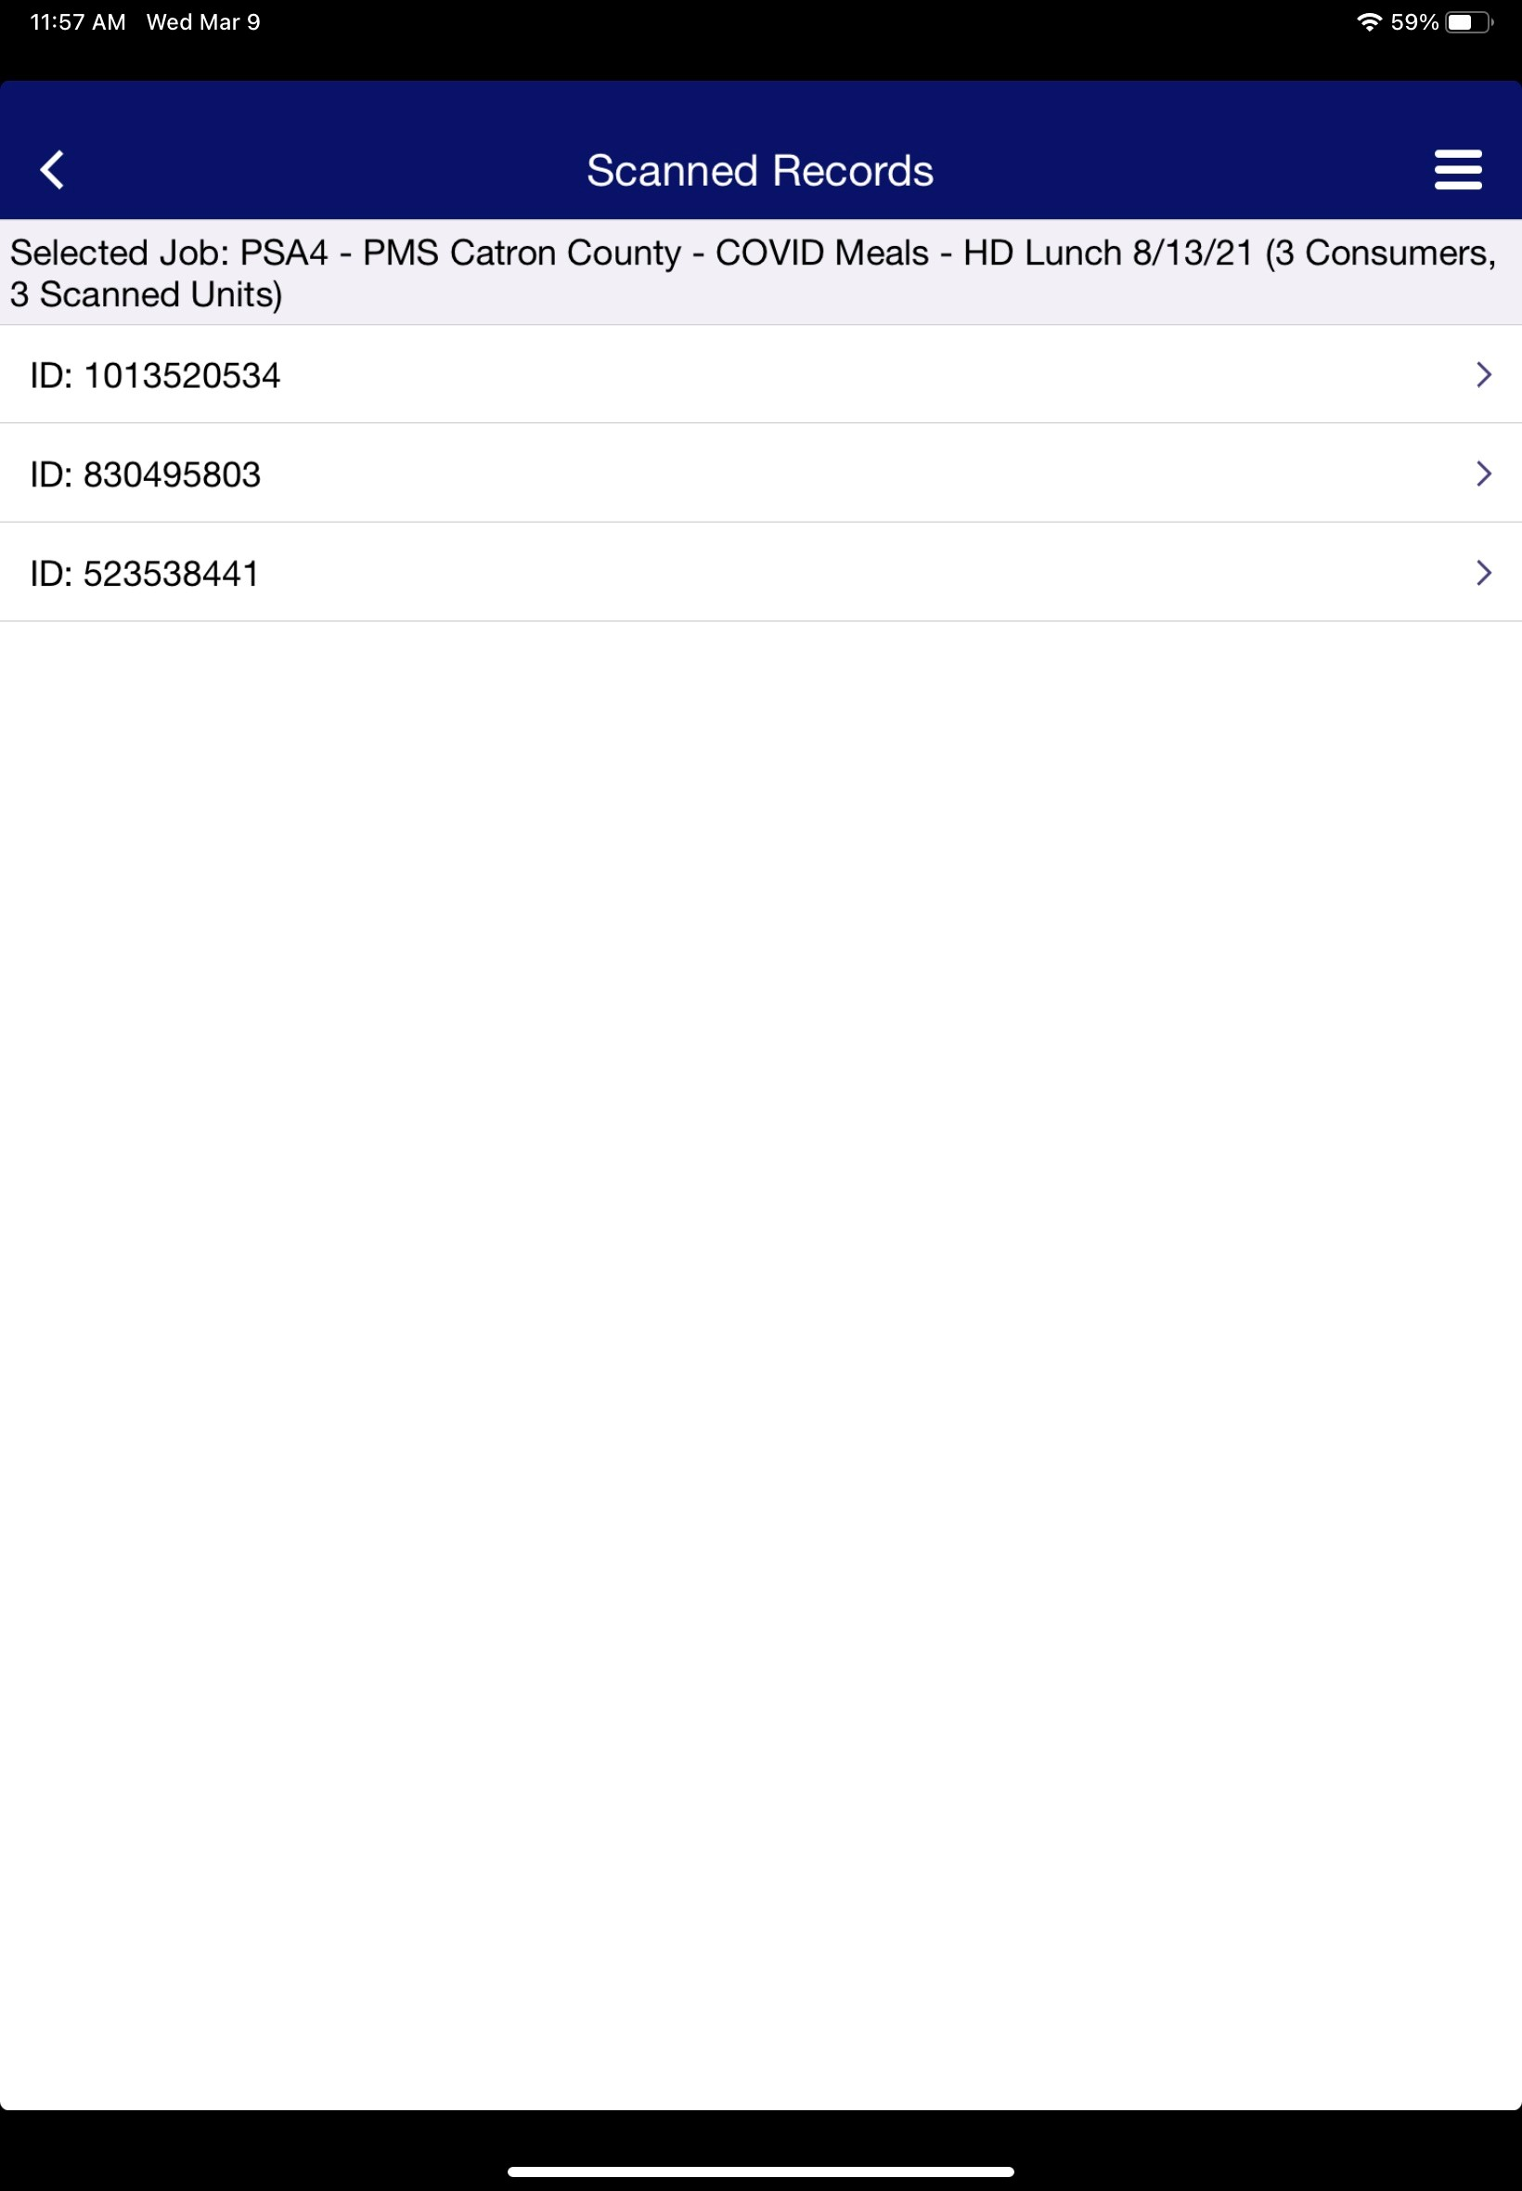
Editing in iPad
“IMPORTANT”
After making changes make sure you tap save, if you don’t tap save it won't save the changes you made.
Tap on the consumer you need to edit
Tap here

Slide 35
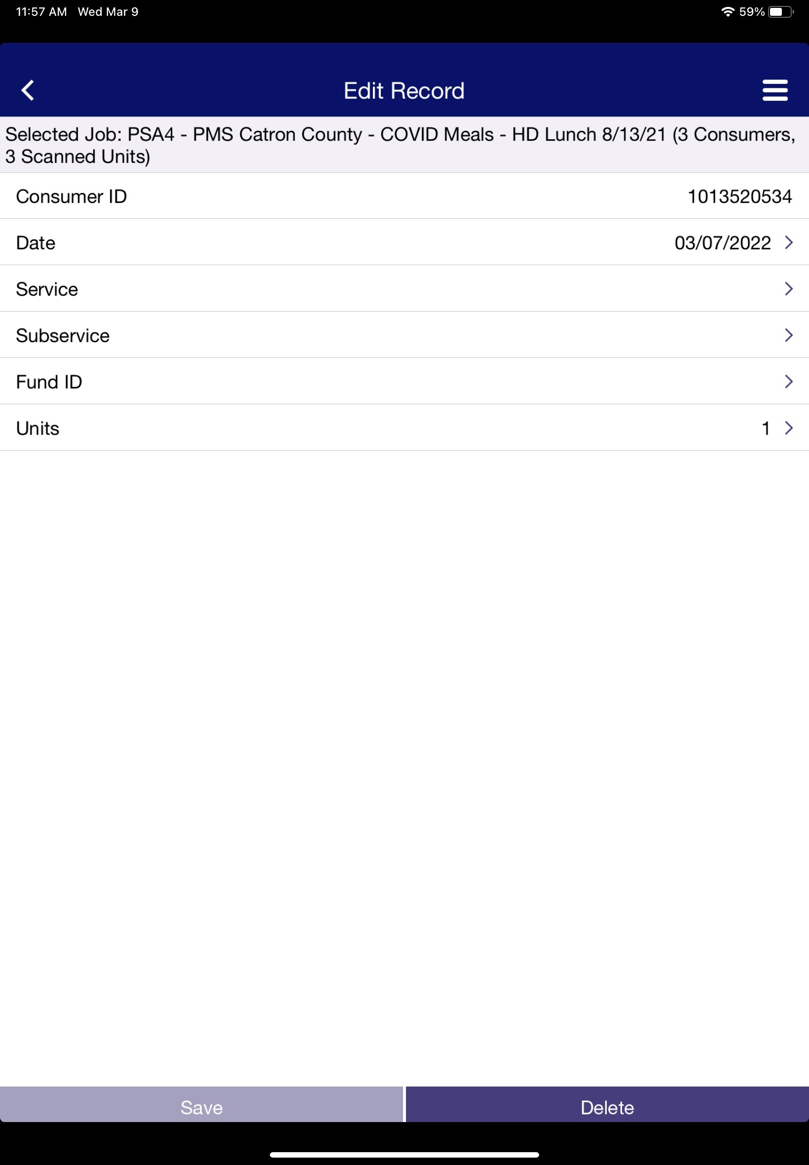
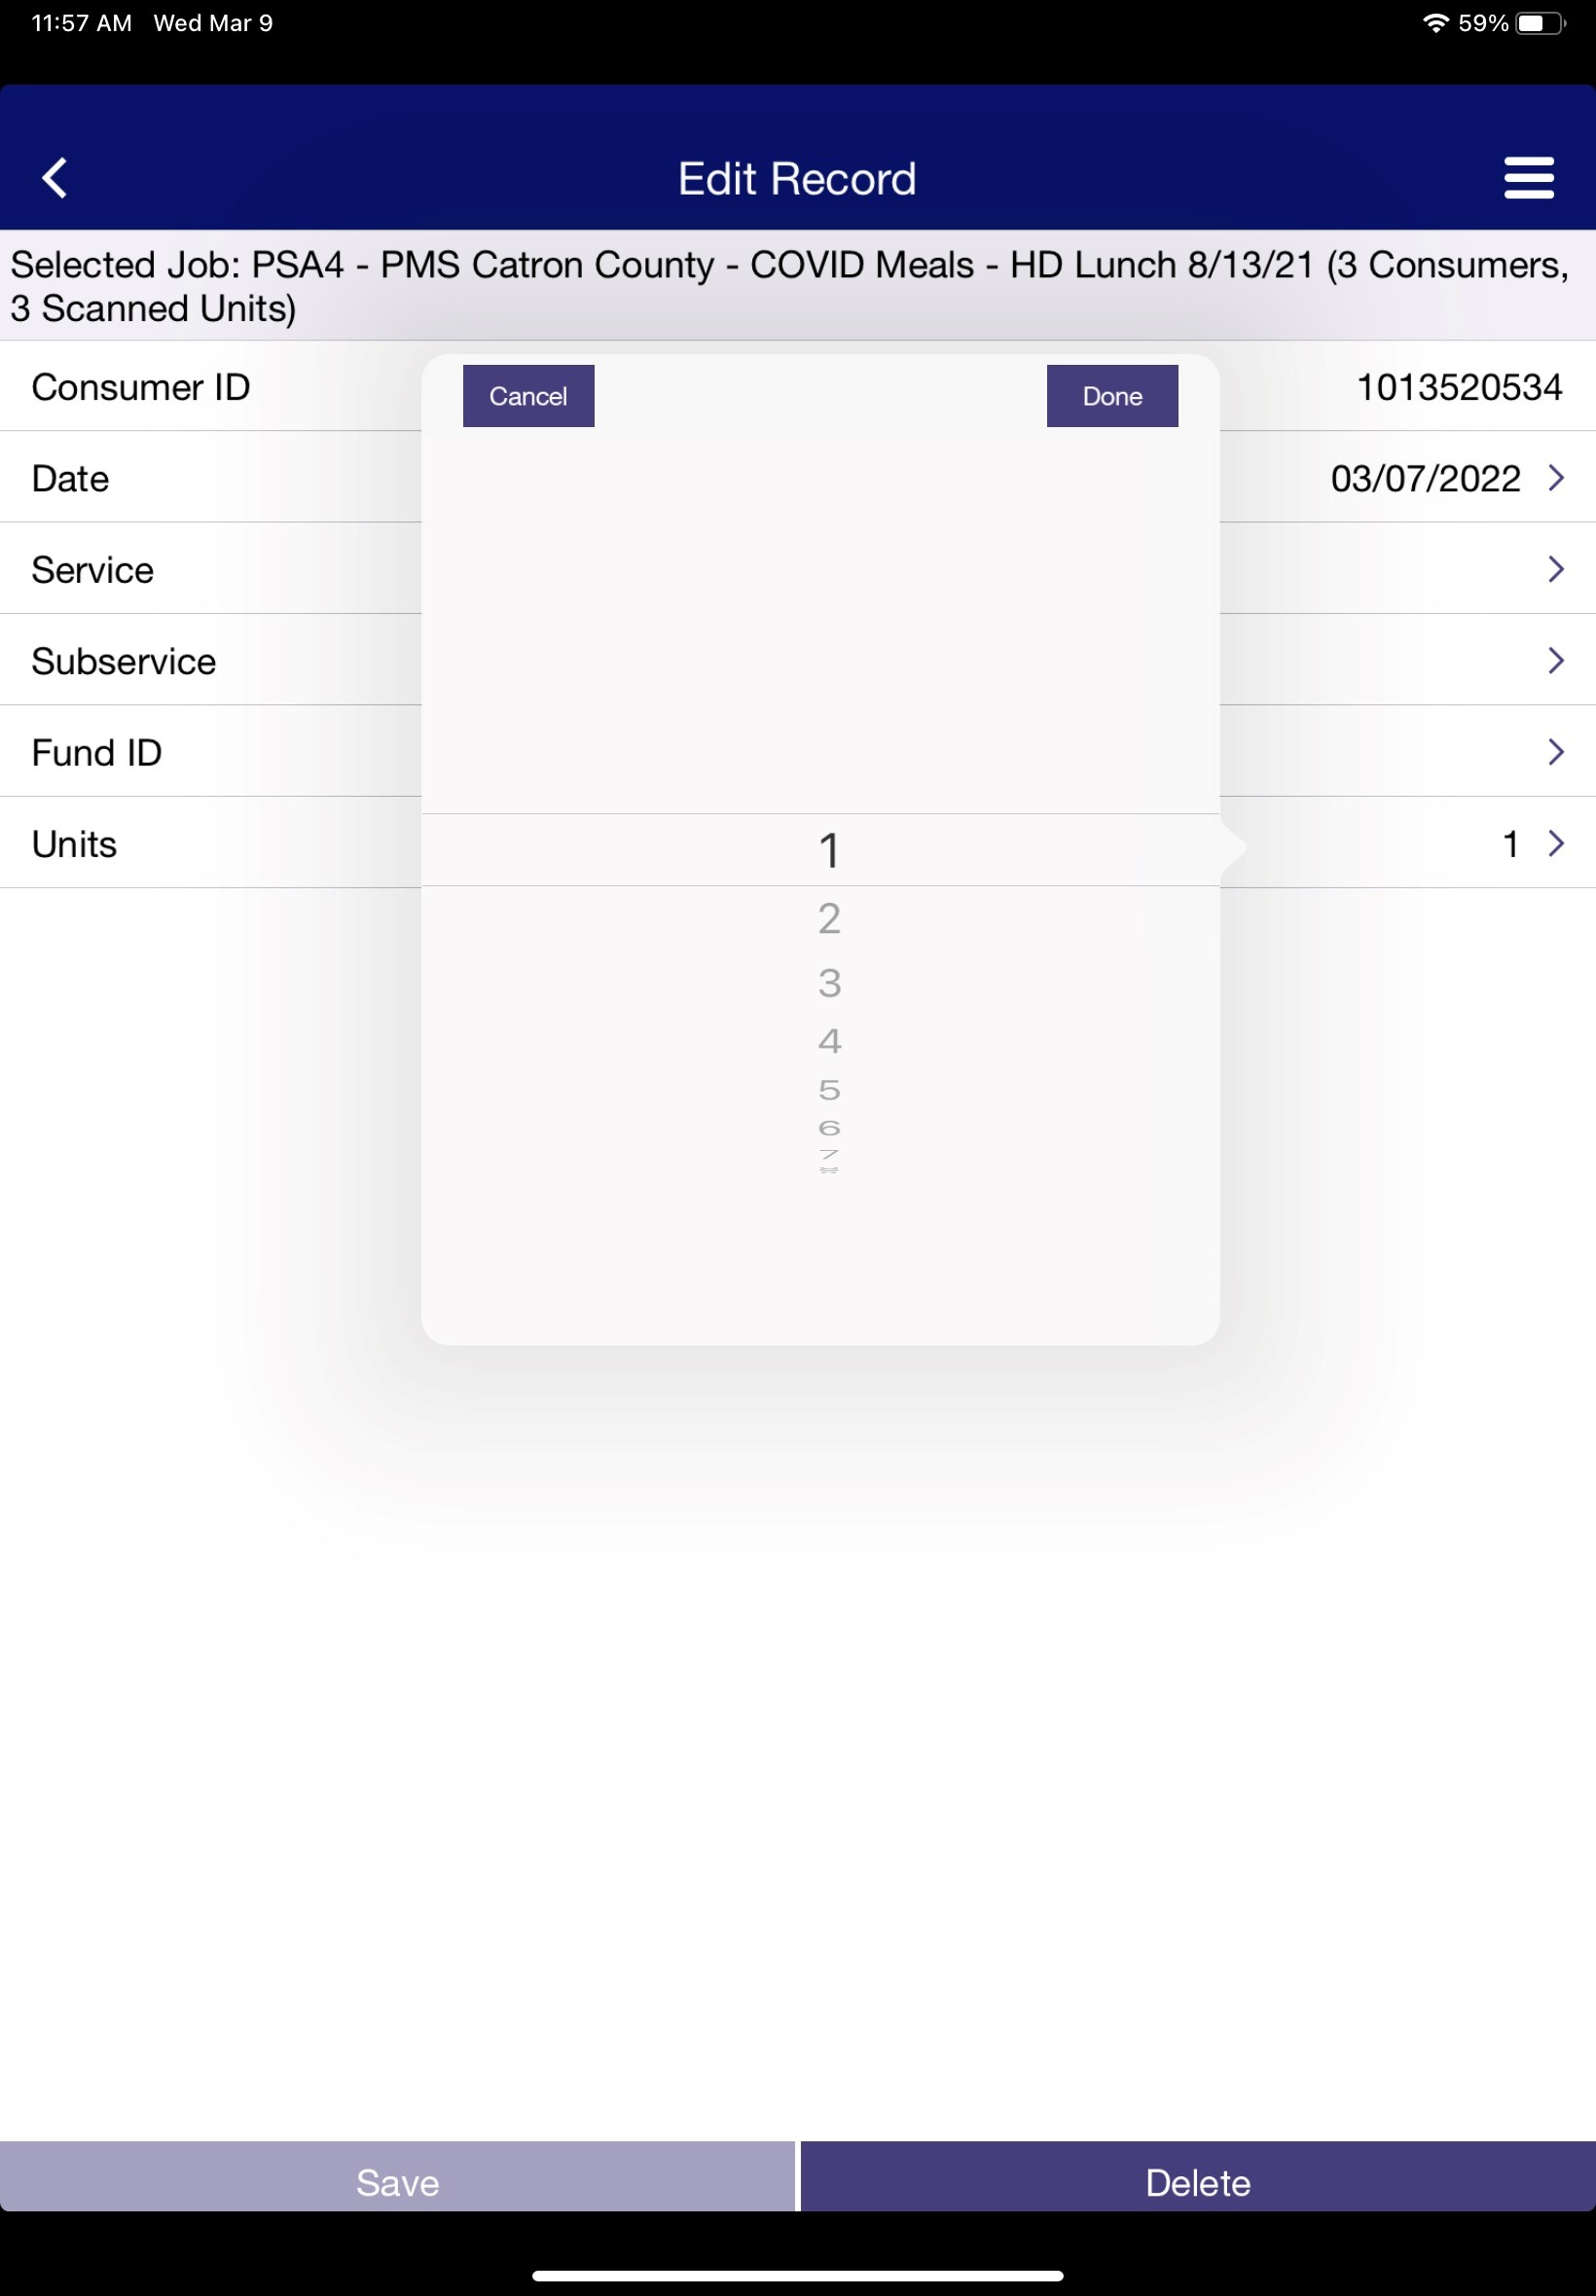
Editing in iPad Continued
Tap Done
To change the date, tap here
Use the tip of your finger to change the month, day & year
To change the number of units, tap here
Save changes
Tap Done
Use the tip of your finger to change the number of units

Slide 36
Getting ready to Export
Now we need to get to the right place to Export. Tap the arrow here.
At the bottom of the job screen; it will show how many consumers and scanned units are in the selected job.
Note: You will need internet to Export from the iPad to your desktop.

Slide 37
How to Export to Service Scan
Successful Export tap OK
Exporting

Slide 38
You will get a warning Alert. “Export Alert” (You are about to export 6 scanned units from 5 consumers within the job PSA4 – PMS Catron County – COVID Meals – HD Lunch 9.1.21) Would you like to continue? Tap Yes.
Tap Export to Service Scan.

Slide 39
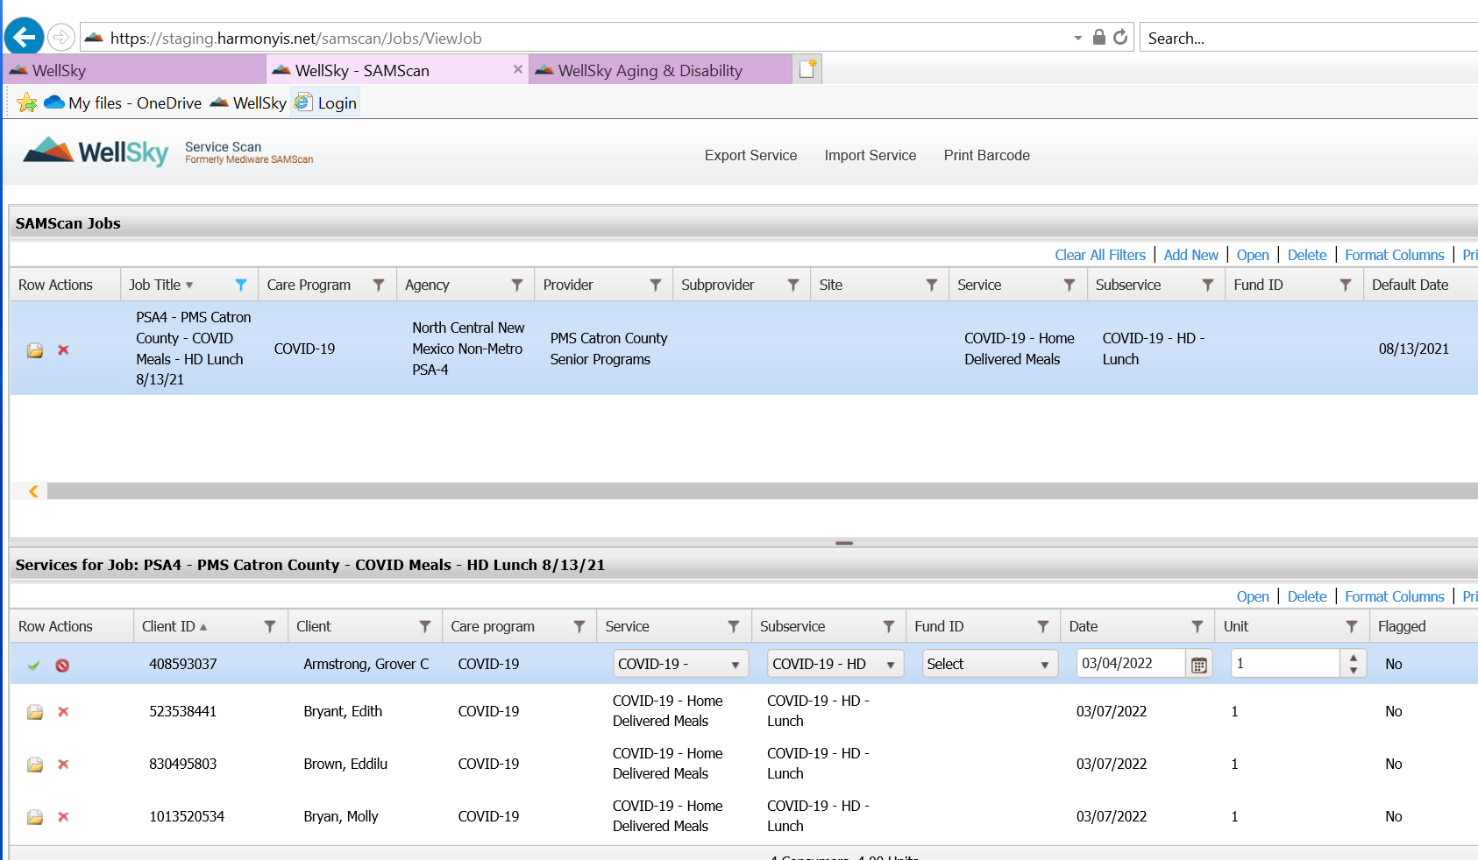
Scans in the Job
A - Now we are going to WellSky: Service Scan Desktop – Test.
B – Select the job you're working on it will bring up the consumers you have scanned on the iPad.
You can edit here by clicking on the file folder on the left side of the screen. When the folder is open you can edit the Service, Subservice, Date, & Units. Once you are done editing the date; click on the green check mark to save your changes.
B
A

Slide 40
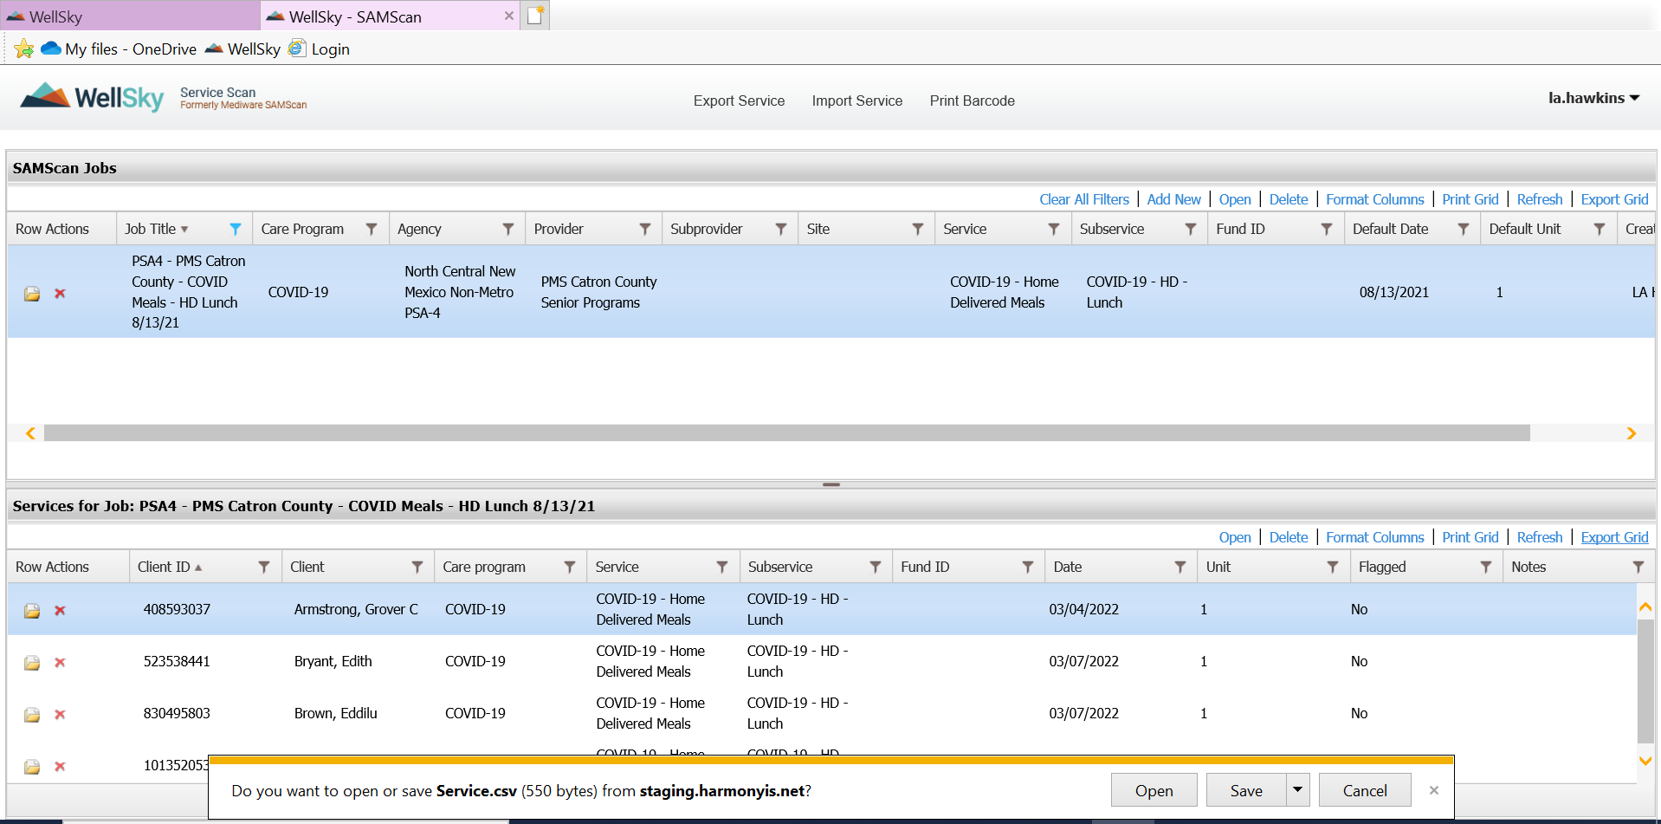
exporting the Grid
C
D
C - Export Grid: Click on Export Grid.
(Note: Remember you will be working in the test site until you are confident about going live.)
D – Click open. (this will open a excel page)

Slide 41
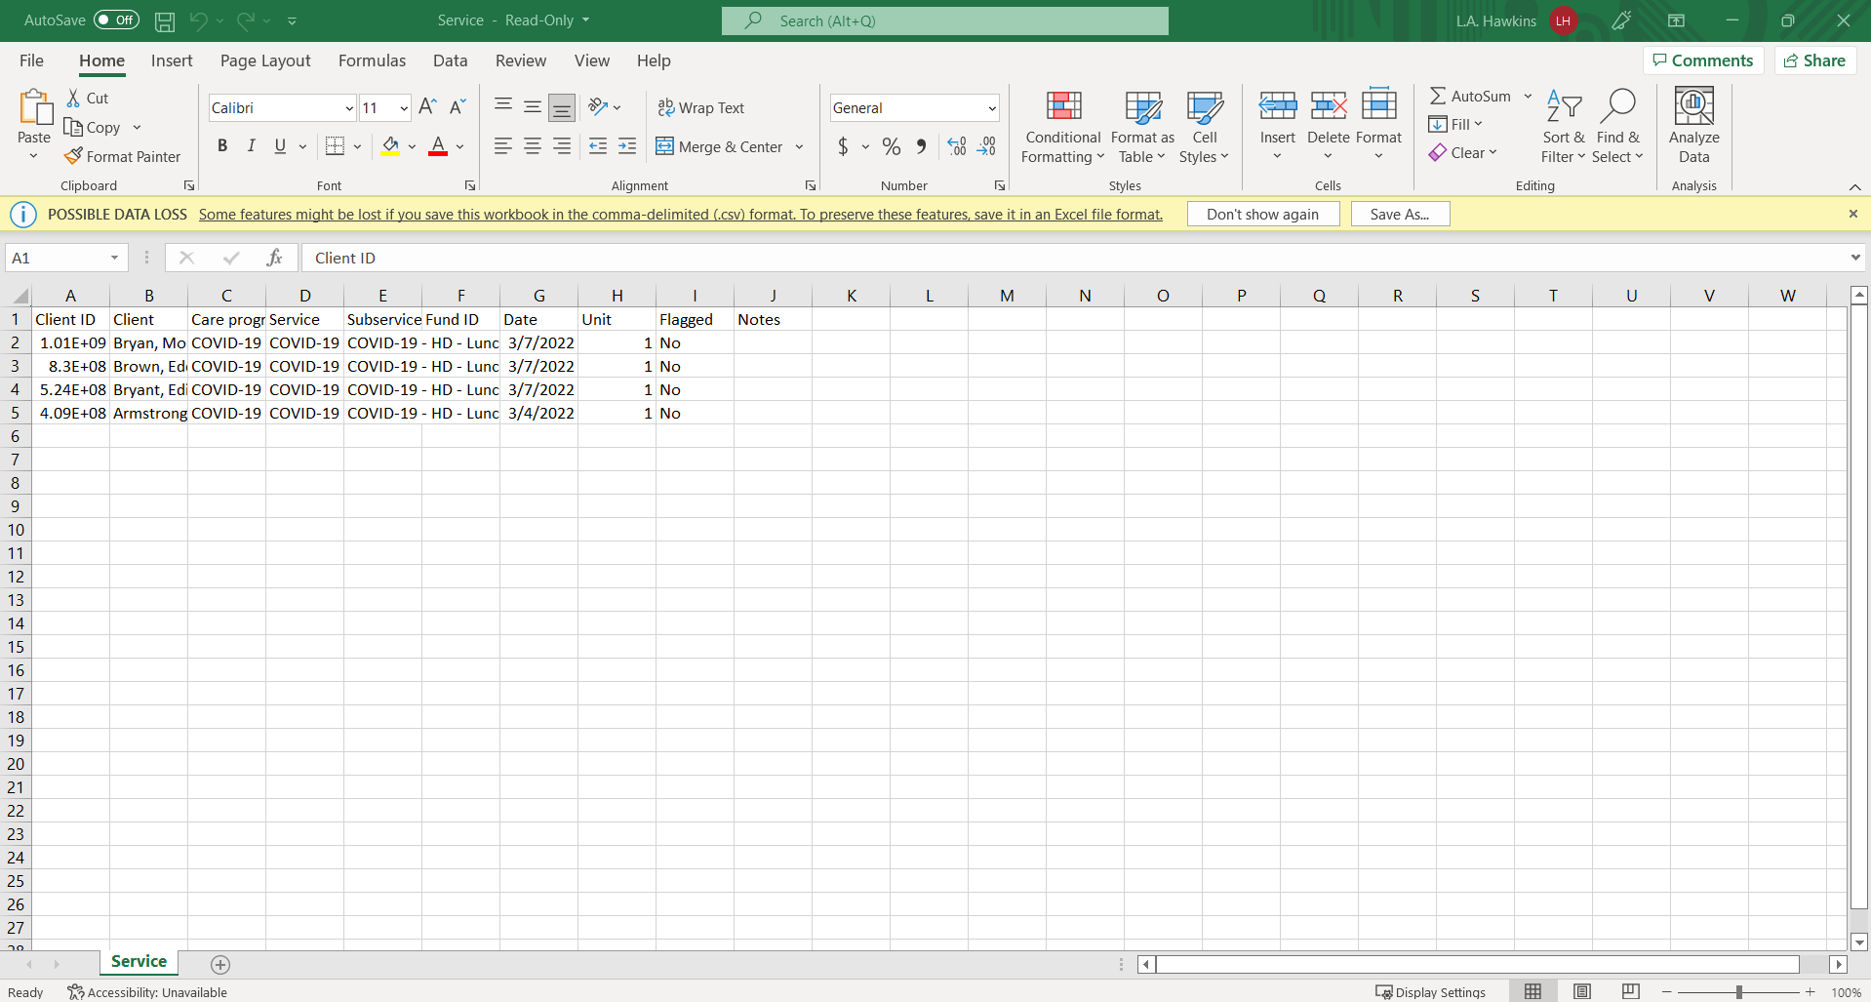
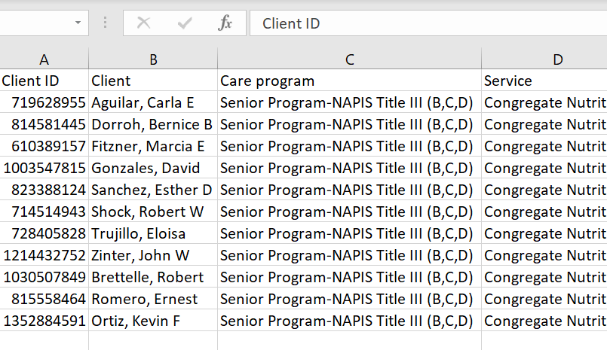
This is a fixed Grid.
You may need to adjust the width of each column to see the consumer’s ID & Name.
Note: Remember to save the Excel Spread Sheet to your desktop.
Now save.

Slide 42
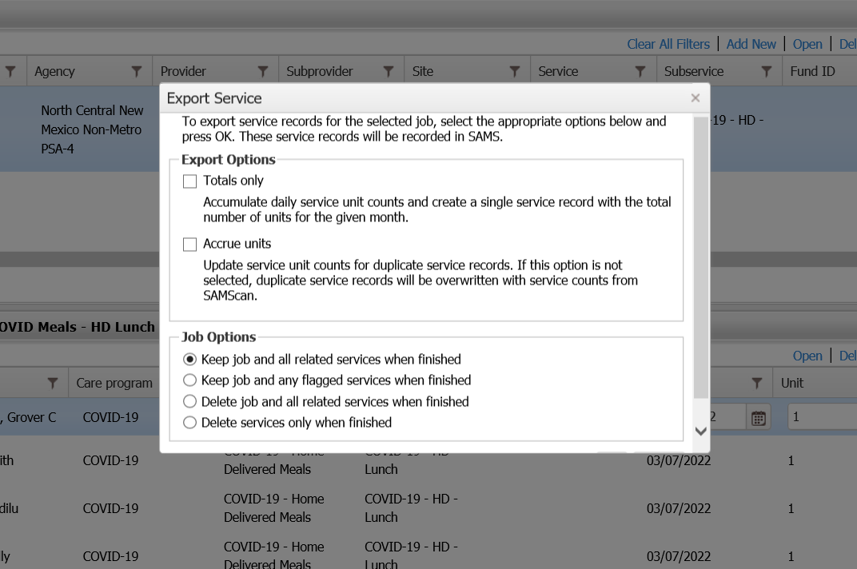
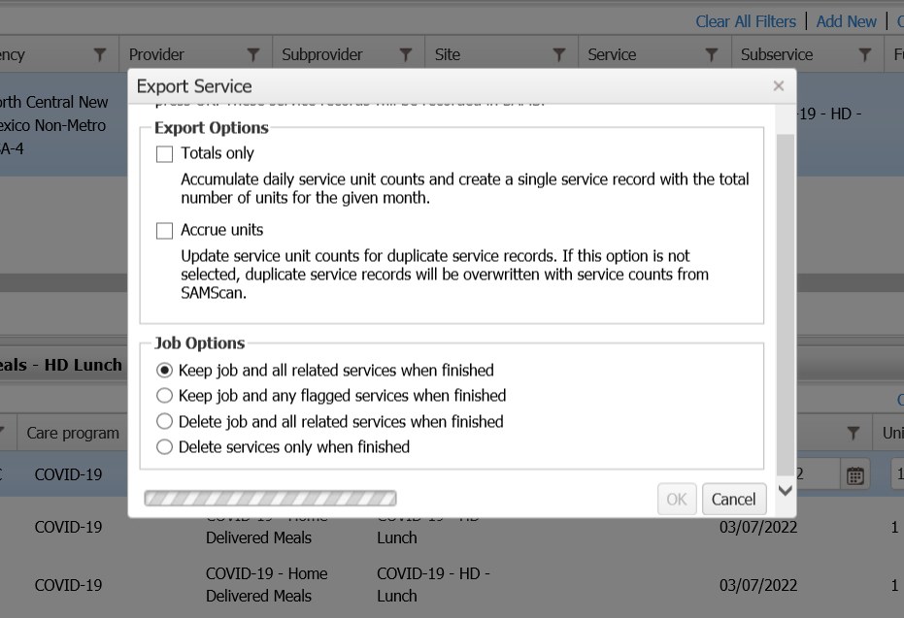
Export Service
Export Service
Now we want to export service.
Make sure you click Keep job and all related services when finished.
Click OK
Click OK

