Slide 1
Menu Planning and Nutrition Requirements Updated October 2023
Constance Rudnicki MS, RDN, LD
Registered Dietitian/Nutritionist
Karen Zarrella
Nutrition Education Intern
NM-AAA

Slide 2
OBJECTIVES
The learner will learn basic information about older adults.
The learner will learn the menu meal pattern for breakfast and lunch
The learner will learn the nutrition requirements for fiber and sodium
The learner will learn about types of carbohydrates
The learner will learn about types of fats
The learner will learn about menu Vitamin and Minerals

Slide 3
Nutrition Services Program
Assist older Americans to live independently by:
Promoting better health
Improved nutrition
Reducing isolation

Slide 4
Purpose of Nutrition Service Program
Reduce hunger and food insecurity
Promote socialization of older adults
Promote health and well being of older individuals
This will provide assistance in accessing nutrition, disease prevention, and health promotion services
Goal is to delay the onset of adverse health condition result from poor nutrition or sedentary behavior

Slide 5
Dietary Reference Intake (DRI’s)
Older American’s Act requires all meals served in the senior program to provide at least 1/3 Dietary Reference Intakes (DRI) and to comply with Dietary Guidelines for Americans (DGA)
DRI’s
Set of nutrients and energy standards set by the Food and Nutrition Board of the National Academy of Sciences for person over the age of 51

Slide 6
DRI’s
DRI’s are average over a 1 week period
A minimum of 1/3 of DRI must be met if participants are offered one meal per day
A minimum of 2/3 of the DRI if the participant is offered two meals a day
100% of the allowances if the participant is offered three meals a day

Slide 7
MENU DRI’s (Dietary Reference Intake)
K calories Daily 1/3
2100kcals
Breakfast 450 kcals
Lunch 700 kcals
Protein 56-190 19-63 15-25% of total kcals
Carbohydrates (g) 270-300 90-100 45-55% of total kcals
Fiber (g) ≥ 30 ≥10
Total Fat (g) 49-86 16-63 25-35% of total kcals
Saturated Fat (g) 24 8
Calcium (mg ) 1200 400
Iron (mg) 8 2.6
Sodium (mg) 2300 766
Vitamin A (RAE) 900 300
Vitamin C (mg) 90 30
Vitamin B-12 (µg) 2.4 0.8

Slide 8
Nutrition Requirements: Breakfast
Nutrient | Daily Lunch Requirement | Menu Week 1 | Menu Week 2 | Menu Week 3 | Menu Week 4 | Menu Week 5
Calories | 450 or more
% Carbohydrates from Calories | 45-55%
% Protein from Calories | 15-25%
% Fat from Calories | 25-35%
Saturated Fat | less than 8g
Fiber | 10g or more
Vitamin B-12 | .8ug or more
Vitamin A | 300ug RAE or more
Vitamin C | 30mg or more
Iron | 2.6mg or more
Calcium | 400mg or more
Sodium | less than 766mg

Slide 9
Nutrition Requirements: Lunch
Nutrient | Daily Lunch Requirement | Menu Week 1 | Menu Week 2 | Menu Week 3 | Menu Week 4 | Menu Week 5
 |  | Days in Week: 4 | Days in Week: 5 | Days in Week: 4 | Days in Week: 5 | Days in Week: 2
Calories | 700 or more
% Carbohydrates from Calories | 45-55%
% Protein from Calories | 15-25%
% Fat from Calories | 25-35%
Saturated Fat | less than 8g
Fiber | 10g or more
Vitamin B-12 | .8ug or more
Vitamin A | 300ug RAE or more
Vitamin C | 30mg or more
Iron | 2.6mg or more
Calcium | 400mg or more
Sodium | less than 766mg

Slide 10
Menu Planning
Consumer input
Repetition of entrees must be kept a minimum as well as duplication of menu items
If a cycle menu is utilized there shall be at least three cycles per year
Substitutions may be made by using the Substitution Guide found in the provider portal
https://www.nonmetroaaa.com/

Slide 11
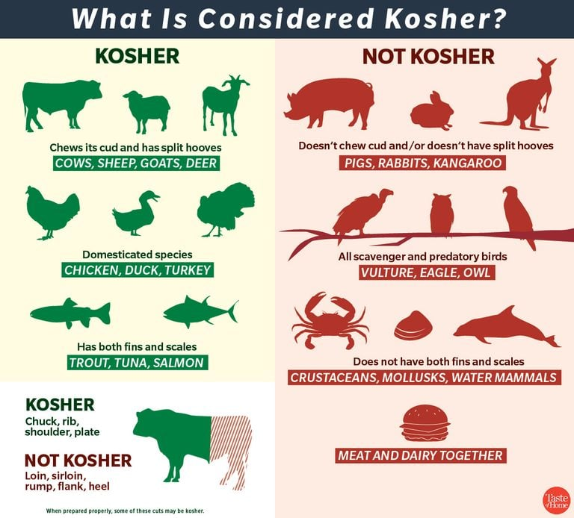
Special Menus
When feasible and appropriate, provide special menu to meet special dietary needs arising from health, religious, or ethnic requirements of the consumer
Feasibility and appropriateness are determined by:
A sufficient number of person need the special menus to make their preparation practical
The food and skill necessary to prepare the special menu are available to the program
The special menu does not adversely affect the program’s budget

Slide 12
Therapeutic diets
The need has been determined as evidenced by written diet order signed by physician and placed in the consumer's file
The necessary resources are available to the program
Supervision is provided by registered dietitian, or the meals are purchased from a qualified agency (hospital or similar facility) whose meal preparation is supervised by a registered dietitian
Mom’s meals can also be used

Slide 13
Food Preparation, Temperature and Storage
Frozen meals must be dated and labeled
If Sectioned aluminums trays are used, frozen meals must be delivered within two (2) weeks
If a heat sealed packaging method is used, frozen meals can be stored up to forty-five (45) days

Slide 14
Menu Submission
Providers must prepare and publicize menus that meet the requirement at least one month in advance
Menus must be submitted to NM-AA for nutritional analysis
Send menus in word format only-excel, pdf etc will not be accepted
Send me 2 menus at a time only
Please do not send me 6 months or 1 year of menus in advance
Pricing changes, product availability, all varies
Old GN menus will be removed Jan 2, 2024 from website and will not be available

Slide 15
Other reminders
If you are not serving a menu item due any reason, you must substitute for that menu item.
For example:
3oz LS Herbed Fish (cod)
2 TBSP tartar Sauce and lemon
1/2c Broccoli Slaw w/ 2 TBSP Dressing
Wheat roll w/ 1 tsp margarine
1/2c Herb Roasted Potatoes
1/2c Pears
If you are not serving the pears and wheat roll/margarine, you must sub for those items, you will not be meeting DRI’s for that meal
If making menu changes you must fill out a sub request form and send it to constancer@ncnmedd.com for approval.
Sub request form available on website: https://www.nonmetroaaa.com

Slide 16
Reminders Continued
Please include if you are serving margarine, dressings, any condiments, etc.
Please tell me what vegetable, fruit, cookie, dessert that you are serving at your meals
New Mexico Grown: please let me know if what fruit and vegetables you are using
Please use natural colored foods, don’t get artificially colored canned fruits or artificially flavored

Slide 17
Abbreviations on menus:
NAS-No Added Salt
LS-Low Sodium
SF-Sugar Free
LF-Low Fat
FF-Fat Free
WW-Whole Wheat

Slide 18
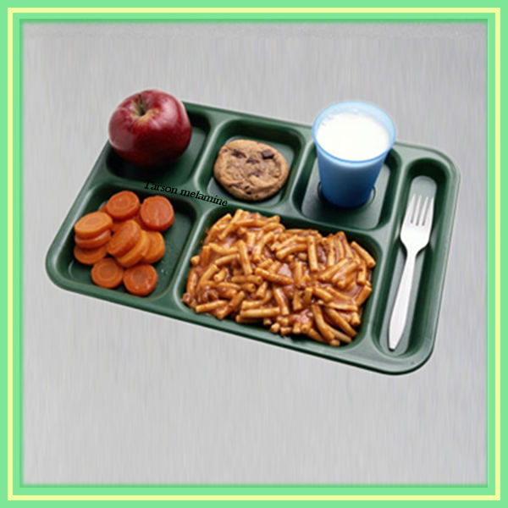
MENU REQUIREMENTS

Slide 19
Lunch menus must follow the following meal pattern:
3oz of Protein Foods (should be lean or low fat)
Meat, Poultry Eggs:
Beef, goat, lamb, pork, game meat, poultry, organ meats
Limit red meat to 3x a week
Seafood-catfish, crab, flounder, haddock, perch, salmon, sardine, cod, tilapia, light tuna
Unsalted Nuts, Seeds, Soy Products:
Tree Nuts and Peanuts, Nut butters, seeds (chia, flax pumpkin, sesame)
Tofu
Beans, Peas, Lentils: (can be part of the protein group or vegetable group;
but can only be counted in 1 group only

Slide 20
1oz of meat/protein equals the following: or Alternative
1 medium egg
1oz Pepperoni ~14 slices*
1T L.S. Peanut/soy/Nut Butter
½ ounce seeds
1/4c Cottage Cheese*
1/3c Unsalted Nuts
1/4c Tofu
1/2c Lowfat or nonfat Yogurt
1oz Cheese*
Hot Dog oz can vary ( 2oz-4oz)
High in sodium and/or sat. fat
Beans
(Dry or canned beans, peas, chickpeas, and lentils)
1/4c=1oz
1/2c=2oz
3/4c=3oz
Does not include green beans or green peas

Slide 21
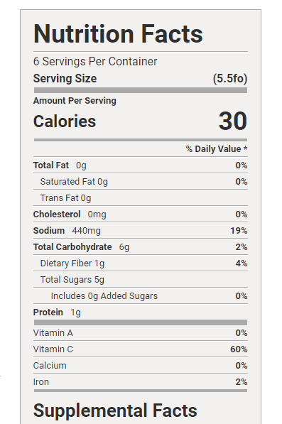
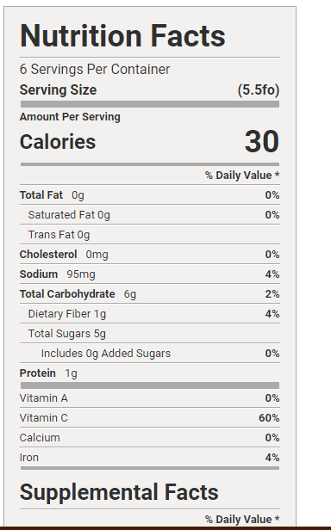
Vegetables
Two (1/2cup) servings of vegetables required
1/2c Cooked, drained, fresh, frozen, canned or raw vegetables (green beans, peas, beets, etc)
1c Raw leafy greens,
1/2c L.S. tomato juice
1/2c 100% L.S. vegetable juice
3/4c Tomato or vegetable soup

Slide 22
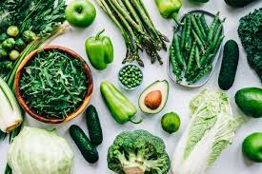
Dark Green Vegetables (fresh, frozen, canned)
Broccoli
Bok choy
Chard
Cilantro
Collard
Kale
Mustard greens
Spinach
Turnip greens

Slide 23
Red and Orange Vegetables (Fresh, frozen canned)
Carrots
Red chili peppers
Red or orange bell peppers
Red onions
Tomatoes
Radishes
Red beets

Slide 24
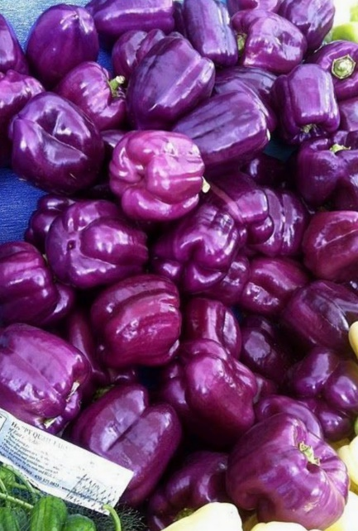
Blue and Purple Vegetables
Eggplant
Purple Cabbage
Purple Bell Pepper
Purple Carrots
Kohlrabi
Purple Asparagus

Slide 25
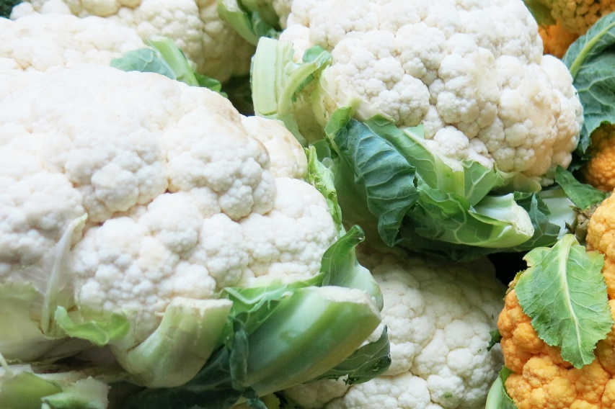
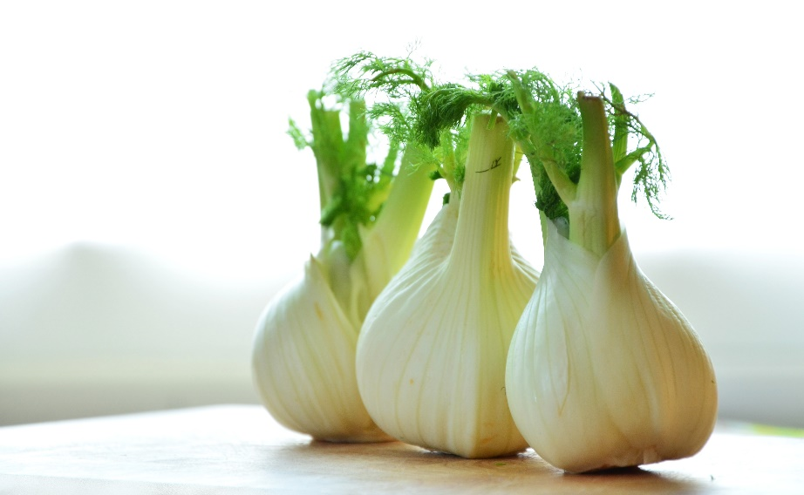
White and brown vegetables
Onions
Cauliflower
Garlic
Leeks
Parsnips
Mushrooms
Fennel

Slide 26
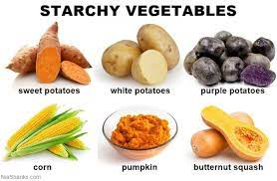
Starchy Vegetables (fresh frozen, canned)
Corn
Lima beans
Peas (green peas, cow peas (black eyed peas), pigeon peas)
White potatoes
Yams
Sweet potatoes

Slide 27
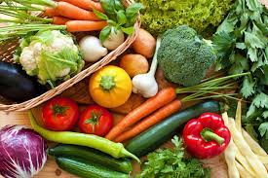
Other vegetables (non-starchy)(fresh, frozen, canned)
Artichokes
Asparagus
Avocado
Beets
Brussel sprouts
Celery
Chives
Cucumbers
Eggplant
Garlic
Ginger
Green Beans
Summer Squash
Turnips
Radish

Slide 28
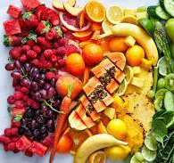
Fruits (Fresh, Frozen, Canned, Dried)
One (1/2cup) a minimum of three times a week
1/2c fruit
1 medium size piece of fresh fruit
1/2c 100% Fruit Juice*
1/3c Cranberry Juice*
1/4c Dried Fruit*
15 grapes
*will increase % Carbohydrate

Slide 29
Breads or Alternatives One or more servings of bread (whole grain desirable, enriched, or bread alternate allowed)
1 slice bread (whole grain preferred)
1/2c Cooked pasta, rice noodles
1 oz Ready to eat cereal
1/2c cooked cereal
2”cornbread
1 slice French toast
½ English Muffin
4-6 crackers (1oz)
1 6” tortilla
½ bagel, 3-4” diameter
1 small sandwich bun
½ large hotdog/hamburger bun (1oz)
1/2c Bread dressing stuffing*
*high in Sodium
1 oz roll (whole grain preferred)
8 animal crackers
3 (2 ½” square) graham crackers
1/2c Croutons
4” across pancake
2.5 oz Dumpling
1oz Fry Bread
1/2c Mesa
1oz Pretzels/ Tortilla chips, Chips
2 ½‘’ biscuit
4”square waffle

Slide 30
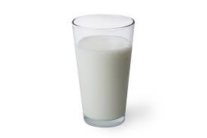
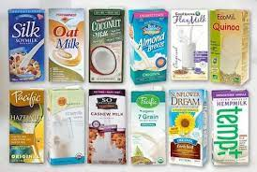
Milk
Daily 8oz (1cup or ½ pint) of milk or equivalent
8 oz Milk alternative, such lactose free milk
Soy milk
Almond milk
Oat milk
1 cup yogurt
1/4c Nonfat powdered dry milk per 1 cup water
Calcium fortified ready to eat cereal
Fortified Orange Juice*
* May increase % CHO

Slide 31
Desserts: Optional item
Strawberry shortcake
Lemon bar
Pudding (low sugar)
Rice pudding
Sugar free cookie
Angel Food cake
Fortune Cookie
Peach Cobbler
Oatmeal Cookie
Date Bar

Slide 32
Oils and Fats
Variable servings per meal
1 TBSP oil (vegetable, canola, corn, olive, soybean)
1 TBSP Margarine or butter
1 TBSP Mayonnaise
2oz LS Gravy

Slide 33
Daily Lunch meal pattern summary
3oz meat or alternate
Two (1/2c) servings of different vegetables or 1c leafy vegetables
One or more serving of bread or alternates-whole grain preferred
8oz (1c) of milk or equivalent
One (1/2c) serving of fruit 3x a week
Dessert Optional
Fat as needed

Slide 34
Breakfast Meal Pattern
Fruit-same as lunch pattern
Breads or Alternatives: two or more servings of bread
Low fat Milk-same as lunch meal pattern
Meat or alternate 1-3oz meat

Slide 35
Summary of Breakfast Meal Pattern
1-3oz of meat or alternate
One (1/2c) serving of fruit
Two or more servings of bread-whole grain preferred
8oz (1cup ) milk or equivalent
Fat as needed
Vegetables as needed to increase nutrition requirements

Slide 36
Approved online menus
Follow instructions in provider portal
https://www.nonmetroaaa.com/
If using approved menus, must follow as is, without any changes, if you make any changes, must submit menu for approval
constancer@ncnmedd.com

Slide 37
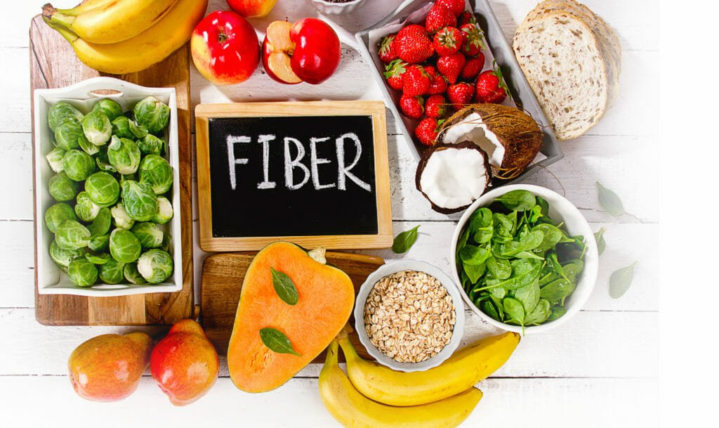
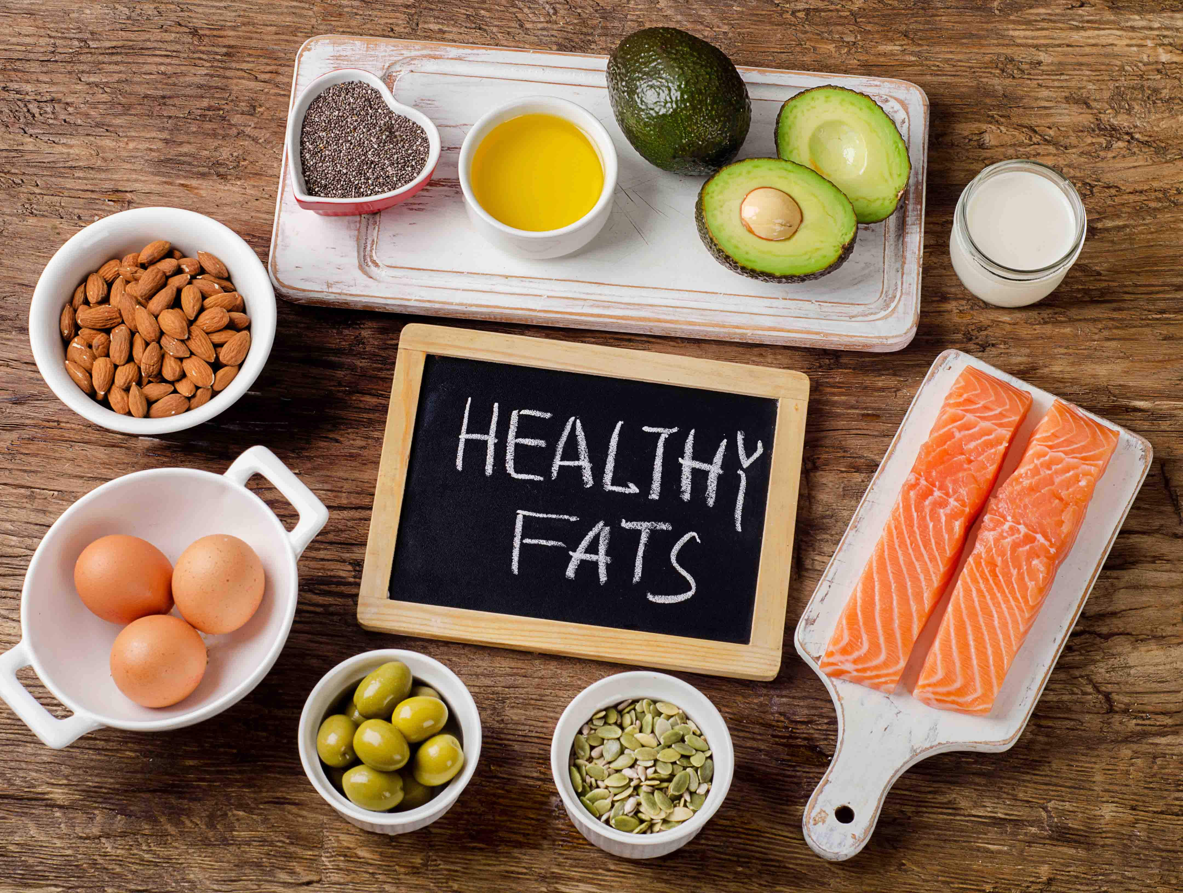
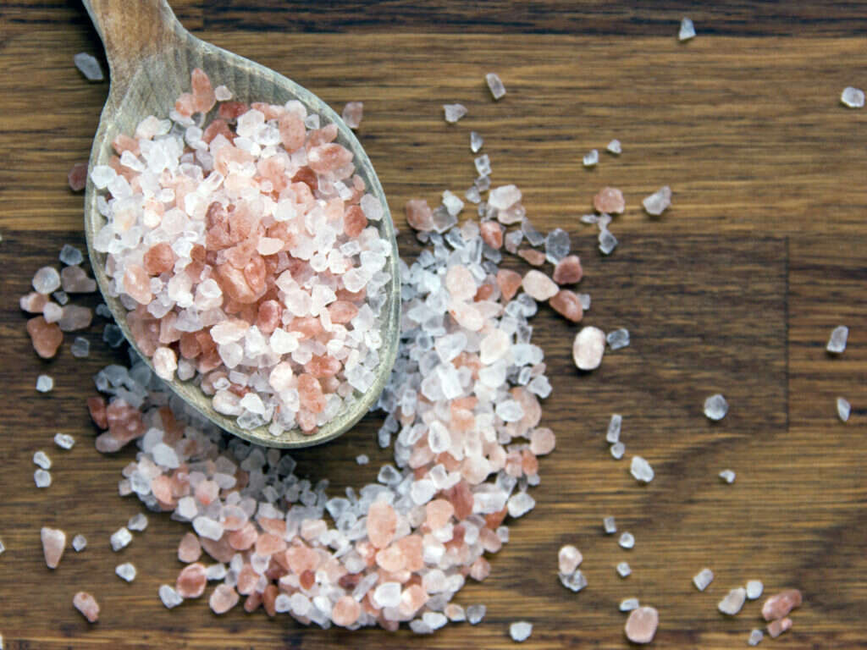
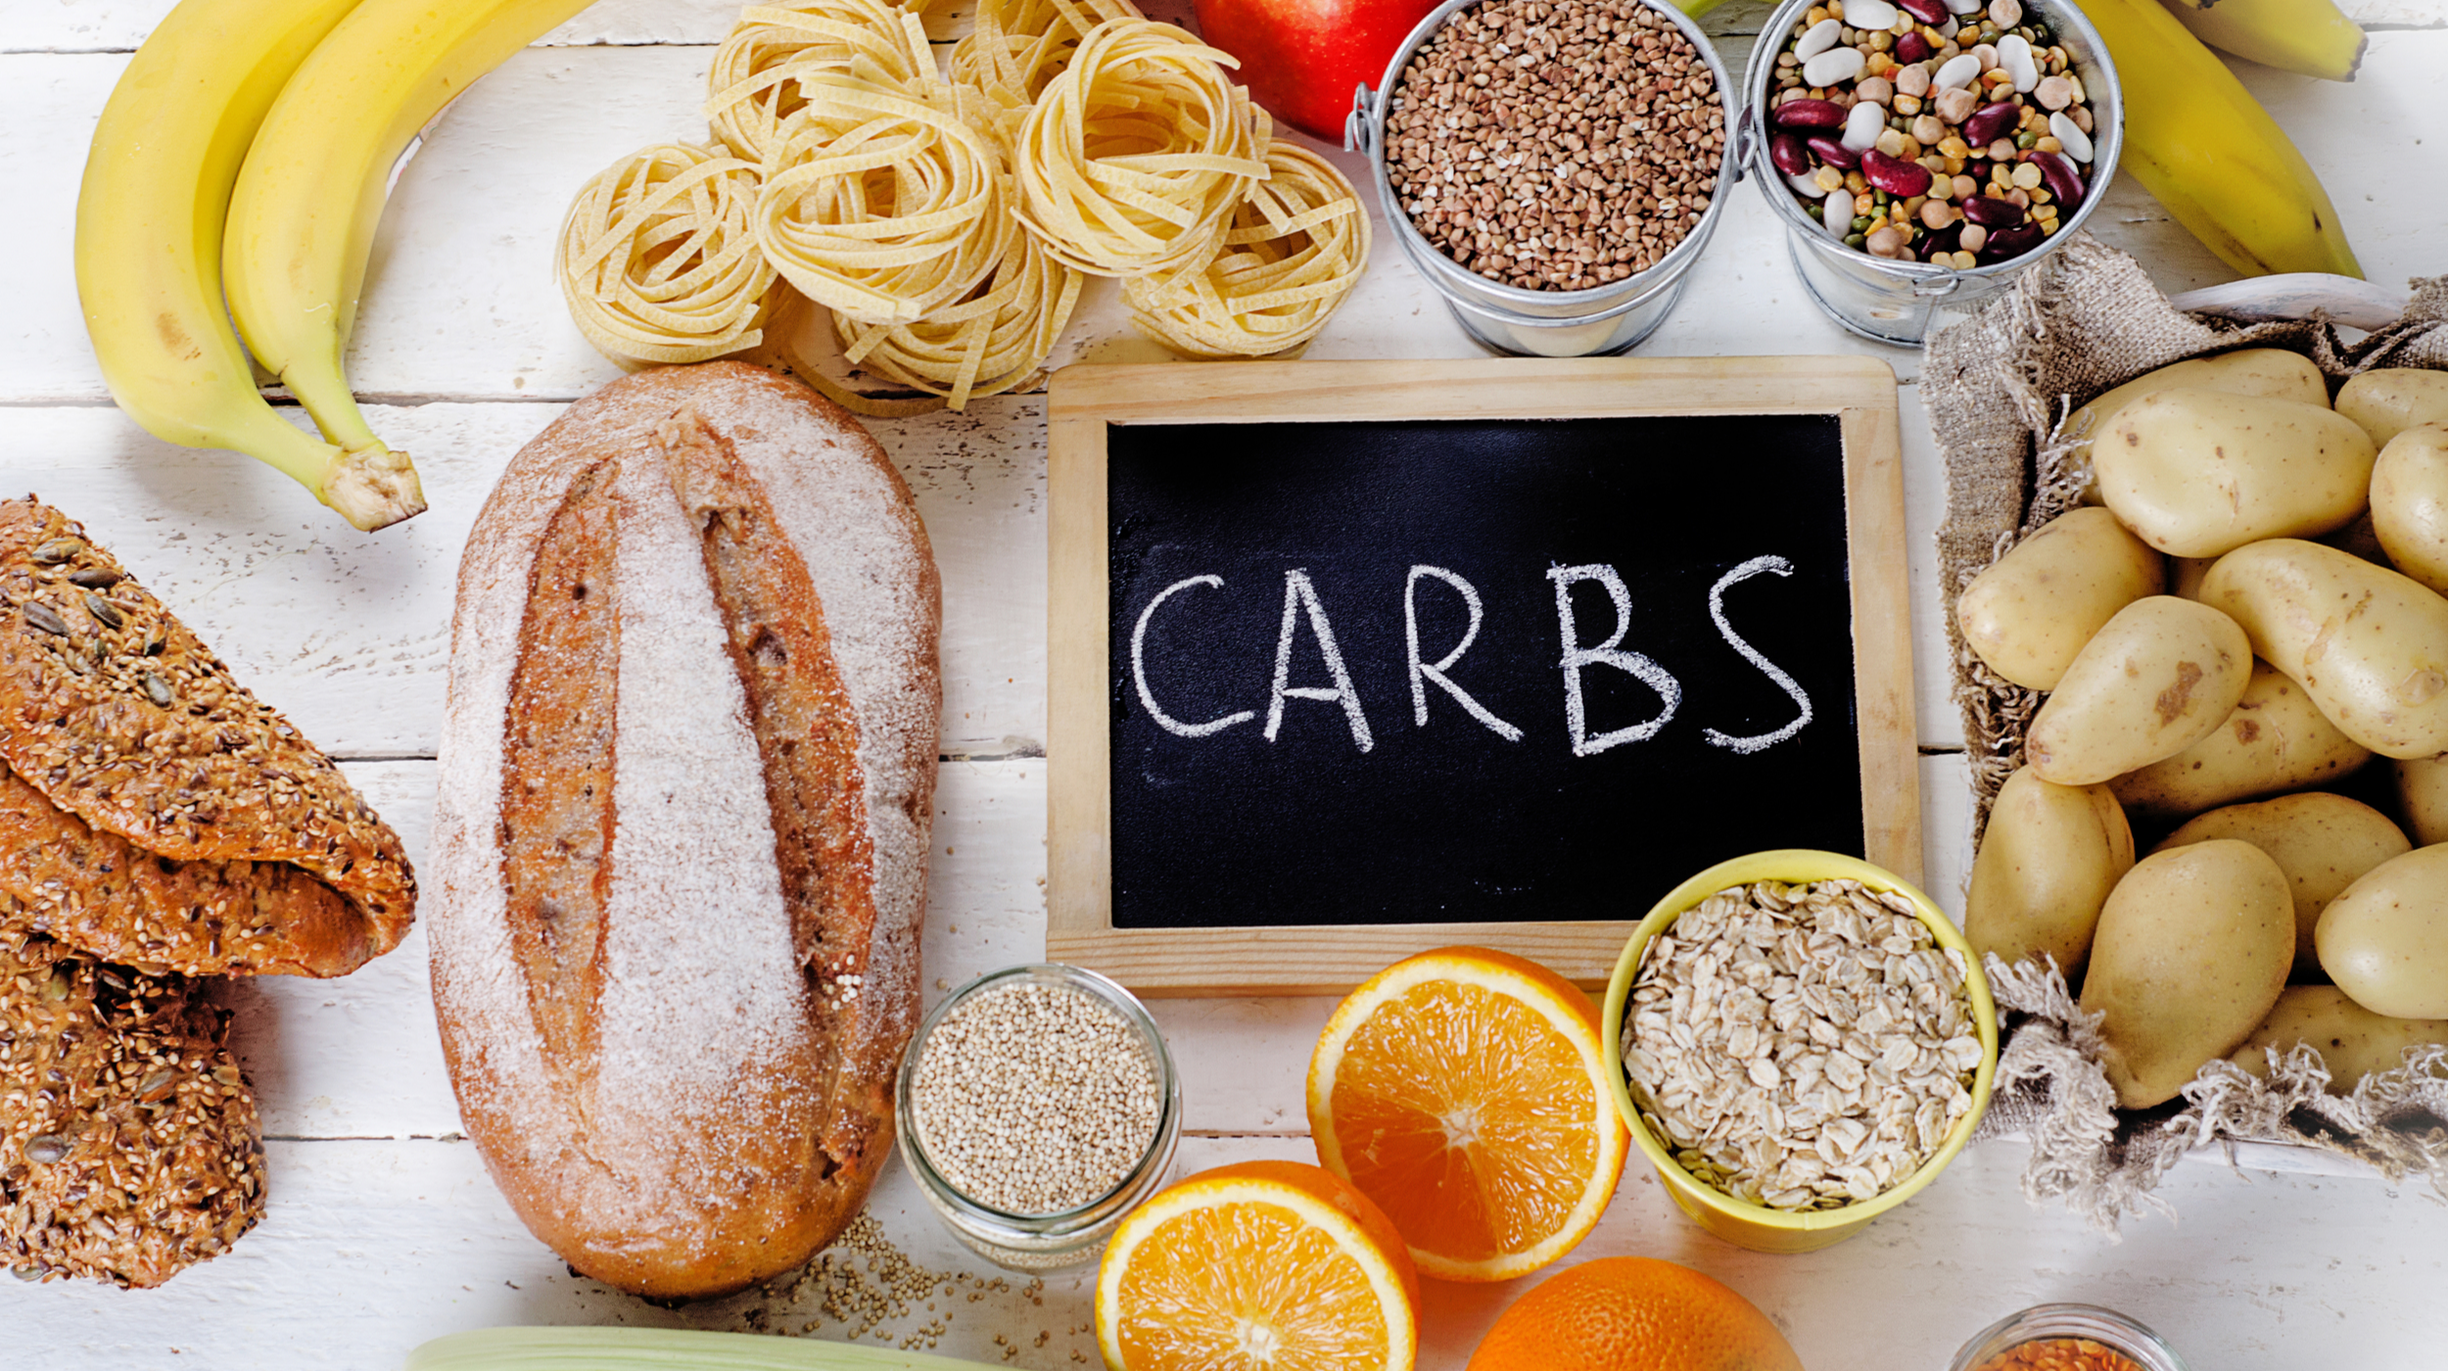
Section 2: Menu Nutrients
Carbohydrates
Fiber
Sodium
Fats
Vitamins and Minerals

Slide 38
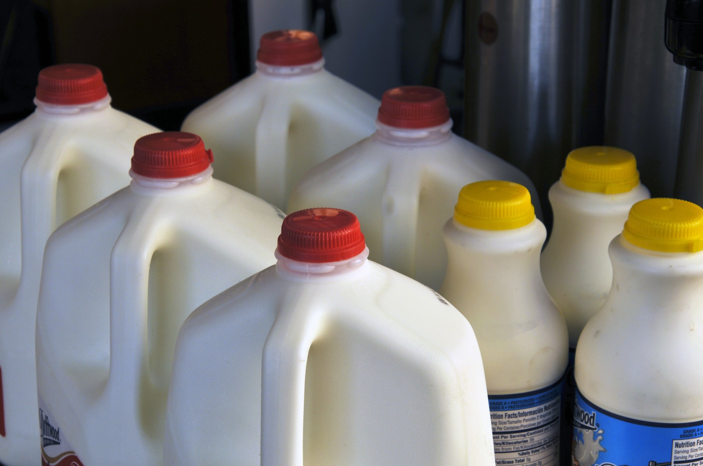
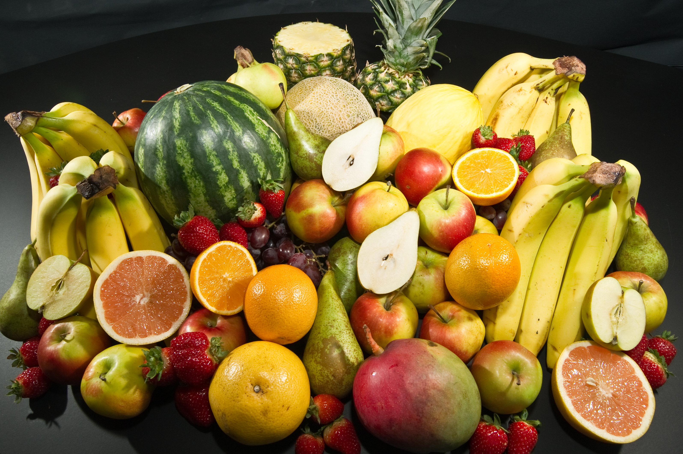
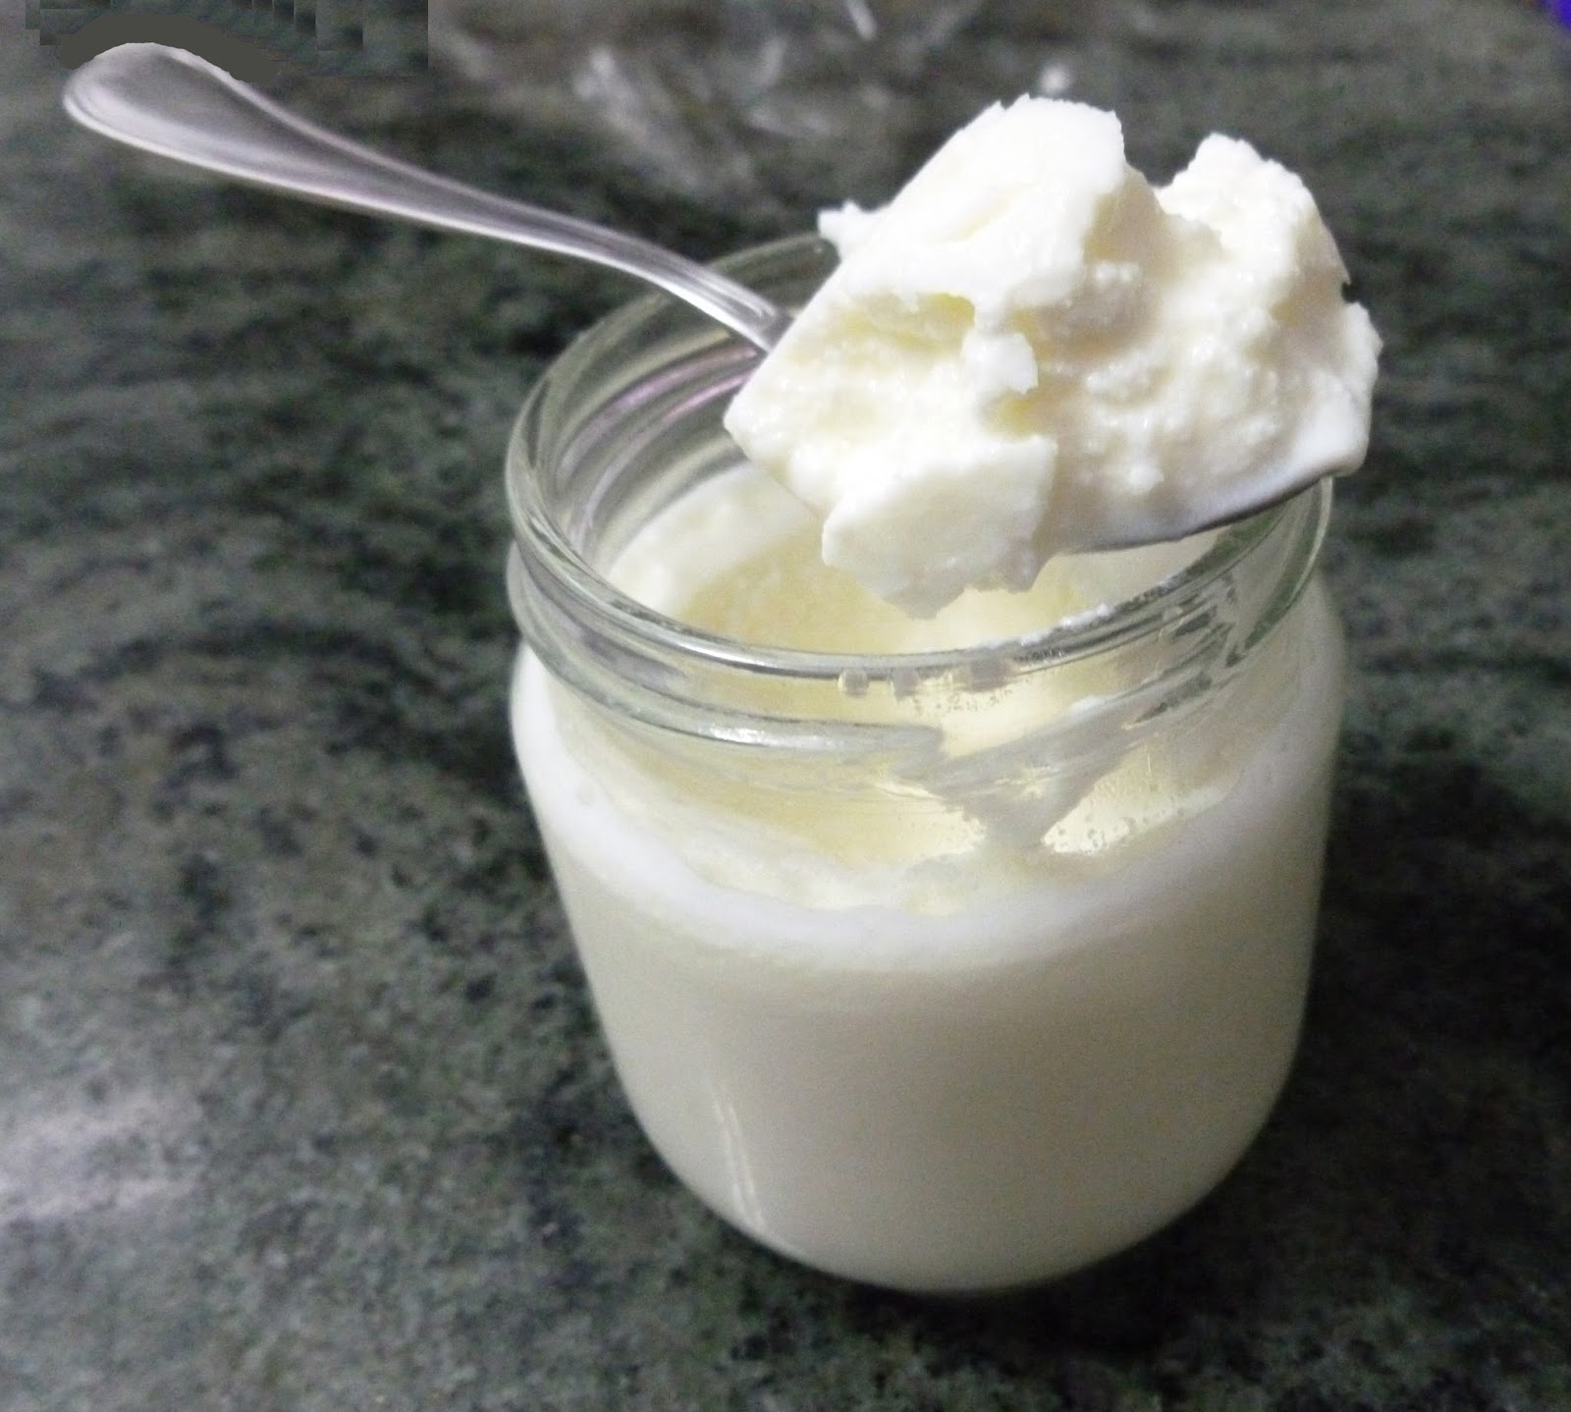
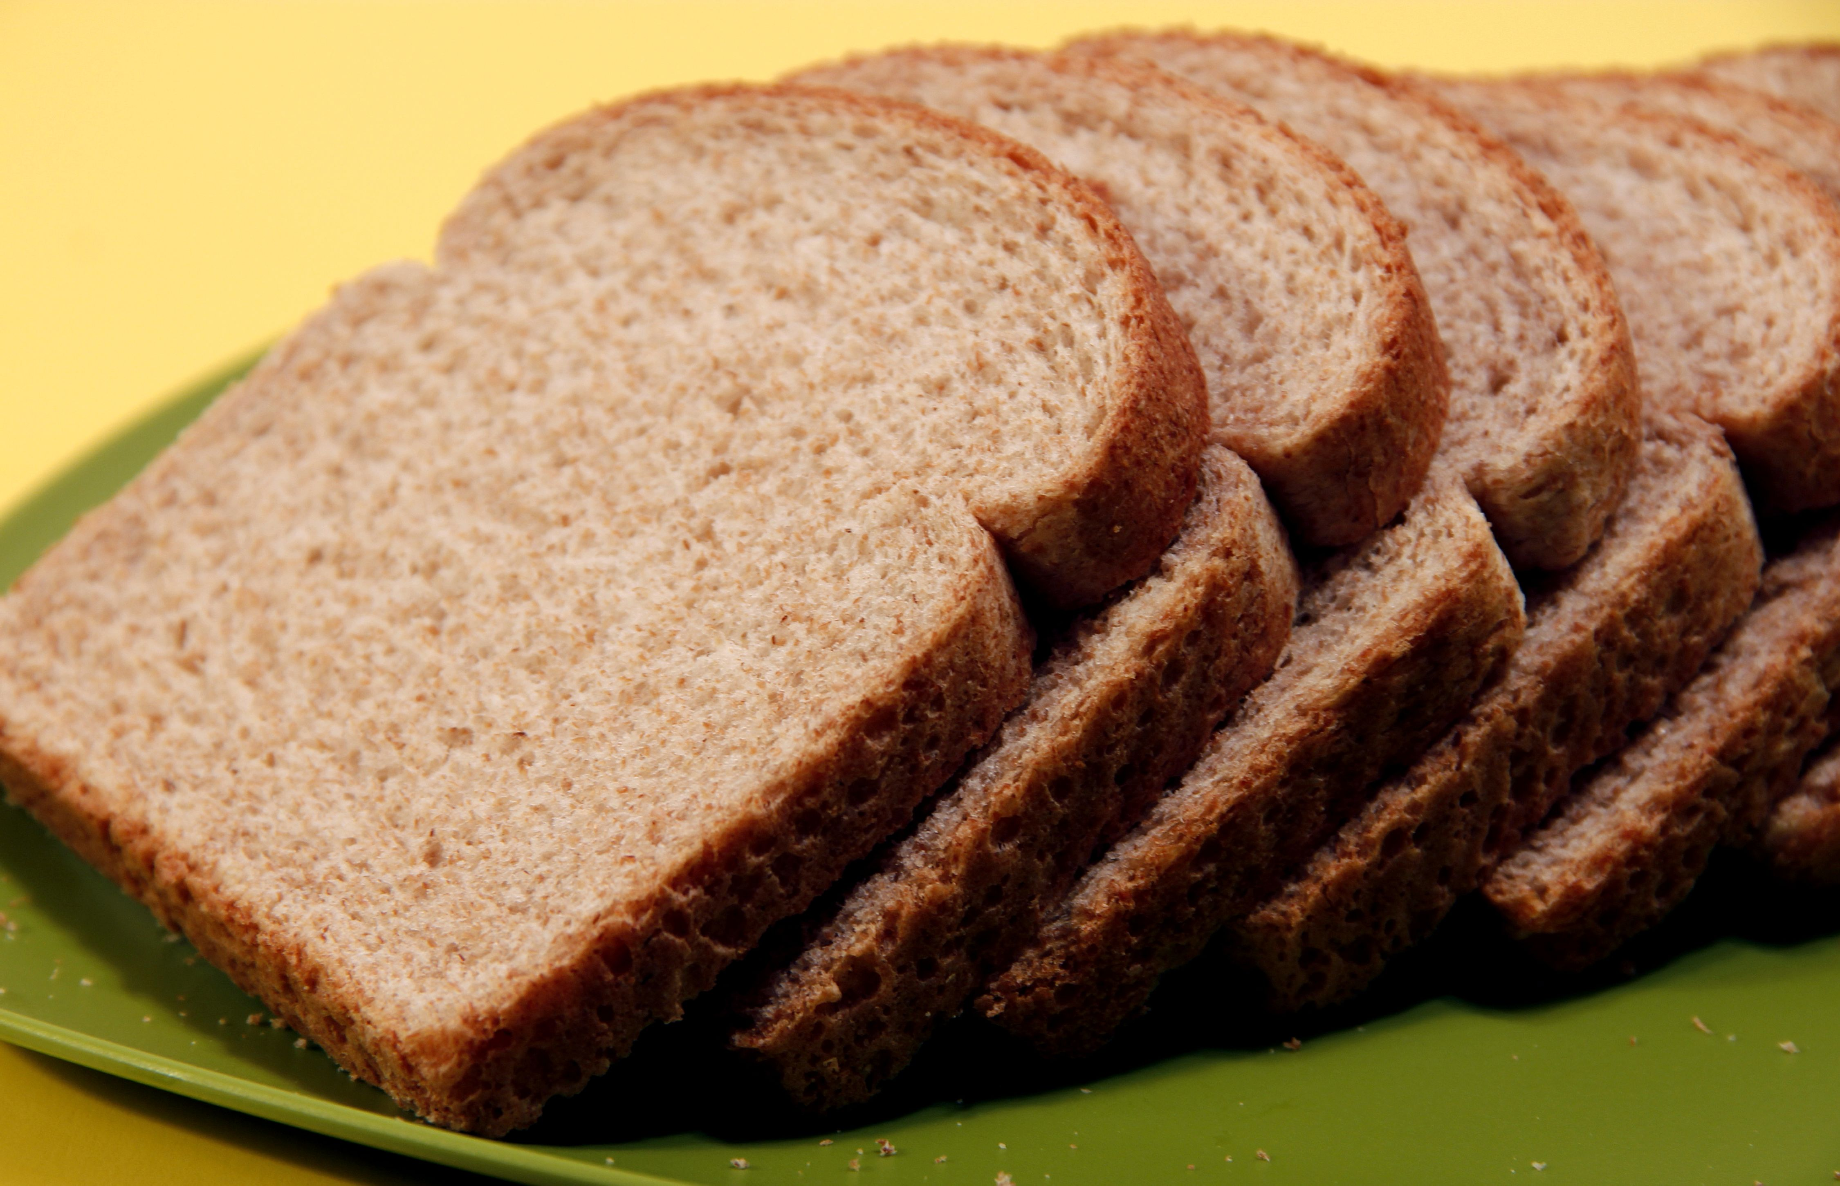
CARBOHYDRATES

Slide 39
Carbohydrates
What are carbohydrates?
Carbohydrates are sugars and starches that provide energy to all cells of the body, including the muscles, brain, and nervous system.
Notes:
Bean photo: https://www.gracefullittlehoneybee.com/slow-cooker-pinto-beans/
Donut photo: https://www.dunkindonuts.com/en/menu/donuts/product-donuts-id1001201

Slide 40
Types of Carbohydrates-Simple
Monosaccharides
Made up of 1 sugar
Examples:
Glucose (blood Sugar)
Fructose( Fruit Sugar)
Galactose
Disaccharides
Made up of two monosaccharides
Examples:
Lactose (milks and yogurt)
Sucrose
Maltose

Slide 41
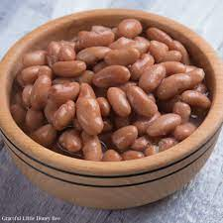
Complex Carbs
Made up long chains of three to hundreds or even thousands of sugars
Examples:
Starch
Fiber

Slide 42
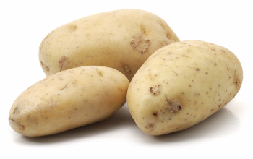
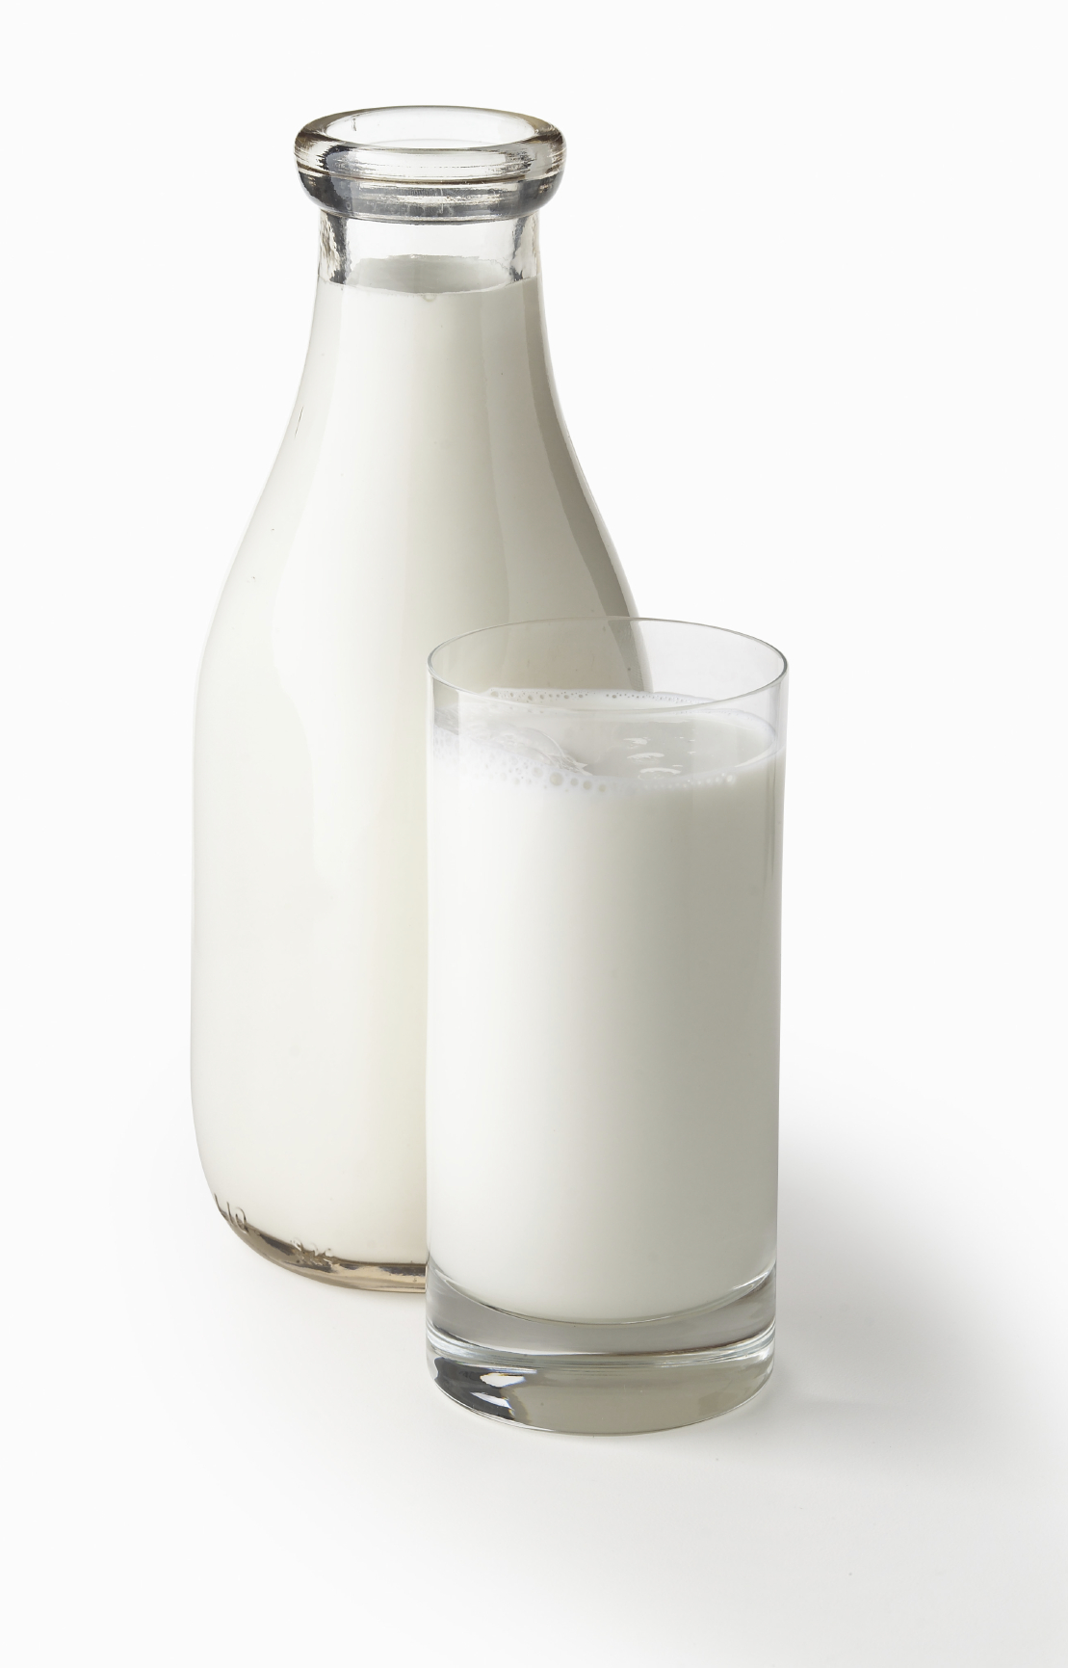
Sources of Carbohydrates
Fruit
Milk
Some Vegetables (Starchy Vegetables)
Honey
Refined sugars

Slide 43
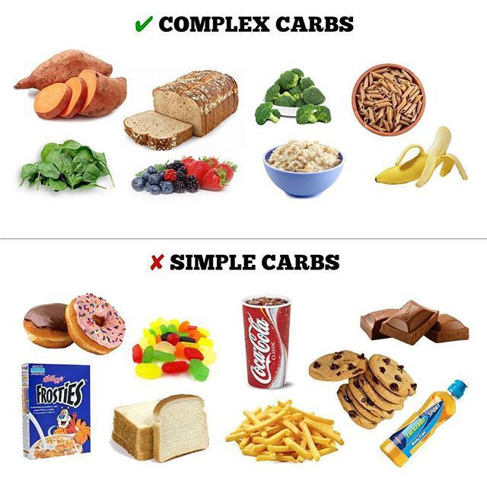
It is recommended that the majority of carbohydrates come from complex carbohydrates such as grains, vegetables, legumes, fruits, and vegetables. Carbohydrates should provide 45 – 65% of the daily calories.
Notes:
Image from https://www.drnewmed.com/blog/simple-carbs-vs-complex-carbs-whats-the-difference/

Slide 44
Common Added Sugars
Watch for words ending in “ose”
Sugar
Brown Sugar
Sucrose
Dextose
Fructose
High Fructose Corn Syrup
Invert Sugar
Maltose
Molasses
Honey
Raw Sugar

Slide 45
Carbohydrate FYI
Fuels the brain
Provides 4 calories per gram
Excess converted and stored as fat
Notes:
Institute of Child Nutrition 101 . The University of Mississippi. taste of Food and Fitness 4th Edition

Slide 46
Fiber

Slide 47
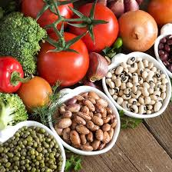
What is Fiber?
Non-digestible part of plant foods (2).
Found in:
Whole-grain products
Fruits
Vegetables
Beans, peas and other legumes
Nuts and seeds

Slide 48
Parts of a grain

Slide 50
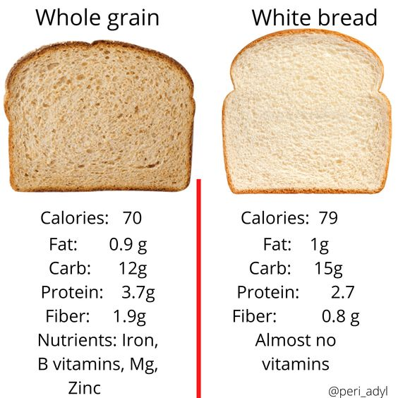

Slide 52
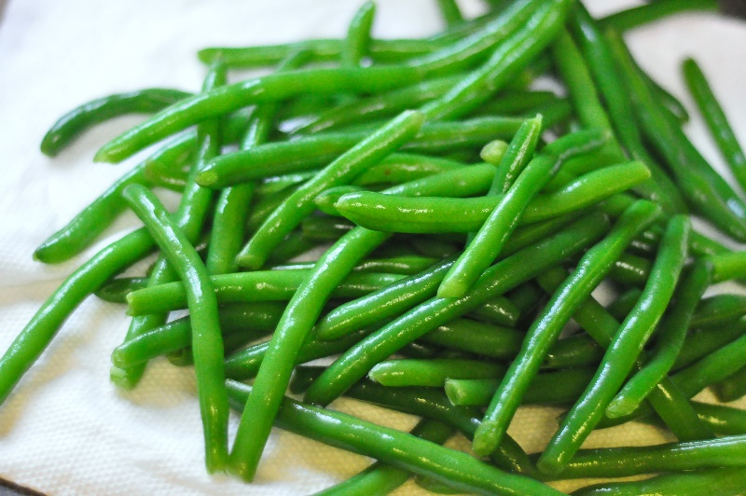
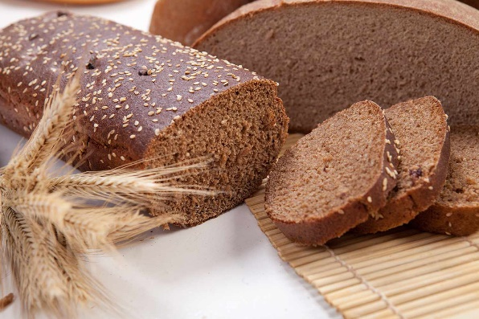
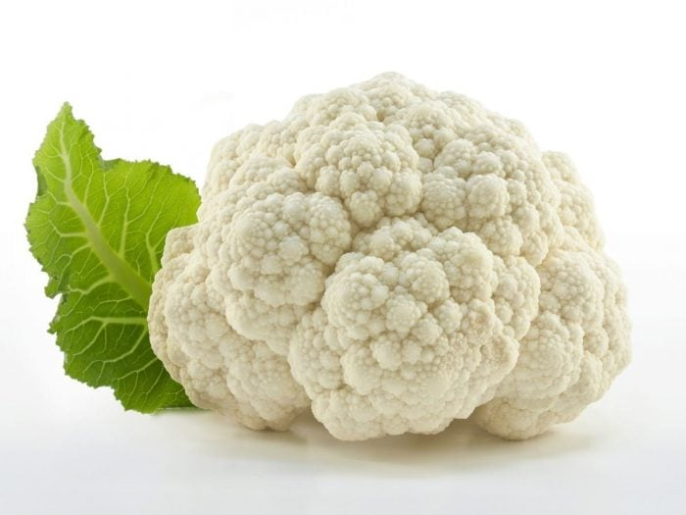
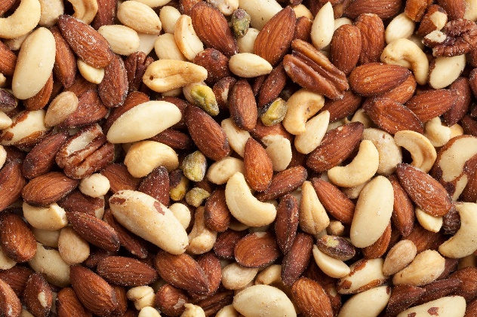
Insoluble Fiber (2
Attracts water into your stool
Keeps you regular
Found in:
Whole wheat products
Nuts
Bran
Many Vegetables

Slide 53
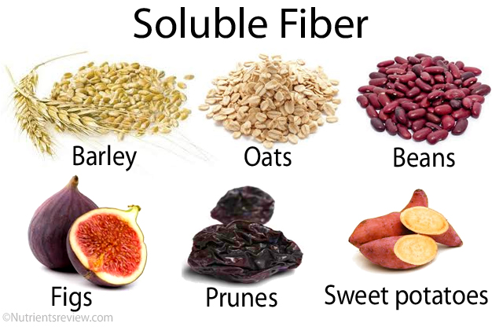
Soluble Fiber (2)
“Heart Healthy”
Found in:
Oats
Peas
Beans
Apples
Citrus Fruit
Carrots

Slide 54
Fiber Recommendations
Fiber: Daily recommendations for adults
 | Age 50 or younger | Age 51 or older
Men | 38 grams | 30 grams
Women Menu Fiber Requirement: 10 g or more fiber | 25 grams | 21 grams

Slide 55
Health Benefits of Fiber (2)
Helps to main a healthy weight
Help Control blood sugar levels
Lower cholesterol Levels
Some types of cancer
Normalizes bowel movements
Helps main bowel health

Slide 56
Refined or Processed foods (2)
Canned fruits and vegetables, pulp-free juices, white breads and pastas, and non-whole-grain cereals
are lower in fiber
The grain-refining process removes the outer coat (bran) from the grain, which lowers its fiber content.
Enriched foods have some of the B vitamins and iron added back after processing, but not the fiber.

Slide 57
Additional fiber sources
Cereal, granola bars, yogurt and ice cream, with fiber added.
usually is labeled as "inulin" or "chicory root."

Slide 58
Suggestions on how to increase fiber (2)
Switch to whole grains.
Look for breads that list whole wheat, whole-wheat flour or another whole grain as the first ingredient on the label
2 grams of dietary fiber a serving.
brown rice
wild rice
barley
whole-wheat pasta
bulgur wheat

Slide 59
Jump start your day
For Breakfast choose a high fiber cereal
5 or more grams of fiber a serving
Look for cereal that says whole grain, bran, fiber in the name
Also can add wheat bran to your cereal

Slide 60
Bulk up baked goods
Substitute whole-grain flour for half or all of the white flour when baking
Try adding crushed bran cereal, unprocessed wheat bran or uncooked oatmeal to muffins, cakes and cookies

Slide 61
Lean on legumes
Beans, peas and lentils are excellent sources of fiber.
Add kidney beans to canned soup or a green salad.
Or make nachos with refried black beans,
lots of fresh veggies,
whole-wheat tortilla chips and salsa.

Slide 62
Eat more fruit and vegetables
Fruits and vegetables are rich in fiber, as well as vitamins and minerals.
FYI: Fiber is found on the skin on skin on fruits and vegetables
Try to eat five or more servings daily

Slide 63
Fiber Supplements
Maybe needed in addition to dietary changes aren't sufficient
If they have certain medical conditions, such as constipation, diarrhea or irritable bowel syndrome.
Check with your doctor before taking fiber supplements.

Slide 64
Caution with fiber
High-fiber foods are good for your health.
But adding too much fiber too quickly can promote intestinal gas, abdominal bloating and cramping.
Increase fiber in your diet gradually over a few weeks.
This allows the natural bacteria in your digestive system to adjust to the change.

Slide 65
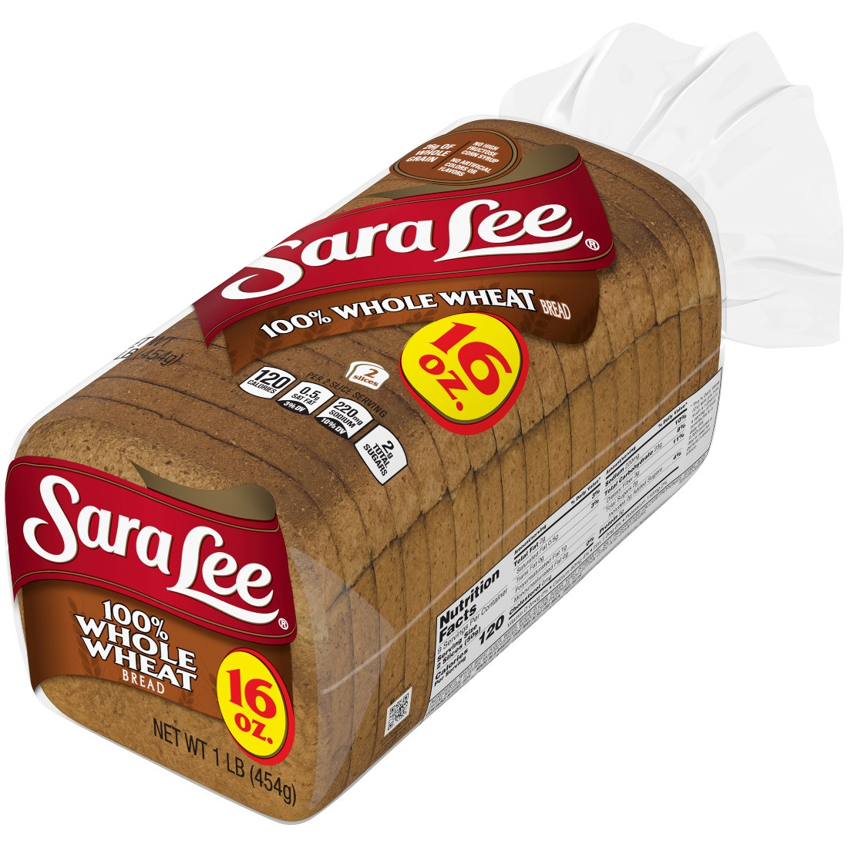
Food label examples
Ingredients
Whole Wheat Flour, Water, Wheat Gluten, Sugar, Yeast, Soybean Oil, Salt, Preservatives [Calcium Propionate, Sorbic Acid], Datem, Natural Flavors, Monoglycerides, Monocalcium Phosphate, Soy Lecithin, Citric Acid, Grain Vinegar.

Slide 66
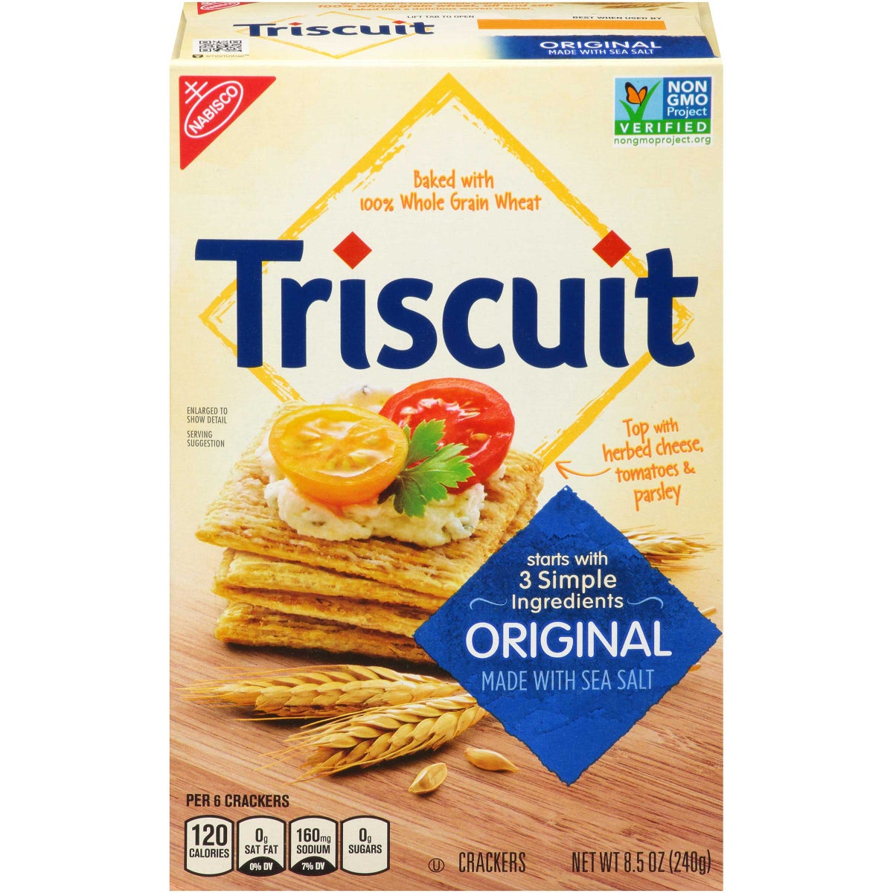
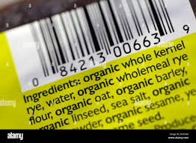

Slide 67
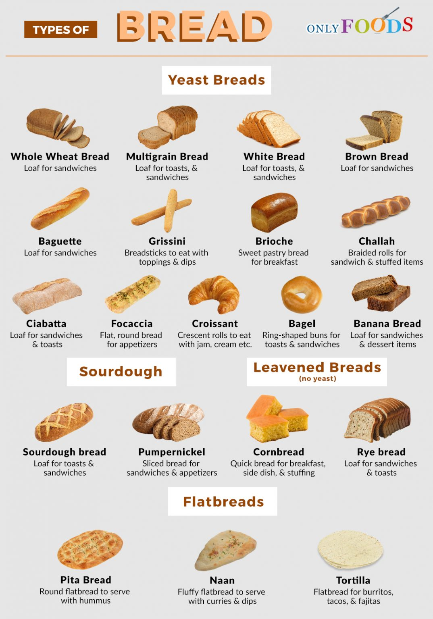
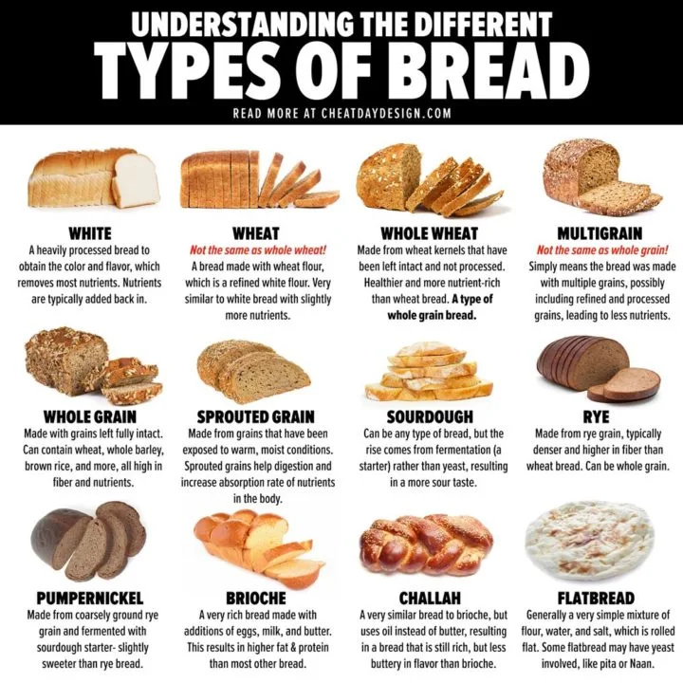

Slide 68
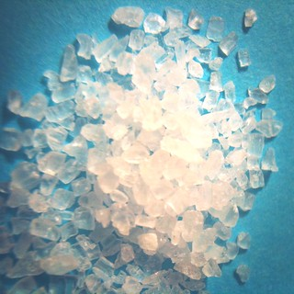
Sodium

Slide 69
Sodium Requirements
The American Heart Association recommends no more than 2,300 milligrams (mg) a day and moving toward an ideal limit of no more than 1,500 mg per day for most adults (3).
Most American consume >3400mg a day
Sodium Requirement is based on 2300milligrams, 1/3 requirement: 766mg

Slide 70
The role of the sodium in the body:
The balance of fluids in your body
The way nerves and muscles work

Slide 71
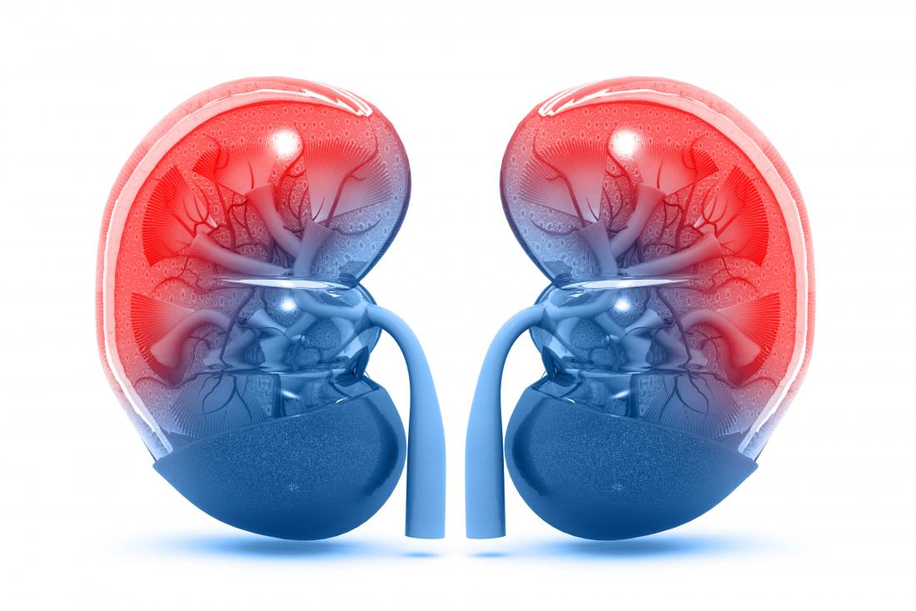
Sodium and Kidneys (4):
The kidneys balance the amount of sodium in
the body.
When sodium is low, the kidneys hold on to it.
When sodium is high, the kidneys release some in urine.
If the kidneys can't eliminate enough sodium, it builds up in the blood.
Sodium attracts and holds water, so the blood volume increases. The heart must work harder to pump blood, and that increases pressure in the arteries.
Over time this can increase the risk of heart disease, stroke and kidney disease.

Slide 72
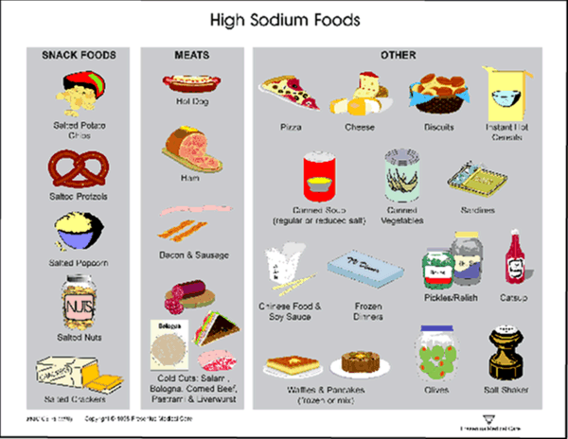
Where is sodium found:
Processed foods or prepared foods
Bread
Pizza
Cold Cuts
Bacon
Cheese
Soups
Fast Food
Prepared dinners-pasta, meat and egg dishes

Slide 73
Salt is also found naturally in foods:
All vegetables
Dairy products,
Meat
Shellfish
While these foods don't have an abundance of sodium, eating them does add to your overall body sodium content.
For example, 1 cup (237 milliliters) of low-fat milk has about 100 mg of sodium.

Slide 74
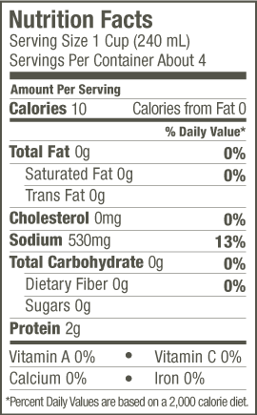
Sodium on a food label

Slide 75
Other names for salt (4)
Monosodium glutamate (MSG)
Baking soda (also called sodium bicarbonate)
Baking powder
Disodium phosphate
Sodium alginate
Sodium citrate
Sodium nitrite
Try to avoid products with more than 200 mg of sodium per serving. And be sure you know how many servings are in a package — that information is also on the Nutrition Facts label.

Slide 76
Sodium Lingo (3)
Sodium-free or salt-free. Each serving in this product contains less than 5 mg of sodium.
Very low sodium. Each serving contains 35 mg of sodium or less.
Low sodium. Each serving contains 140 mg of sodium or less.
Reduced or less sodium. The product contains at least 25% less sodium than the regular version.
Lite or light in sodium. The sodium content has been reduced by at least 50% from the regular version.
Unsalted or no salt added. No salt is added during processing of a food that normally contains salt. However, some foods with these labels may still be high in sodium because some of the ingredients may be high in sodium.

Slide 77
How to cut back on Sodium (4)

Slide 78
Eat more fresh foods
Most fresh fruits and vegetables are naturally low in sodium.
Fresh meat is lower in sodium than are lunchmeat, bacon, hot dogs, sausage and ham
Buy fresh or frozen poultry or meat that hasn't been injected with a sodium-containing solution. Look on the label

Slide 79
Choose low-sodium products
If you buy processed foods, choose ones that are labeled low sodium. Better yet, buy plain, whole-grain rice and pasta instead of products that have added seasonings.

Slide 80
Eat at home
Restaurant foods and meals are often high in sodium. One entree may be at or above your daily limit.

Slide 81
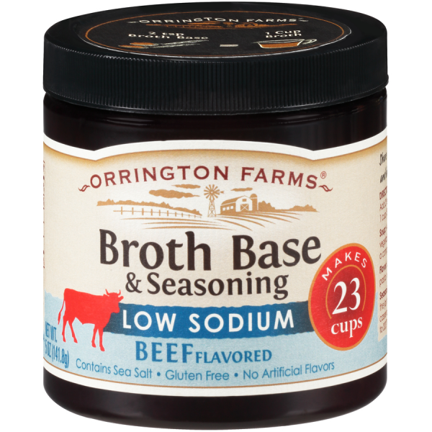
Remove salt from recipes whenever possible.
You can leave out the salt in many recipes, including casseroles, soups, stews and other main dishes that you cook
Use low sodium broths

Slide 82
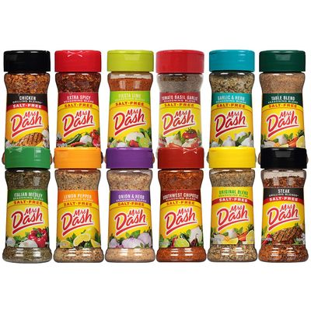
Replace salt with herbs, spices and other flavorings.
Use fresh or dried herbs, spices, and zest and juice from citrus fruit to jazz up your meals.

Slide 83
Go easy on the condiments
Soy sauce, salad dressings, sauces, dips, ketchup, mustard and relish all contain sodium.

Slide 84
Take your time to use less salt
Salt is an acquired taste
Decrease your salt intake gradually and taste buds will adjust
Start by using no more than 1/4 teaspoon of salt daily — at the table and in cooking.

Slide 85
Resources- available on NM-AAA website
DASH Diet Handouts (Dietary Approaches to Stop Hypertension)
DASH Eating Plan
A week with the DASH Eating Plan
Getting Started
Making the Move to DASH
Tips to Reduce Salt and Sodium
Why DASH works
ACL Handouts:
Create a Flavor Station
Managing Sodium in Meals and Menus
Sodium Reduction Toolkit Reference List

Slide 87
FAT FACTS
Fat is one of the macronutrients
(Carbohydrates, Protein, and Fats)
Fat is a source of energy providing 9 calories per gram
Fats are needed to absorb Vitamins A, D, E and K
Fats support cell growth
Fats protect our organs and provide insulation
Notes:
Fats get a lot of negative attention, however, fats are important in a healthy diet.

Slide 88
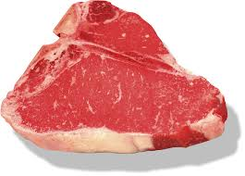
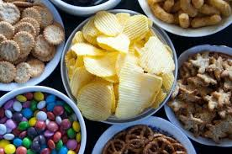
Let’s talk about the types of fat
Saturated fats tend to stay solid at room temp (includes trans fats) Their chemical structures are “saturated” with hydrogen atoms.
Examples of foods that contain saturated fats are animal meats, dairy products, processed meats, and some prepackaged snacks and desserts.
EAT LESS OF THESE
Notes:
Trans fats = hydrogen added to vegetable oil so that it becomes a solid at room temperature (hence partially hydrogenated oil).

Slide 89
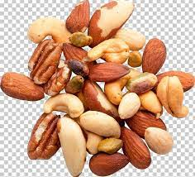
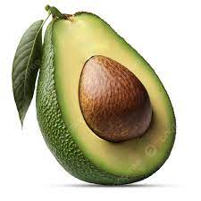
AND eat more of these
Unsaturated fats tend to stay liquid at room temperature. Their structures have one or more double bonds.
Monounsaturated fats have one double bond giving it a bent structure.
Polyunsaturated fats have more than one double bond making it even more bent.
Examples of foods that contain unsaturated fats are nuts, olives, avocados, plant oils, and some fish such as salmon.

Slide 90
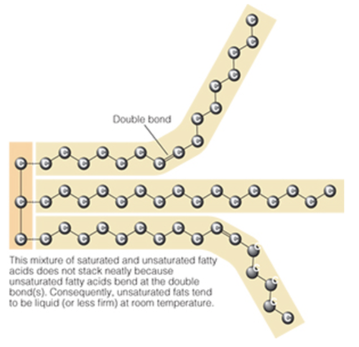
The Difference in Chemical Structures
Saturated Fat
Unsaturated Fat

Slide 91
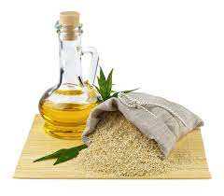
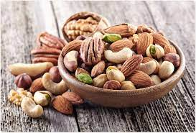
Notes:
Let’s look at the different fats all together with some examples.

Slide 92
It’s all about making good choices!
Saturated fats raise cholesterol levels in the bloodstream which increases the risk of heart disease and have links to an increased risk of Alzheimer’s disease and dementia.
Trans fats raise bad cholesterol and lower good cholesterol.
LDL = Low-density lipoprotein (bad cholesterol)
HDL = High-density lipoprotein (good cholesterol)
Triglycerides = fat cells that circulate in the bloodstream and are stored.
Replacing saturated fats with monounsaturated fats in the diet may lower the level of bad cholesterol and triglycerides. Monounsaturated fats from plants may support heart health and blood sugar regulation.

Slide 93
Notes:
3-in-1 beverage example is instant coffee, sugar, and powdered creamer. The difference between Tallow and Lard is Tallow is made from beef fat and lard made from pork fat.
Picture from https://www.pharmacy.nhg.com.sg/all-about-fat-3

Slide 94
Too much fat can increase the risk of cardiovascular disease.
Limiting fat too severely may lead to weight loss and/or nutrient deficiency.
American Heart Association recommends a goal of 5% to 6% of daily calories from saturated fats.
DRI of Total Fat 49-86 g
25-35% of total kcals
DRI of saturated fat is 24g
1/3 requirement is 8 g

Slide 95
Recommendations
The Dietary Guidelines for Americans 2020 -2025 recommends choosing:
low-fat or fat-free milk instead of full fat dairy products
lean cut meats rather than fatty cuts
using canola or olive oil instead of butter or coconut oil
replace regular cheese with “oils” such as nuts, seeds, or avocado
(example: almond butter)
reading the Nutrition Facts labels

Slide 96
20% or more of the Daily Value is considered high
The Food and Drug Administration (FDA) requires that total fat, as well as saturated and trans fat be listed on food labels
Remember to read the label !!!
Notes:
We learned from previous trainings that 20% of daily value or more is considered high. Make sure to read the labels and pay attention to the serving sizes.
https://www.researchgate.net/figure/Sample-Nutritions-Facts-Panel-on-a-food-label-in-the-United-States_fig2_5588296

Slide 97
VITAMINS AND MINERALS

Slide 98
Vitamins and Minerals
Vitamins and minerals are micronutrients that are used to carry out normal body functions.
There are two types of vitamins:
Fat-Soluble Vitamins = dissolve in fat and can be stored in the body
A,D,E,K
Water-Soluble Vitamins = dissolve in water before they can be absorbed in the body and cannot be stored
B and C

Slide 99
Minerals
Minerals are elements in soil and water. Plants absorb minerals which are then eaten by animals. Some minerals are required in larger amounts than others (trace minerals).
Although the micronutrients don’t give us energy, they are involved in many metabolic processes.
The Older Adults Act (OAA) has requirements for many of the micronutrients.

Slide 100
Vitamin A
Why do we need Vitamin A?
Helps promote a healthy immune system helps keep our skin healthy
supports reproduction and growth
supports eye health
The DRI for people 51 and older is 900 mcg of Vitamin A.

Slide 101
Vitamin C
Why do we need Vitamin C?
supports a healthy immune system
helps control infections
helps heal wounds
helps make some hormones and chemical messengers used in the brain and nerves
needed to make collagen
The DRI for people 51 and older is 90 mg of Vitamin C.
Notes:
Citrus fruits are oranges, kiwi, lemon, grapefruit
Cruciferous veggies are broccoli, brussels sprouts, cabbage, cauliflower.

Slide 102
Vitamin B12
Why do we need Vitamin B12?
needed to form red blood cells
needed to form DNA
helps development of brain and nerve cells

Slide 103
Calcium
Why do we need Calcium?
supports healthy bones and teeth
plays a role in blood clotting
helps muscles contract
regulates normal heart rhythms
regulates normal nerve functions
Notes:
Calcium is a mineral

Slide 104
Iron
Why do we need Iron?
helps maintain healthy blood
major component of hemoglobin
part of myoglobin
supports healthy brain development and growth in children
Food Sources:
Oysters, clams, mussels
Beef and chicken liver
Organ meats
Canned sardines
Beef
Poultry
Canned Light Tuna
Beans and Lentils
Spinach
Potato with skin
Nuts and Seeds
Enriched rice and bread
Dark Chocolate
Fortified Breakfast Cereals
The DRI for people 51 and older is 10 mg of Iron.
Notes:
Hemoglobin is a type of protein in red blood cells that carry oxygen from the lungs to all other parts of the body.
Myoglobin is a protein that carries and stores oxygen in muscle tissue.

Slide 105
Thiamin (B1)
Why do we need Thiamin?
supports growth and function of cells
helps converts food into energy
supports a healthy nervous system
The DRI for people 51 and older is 1.2 mg of Thiamin.

Slide 106
Niacin (B3)
Why do we need Niacin?
helps convert food into energy
helps create cholesterol and fats
helps create and repair DNA

Slide 107
Riboflavin (B2)
Why do we need Riboflavin?
helps convert food to energy
assists in breaking down of fats, steroids and medications
involved in cell growth
Food Sources:
dairy milk
yogurt
Cheese
eggs
lean beef and pork
organ meats
chicken breasts
salmon
almonds
spinach
fortified cereal and bread
The DRI for people 51 and older is 1.3 mg of Riboflavin.

Slide 108
Phosphorus
Why do we need Phosphorus?
is a key element of bones, teeth, and cell membranes
activates enzymes
keeps blood pH in normal range
regulates nerve and muscle function
Food Sources:
dairy: milk, yogurt, cheese
salmon
beef
poultry
pork
legumes
nuts and seeds
whole wheat breads and cereals
asparagus, tomatoes, cauliflower
some processed foods such as deli meat, bacon, soda
The DRI for people 51 and older is 700 mg of Phosphorus.

Slide 109
References
Mayo Clinic Staff. Trans fat is double trouble for heart health. Available at: https://www.mayoclinic.org/diseases-conditions/high-blood-cholesterol/in-depth/trans-fat/art-20046114 Accessed on September 25, 2023.
Mayo Clinic Staff. Dietary fat: Know which to choose. Available at: https://www.mayoclinic.org/healthy-lifestyle/nutrition-and-healthy-eating/in-depth/fat/art-20045550 Accessed on September 27, 2023.
Dietary Guidelines for Americans. 2020-2025. Make Every Bite Count with the Dietary Guidelines. Available at: Dietary Guidelines for Americans, 2020-2025. Accessed on September 25, 2023.
The Nutrition Source. Vitamin A. Available at: https://www.hsph.harvard.edu/nutritionsource/vitamin-a/ Accessed on September 26, 2023.
The Nutrition Source. Vitamin C. Available at: https://www.hsph.harvard.edu/nutritionsource/vitamin-c/ Accessed on September 26, 2023.
Bernstein, M. and Munoz, N. (2020) Nutrition for the Older Adult, 3rd Edition.

Slide 110
Provider portal will be password protected soon
Will notify providers of date
January 2, 2024 OLD GN approved menus will be removed from website

Slide 113
References
Dietary Guidelines for Americans. 2020-2025. Make Every Bite Count with the Dietary Guidelines. Available at: Dietary Guidelines for Americans, 2020-2025. Access on January 10,2023.
Mayo Clinic Staff. Healthy Lifestyle: Nutrition and healthy eating. Available at: Dietary fiber: Essential for a healthy diet - Mayo Clinic. Accessed on January 10, 2023.
American Heart Association. How much sodium should I eat per day? Available at: https://www.heart.org/en/healthy-living/healthy-eating/eat-smart/sodium/how-much-sodium-should-i-eat-per-day. Accessed on January 10, 2023.
Mayo Clinic Staff Healthy Lifestyle: Nutrition and Healthy Eating: Sodium: how to tame your salt habit. Available at: https://www.mayoclinic.org/healthy-lifestyle/nutrition-and-healthy-eating/in-depth/sodium/art-20045479. Accessed on January 10, 2023.

