Slide 1
Food Service 101 (Back to basics) NMAAA Training #3
Constance Rudnicki MS, RDN, LD
Registered Dietitian/Nutritionist
Non-Metro Area Agency on Aging

Slide 2
Objectives:
Understand
The learner will understand portion control and why it is important
Understand
The learner will understand portion control utensils and which ones to use
Know
The learner will know how to do a recipe conversion
Know
The learner will know what ergonomics is
Know
The learner will know proper standing, driving and sitting posture

Slide 3
Part 1: Portion Control

Slide 4
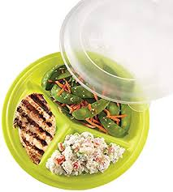
What is portion control?
Portion control means getting the right number of servings from a recipe and serving the right amount
Portion sizes are just as an important part of the production function
Some portions sizes are included in the product:
Chicken breasts
Fish
Fresh fruit
Canned Fruit pcs (Dole Fruit snacks)
Packaged items (cheese sticks, jello, etc)

Slide 5
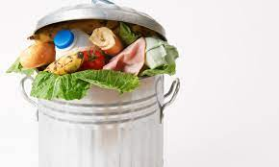
Why is portion control important?
Control Costs
Minimize Waste
Guide the ordering of food and preparation of food
Contributing factor in giving a consistent yield and portion size
Customers know exactly how much food they are going to get
Consistency

Slide 6
Portion Control Issues
Senior that are recovering, have certain medical condition, or simply need to watch their food intake
Too much or too little food can result in unplanted weight loss or weight gain
Seniors will get confused on what a correct portion is
Seniors will compare what they received to what others receive and notice it is different

Slide 7
Portion Control Issues Con’t
Serving too little can result in leftover food-food waste
Serving too much can result in running out of food
Serving too much can result in higher than necessary food costs

Slide 8
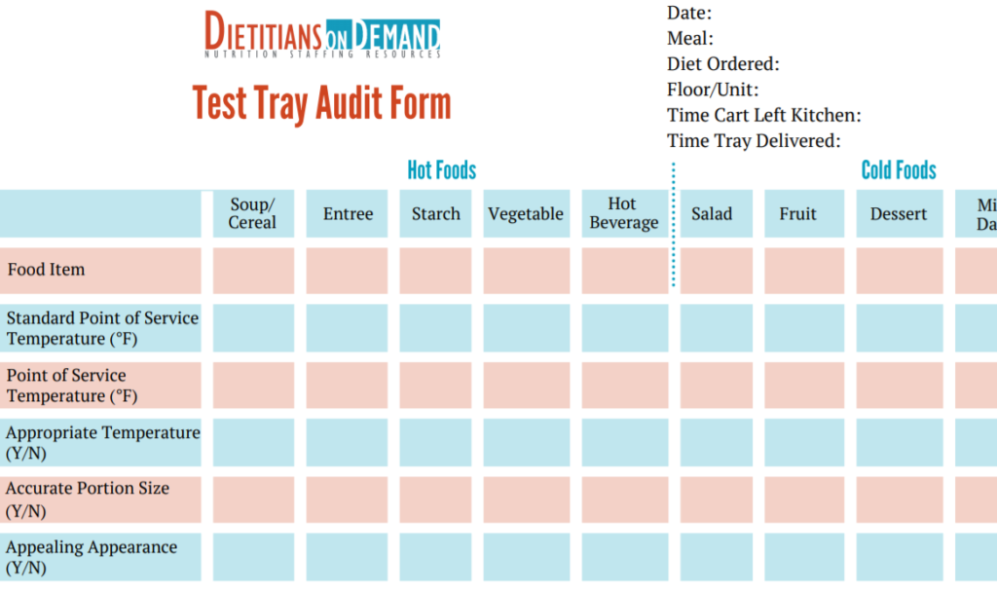
Assuring Tray Accuracy and Portion Control
Know what scoops to use for each food item

Slide 9
Example of Portion Control Cheat Sheet

Slide 11
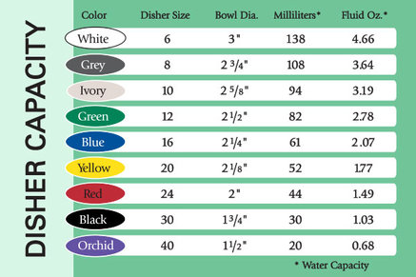
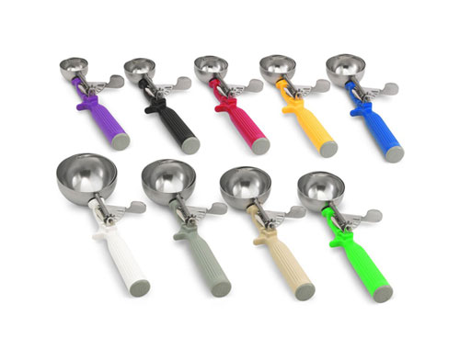

Slide 12
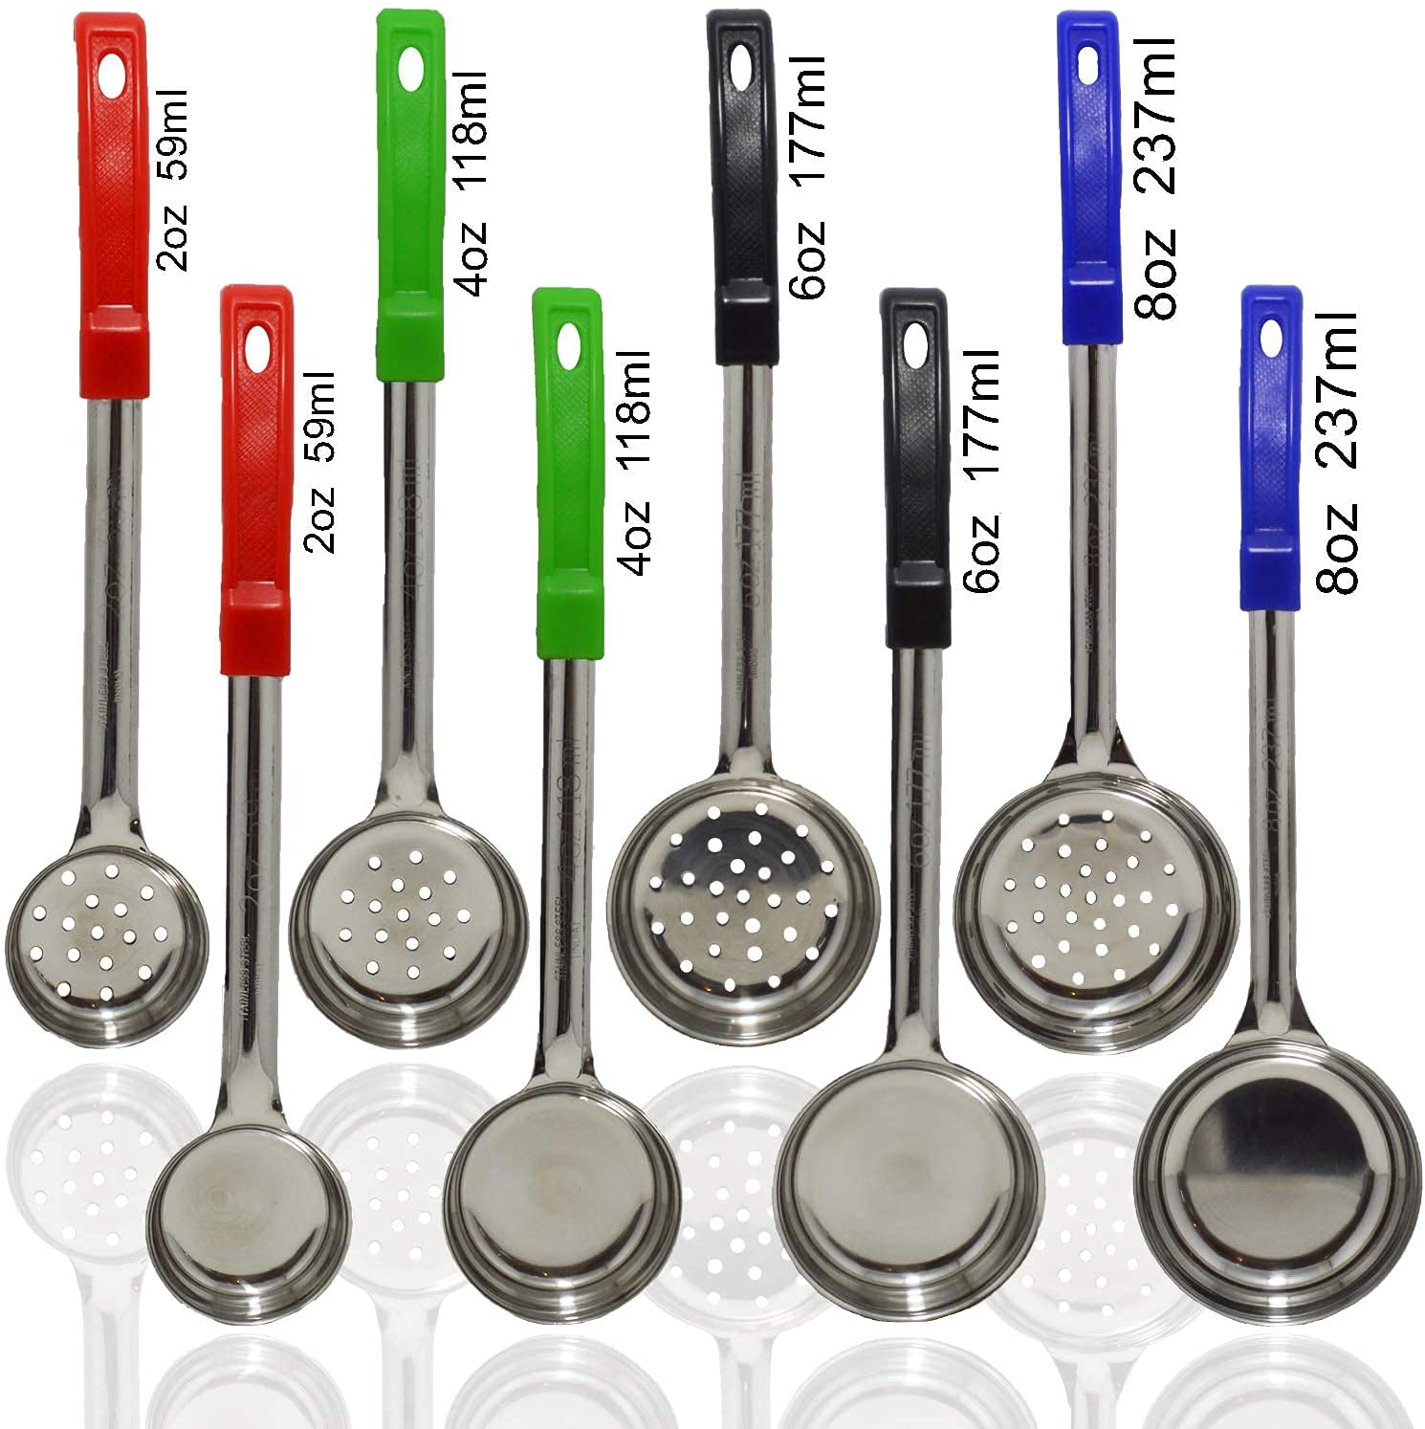

Slide 13
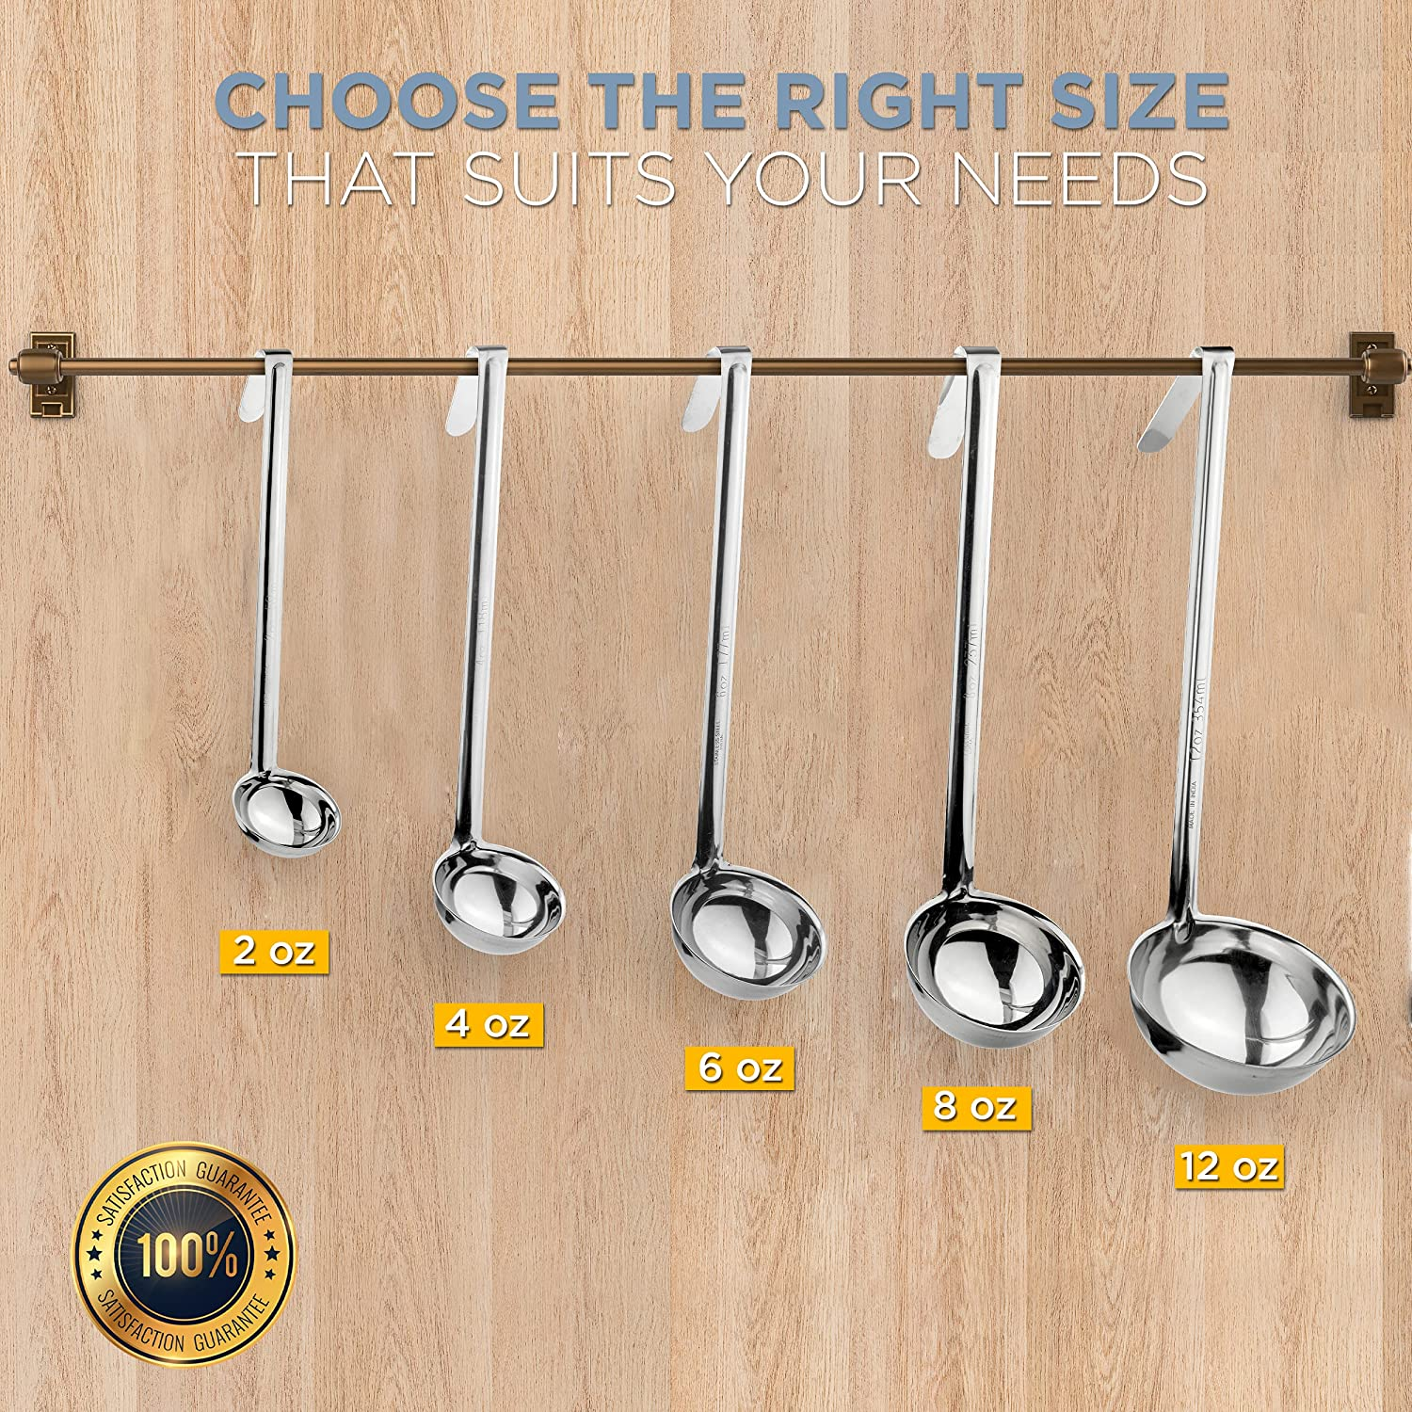

Slide 14
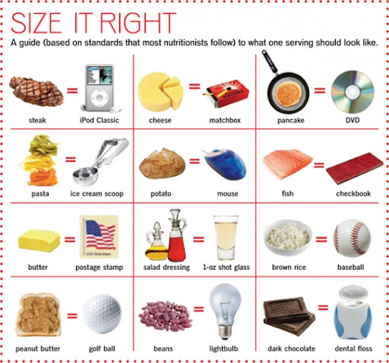

Slide 15
Methods of Portion Control
Cutting-Method of dividing food into uniform pieces before it is placed on the serving line
Meatloaf, cakes, brownies
Measuring-Method of portioning food on the serving line that involves the use of scoops, dishers, ladles, spoodles
Counting-Method used for chicken, hamburger patties, fish, fresh fruits, vegetable sticks, crackers, roll, biscuits, and cookies

Slide 16
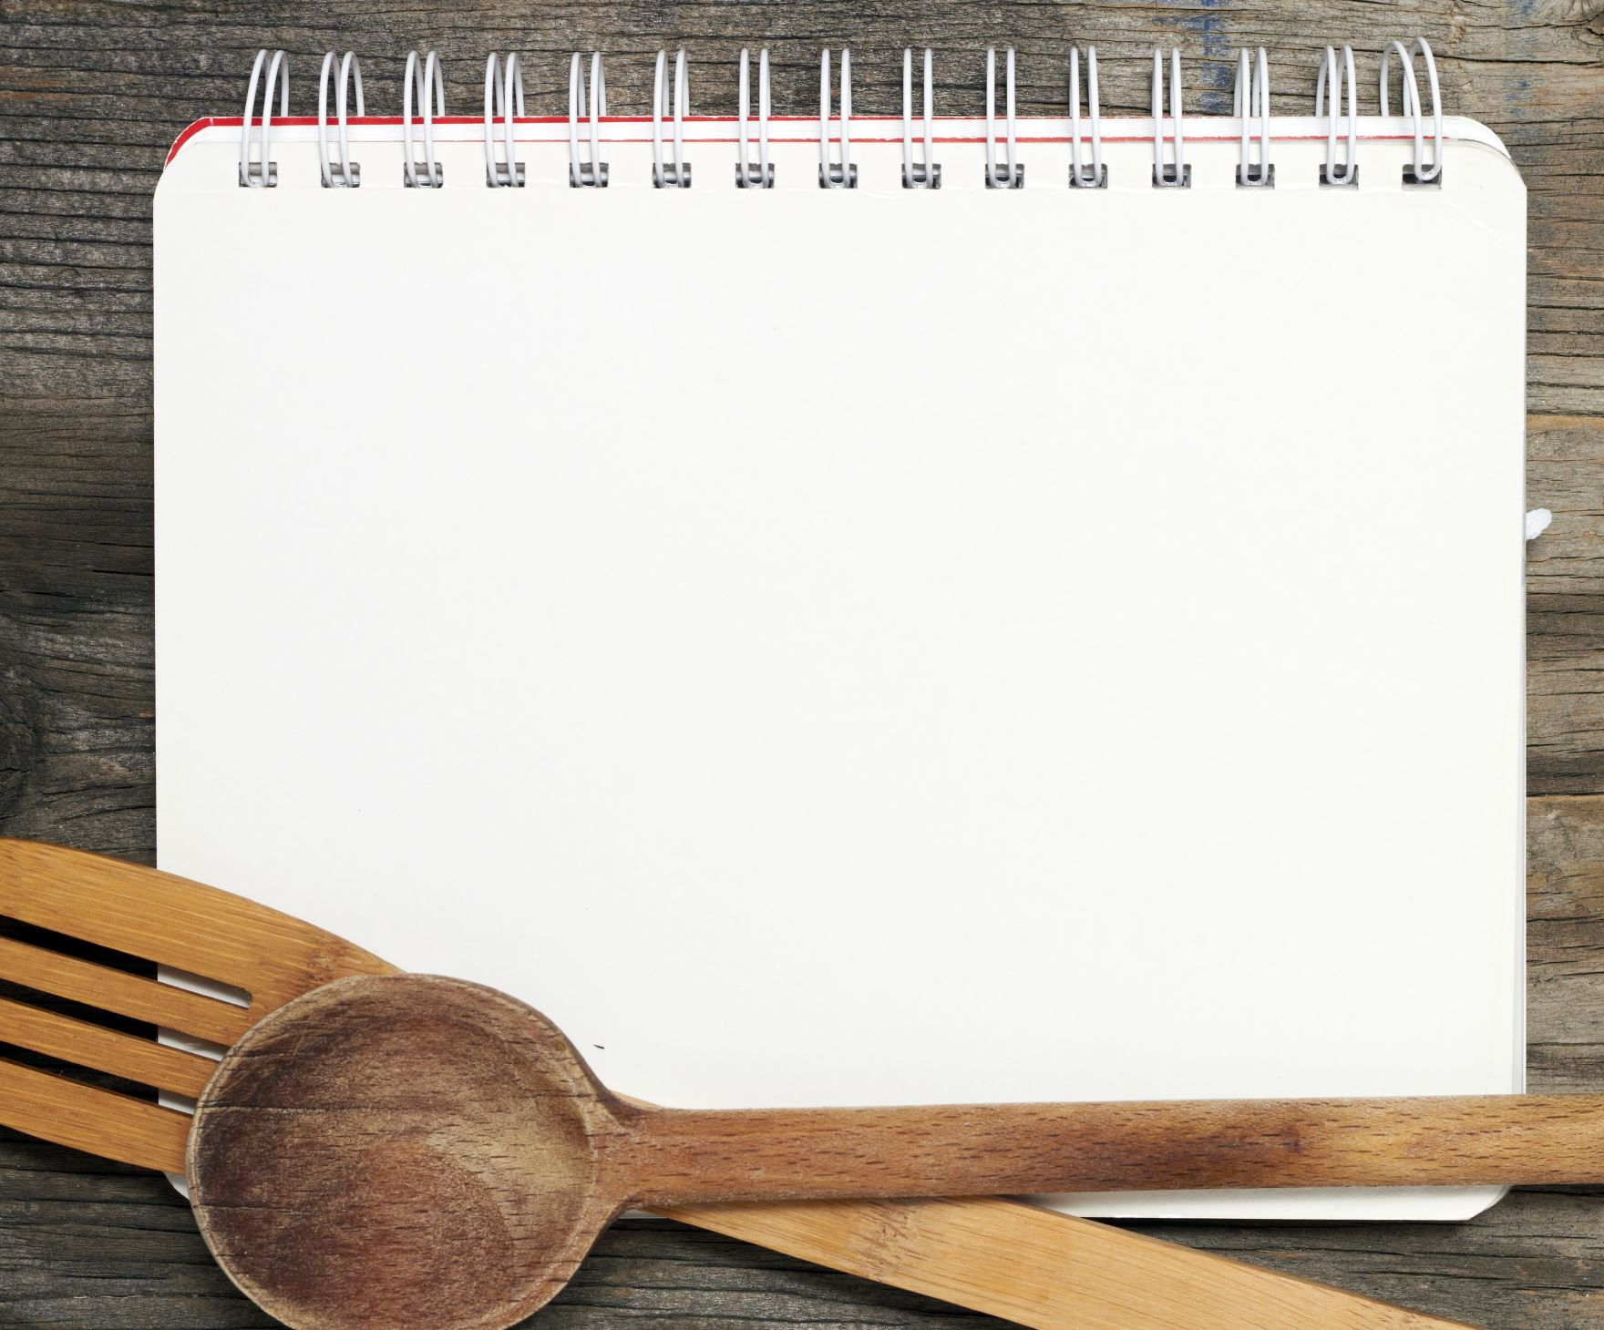
Portion Control Suggestions
Ensure that staff what the planned portion sizes for each menu item
Use correct type and the correct size portion control tool for each food item

Slide 17
Example of menu with portion size and serving utensil

Slide 18
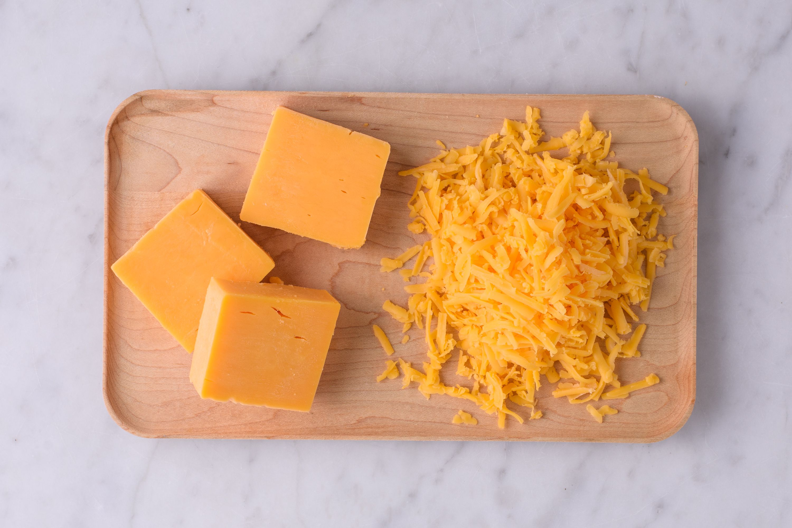
What is the portion size of this item?
Calories: 120
Fat: 10g
Sodium: 190 mg
Carbohydrates: 0g
Fiber 0g
Sugar: 1g
Protein: 7g

Slide 19
Be Aware of serving size

Slide 20
Be Aware of serving size con’t

Slide 21
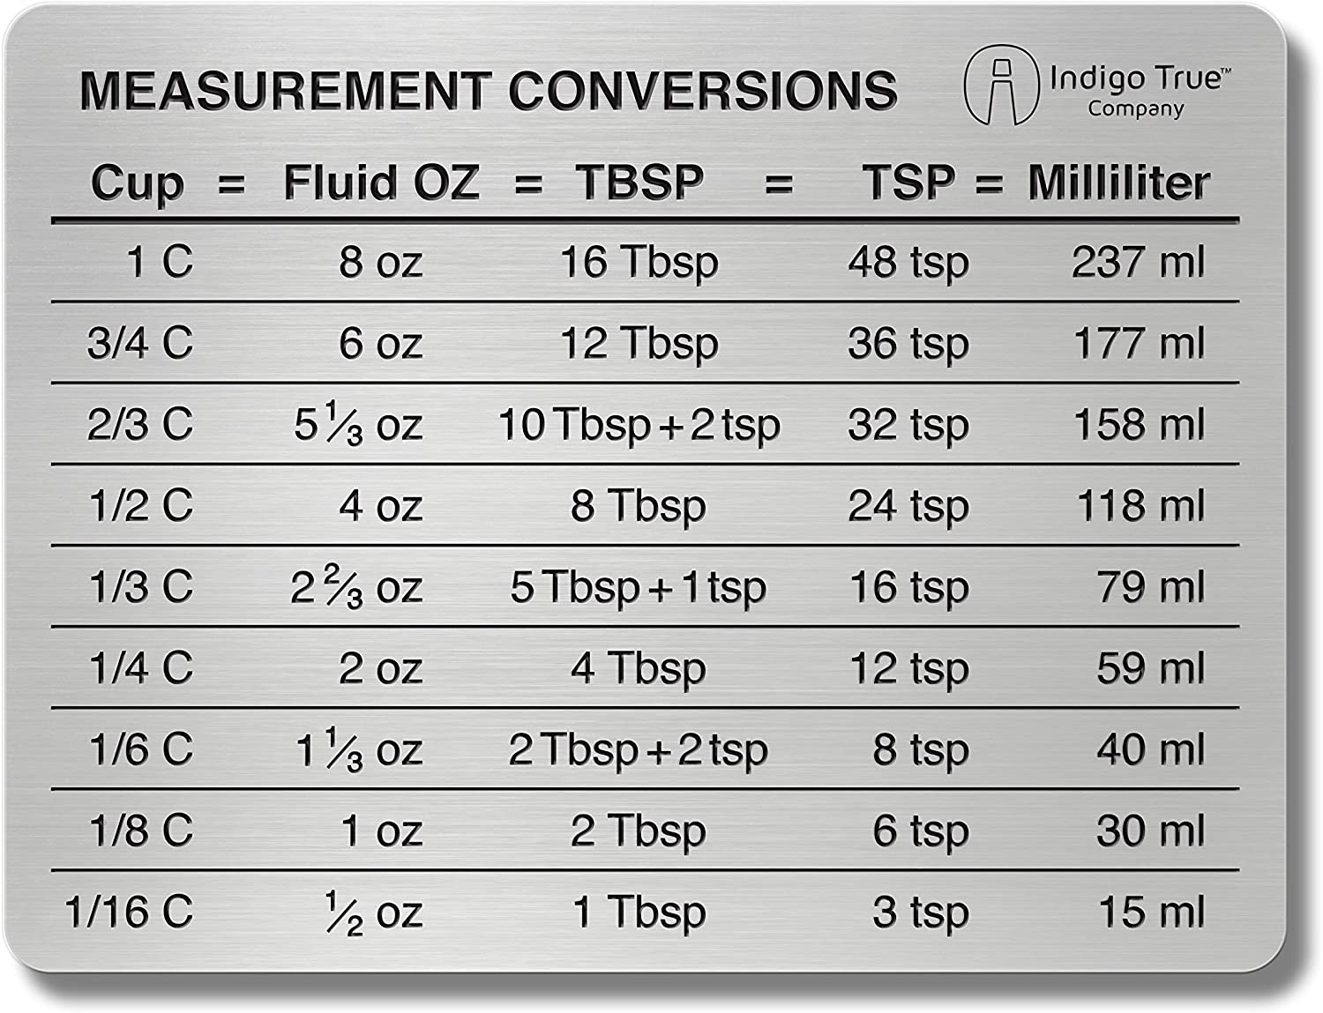

Slide 22
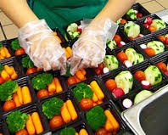
Food Safety While Serving
Always wash your hands before serving food
Avoid touching hair or face during service
If you do, wash your hands immediately

Slide 23
Hand-Washing
1. Wet your hands with clean, running water (warm or cold), turn of tap, apply soap
2. Lather your hand by rubbing them together with the soap, Be sure to lather the backs of your hands between your fingers and under your nails
3. Scrub your hands for at least 20 seconds
4. Rinse you hands well under clean running water
5. Dry your hands using a clean towel or air dry them

Slide 24
References
Payne-Palacio J, Theis M. Foodservice Management: Principles and Practices. Boston: Prentice Hall. 2014
CDC. Center for Disease Control and Prevention. https://www.cdc.gov/handwashing/videos.html. Published June 23, 2021. Accessed December 29, 2021.

Slide 25
Part 2: Recipe Conversion

Slide 26
Standardized Recipe:
A recipe or formula that can be easily duplicated by number of individuals and still achieve the same result

Slide 27
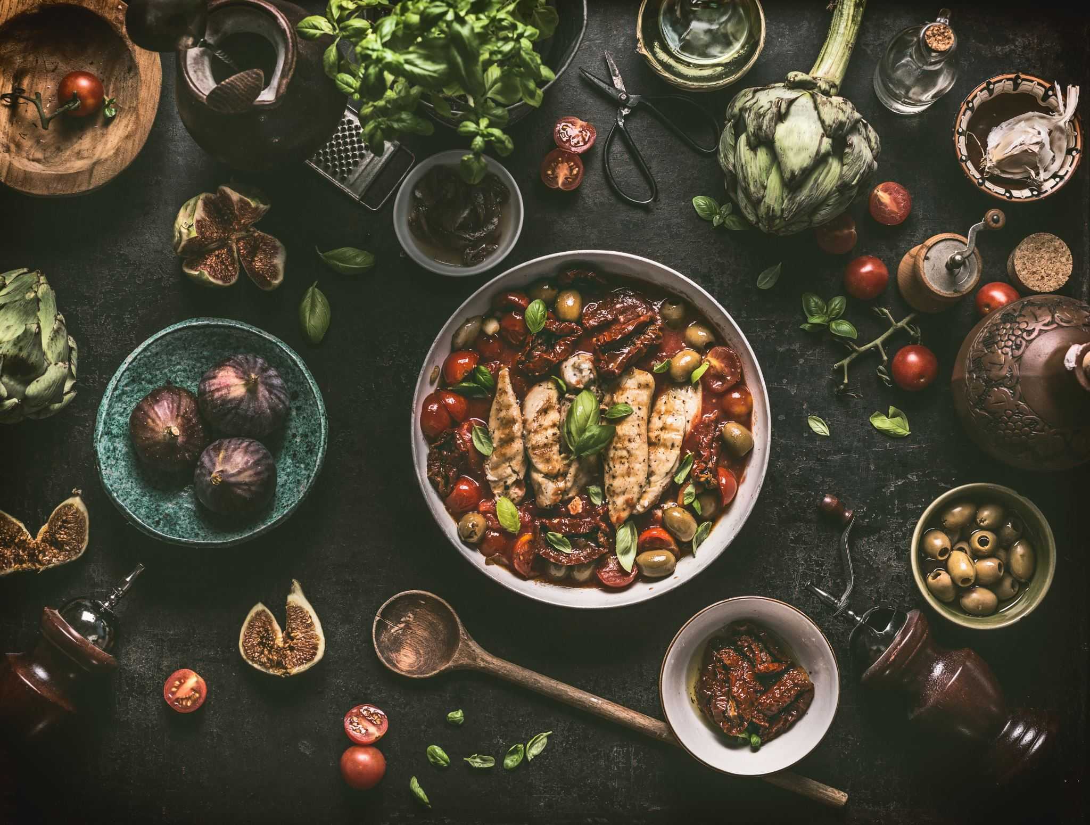
Standard Recipes and Consistency
Benefits the guest
Benefits the senior center

Slide 28
Standard Recipes indicate:
Necessary ingredients
Large equipment
Procedures for pre-preparation, preparation, cooking, holding and portioning
Yield (number of portions and portion size)

Slide 29
To Enlarge a Small-Quantity Recipe:
The original recipe should be created exactly
Evaluate recipe to see if it acceptable
The recipes yield should be double or should be expanded to the appropriate amount for the pan size to be used
Prepare recipe again, observe product and make adjustments
If results are satisfactory, the recipe yield scan be double once again for further evaluation and revision
If the product is still satisfactory, the recipe can then be increased by increments of 25 portions or complete serving pans) until approximately 100 portions are prepared

Slide 30
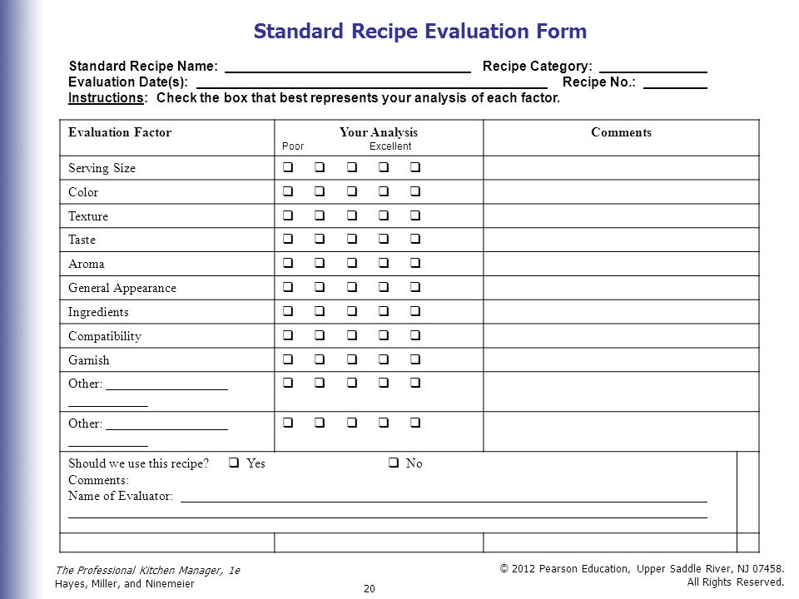

Slide 31
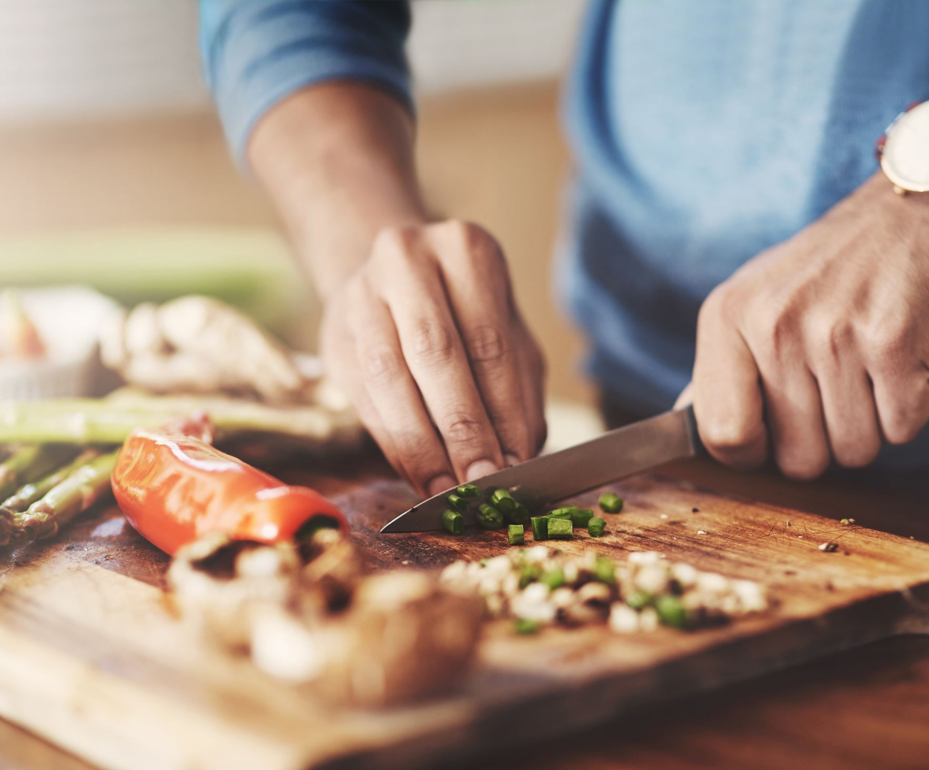
Recipe Conversions
Yield:
The total amount that a recipe produces

Slide 32
Recipe Conversions
Portion size:
The exact amount of food that a guest is given

Slide 33
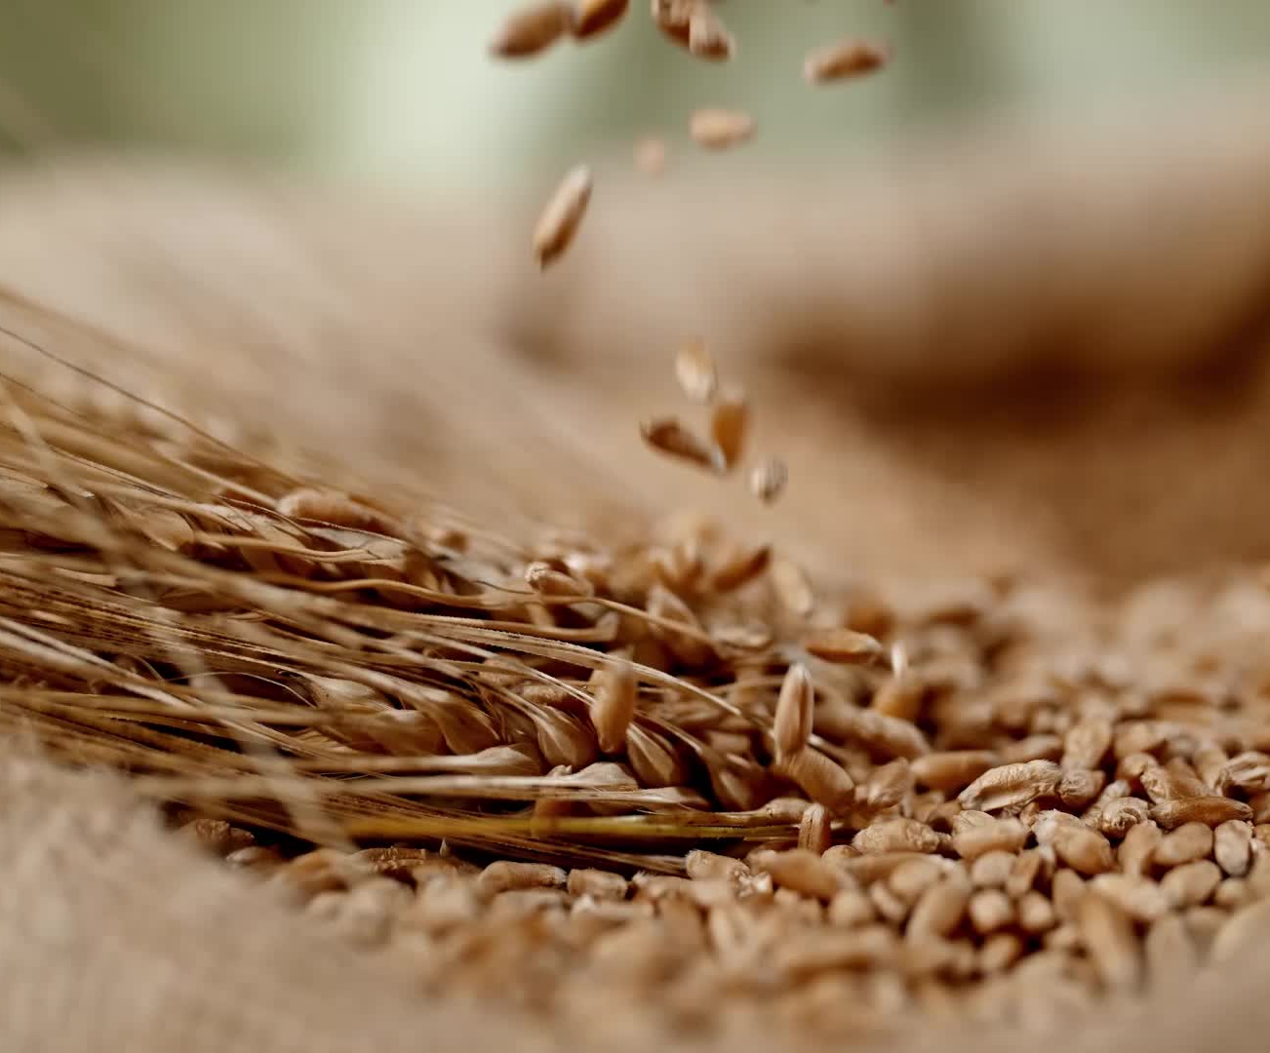
Conversion Factor:
“Changing the Yield “
The number we multiply ingredients by to arrive a new yield

Slide 34
Step #1
Determine original yield
Determine desired yield
DESIRED YIELD =Conversion Factor
ORGINAL YIELD (Scaling Factor)
Example:
White Chili
Scale up from 6 to 20 servings
20(Desired Yield)/
6 (Current Recipe Yield) =

Slide 35
Step #2
Multiply all recipe ingredients by conversion factor
EXAMPLE:
48 oz Ground Turkey x 3.33 Conversion Factor = 159.84 oz
Simply and Round
Ground Turkey
159.84 oz / 16 oz per pound (lb)= 9.99 lbs or 10 lbs use in recipe

Slide 36
Portion size conversion
The original recipe yields 70 portions (1/4 cup each); the restaurant manager desires 70 portions ( 3/4 cup each).
Step 1: Calculate adjustment factor:
Desired Portions (x) Portion Size
Original Portions (x) Portion Size=
70 (.75) 52.50 cups
70 (.25) 17.50 cups
=3
Step 2: Multiply the quantity of ingredients in the original recipe by the adjustment factor.
Example: 1/2 pound (8 ounces) of flour is specified in the original recipe.
8 ounces x 3.0 24 ounces
(original amount) (adjustment factor) (new recipe)

Slide 37
Changing the number of portions and portion sizes
The original recipe yield 50 portions (1/4 cup each); the chef desires 75 portions (3/4 cups each)
Step 1: Calculate adjustment Factor: Desired Portions (Portion size)
Original portions (portion size)
= 75(.75)
50(.25)
= 56.25 cups
12.50 cups
= 4.5

Slide 38
Changing the number of portions and portion sizes Con’t
Step 2: Multiply the quantity of ingredients in the original recipe by the adjustment factor.
Example: ½ pound (8 ounces) of flour is specified in the original recipe.
8 ounces x 4.5 = 36 ounces ( 2lbs. 4oz new recipe)
Original amount adjustment factor

Slide 39
Calculate the Conversion factor

Slide 40
In Review
1. Calculate Original Yield
2. Calculate Desired Yield
3. “DO” (Desired Original)
4. Multiply ingredients by conversion factor

Slide 41
References
Part 1 Recipe Conversion. Accessed December 21, 2021. Http://slideplayer.com/slide/6625152.

Slide 42
Menu Planning Revisited
REMINDERS when planning menu:
Be aware of high sodium (salt) food items:
Cheese
Bacon
Ham
Salad Dressings
Canned items (pasta sauce, scalloped potatoes, au gratin potatoes, canned beans, pork and beans, ranch beans etc).
Instant Mashed potatoes
Limit these items on your menu
Add more whole grains to menus (brown rice, whole grain wheat bread/rolls)

Slide 43
Part 3:

Slide 44
Food Service Ergonomics
Who does Ergonomics affect:
Kitchen staff
Drivers
Senior Center Staff

Slide 45
What is ERGONOMICS?
Ergonomics
“The scientific discipline concerned with understanding of interactions among humans and other elements of a system, and the profession that applies theory, principles, methods and data to design in order to optimize human well-being and overall system performance”

Slide 47
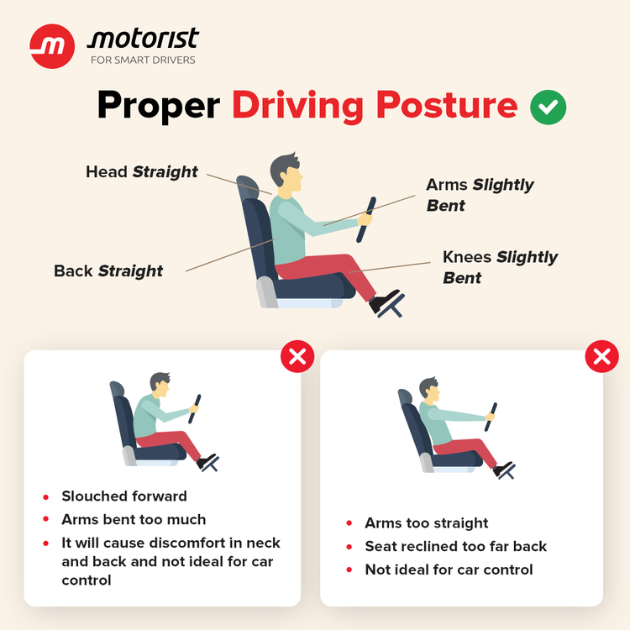

Slide 48
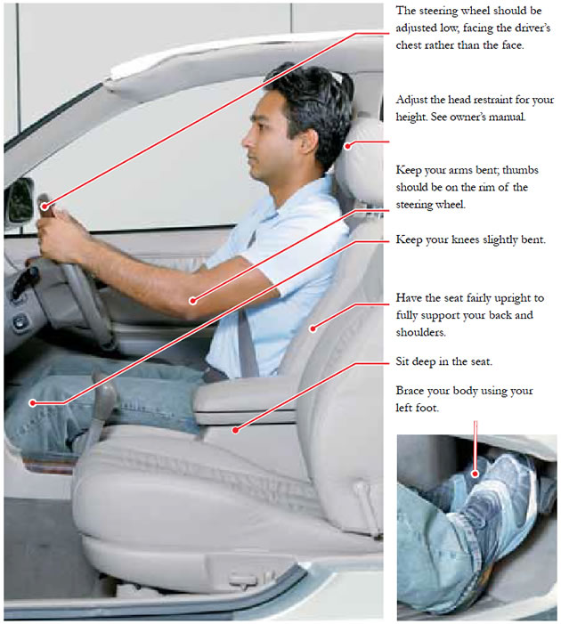

Slide 49
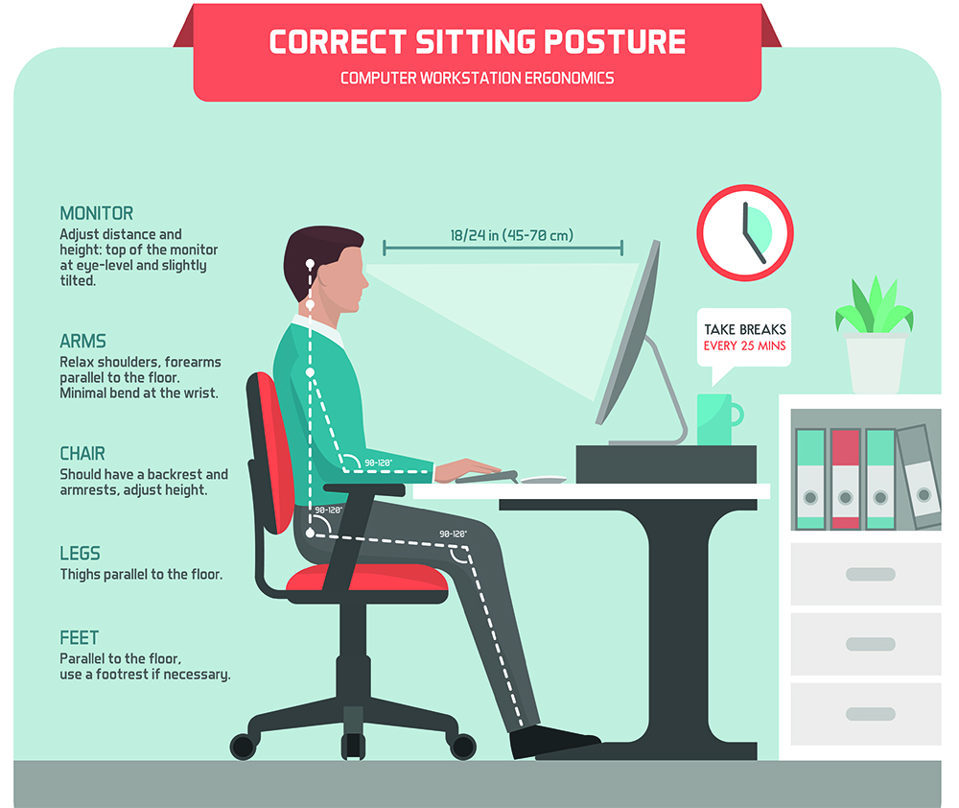

Slide 50
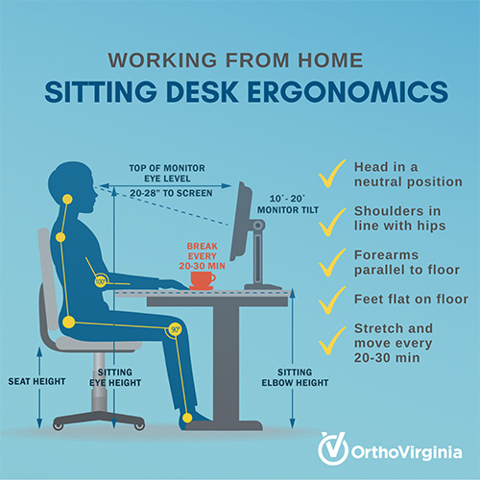

Slide 51
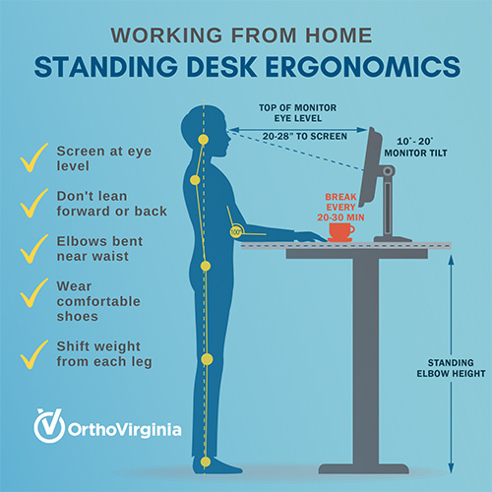

Slide 53
Menu
Sanitation
Documentation
Other ideas???

Slide 54
NATIONAL NUTRITION MONTH- MARCH 2022

Slide 55
Thank you ???

