Slide 1
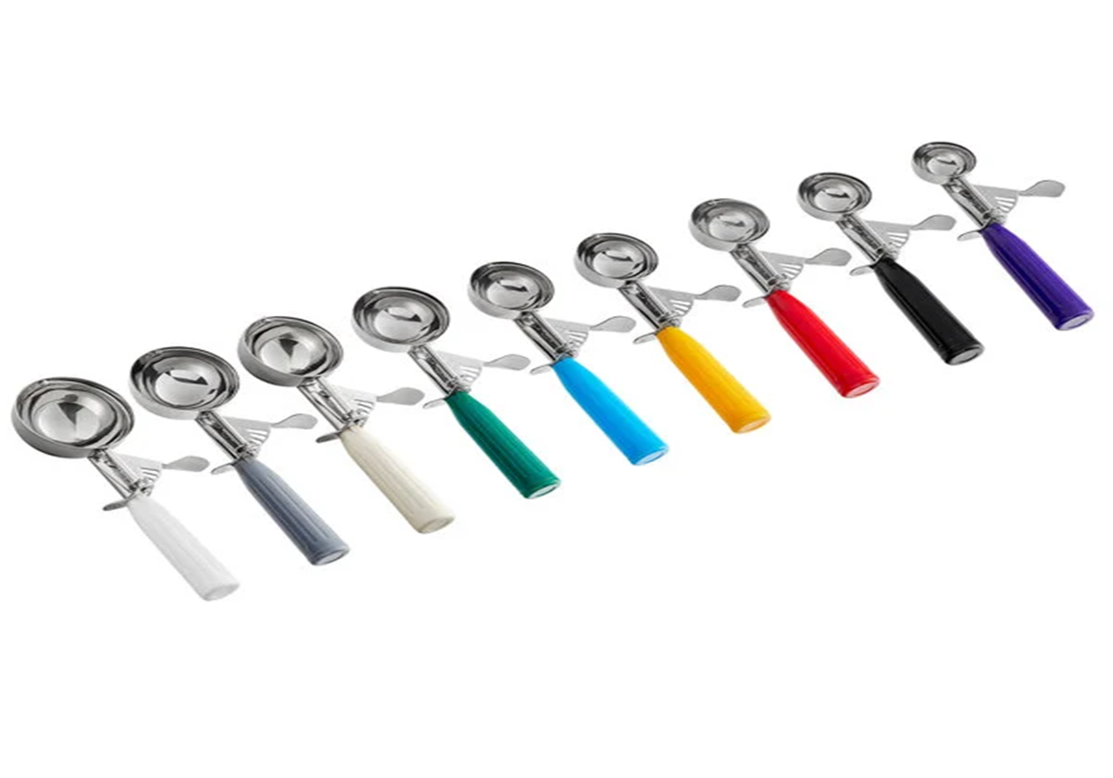
Serving Sizes, and Reducing Food Waste
NM-AAA
March/ April 2024
Constance Rudnicki MS, RDN, LD
Registered Dietitian/Nutritionist
Karen Zarrella - Nutrition Education Intern

Slide 2
Objectives:
Explain why portion/serving sizes are important
Describe ways to help minimize food waste
Explain how to change the yield of a recipe
Explain the different types of dates on packages
Describe FIFO
Explain when/how your facility should be labeling items
Identify the correct way to prepare and store food
Describe types of inventory

Slide 3
Portion Control v. Serving Size
Portion control and serving size are often used interchangeably, however, they have an important difference.
A portion is the amount of food you choose to put on your plate.
A serving size is the amount of a specific food that people typically consume.

Slide 4
Why is it important?

Slide 5
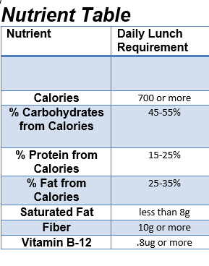
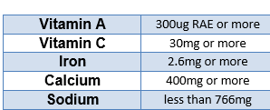
Nutritional Value
When menus are submitted for approval, the nutritional analysis is based on the serving size.
Larger portions can cause consumers to get too many calories, sodium, and/or fat.
Serving smaller portions prevents the consumers from getting the necessary nutrients.

Slide 6
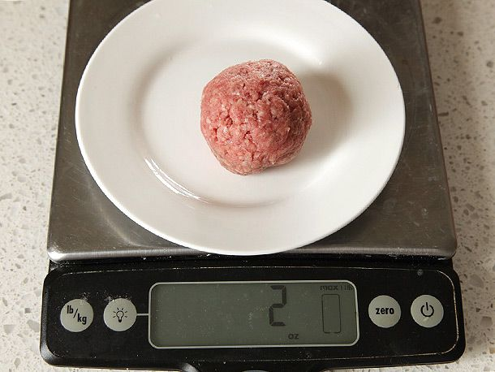
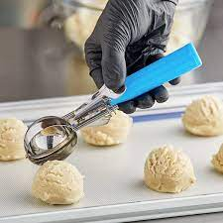
Ways to ensure the right serving sizes are being served:
Weighing and measuring individual portions
Using dishers (portion scoop, spoodle)
Notes:
Spoodle – a big spoon

Slide 7
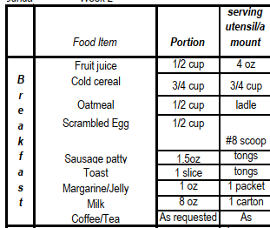
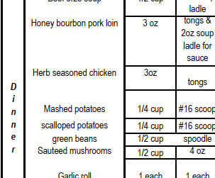
Budget Control
Purchasing ingredients for your menus is based on the serving size and number of servings the recipe makes (yield).
Make sure the staff is aware of the specific serving sizes and serving utensils to help standardize the portion control (on-going training).
Menus should have serving sizes

Slide 8
Serving larger portions could cause a shortage in meals or create a need to make more (cost). It can also create more food waste because the consumer is unable to eat it all.
If serving smaller portions, you may have too much food left over. This could lead to food waste (cost).

Slide 9
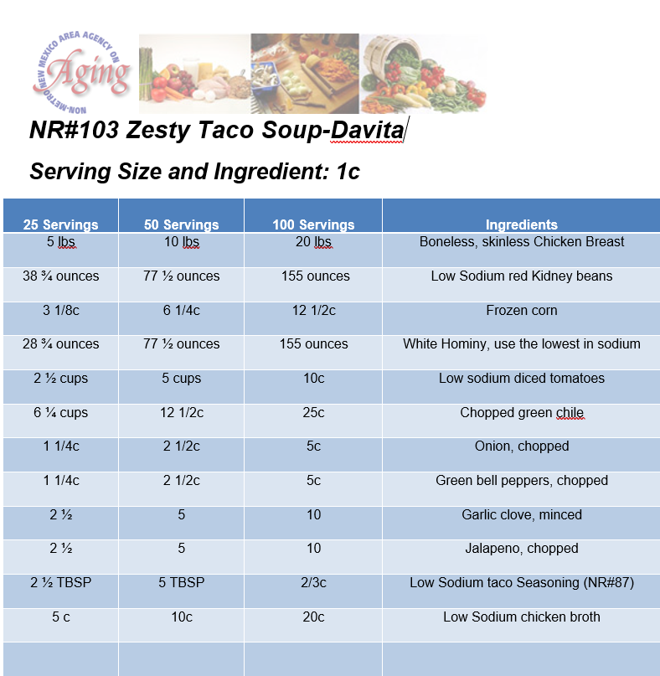
Standardized Recipes
Written instructions to prepare food consistently:
quality, appearance, taste
yield or number of servings for portion size
nutrition value
preparation time
costs of meal
If ingredient amounts or serving sizes are increased, your budget will be affected. Standardized recipes help predict and control expenses.
Notes:
A standardized recipe helps produce a product identical in taste and yield every time no matter who is cooking it. Constance has created many recipes that are located on the website.

Slide 10
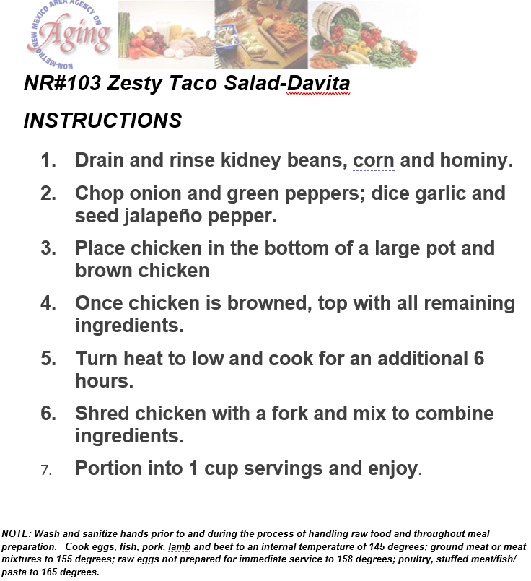
The instructions (or procedure) for the Standardized Recipe also help ensure consistency.

Slide 11
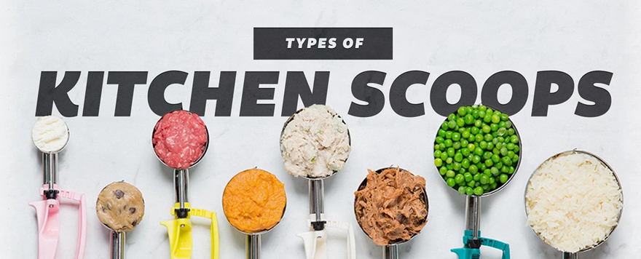
Each disher size is coordinated with a colored handle to make it easier to distinguish from the rest.

Slide 12
Notes:
Located on website

Slide 13
Standard Scoop #/ Serving Size
#4 scoop=1 cup
#6 scoop=2/3 cup
#8 scoop=1/2cup
#10 scoop=3oz
#12 scoop=1/3 cup
#16 scoop=1/4 cup
#60 Scoop= ½ oz

Slide 14
Incorrect Portioning Tools
A. Tongs
B. Gloved hands
C. Slotted spoon
Notes:
Any tools that does not allow for accurate portioning

Slide 15
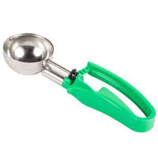
Two Types of Dishers
Thumb Press Disher
Squeeze Handle Disher

Slide 16
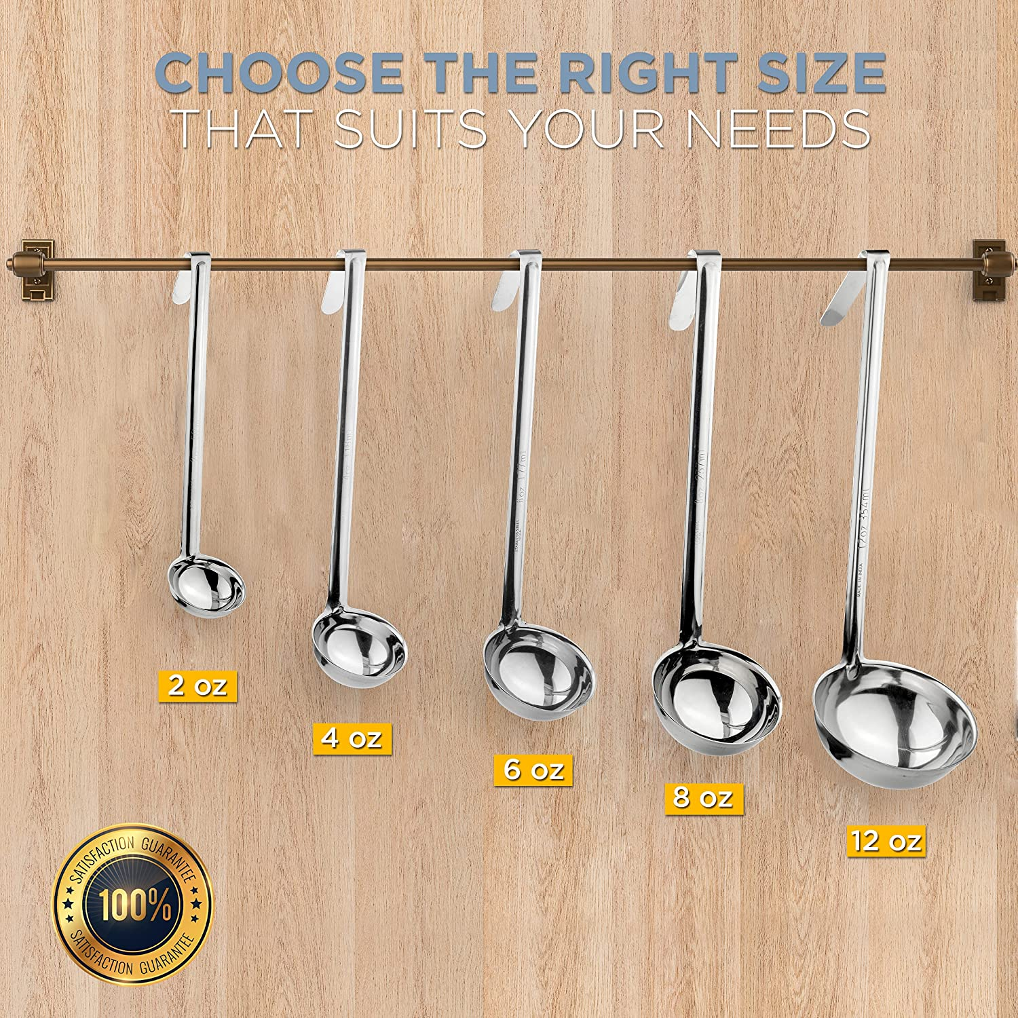
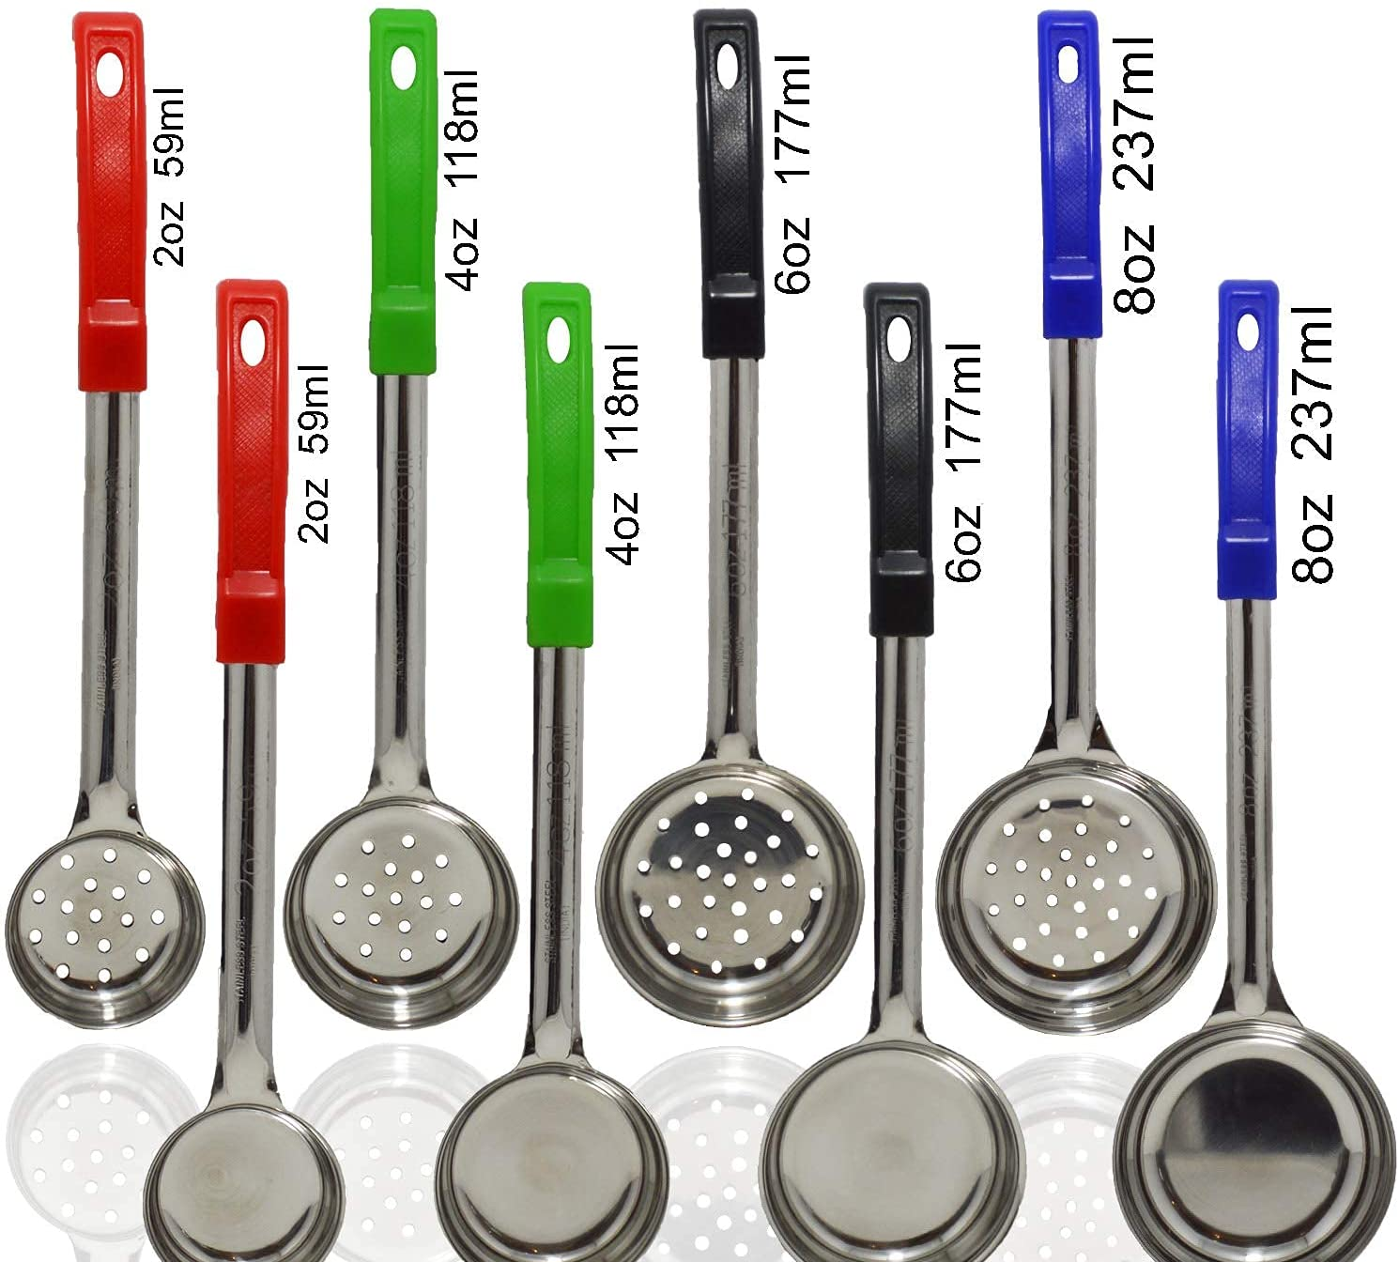
Spoodles and Ladles

Slide 17
To Enlarge a Small-Quantity Recipe:
The original recipe should be created exactly
Evaluate recipe to see if it is acceptable
The recipes yield should be double or should be expanded to the appropriate amount for the pan size to be used
Prepare recipe again, observe product and make adjustments
If results are satisfactory, the recipe yield can be doubled once again for further evaluation and revision
If the product is still satisfactory, the recipe can then be increased by increments of 25 portions or complete serving pans until approximately 100 portions are prepared

Slide 18
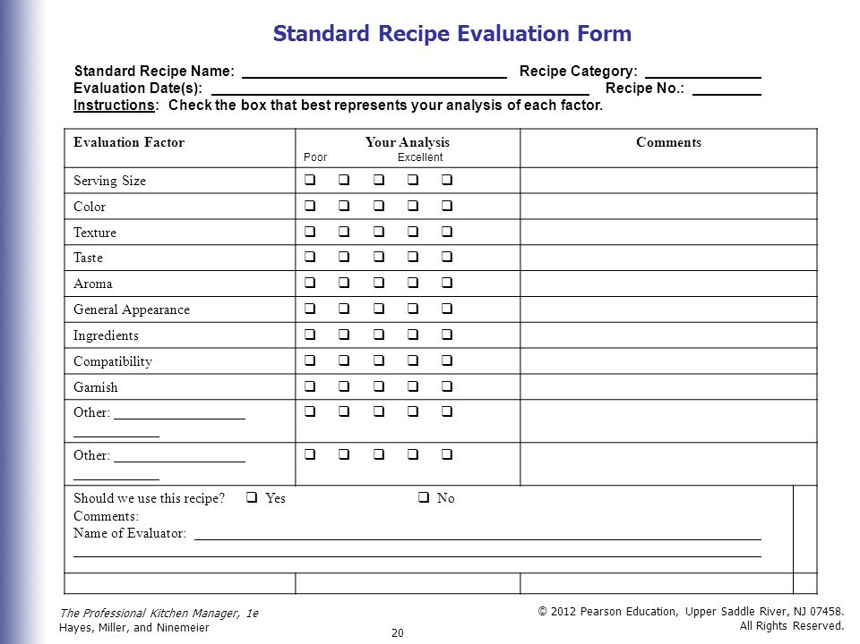

Slide 19
Recipe Conversions
Yield:
The total amount that a recipe produces

Slide 20
Conversion Factor:
“Changing the Yield “
The number we multiply ingredients by to arrive a new yield

Slide 21
Step #1
Determine original yield
Determine desired yield
DESIRED YIELD =Conversion Factor
ORGINAL YIELD (Scaling Factor)
Example:
Green Chile Chicken Stew
Scale up from 6 to 20 servings
20(Desired Yield)/
6 (Current Recipe Yield) = 3.33 (conversion factor)

Slide 22
Step #2
Multiply all recipe ingredients by conversion factor
EXAMPLE:
48 oz Ground Turkey x 3.33 Conversion Factor = 159.84 oz
Divide and Round
Ground Turkey
159.84 oz / 16 oz per pound (lb)= 9.99 lbs or 10 lbs use in recipe

Slide 23
Serving size conversion
The original recipe yields 70 servings (1/4 cup each); the kitchen manager desires 70 servings ( 3/4 cup each).
Step 1: Calculate adjustment factor:
Desired servings (x) Serving Size
Original servings (x) Serving Size=
70 (.75) 52.50 cups
70 (.25) 17.50 cups
=3
Step 2: Multiply the quantity of ingredients in the original recipe by the adjustment factor.
Example: 1/2 pound (8 ounces) of flour is specified in the original recipe.
8 ounces x 3.0 24 ounces
(original amount) (adjustment factor) (new recipe

Slide 24
Changing the number of servings and serving sizes
The original recipe yield 50 servings (1/4 cup each); the chef desires 75 servings (3/4 cups each)
Step 1: Calculate adjustment Factor: Desired Servings (Serving size)
Original servings (serving size)
= 75(.75)
50(.25)
= 56.25 cups
12.50 cups
= 4.5

Slide 25
Changing the number of servings and serving sizes con’t
Step 2: Multiply the quantity of ingredients in the original recipe by the adjustment factor.
Example: ½ pound (8 ounces) of flour is specified in the original recipe.
8 ounces x 4.5 = 36 ounces ( 2lbs. 4oz new recipe)
Original amount adjustment factor

Slide 26
Preventing Food Waste
Regularly take inventory of what you have
A perpetual inventory (PI) is updated continuously as goods are brought in or used. This can be done electronically or on an inventory log.
Stick to the menu. Ordering is done based on the menu.
Be aware of what is being thrown away by your seniors. This is good data that lets you know what menu items are not liked.
If you have a lot of food going in the garbage, you are wasting budget money.
Make your seniors aware of your plan to reduce food waste. Get their input.
Be creative with leftovers
Spoiled food = budget cost

Slide 27
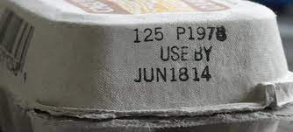
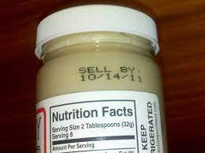
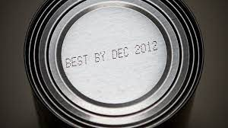
Terminology Explained
Use-by or expiration date | Sell-by date | Best-by date
This date is the last date that the item will be at peak quality. When receiving, reject any products that are missing this date. | This date lets stores know how long to display the product for sale. | This is the date by which the product should be eaten for the best flavor.

Slide 28
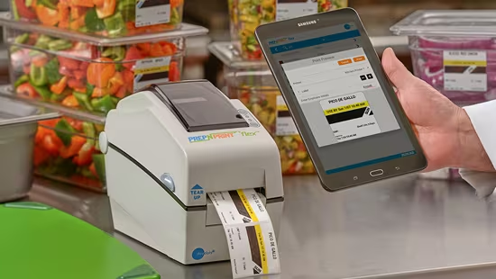
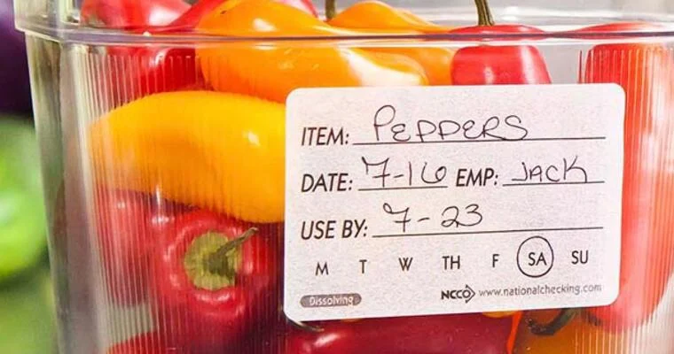
When should YOU label?
When a product is received and/or opened
Ready-to-eat TCS can be held for seven days. The count begins on the day the food is prepared or the container was opened.
Example: If potato salad was made on March 1st, the expiration date would be March 7th.
Notes:
TCS =Time and Temperature Control for Safety

Slide 29
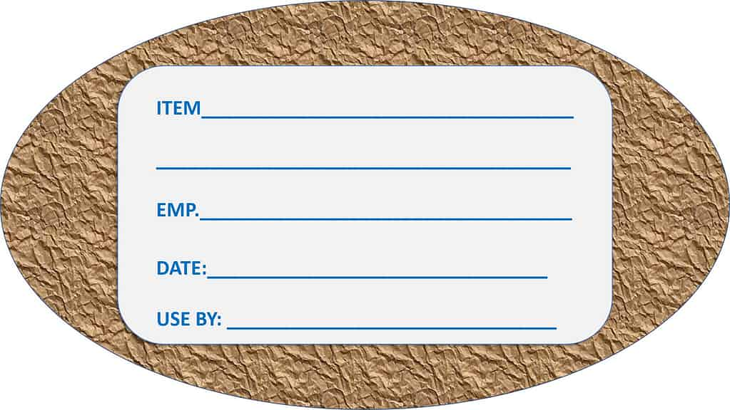
Labeling and Dating
All products need to be labeled with the date was received and the expiration date
Foodkeeper app or https://www.foodsafety.gov/keep-food-safe/foodkeeper-app
Refrigerator and Freezer storage chart handout: available at https://www.nonmetroaaa.com/provider-portal

Slide 30
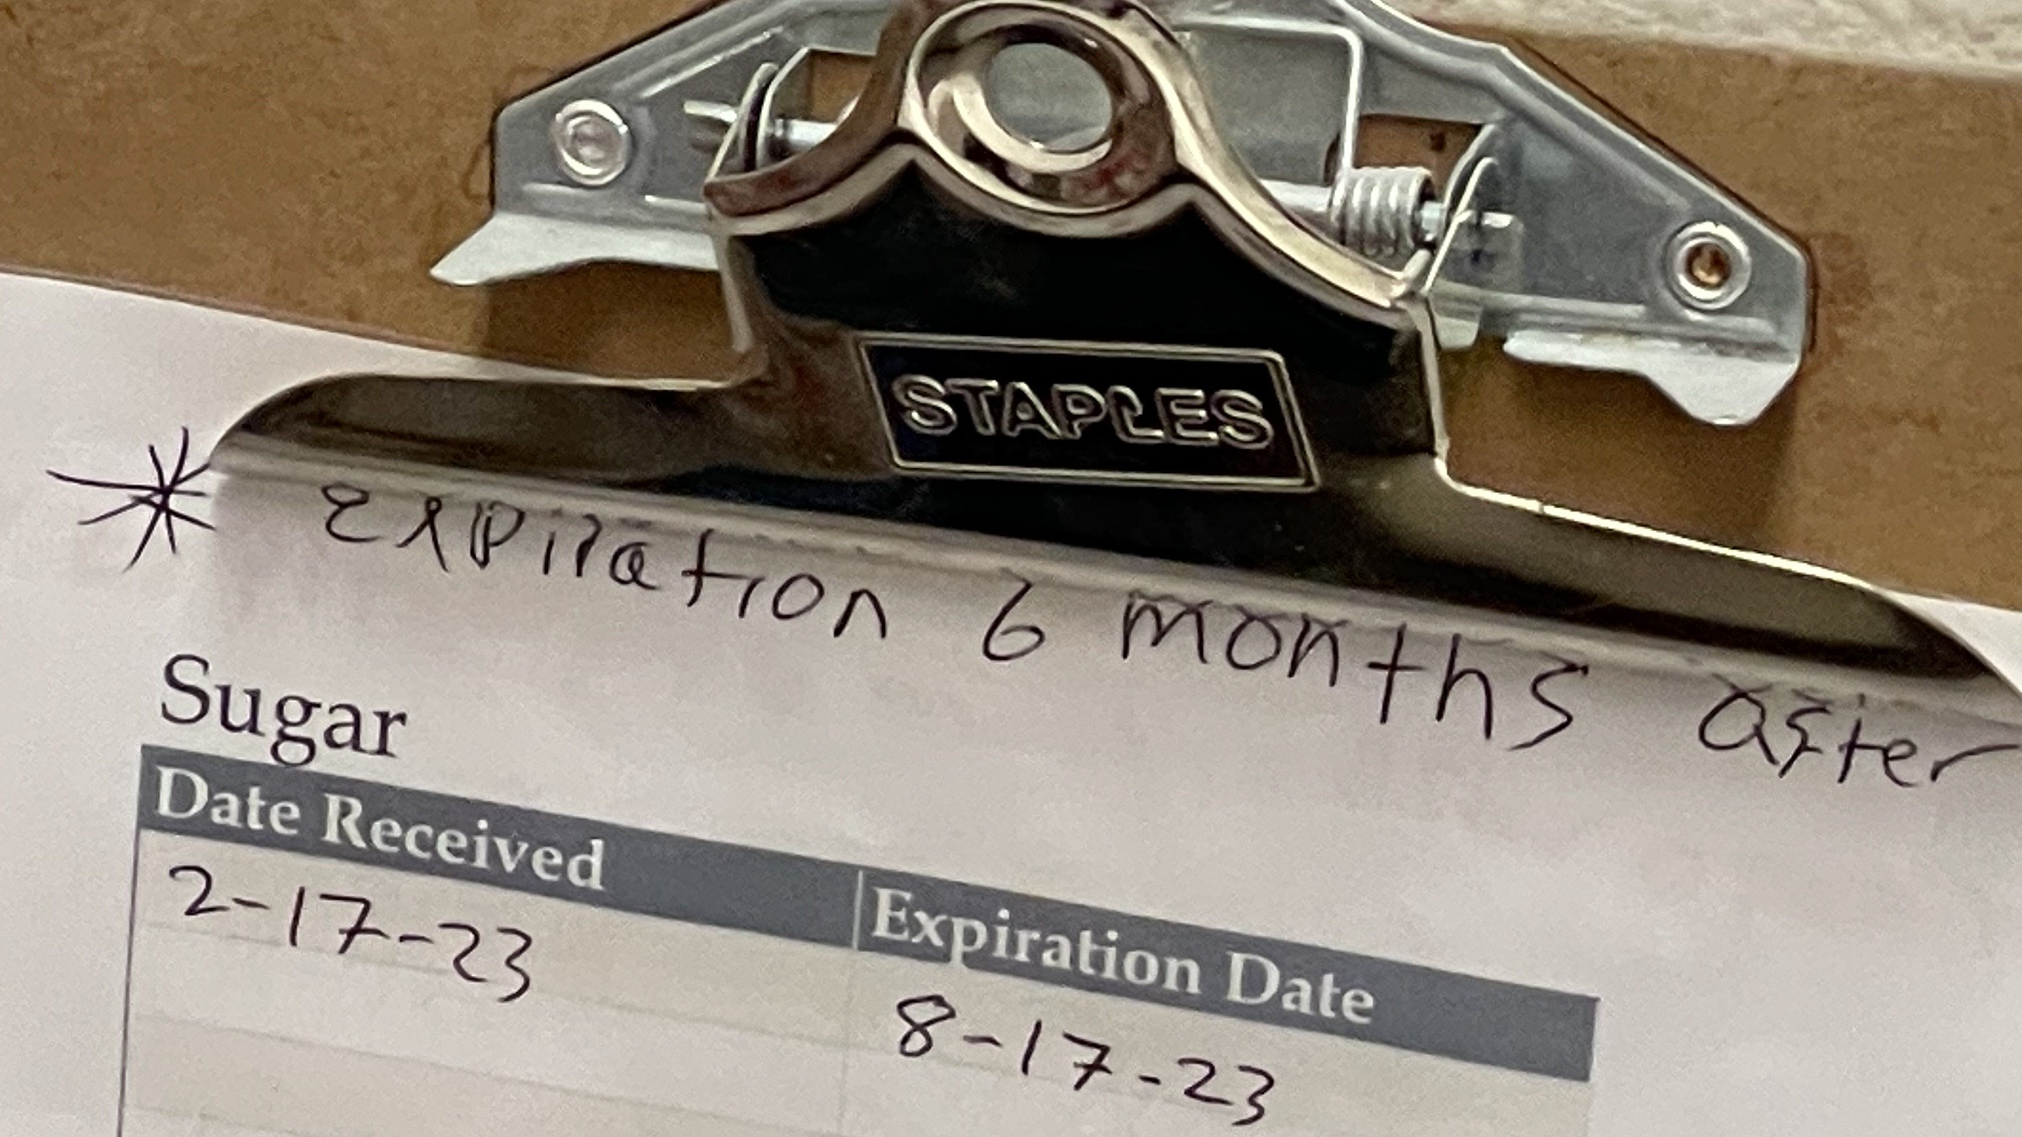

Slide 31
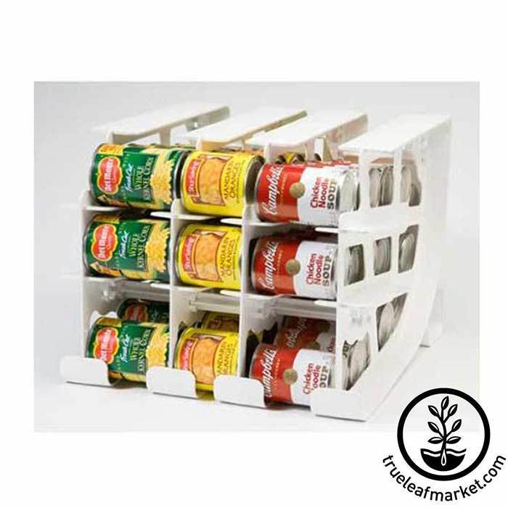
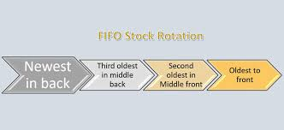
FIFO First-In, First-Out
Food items must be rotated so that items with the earliest use-by or expiration dates are used first. This helps to maintain quality and limit pathogen growth.
Throw away food that has passed the use-by or expiration date.

Slide 32
FIFO
Items should be stored in original packaging
If removed
Wrap in clean moisture proof material or place it in a lean sanitized container with tight fitting lid
All packaging and containers should be labeled with NAME OF THE FOOD and EXPIRATION DATE

Slide 33
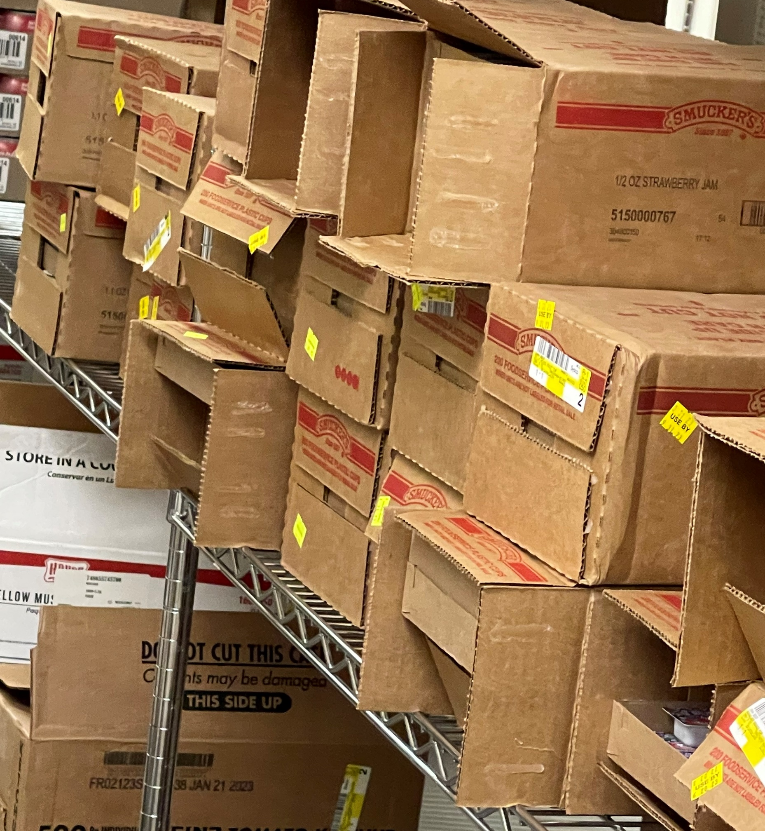
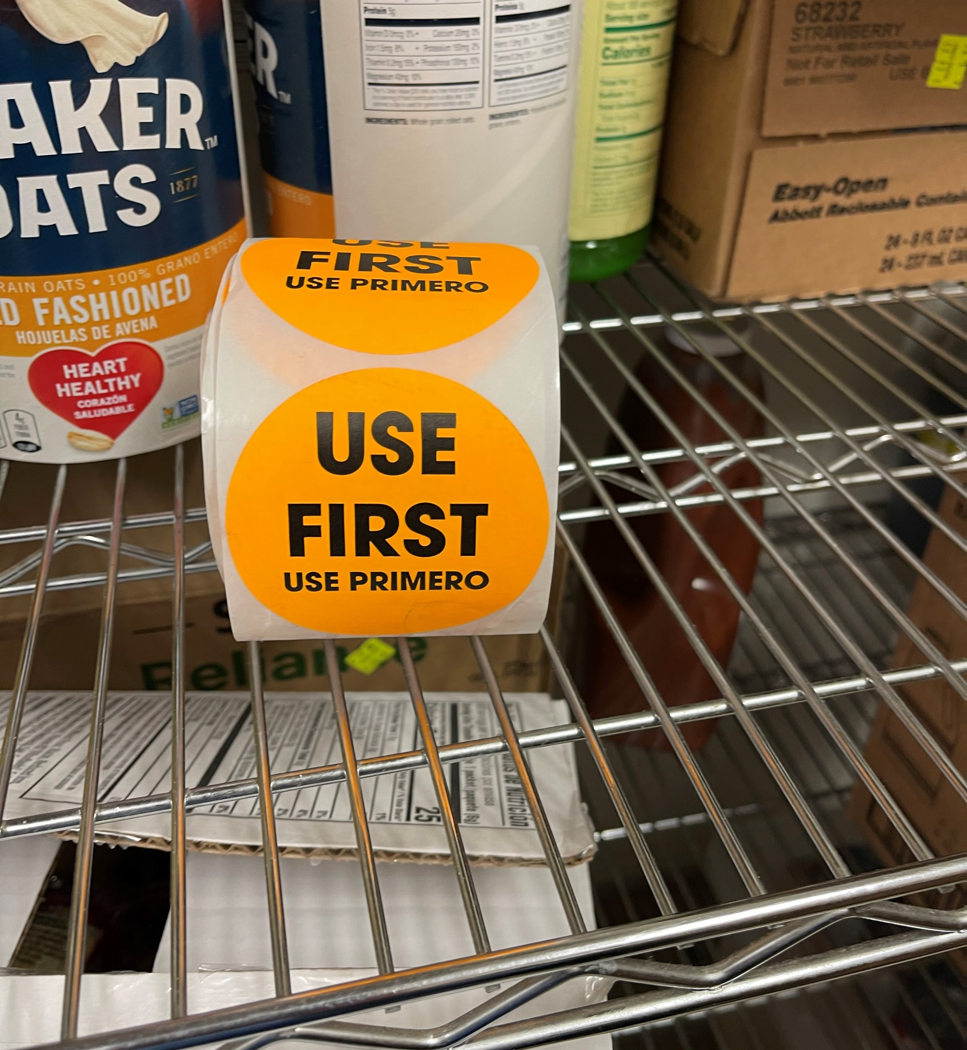

Slide 34
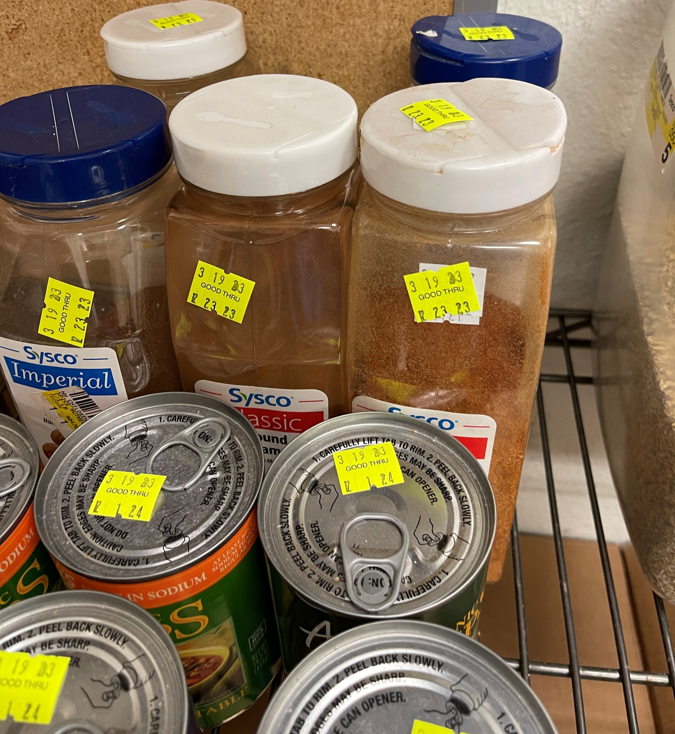

Slide 35
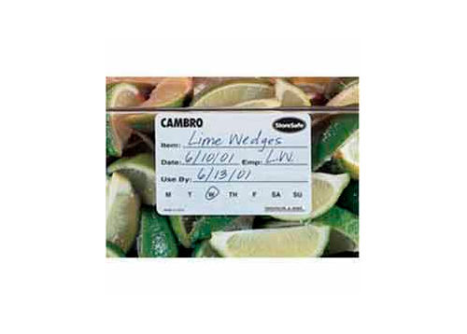
TCS FOODS PREPARED ON SITE
Must be labeled
Name of the food
The date it should be sold, consumed or discarded
It can be stored at a maximum of SEVEN DAYS at 41°F or lower before it must be discarded.
THROW OUT ALL FOOD THAT HAS PASSED THE MANUFACTURE’S EXPIRATION DATE

Slide 36
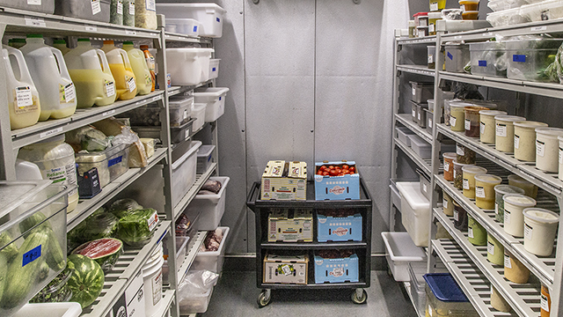
Refrigerators
Set at 39°F or lower
Never place hot food in refrigerators, which could raise the temperature inside
Cool food to 70°F before placing it in the refrigerator
Do not line refrigerator shelves, overload units or open doors too often
Internal and external thermometers must be maintained

Slide 37
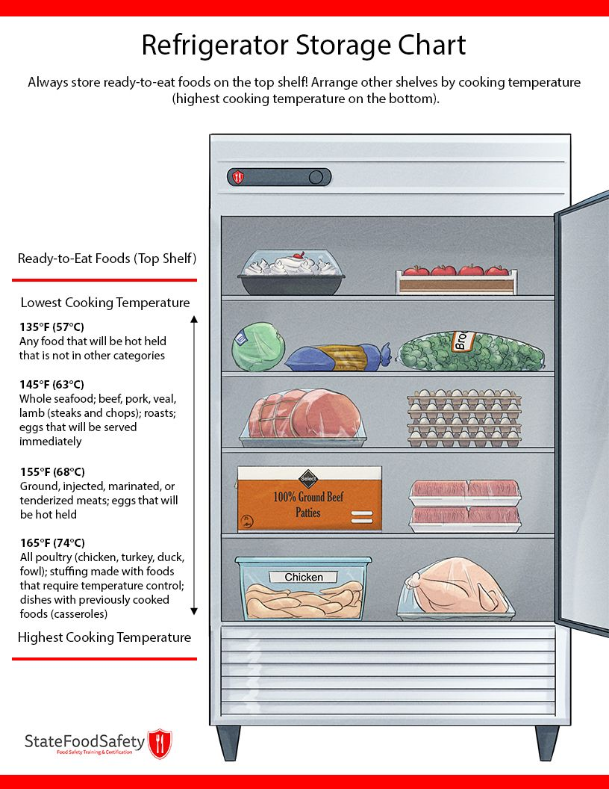

Slide 38
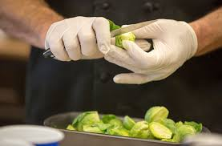
Preparation
THAW frozen food in the refrigerator, under cool running water, in a microwave oven, or as part of the cooking process
NEVER THAW AT ROOM TEMPERATURE
Control time and temperature
Prepare food in small batch, used pre-chilled ingredients utensils and bowls

Slide 39
Dry Storage
Areas should be kept at the appropriate temperature, between 50°F and 70°F with a relative humidity of 50-60%
Should be clean and well ventilated to maintain food quality
Foods should be 6 inches off the floor
Do not store food products near chemicals or cleaning supplies since food can be easily contaminated
Opened dry food items should be labeled and stored in a sealed container

Slide 40
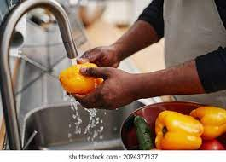
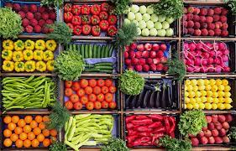
Produce and Fruit
Should only be washed before cooking, but do not mix different items or do multiple batches
If opening a new box of produce, items need to be washed before serving

Slide 41
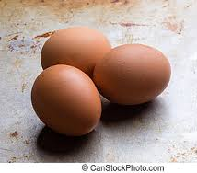
EGGS and EGG mixtures
Pooled eggs that are cracked open and combined in a common container should be cooked promptly or stored at 41°F
High risk establishments should only serve Pasteurized Eggs

Slide 42
Food Preparation, Temperature and Storage
Frozen meals must be dated and labeled
If sectioned aluminum trays are used, frozen meals must be delivered within two (2) weeks
If a heat-sealed packaging method is used, frozen meals can be stored up to forty-five (45) days

Slide 43
Inventory Records
Inventory control records must include adequate procedures to provide the food service manager with up-to-date and reliable data on costs of operation
Inventory records have 4 major objectives:
1. provision of accurate information of food and supplies in stock
2. determination of purchasing needs
3. provision of data for food cost control
4. prevention of theft and pilferage

Slide 44
Types of Inventory
Physical Inventory
Periodic inventory and recording of all products in stock in all storage areas
Usually taken at the end of the month
In operations that monthly inventory is taken, food costs can be determined in one of two ways:
Simplest one:
Beginning inventory
+Purchases
=Cost of food available
-ending inventory
=Cost of food used
Perpetual Inventory
Involves keeping records of purchases and issues for each product in storage so that he balance in stock is known at any point in time.

Slide 47
Why is it important to follow the serving size recommendations?
To make sure that our seniors are getting the required nutrients for that meal
To ensure that we will get the right number of servings based on the recipe’s yield
To help prevent food waste
Choose all that apply.

Slide 48
Which answer below does NOT help reduce food waste?
A. Regularly taking inventory
B. Serving larger portion sizes
C. Paying close attention to expiration and use-by dates
D. Sticking to the menu

Slide 49
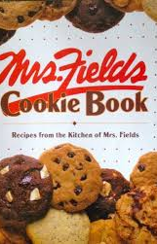
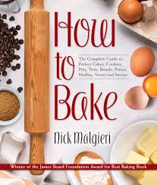
True or False? Yield Conversion
To calculate the conversion factor, you must divide the desired yield by the original yield of the recipe.

Slide 50
Match the date terminology with the correct definition.
Date Terminology | Definition
1. Used-by or expiration date 2. Sell-by date 3. Best-by date | This date lets stores know how long to display the product for sale. This is the date by which the product should be eaten for the best flavor. This date is the last date that the item will be at peak quality.

Slide 51
FIRST-IN, FIRST-OUT (FIFO)
All of the following are true, EXCEPT:
FIFO does not help maintain product quality and maintain pathogen growth.
When rotating, the earliest use-by or expiration dates are first.
All packages and containers must be labeled with the name of the food and expiration date.
Food with expired dates must be thrown away.

Slide 52
Fill in the blanks
All food must be labeled with the date it was _________________ and the
_______________ date.

Slide 53
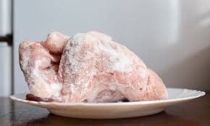
What are the proper ways to thaw food?
Under cool running water
At room temperature
In the refrigerator
Microwave or as part of the cooking process
Choose all that apply.

Slide 54
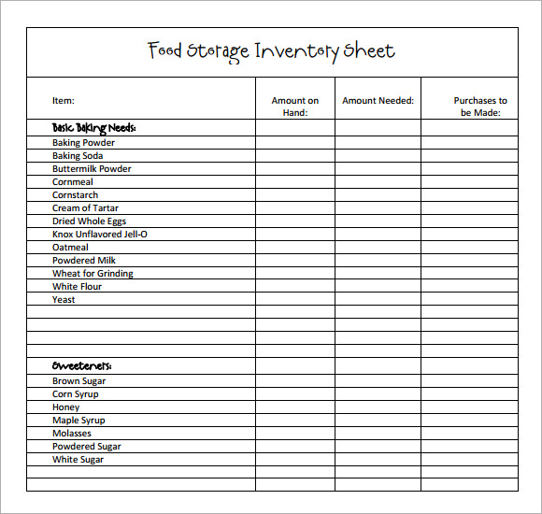
What are the FOUR major objectives for maintaining inventory records?
1. accurate information of food and supplies in stock
2. determination of purchasing needs
3. having an extra surplus of food
4. data for food cost control
5. prevention of theft and pilferage

Slide 55
References:
Legvold, D., Salisbury, K. & Perl, S. (2020) Foodservice Management- By Design
Association of Nutrition & Foodservice professionals
ServSafe Manager (7th Edition)

